Slide 1
Sampling and Measurement
STP702 Digital Data for Policy Analysis

Slide 2
What is population
The entire group of people you are going to study
e.g., you want to study whether cats like Toy A. Then the population is all cats in the world.
E.g., you want to study whether the elderly in Korea is open to riding automated vehicles. Then the population is all the elderly people living in Korea
Sometimes getting the population data is possible
E.g., How does the fortune 500 companies perceive to carbon tax? – you need to get data on 500 companies (which isn’t a lot)

Slide 3
What is population
But more often than not, getting the population data is expensive, takes way too much time, and just not realistic
So, we “sample” instead

Slide 4
What is a sample
Sampling = selecting a number of individuals or corporations, organizations etc. from population to study
How you choose your sample can really change the quality of your study

Slide 5
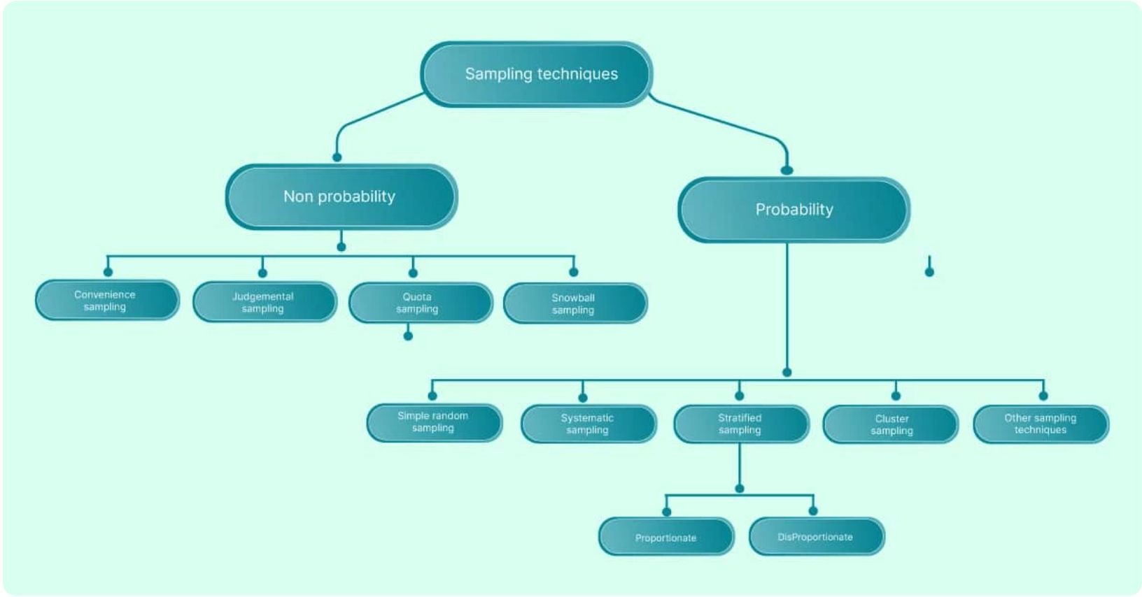
What is a sample

Slide 6
Probability sampling
Simple random sampling
People to study are chosen truly randomly
Lottery method
Random number tables
Systematic sampling
People to study are chosen based on intervals or systematic method
E.g., every 3rd person

Slide 7
Probability sampling
Stratified random sampling
Dividing the population into subsets based on shared characteristics
Characteristics can be gender, age, residence etc.
E.g., How the ELDERLY people in KOREA perceive automated driving
Cluster sampling
Clustering groups of your sample into groups (e.g., residence, gender, age) and then eliminating some groups to reduce the size
E.g., I want to study how people like the Incheon airport in Korea. But people living in Incheon might be biased, so I am not going to include them in the study

Slide 8
Non Probability sampling
Quota sampling
Using control characteristics to categorize a target population
We want at least one person from every city in Korea
Snowball sampling
Researcher uses their first or initial group to get in touch (or find out) about their second group – and then third group and so on
Useful for groups that are not open or welcoming towards strangers
Studying homeless people

Slide 9
What is a sample
How to choose your sampling method
You MUST justify your sampling method (in fact you must justify all decisions you make)
Didn’t have enough time is not a good justification
Didn’t have enough money is not a good justification
Come up with a scholarly justification preferably with a reference
E.g., The elderly group are particularly vulnerable to transportation policy changes because the rate of access of private vehicles is lower among the elderly
E.g., I am studying Korea because they have adopted new and digitalized energy technologies in the past 3 years much more so compared to other countries

Slide 10
What is a sample
You need to identify your sampling limitations
E.g., this study cannot be generalized to other countries because I am focusing on Korea
E.g., this study cannot be generalized to people aged 64 or younger because they are not considered as the elderly

Slide 11
Generalization
What is generalization?

Slide 12
Generalization
What is generalization?
Making statements about all people or most people
E.g., All birds can fly (chickens can’t ☹ - or can they?!?)
E.g., All tree leaves are green

Slide 13
Generalization
Many qualitative studies esp. interviews/ethnography
Generalization is not the goal
The goal is to understand and gain insights that would not be possible with other types of research
For some qualitative studies and many quantitative studies
Generalization is totally the goal
Esp. for policy studies, generalizability (whether your findings can be generalized) is important

Slide 14
Generalization
No quantitative study can make a universal generalization
And if they try to do so, they are doing bad research
Qualitative methods that are covered in this class tend to be more generalizable than interviews/ethnography

Slide 15
Sampling variability and bias
Sampling error
Sampling bias
Response Bias
Missing data

Slide 16
Sampling error
The sampling error of a statistic occurs when analysis based on a sample is used to predict the value of a population
We can infer, but we cannot predict the population behavior using sample data

Slide 17
Sampling bias
Sampling error can cause results to vary from sample to sample
The most common type: volunteer sampling bias

Slide 18
Response bias
Poorly worded or confusing questions lead to response bias
People may understand the question differently
Questions may contain the researcher’s political views
E.g., In favor of new gasoline tax? Vs. Want to reduce dependence on other countries? → they essentially ask the same thing but the response rate may be different

Slide 19
Missing data
People don’t respond
Missing data rate is a deep concern for many researchers
If non response rate is too high, the data may not be usable
Some people say 20% non response rate is too high, some people say 30%
With telephone surveys, people tend to be more generous with the non response rate

Slide 20
Types of Missing data
Missing completely at random (MCAR)
Missing at random (MAR)
Missing not at random (MNAR)

Slide 21
Types of Missing data
Missing completely at random (MCAR)
The data missing is independent of the observed and unobserved data
In reality, this does not happen – there is always some reason why data is missing

Slide 22
Types of Missing data
Missing at random (MAR)
Data missing is systematically related to the observed data but not the unobserved data
Depression survey – female respondents are more likely to respond (in any survey, this has always been the case). Then the missing rate is related to people’s gender, not depression

Slide 23
Types of Missing data
Missing at random (MAR): various ways to deal with missingness
Listwise deletion (deleting missing observations)
Use mean/median/mode to fill in missing data
Imputation (generating a reliable prediction)

Slide 24
Types of Missing data
Missing not at random (MNAR)
Data is missing due to the events or factors that the researcher did not or could not measure
E.g., People with severe depression are less likely to respond to surveys
If your data has MNAR, it may not be salvageable

Slide 25
Open R

Slide 26
Practice
Imagine that you are rolling a dice 10 times
Generate a random sample

Slide 27
Practice
diceRoll<-sample(1:6, size=10, replace=T)
diceRoll
Rolling a pair of dice
diceRoll<-sample(1:6, size=10, replace=T) + sample(1:6, size=10, replace=T)

Slide 28
Open R
Dealing with missing data in r

Slide 29
Practice
Import Knightley_missingdata.csv
I purposely created some missing observations
How many missing observations are there?
When you do a listwise deletion, how many observations are left?
Replace the NAs in the weight variable with the median

