Slide 1
Content analysis
STP702 Digital Data for Policy Analysis

Slide 2
What is content analysis
Method used to determine the PRESENCE of certain words, themes, or concepts within some given qualitative data (usually text)
Can quantify and analyze the presence, meanings, and relationships of certain words, themes, or concepts
E.g., newspaper political biases

Slide 3
What is content analysis
Data can be from
Interviews
Open ended survey questions
Field research notes
Conversations
Newspaper headlines/newspaper articles
Speeches
Media sources
Historical documents
Books/essays/discussion etc.

Slide 4
What is content analysis
Content analysis can be used to
Identify intentions
Describe attitudinal and/or behavioral characteristics/response
Identify patterns in responses/texts
Analyze focus group interviews/survey responses

Slide 5
What is content analysis
Example: Red states (conservative) vs. Blue states (liberal), US
Renewable energy companies are more likely to discuss the economic advantages of solar panels in the red states
Renewable energy companies are more likely to discuss the environmental advantages of solar panels in the blue states
This analysis can be done using newspaper articles, seeing where they were published, and calculating the frequency of specific words in each newspaper

Slide 6
Two types
Conceptual analysis
The existence and frequency of concepts in a text
Relational
Examines the relationships among concepts in a text
Can use visualization technique or concept matrix or a group of interrelated co-occurring words/concepts to suggest an overall meaning

Slide 7
Reliability
Coding errors are inevitable, which should be tried to minimized
Stability: the tendency for coders to consistently re-code the same data int eh same way over a period of time
Reproducibility: tendency for a group of coders to classify categories in the same way
Accuracy: extent to which the classification of text corresponds to a standard or norm

Slide 8
Validity
Closeness of categories: utilizing multiple classifiers to arrive at an agreed upon definition of each specific concept
Conclusions: understanding what level of implications can be (and may be) allowed from content analysis
Generalizability of the results to a theory: dependent on the clear definitions of concept categories (also relates to reliability)

Slide 9
Advantages of content analysis
Allows for both qualitative and quantitative analysis
Provides data when data isn’t necessarily available
Unobtrusive means of understanding interactions
Provides insight into complex models
A more powerful tool when complemented by other research methods (e.g., interviews, focus groups, inferential statistics)

Slide 10
Disadvantages of content analysis
Can be extremely time consuming
Subject to increased error
The frequency of words or the use of words may not catch the underlying meanings
Can be difficult to automate or computerize

Slide 11
Content analysis is
A way to manage data
Despite its name, you are not done with your analysis by just doing content analysis
You need to show your findings using other descriptive/visual/statistical methods

Slide 12
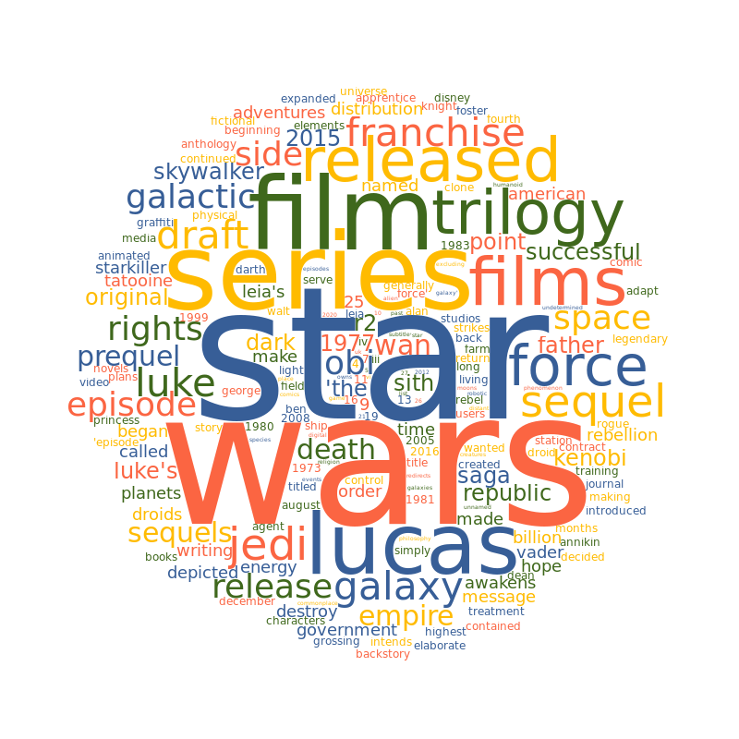
Word cloud

Slide 13
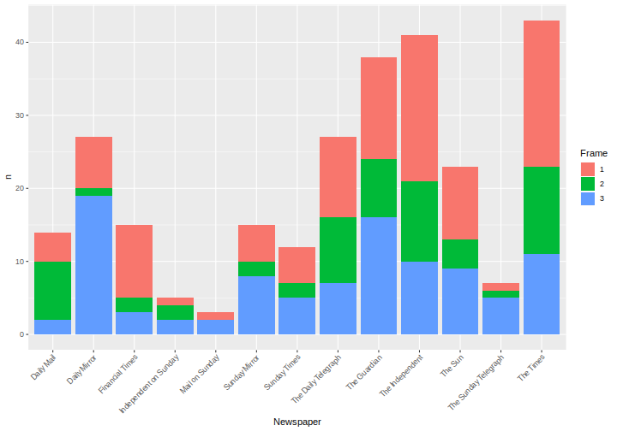
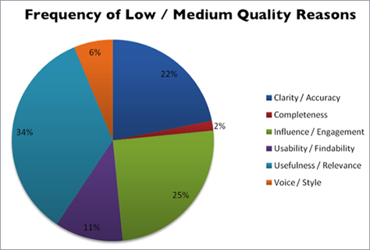
Graphical data analysis

Slide 14
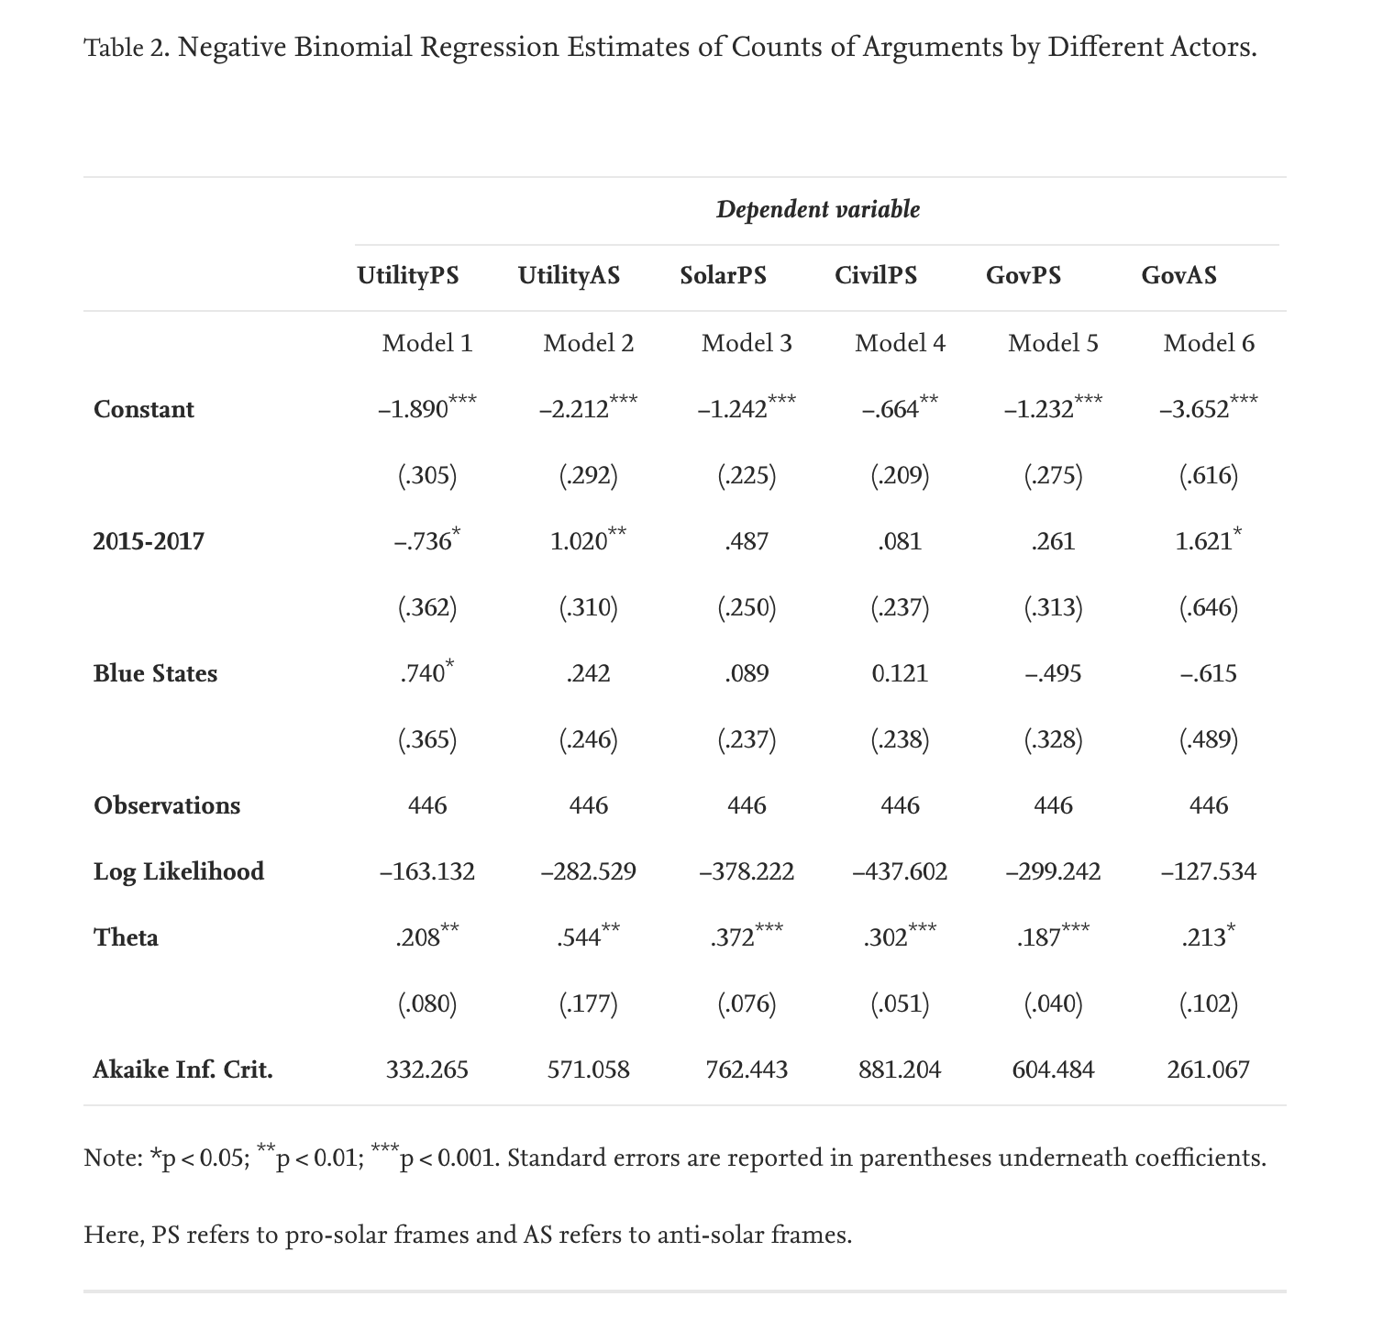
Inferential statistics

Slide 15
Data types
Data frame objects
Corpus objects
Token objects
Document-feature matrices (DFMs)

Slide 16
Data types
Data frame objects

Slide 17

Mixer review data in India

Slide 18
Mixer review data in India
Have a look at the data
Should be fairly easy to understand
Then import data

Slide 19
Open R

Slide 20
Data types
Corpus objects
Similar to data frame
Each row contains a unique text
Each column contains variables for each text (e.g., name)
We need to use the corpus objects to be able to use the quanteda package (here, data frame objects do not work)

Slide 21
Open R

Slide 22
Data types
Token objects
Converting entire texts into individual features is called “tokenization” and allows us to process data automatically
Individual features can include: words, word chains, entire sentences, numbers, punctuation markets etc.
In R, tokenization is done with tokens()

Slide 23
Open R

Slide 24
Data types
Document-feature matrices (DFMs)
A form of matrix that
Has rows to denote the documents that our corpus contains
Columns to denote the features that occur across all documents
Cells indicate the frequency of a single feature in a single text

Slide 25
Open R

Slide 26
Practice
Create a corpus data of just View1 variable. What are the top 20 features?

Slide 27
Data cleaning for content analysis
Need to clean the data before/after we go and do corpus(), token() etc.
Encoding
Removing numbers
Punctuation
Lower cases
Stopwords
Etc.

Slide 28
Encoding issues
Sometimes R reads line break as \n. So, you need to make sure that your data has been read properly

Slide 29
Open R

Slide 30
Removing numbers, punctuations etc.
We need to remove punctuations because they often serve little purpose for content analysis (may be they are important for your work, then keep them!)
We may want to remove numbers
We may want to remove URLs etc.

Slide 31
Open R

Slide 32
Lower case, capital letters
Make sure that all texts are lower case – this reduces confusion

Slide 33
Open R

Slide 34
Removing stopwords
Stopwords = words that are not very informative in detecting similarities and differences
Quanteda already has a list for English ☺

Slide 35
Open R

Slide 36
Lemmatizing/Stemming
Reduce words to their base form (lemmatizing) or to their root (stemming)
E.g., decide = decide, deciding, decided etc. → decid

Slide 37
Open R

Slide 38
Removing rare or too frequent words
You might want to remove words that are too rare or too frequent

Slide 39
Open R

Slide 40
Practice
Using only View1 variable in mixer data
Remove punctuations
Remove numbers
Remove separators
Remove symbols
Make sure that everything is in lower case
Remove stopwords
Only have stem words
Remove the words with minimum frequency of .1
Remove words with the maximum frequency of .95

Slide 41
Descriptive statistics for content analysis
Open R

Slide 42
Descriptive statistics for content analysis
What are the 20 most frequent features of the View 1 variable?

Slide 43
Wordcloud
Open R

Slide 44
Wordcloud
Draw a wordcloud of View1 variable

Slide 45
Co-occurrence analysis
Is there a pattern?
The columns of a co-occurrence matrix denotes features
The rows of a co-occurrence matrix denotes features
Cells indicate how often a feature occurs together
Open R

Slide 46
Using content analysis, you can -
Visualize data using ggplot2
Provide descriptive statistics
Conduct inferential/Bayesian statistics

Slide 47
Writing the methods section
The goal of the methods section is to provide enough information so that people can exactly replicate your process (if they want to)
The structure of a methods section tends to vary widely depending on what kind of method you used
But you are expected to justify everything you did

Slide 48
A good methods section needs to have
How did you collect your data
Why did you do it this way? Time/money shouldn’t be used as justifications
How did you clean your data? Any references that do it in a similar way? (references are great sources for providing justifications)
How did you analyze your data
Why did you do it this way? Time/money shouldn’t be used as justifications
How did you deal with missing data problems (mostly for quant data)
Any methodological limitations? (optional)
Any validity checks for your data?

Slide 49
Your homework should have
Provide some basic descriptive stats of the mixer data (hw mixer data, not the mixer data used in class)
Clean the data
Do an analysis of your choice (word cloud, co-occurrence analysis, graphical data analysis)
Write about what you did – think of this as a methods section of a paper (you can’t write about data collection but write about the processes)

Slide 50
Your homework should have
How did you clean your data? Any references that do it in a similar way? (references are great sources for providing justifications)
How did you analyze your data
Why did you do it this way? Time/money shouldn’t be used as justifications
How did you deal with missing data problems (mostly for quant data)
Any methodological limitations? (optional)
Any validity checks for your data?

