Slide 1
Understanding Data
STP702 Digital Data for Policy Analysis

Slide 2
Outline
Types of data
Importing data and exporting data

Slide 3
Most important lessons for today
You need to completely understand your data
Look at your data as you write your code
Never ever change your original data
Google has the answer

Slide 4
NOIR
Nominal
Ordinal
Interval
Ratio

Slide 5
Nominal
Data that can be categorized
E.g., names

Slide 6
Ordinal
Data that can be categorized and ranked
E.g., how happy are you?
  1. Very happy
  2. Happy
  3. Neutral
  4. Unhappy
  4. Very unhappy

Slide 7
Interval
Data that can be categorized and ranked and infer equal intervals but no true zero point
E.g., temperature (Celsius or Fahrenheit)
  We know that the difference between 32 degrees and 33 degrees is the same as 33 degrees and 34 degrees – 1 degree. So there are equal intervals
  But zero degrees is defined differently depending on the scale and it does not mean the absence of temperature

Slide 8
Ratio
Data that can be categorized and ranked and infer equal intervals and there is a true zero point
E.g., kelvin temperature scale
  No negative numbers, so 0 in kelvin temperature means an absolute lack of thermal energy

Slide 9
Some basic concepts to understand
Mean
Median
Mode (need to write a separate function in R)
Standard deviation
Variance

Slide 10
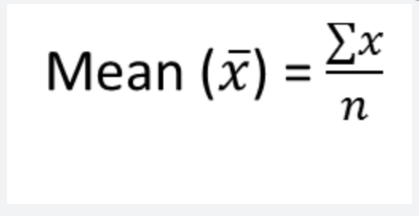
Mean
Average
n= number of observations
x= variable

Slide 11
What is the mean
1, 1, 2, 2, 2, 3, 4, 4, 5, 5, 5, 5, 5, 6

Slide 12
What is the mean
X=1, 1, 2, 2, 2, 3, 4, 4, 5, 5, 5, 5, 5, 6
Xbar = 3.574

Slide 13
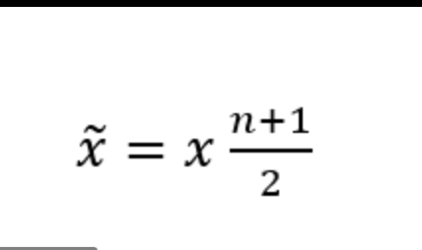
Median
The number that is in the middle
Arrange the scores in numerical order
Count how many numbers you have
Divide the total count by 2
If you have an odd number, round up

Slide 14
What is the median
x=1, 1, 2, 2, 2, 3, 4, 4, 5, 5, 5, 5, 5, 6

Slide 15
What is the median
x=1, 1, 2, 2, 2, 3, 4, 4, 5, 5, 5, 5, 5, 6
Median=4

Slide 16
Mode
The number that appears most often

Slide 17
What is the mode
x=1, 1, 2, 2, 2, 3, 4, 4, 5, 5, 5, 5, 5, 6

Slide 18
What is the mode
x=1, 1, 2, 2, 2, 3, 4, 4, 5, 5, 5, 5, 5, 6
Mode=5

Slide 19
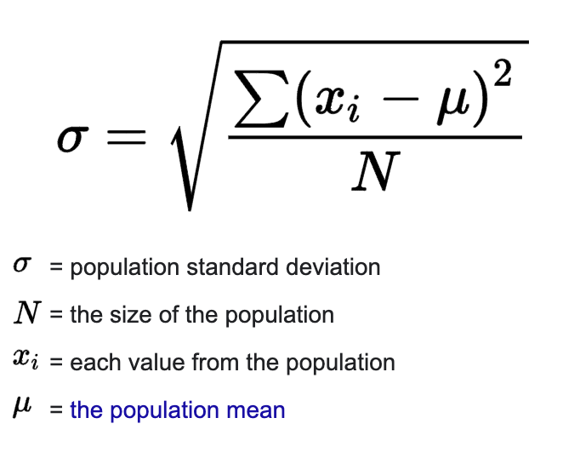
What is the standard deviation
How spread the data is from the mean value
Helps us to understand the
distribution of data

Slide 20
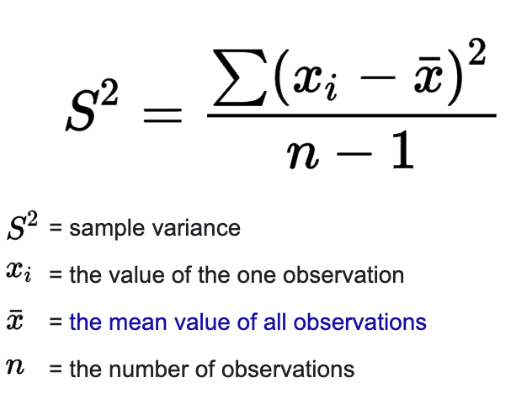
What is the variance
How spread the data is from the mean value
Helps us to understand the
distribution of data
By definition, sd^2 = variance

Slide 21
To understand your data, ask:
What is the unit of analysis?
What kind of variables does the data have?
Missing data rate?
Type of data?
What is interesting about the data?

Slide 22
Practice
Open immprotestdata.csv
Read as a background for the data https://www.cinema.ucla.edu/collections/immigrant-workers-freedom-ride-iwfr-documentary-project-collection

Slide 23
Understand your data
What is the unit of analysis?
What kind of variables does the data have?
Missing data rate?
Type of data?
What is interesting about the data?
What kind of research questions can be derived from the data?

Slide 24
Let’s actually practice
Calculate the mean of metropolitan code (metcode)
Calculate the mean of State variable in the immigrant protest data file
Calculate the mean, median, sd of NativityForeign variable in the immigrant protest data file
Which state has the highest median income? (why do we use median when it comes to income and not the mean)
What are some of the problems with the data?

Slide 25
Main problem
Average participant has decimal places even when the duration is 1
  I don’t know what is happening here either
Some NAs
  Dealing with missing data is a separate topic that I would be happy to discuss if we have time later

Slide 26
Types of data in R
Numeric
Integer
Character
Factor
Logical

Slide 27
Numeric
Most common data type in R
R will store a variable as numeric data if the values are numbers or if it has decimals

Slide 28
Open R

Slide 29
Integer
Special case of numeric data
Numeric data without decimals
If the variable is a count variable, it should not have decimals – then you can save it as an integer in R

Slide 30
Open R

Slide 31
Character
Storing text
Also known as strings
The simplest way to save data under the character format is using ””

Slide 32
Open R

Slide 33
Factor
Special character variable
Used when there are a limited number of unique character strings
  E.g., gender in surveys often give three options, (1) male, (2) female, (3) other so this will often be considered as factor
  E.g., names have a lot of different variations, so this will be character
In reality, character and factors are used quite interchangeably
But some functions are only possible in factors (e.g., setting levels among ordinal variables)

Slide 34
Open R
Change the test variable into a factor and set ”test 3” as the reference group

Slide 35
Importing data
Now you should be able to import data
Some other useful packages
  readxl: reads excel files
  readr : reads text files
  foreign : various types of data files such as SPSS or Stata
Import Knightley.csv file onto R
Name the data frame “Cat”
Open R file

Slide 36
Create a new variable
What is the unit of analysis?
What kind of variables does the data have?
Missing data rate?
Type of data?
What is interesting about the data?
What kind of research questions can be derived from the data?

Slide 37
Create a new variable
We decided to observe Knightley a little more and got some more data on how many times Knightley ate in one day
We want to create a new variable called FoodFrequency within the dataset Cat

Slide 38
Create a new variable
Cat<-read.csv("Knightley.csv", header=T, na.strings=c("","NA")) #If blank, make it NA
Cat$FoodFrequency<-c(4,3,3,4,3,3,3,2,2,3,4,4,2,3,4,5,2,2,4)

Slide 39
Types of objects
Scalars
Vectors
Data frames & matrices
Lists
Other types of objects

Slide 40
Scalars
Scalars are objects consisting of single value – one letter, one word, one sentence, one number etc.
Create a scalar consisting the value 2. Name it “number_two”

Slide 41
Scalars
Scalars are objects consisting of single value – one letter, one word, one sentence, one number etc.
Create a scalar consisting the value 2. Name it “number_two”
number_two<-2

Slide 42
Vectors
Vectors are objects that consist of several values of the same type of data
  E.g., several words or numbers separately as vectors
  We can use c() in r to group vectors together
Create a vector that contains the values 1 to 20 and name it “numbers”

Slide 43
Vectors
Vectors are objects that consist of several values of the same type of data
  E.g., several words or numbers separately as vectors
  We can use c() in r to group vectors together
Create a vector that contains the values 1 to 20 and name it “numbers”
numbers<-c(1:20)
numbers<-c(1,2,3,4,5,6,7,8,9,10,11,12,13,14,15,16,17,18,19,20)

Slide 44
Data frames and matrices
Data frames and matrices consist of several vectors of the same length
Knightley.csv is a data frame
immprotestdata.csv is a data frame

Slide 45
Data frames and matrices
Let’s create a data frame from scratch (without importing)
Open R

Slide 46
Lists
Lists can be described as an array of (different) objects
Open R

Slide 47
Practice
Open R
Create a data frame called df1
The data frame should contain the following variables
  One vector called food – it should contain 5 elements (or observations), i.e., the names of your favorite food
  One vector called description – give a one sentence description of your five favorite dishes (e.g., pizza: Italian dish with cheese)
  One vector called rating – give it a rating out of 5, 5 being your favorite and 1 being your least favorite

Slide 48
Transforming objects
Open R

