Slide 1
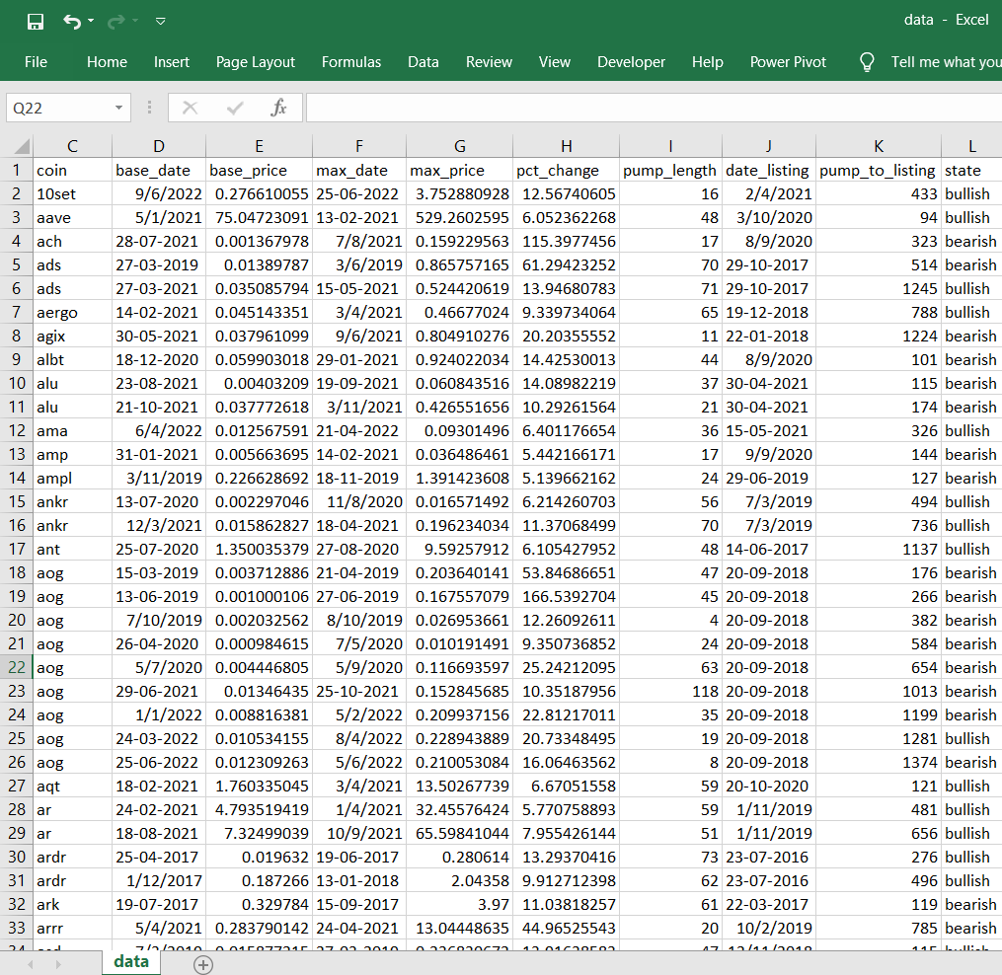


1. Create Database of Pumping (>500%) Occurrence
Definition
Base_price : minimum price before pumping
Pct_change : max_price/base_price

Slide 2
