Slide 1
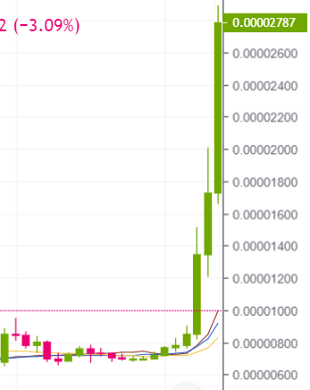
SHIB 17/9/2021 – 4/10/2021

