Slide 1
Magnetohydrodynamics

Slide 2
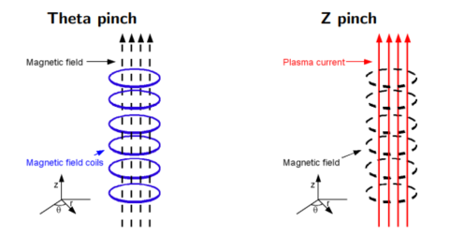
Pinches

Slide 3
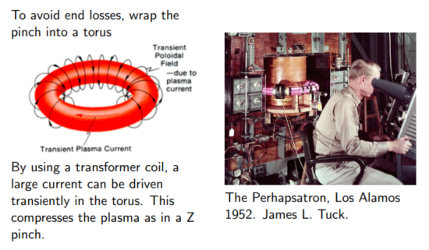
Toroidal Pinches

Slide 4
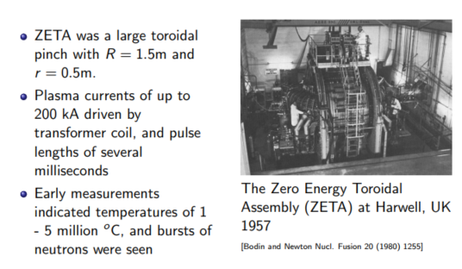
Toroidal pinches: ZETA

Slide 5
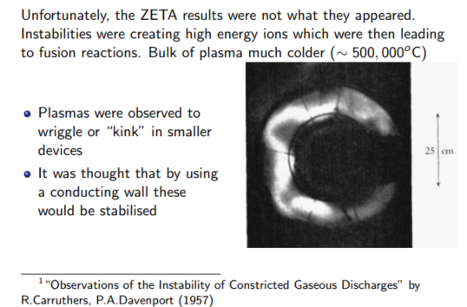
Instabilities

Slide 6
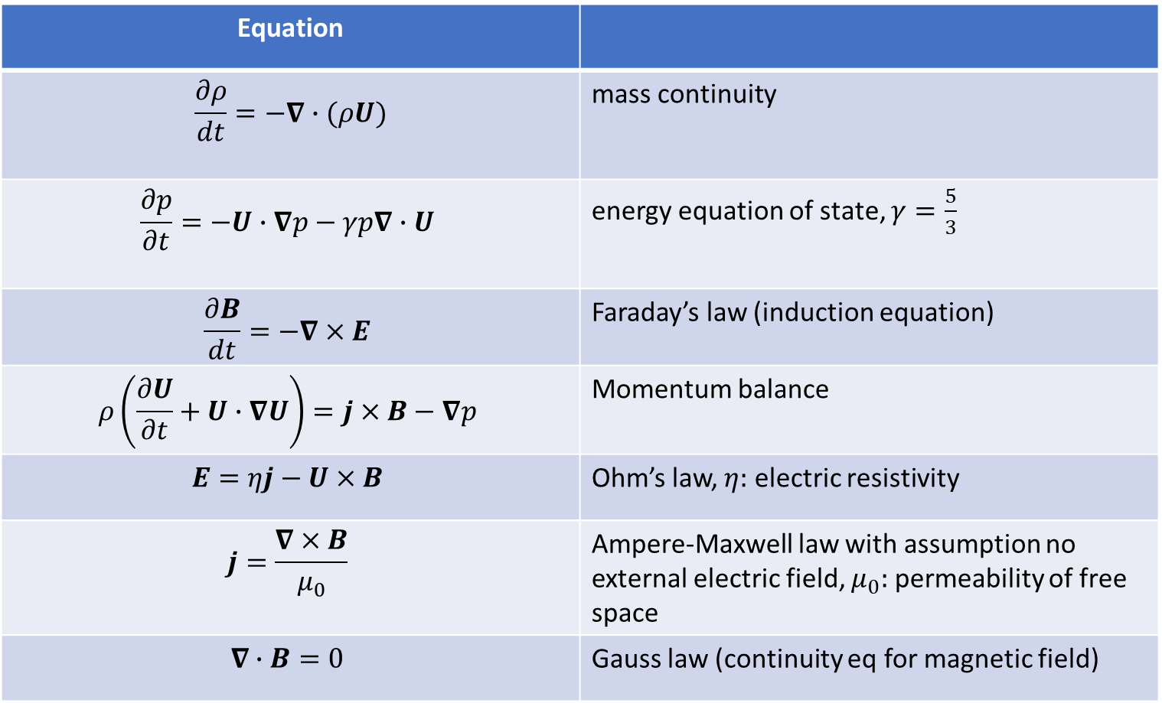
Governing Equations of Resistive MHD
Equation
$$\frac{∂ρ}{dt}=−∇∙(ρU)$$ | mass continuity
$$\frac{∂p}{∂t}=−U∙∇p−γp∇∙U$$ | energy equation of state, $γ=\frac{5}{3}$
$$\frac{∂B}{dt}=−∇×E$$ | Faraday’s law (induction equation)
$$ρ\left(\frac{∂U}{∂t}+U∙∇U\right)=j×B−∇p$$ | Momentum balance
$$E=ηj−U×B$$ | Ohm’s law, $η:$ electric resistivity
$$j=\frac{∇×B}{μ_{0}}$$ | Ampere-Maxwell law with assumption no external electric field, $μ_{0}:$ permeability of free space
$$∇∙B=0$$ | Gauss law (continuity eq for magnetic field)
Definition
Constraint

Slide 7

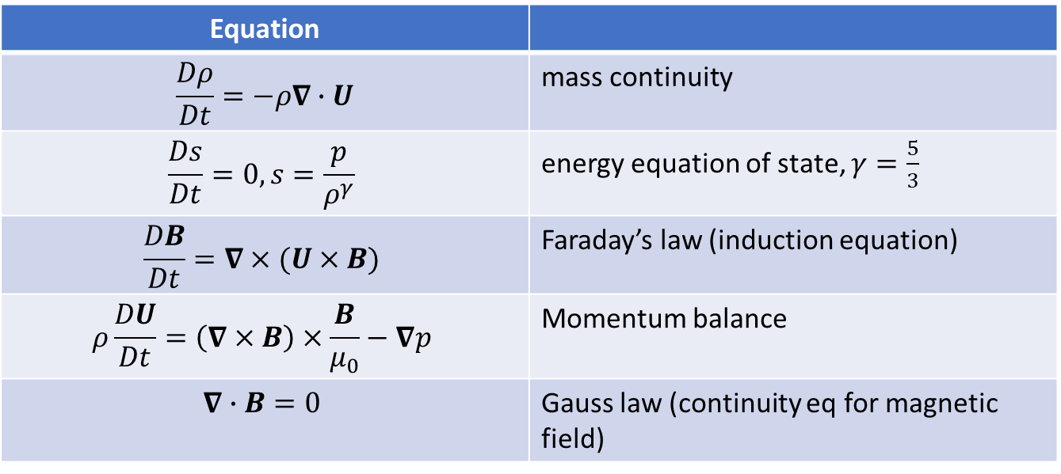
Define:
$$\frac{D}{Dt}=\frac{∂}{∂t}+U∙∇$$
In hot plasmas, $η=0$, and convert electrical terms ($j,E)$ in terms of magnetic $(B)$ and velocity ($U$) terms
Equation
$$\frac{Dρ}{Dt}=−ρ∇∙U$$ | mass continuity
$$\frac{Ds}{Dt}=0, s=\frac{p}{ρ^{γ}}$$ | energy equation of state, $γ=\frac{5}{3}$
$$\frac{DB}{Dt}=∇×(U×B)$$ | Faraday’s law (induction equation)
$$ρ\frac{DU}{Dt}=\left(∇×B\right)×\frac{B}{μ_{0}}−∇p$$ | Momentum balance
$$∇∙B=0$$ | Gauss law (continuity eq for magnetic field)
Notes:
Friedberg 272

Slide 8
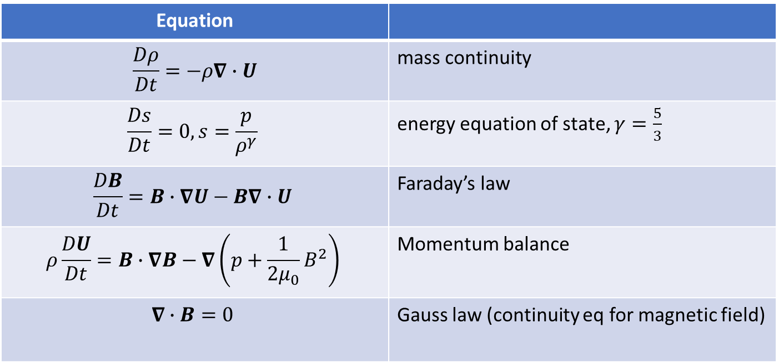
Using vector calculus identities, manipulate the cross product:
Equation
$$\frac{Dρ}{Dt}=−ρ∇∙U$$ | mass continuity
$$\frac{Ds}{Dt}=0, s=\frac{p}{ρ^{γ}}$$ | energy equation of state, $γ=\frac{5}{3}$
$$\frac{DB}{Dt}=B∙∇U−B∇∙U$$ | Faraday’s law
$$ρ\frac{DU}{Dt}=B∙∇B−∇\left(p+\frac{1}{2μ_{0}}B^{2}\right)$$ | Momentum balance
$$∇∙B=0$$ | Gauss law (continuity eq for magnetic field)
“We can therefore say that magnetic field lines move with the plasma flow in ideal MHD. It follows that in an ideal MHD plasma, magnetic field lines cannot be created or annihilates, nor can they break up and reconnect. The magnetic topology is conserved, “frozen in the fluid”, so to speak.”

Slide 9
MHD Instablities
Ideal MHD is frequently used to describe macroscopic instabilities.
MHD is often a mediocre approximation, but it does a surprisingly good job at describing instabilities.
Ideal instabilities are usually the strongest and most unstable.
Current-driven vs pressure-driven.
General strategy for studying plasma stability:
Start from an initial equilibrium.
Linearize the equations of MHD and discard higher order terms.
Slightly perturb that equilibrium.

Slide 10
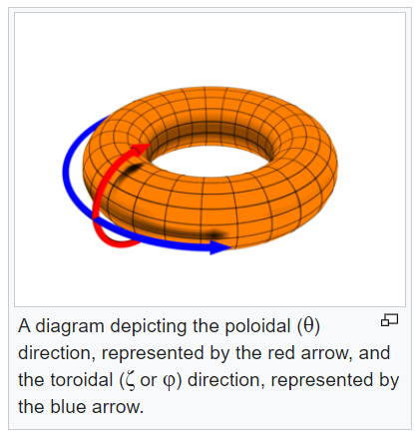
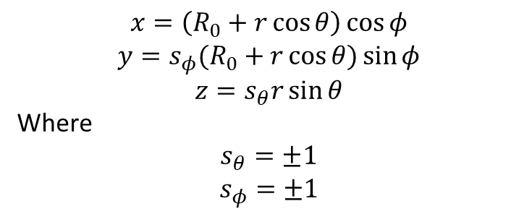
Torus Coordinates
$$x=\left(R_{0}+r\cos{θ}\right)\cos{φ}$$
$$y=s_{φ}(R_{0}+r\cos{θ)\sin{φ}}$$
$$z=s_{θ}r\sin{θ}$$
Where
$$s_{θ}=±1$$
$$s_{φ}=±1$$

Slide 11
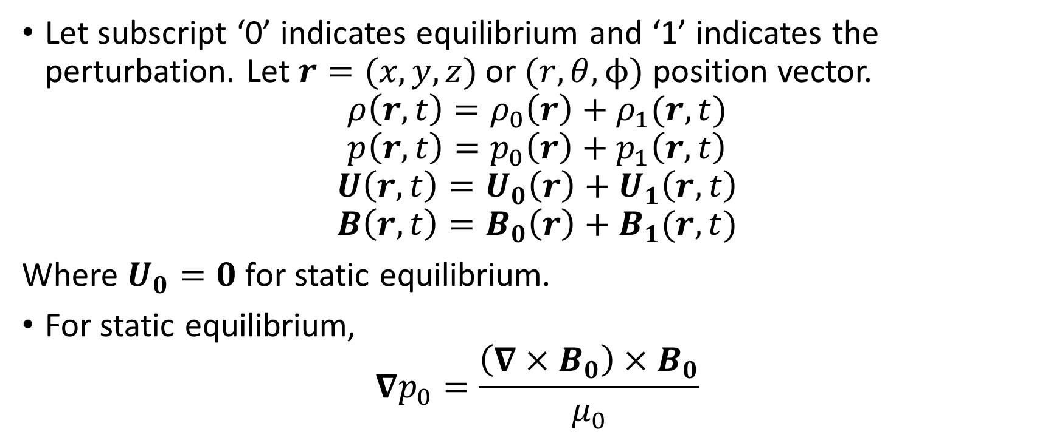
Linearizing the equations of ideal MHD
Let subscript ‘0’ indicates equilibrium and ‘1’ indicates the perturbation. Let $r=(x,y,z)$ or $(r,θ,ϕ)$ position vector.
$$ρ\left(r,t\right)=ρ_{0}\left(r\right)+ρ_{1}(r,t)$$
$$p\left(r,t\right)=p_{0}\left(r\right)+p_{1}\left(r,t\right)$$
$$U\left(r,t\right)=U_{0}\left(r\right)+U_{1}\left(r,t\right)$$
$$B\left(r,t\right)=B_{0}\left(r\right)+B_{1}(r,t)$$
Where $U_{0}=0$ for static equilibrium.
For static equilibrium,
$$∇p_{0}=\frac{\left(∇×B_{0}\right)×B_{0}}{μ_{0}}$$

Slide 12
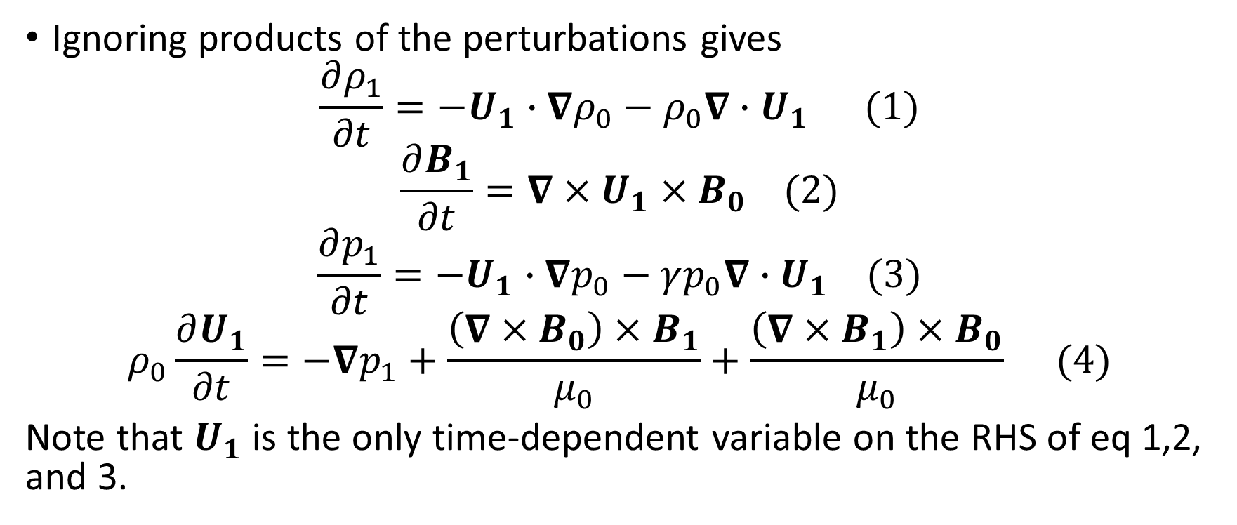
Linearizing the equations of ideal MHD
Ignoring products of the perturbations gives
$$\frac{∂ρ_{1}}{∂t}=−U_{1}∙∇ρ_{0}−ρ_{0}∇∙U_{1} (1)$$
$$\frac{∂B_{1}}{∂t}=∇×U_{1}×B_{0} (2)$$
$$\frac{∂p_{1}}{∂t}=−U_{1}∙∇p_{0}−γp_{0}∇∙U_{1} (3)$$
$$ρ_{0}\frac{∂U_{1}}{∂t}=−∇p_{1}+\frac{\left(∇×B_{0}\right)×B_{1}}{μ_{0}}+\frac{\left(∇×B_{1}\right)×B_{0}}{μ_{0}} (4)$$
Note that $U_{1}$ is the only time-dependent variable on the RHS of eq 1,2, and 3.

Slide 13
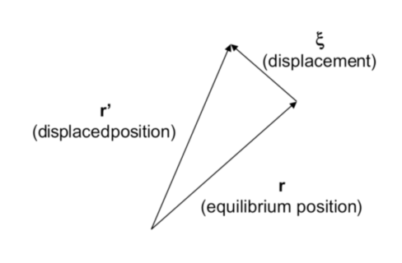
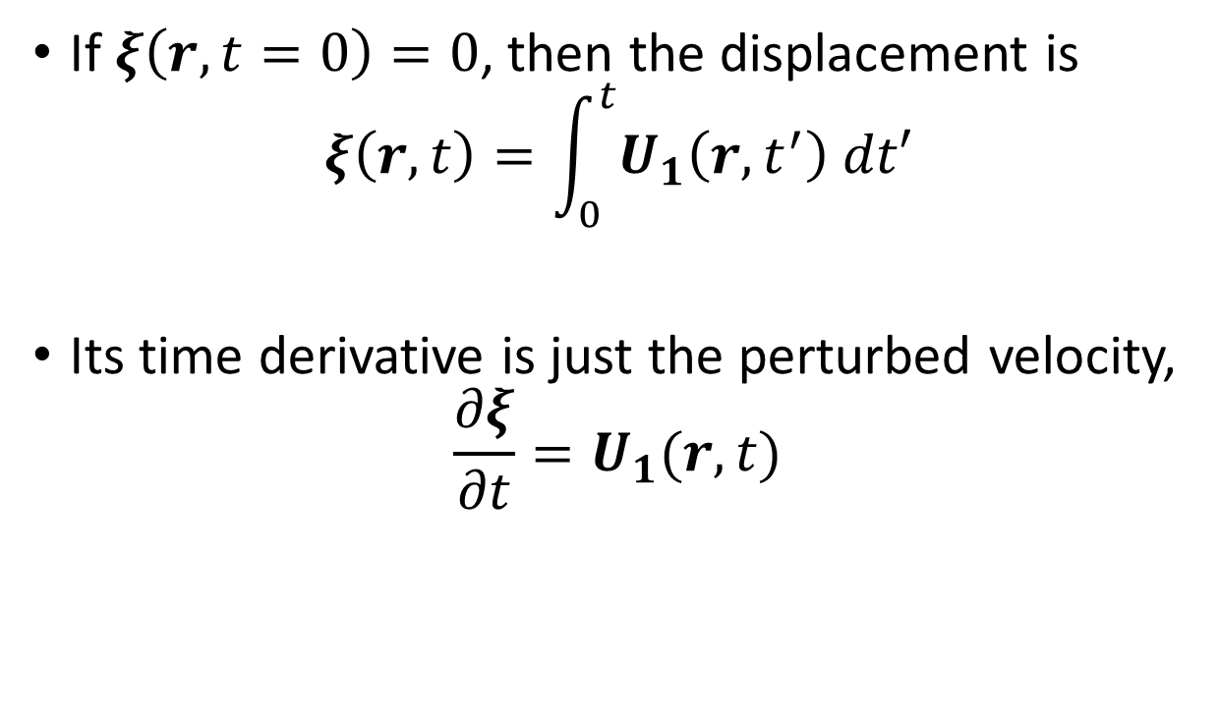

The displacement vector, $ξ$, describes how much the plasma is displaced from the equilibrium state.
If $ξ\left(r,t=0\right)=0$, then the displacement is
$$ξ\left(r,t\right)=\int_{0}^{t}{U_{1}\left(r,t^{′}\right) dt′}$$
Its time derivative is just the perturbed velocity,
$$\frac{∂ξ}{∂t}=U_{1}(r,t)$$

Slide 14
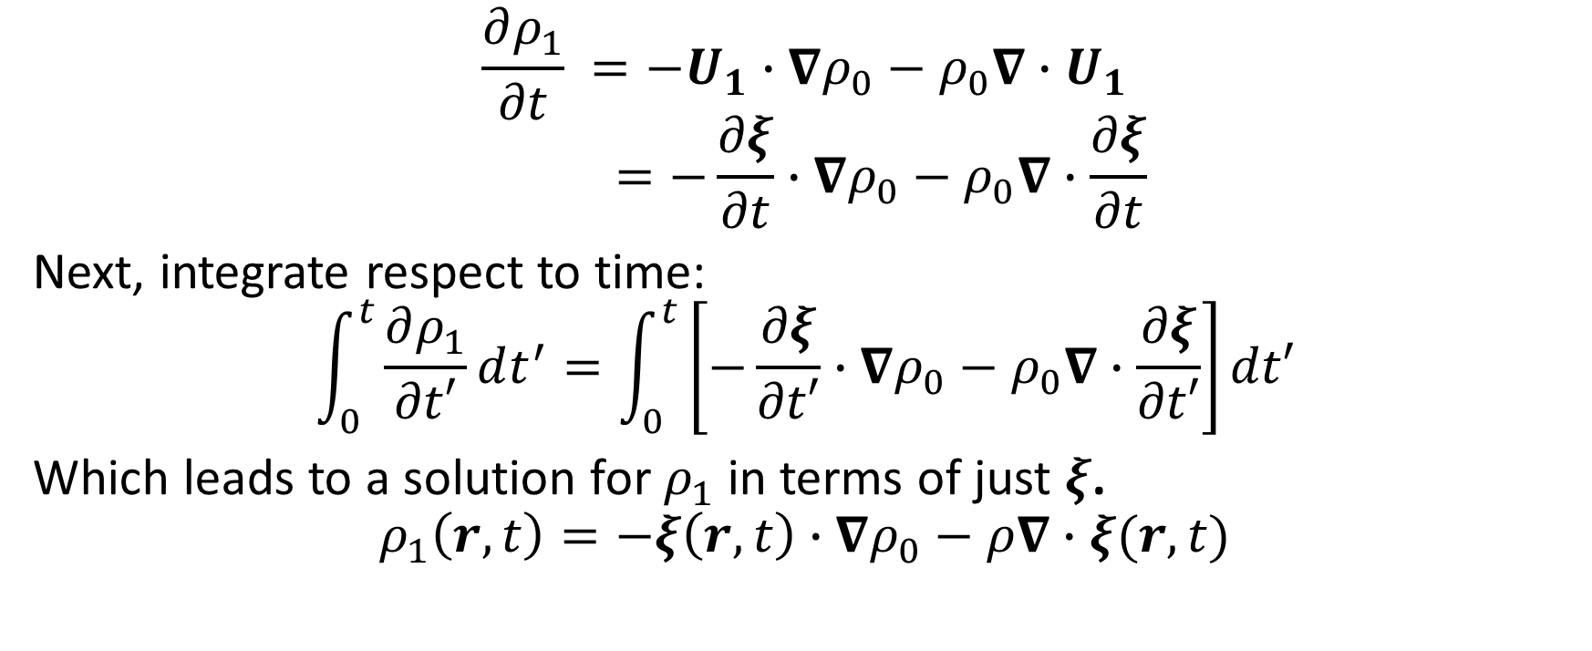
Integrate the continuity equation with respect to time
$$\frac{∂ρ_{1}}{∂t} =−U_{1}∙∇ρ_{0}−ρ_{0}∇∙U_{1}$$
$$=−\frac{∂ξ}{∂t}∙∇ρ_{0}−ρ_{0}∇∙\frac{∂ξ}{∂t}$$
Next, integrate respect to time:
$$\int_{0}^{t}{\frac{∂ρ_{1}}{∂t′}dt^{′}}=\int_{0}^{t}{\left[−\frac{∂ξ}{∂t′}∙∇ρ_{0}−ρ_{0}∇∙\frac{∂ξ}{∂t′}\right]dt′}$$
Which leads to a solution for $ρ_{1}$ in terms of just $ξ$.
$$ρ_{1}\left(r,t\right)=−ξ\left(r,t\right)∙∇ρ_{0}−ρ∇∙ξ(r,t)$$

Slide 15
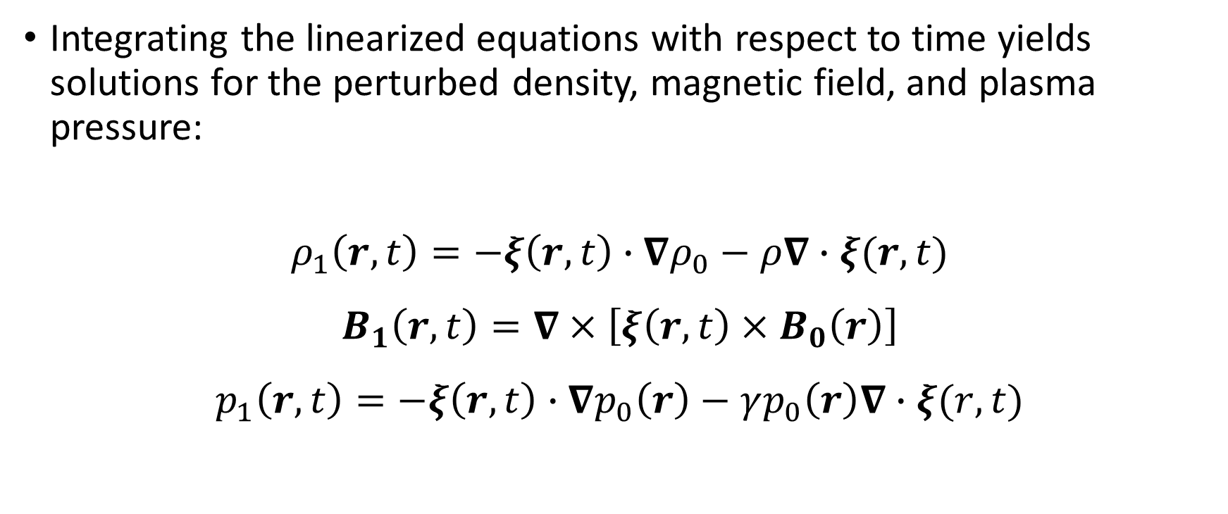

We can similarly put the linearized induction and energy equations in terms of $ξ$
Integrating the linearized equations with respect to time yields solutions for the perturbed density, magnetic field, and plasma pressure:
$$ρ_{1}\left(r,t\right)=−ξ\left(r,t\right)∙∇ρ_{0}−ρ∇∙ξ(r,t)$$
$$B_{1}\left(r,t\right)=∇×\left[ξ\left(r,t\right)×B_{0}\left(r\right)\right]$$
$$p_{1}\left(r,t\right)=−ξ\left(r,t\right)∙∇p_{0}\left(r\right)−γp_{0}\left(r\right)∇∙ξ(r,t)$$

Slide 16
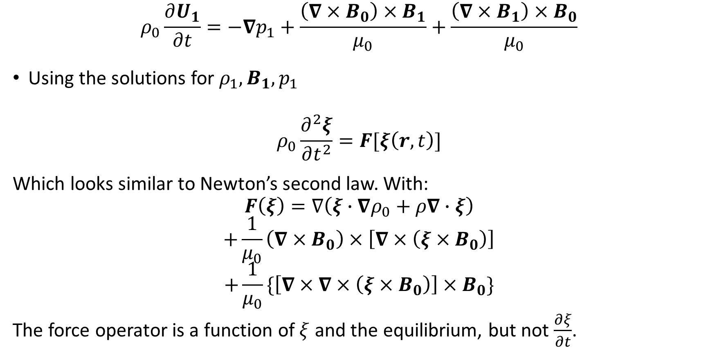

Linearized momentum equation in terms of $ξ$
$$ρ_{0}\frac{∂U_{1}}{∂t}=−∇p_{1}+\frac{\left(∇×B_{0}\right)×B_{1}}{μ_{0}}+\frac{\left(∇×B_{1}\right)×B_{0}}{μ_{0}}$$
Using the solutions for $ρ_{1},B_{1},p_{1}$
$$ρ_{0}\frac{∂^{2}ξ}{∂t^{2}}=F[ξ\left(r,t\right)]$$
Which looks similar to Newton’s second law. With:
$$F\left(ξ\right)=∇\left(ξ∙∇ρ_{0}+ρ∇∙ξ\right)$$
$$+\frac{1}{μ_{0}}\left(∇×B_{0}\right)×\left[∇×\left(ξ×B_{0}\right)\right]$$
$$+\frac{1}{μ_{0}}\{\left[∇×∇×\left(ξ×B_{0}\right)\right]×B_{0}\}$$
The force operator is a function of $ξ$ and the equilibrium, but not $\frac{∂ξ}{∂t}$.

Slide 17
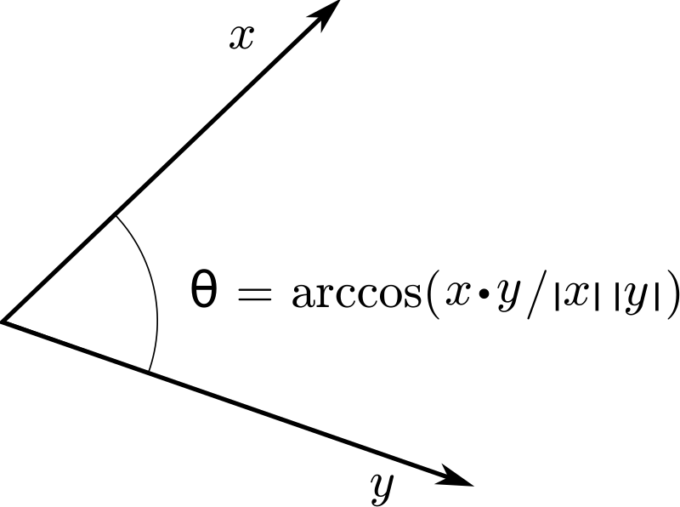
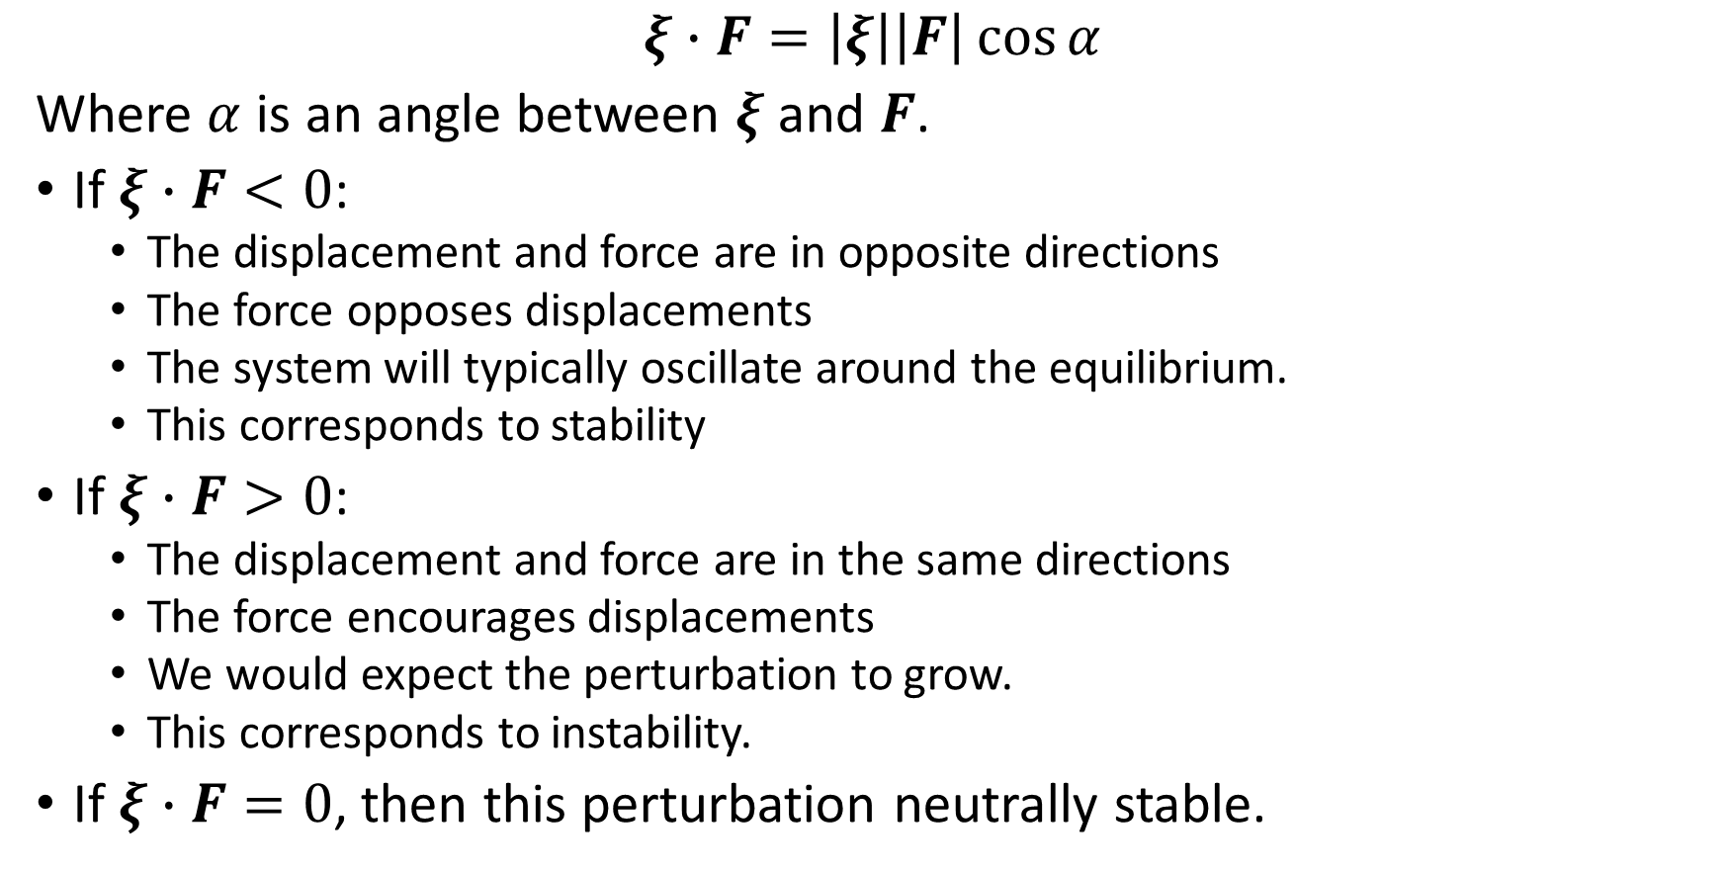
Intuition for the force operator
$$ξ∙F=\left|ξ\right|\left|F\right|\cos{α}$$
Where $α$ is an angle between $ξ$ and $F$.
If $ξ∙F<0$:
The displacement and force are in opposite directions
The force opposes displacements
The system will typically oscillate around the equilibrium.
This corresponds to stability
If $ξ∙F>0$:
The displacement and force are in the same directions
The force encourages displacements
We would expect the perturbation to grow.
This corresponds to instability.
If $ξ∙F=0$, then this perturbation neutrally stable.

Slide 18
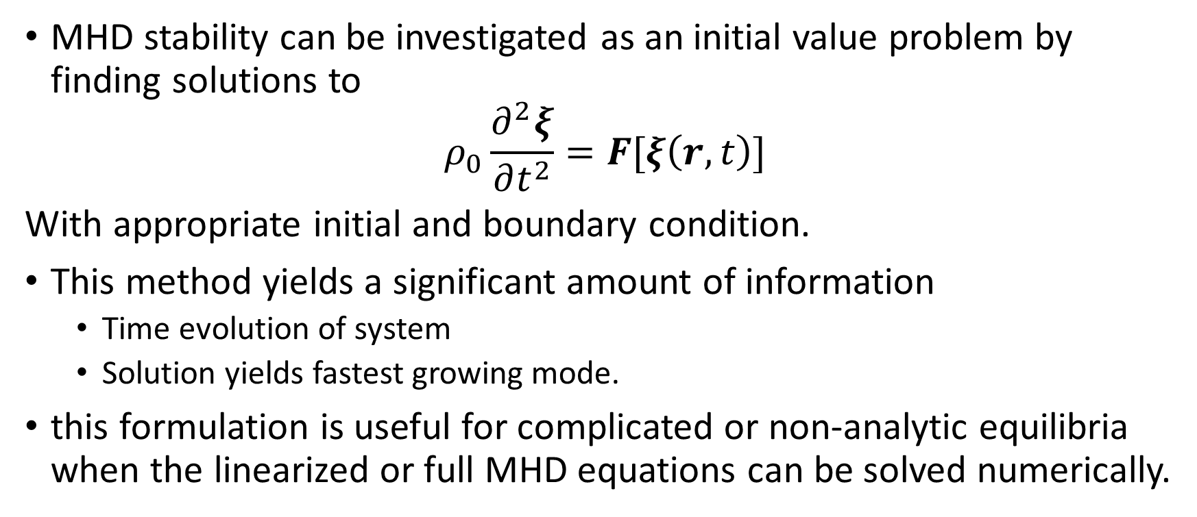
1. Initial value formulation
MHD stability can be investigated as an initial value problem by finding solutions to
$$ρ_{0}\frac{∂^{2}ξ}{∂t^{2}}=F[ξ\left(r,t\right)]$$
With appropriate initial and boundary condition.
This method yields a significant amount of information
Time evolution of system
Solution yields fastest growing mode.
this formulation is useful for complicated or non-analytic equilibria when the linearized or full MHD equations can be solved numerically.

Slide 19
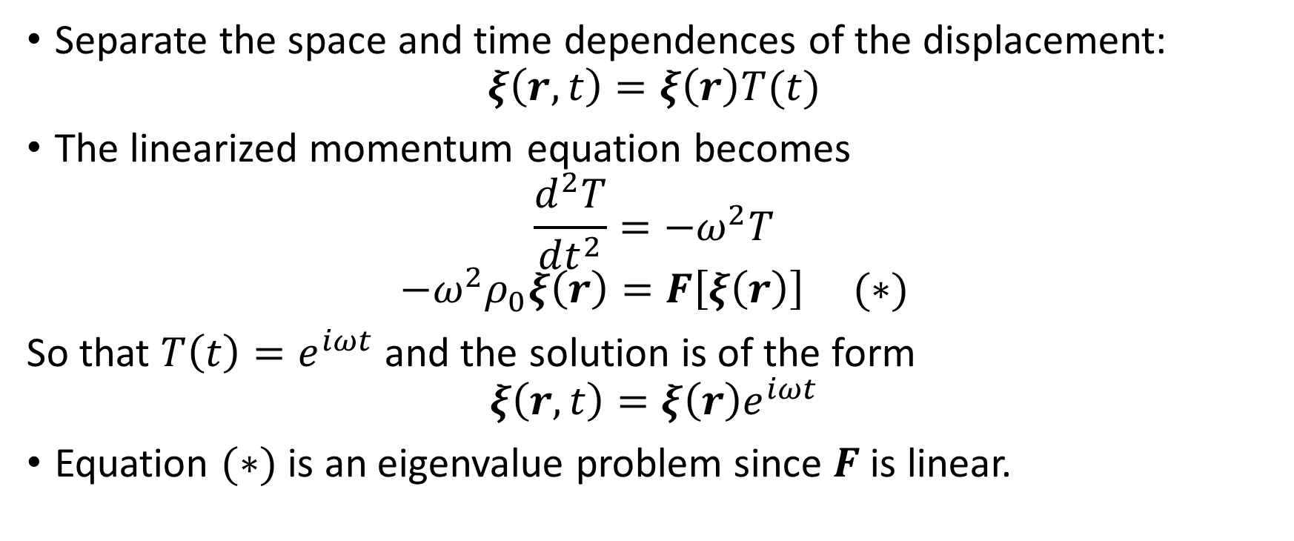
2. Finding the normal mode solution
Separate the space and time dependences of the displacement:
$$ξ\left(r,t\right)=ξ\left(r\right)T(t)$$
The linearized momentum equation becomes
$$\frac{d^{2}T}{dt^{2}}=−ω^{2}T$$
$$−ω^{2}ρ_{0}ξ\left(r\right)=F\left[ξ\left(r\right)\right] (∗)$$
So that $T\left(t\right)=e^{iωt}$ and the solution is of the form
$$ξ\left(r,t\right)=ξ\left(r\right)e^{iωt}$$
Equation $(∗)$ is an eigenvalue problem since $F$ is linear.

Slide 20
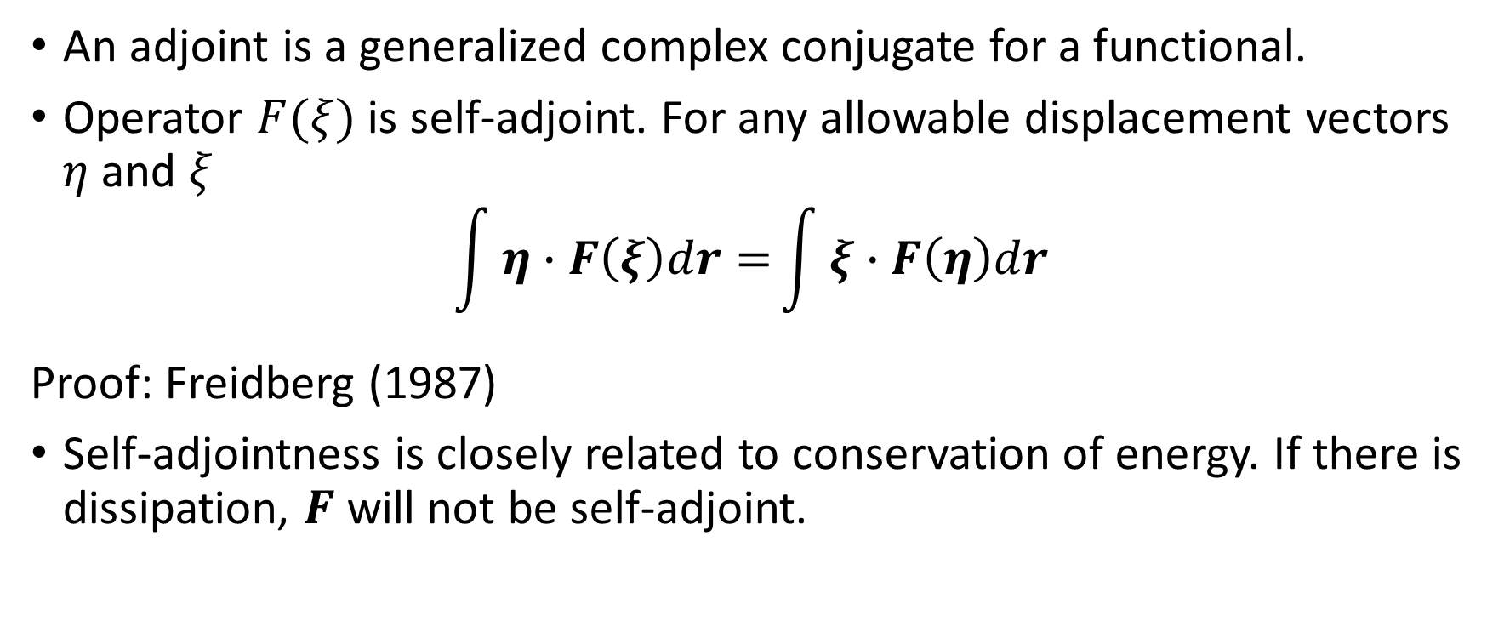
The MHD force operator is self-adjoint
An adjoint is a generalized complex conjugate for a functional.
Operator $F(ξ)$ is self-adjoint. For any allowable displacement vectors $η$ and $ξ$
$$\int{η∙F\left(ξ\right)dr=}\int{ξ∙F\left(η\right)dr}$$
Proof: Freidberg (1987)
Self-adjointness is closely related to conservation of energy. If there is dissipation, $F$ will not be self-adjoint.

Slide 21
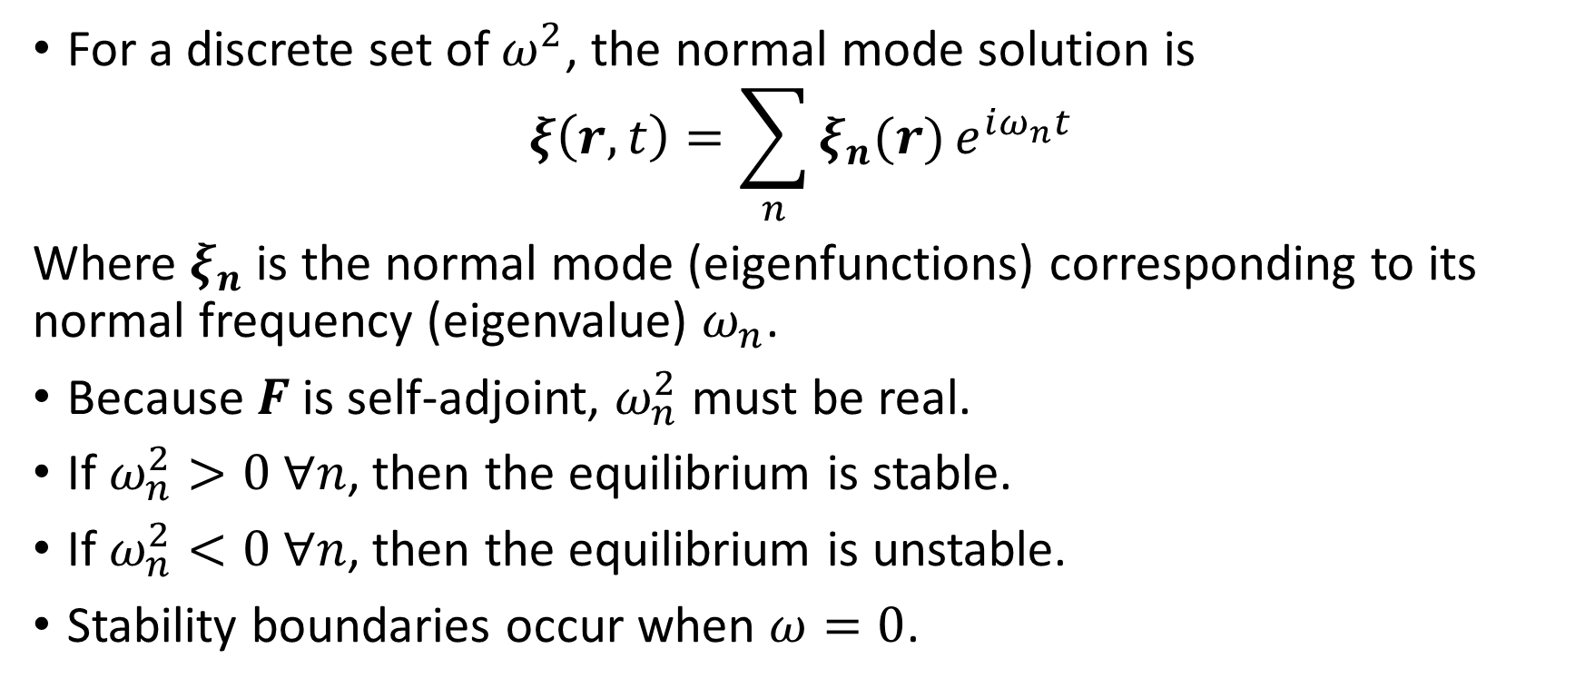
2. Finding the normal mode solution
For a discrete set of $ω^{2}$, the normal mode solution is
$$ξ\left(r,t\right)=\sum_{n}{ξ_{n}(r)}e^{iω_{n}t}$$
Where $ξ_{n}$ is the normal mode (eigenfunctions) corresponding to its normal frequency (eigenvalue) $ω_{n}$.
Because $F$ is self-adjoint, $ω_{n}^{2}$ must be real.
If $ω_{n}^{2}>0 ∀n$, then the equilibrium is stable.
If $ω_{n}^{2}<0 ∀n$, then the equilibrium is unstable.
Stability boundaries occur when $ω=0$.

Slide 22
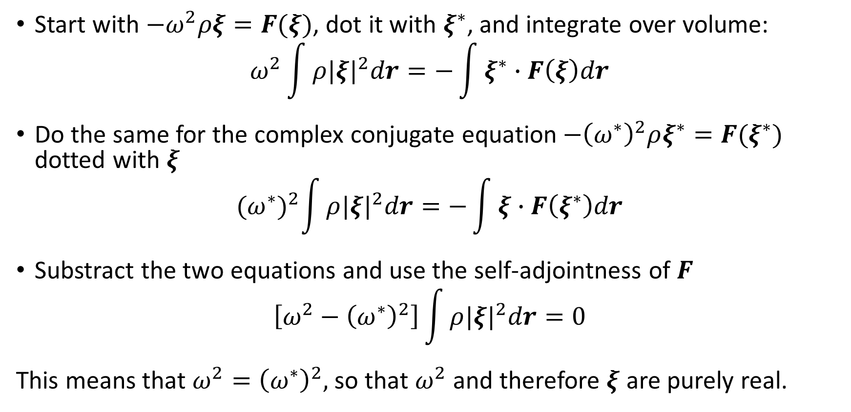

Proof that $ω^{2}$ is real
Start with $−ω^{2}ρξ=F(ξ)$, dot it with $ξ^{∗}$, and integrate over volume:
$$ω^{2}\int{ρ|{ξ|}^{2}dr=−\int{ξ^{∗}∙F\left(ξ\right)dr}}$$
Do the same for the complex conjugate equation$−{\left(ω^{∗}\right)}^{2}ρξ^{∗}=F(ξ^{∗})$ dotted with $ξ$
$${(ω^{∗})}^{2}\int{ρ|{ξ|}^{2}dr=−\int{ξ∙F\left(ξ^{∗}\right)dr}}$$
Substract the two equations and use the self-adjointness of $F$
$$\left[ω^{2}−{\left(ω^{∗}\right)}^{2}\right]\int{ρ|{ξ|}^{2}dr}=0$$
This means that $ω^{2}={\left(ω^{∗}\right)}^{2},$ so that $ω^{2}$ and therefore $ξ$ are purely real.

Slide 23
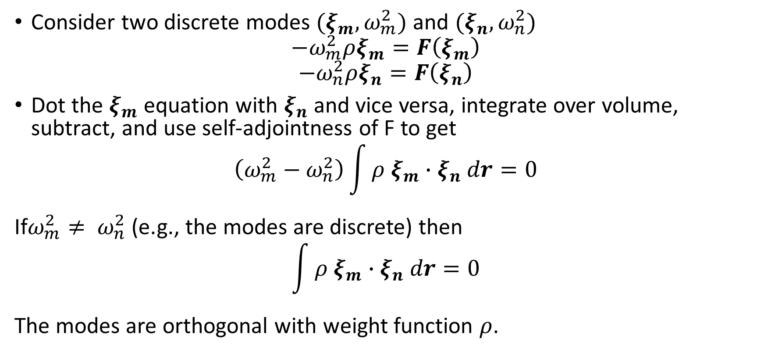
Showing that the normal modes are orthogonal
Consider two discrete modes $(ξ_{m},ω_{m}^{2})$ and $(ξ_{n},ω_{n}^{2})$
$$−ω_{m}^{2}ρξ_{m}=F\left(ξ_{m}\right)$$
$$−ω_{n}^{2}ρξ_{n}=F\left(ξ_{n}\right)$$
Dot the $ξ_{m}$ equation with $ξ_{n}$ and vice versa, integrate over volume, subtract, and use self-adjointness of F to get
$$\left(ω_{m}^{2}−ω_{n}^{2}\right)\int{ρ ξ_{m}∙ξ_{n} dr=0}$$
If$ω_{m}^{2}≠ ω_{n}^{2}$ (e.g., the modes are discrete) then
$$\int{ρ ξ_{m}∙ξ_{n} dr=0}$$
The modes are orthogonal with weight function $ρ$.

Slide 24
Normal mode formulation
Requires less effort than the initial value formulation.
More amenable to analysis.
Cannot be used to describe nonlinear evolution (after the linearization approximation breaks down)
Normal mode analysis requires that the eigenvalues are discrete and distinguishable.

Slide 25
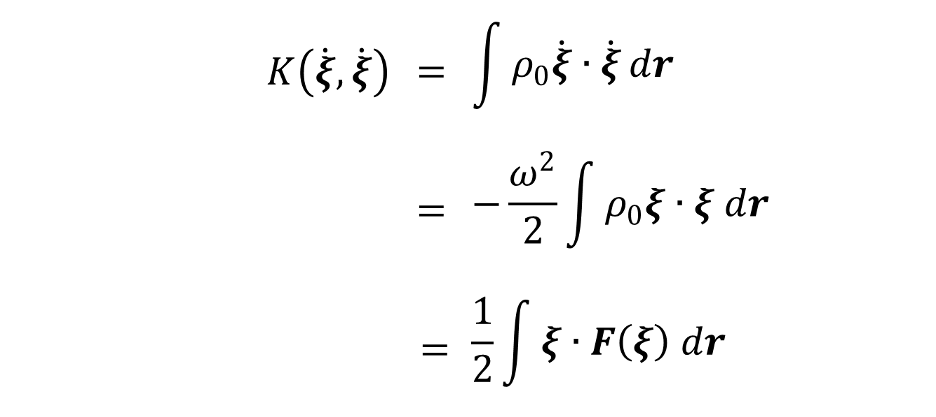

3. Variational principle
The kinetic energy is $\frac{1}{2}ρ_{0}{\dot{ξ}}^{2}$ integrated over the volume
From conservation of energy, the change in potential energy is
$$δW\left(ξ,ξ\right)=−\frac{1}{2}\int{ξ∙F\left(ξ\right) dr}$$
$$K\left(\dot{ξ},\dot{ξ}\right)$$ | $$=$$ | $$\int{ρ_{0}\dot{ξ}∙\dot{ξ}}dr$$
 | $$=$$ | $$−\frac{ω^{2}}{2}\int{ρ_{0}ξ∙ξ dr}$$
 | $$=$$ | $$\frac{1}{2}\int{ξ∙F\left(ξ\right) dr}$$

Slide 26
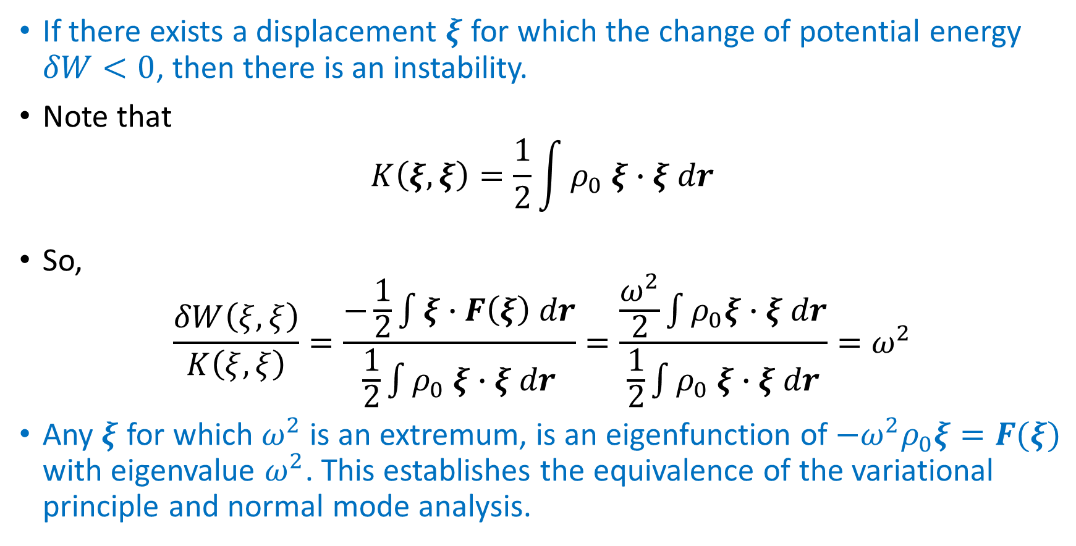
3. Variational principle
If there exists a displacement $ξ$ for which the change of potential energy $δW<0$, then there is an instability.
Note that
$$K\left(ξ,ξ\right)=\frac{1}{2}\int{ρ_{0} ξ∙ξ dr}$$
So,
$$\frac{δW\left(ξ,ξ\right)}{K\left(ξ,ξ\right)}=\frac{−\frac{1}{2}\int{ξ∙F\left(ξ\right) dr}}{\frac{1}{2}\int{ρ_{0} ξ∙ξ dr}}=\frac{\frac{ω^{2}}{2}\int{ρ_{0}ξ∙ξ dr}}{\frac{1}{2}\int{ρ_{0} ξ∙ξ dr}}=ω^{2}$$
Any $ξ$ for which $ω^{2}$ is an extremum, is an eigenfunction of $−ω^{2}ρ_{0}ξ=F(ξ)$ with eigenvalue $ω^{2}$. This establishes the equivalence of the variational principle and normal mode analysis.

Slide 27
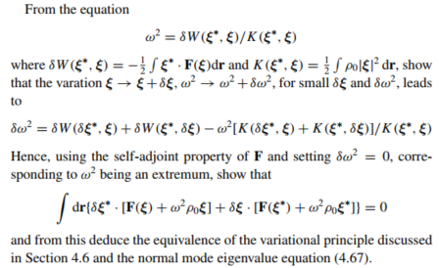
Notes:
· : dot product

Slide 28
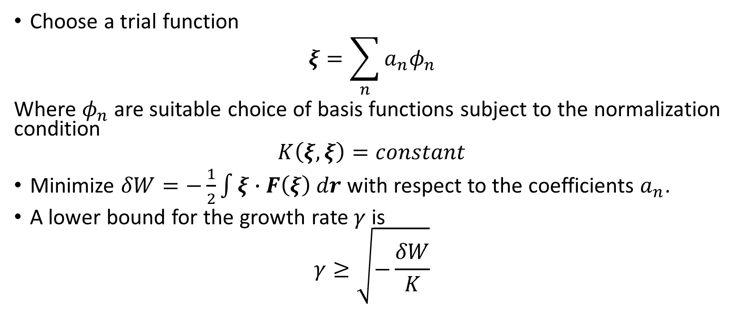
Strategy for the variational principle
Choose a trial function
$$ξ=\sum_{n}{a_{n}φ_{n}}$$
Where $φ_{n}$ are suitable choice of basis functions subject to the normalization condition
$$K\left(ξ,ξ\right)=constant$$
Minimize $δW=−\frac{1}{2}\int{ξ∙F\left(ξ\right) dr}$ with respect to the coefficients $a_{n}$.
A lower bound for the growth rate $γ$ is
$$γ≥\sqrt{−\frac{δW}{K}}$$

Slide 29
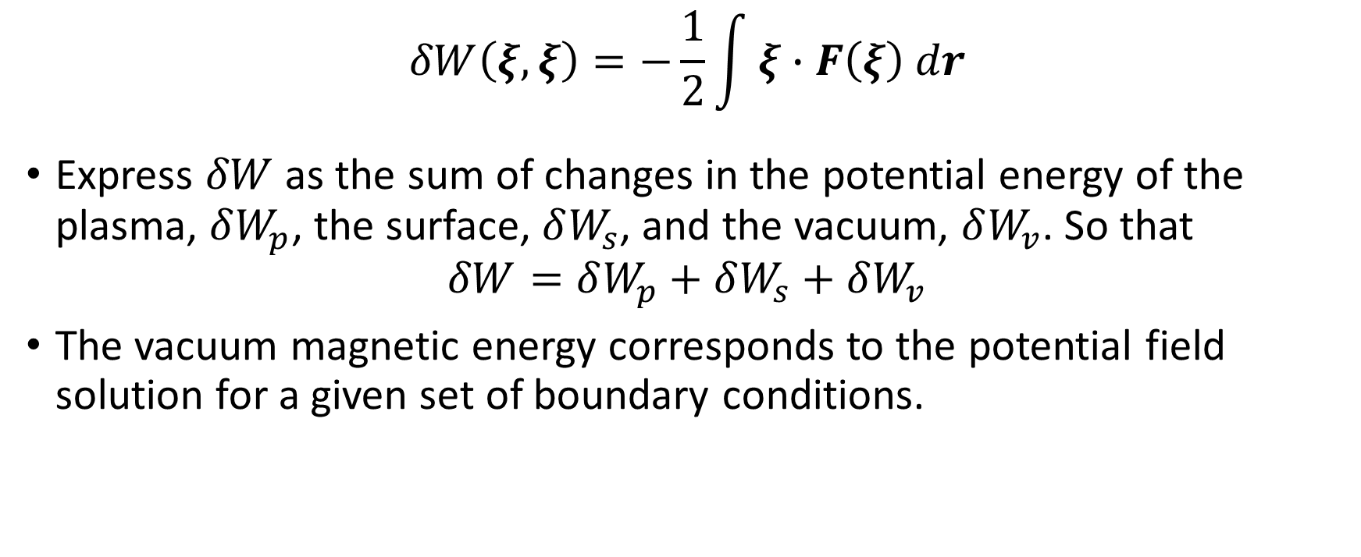
4. Energy principle
$$δW\left(ξ,ξ\right)=−\frac{1}{2}\int{ξ∙F\left(ξ\right) dr}$$
Express $δW$ as the sum of changes in the potential energy of the plasma, $δW_{p}$, the surface, $δW_{s}$, and the vacuum, $δW_{v}$. So that
$$δW=δW_{p}+δW_{s}+δW_{v}$$
The vacuum magnetic energy corresponds to the potential field solution for a given set of boundary conditions.

Slide 30
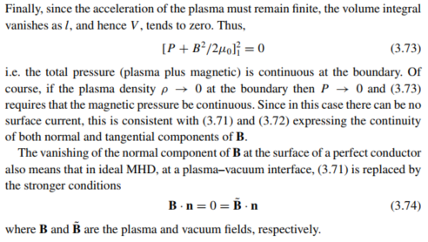
Boundary condition at the surface of plasma.

Slide 31
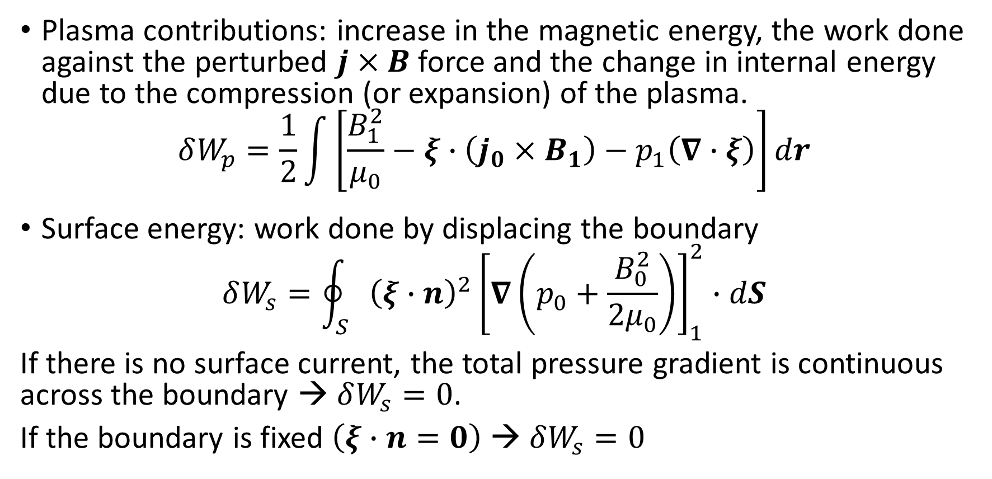
4. Energy principle
Plasma contributions: increase in the magnetic energy, the work done against the perturbed $j×B$ force and the change in internal energy due to the compression (or expansion) of the plasma.
$$δW_{p}=\frac{1}{2}\int{\left[\frac{B_{1}^{2}}{μ_{0}}−ξ∙\left(j_{0}×B_{1}\right)−p_{1}\left(∇∙ξ\right)\right]dr}$$
Surface energy: work done by displacing the boundary
$$δW_{s}=\oint_{S}{{\left(ξ∙n\right)}^{2}{\left[∇\left(p_{0}+\frac{B_{0}^{2}}{2μ_{0}}\right)\right]}_{1}^{2}}∙dS$$
If there is no surface current, the total pressure gradient is continuous across the boundary → $δW_{s}=0$.
If the boundary is fixed $\left(ξ∙n=0\right)$ → $δW_{s}=0$

Slide 32
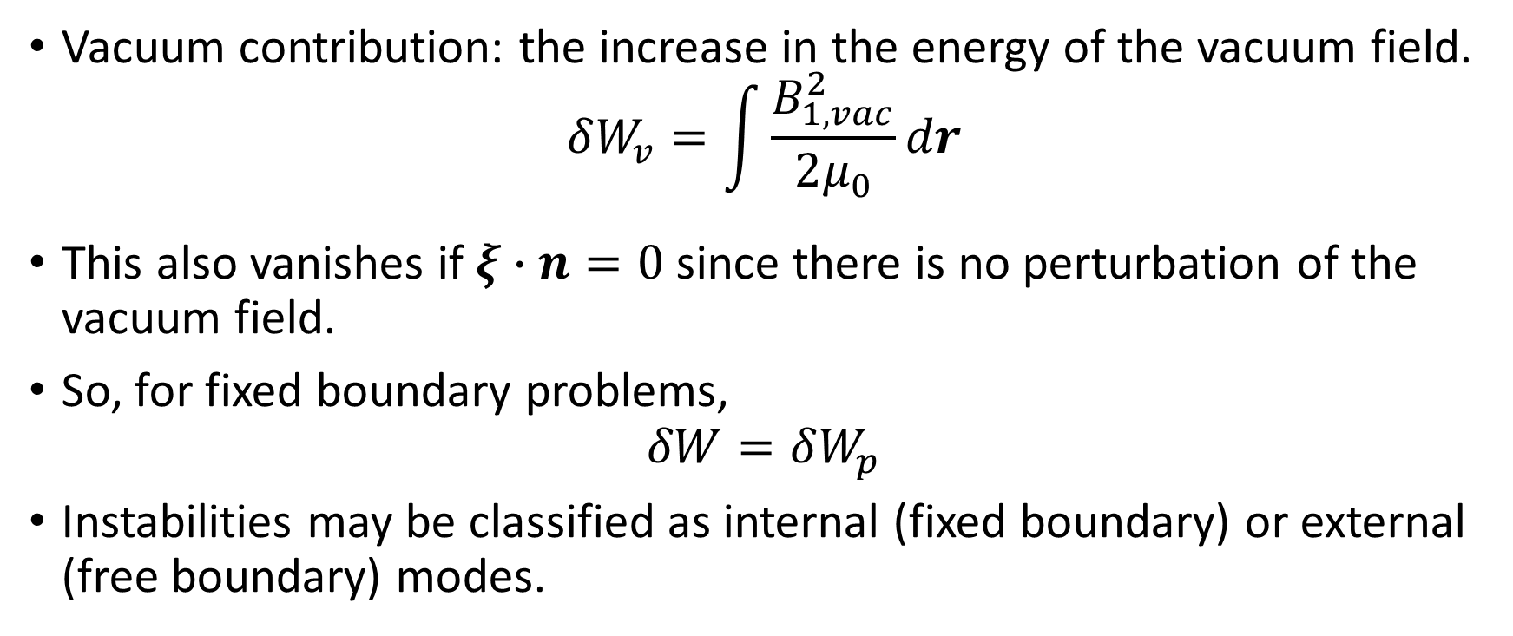
4. Energy principle
Vacuum contribution: the increase in the energy of the vacuum field.
$$δW_{v}=\int{\frac{B_{1,vac}^{2}}{2μ_{0}}dr}$$
This also vanishes if $ξ∙n=0$ since there is no perturbation of the vacuum field.
So, for fixed boundary problems,
$$δW=δW_{p}$$
Instabilities may be classified as internal (fixed boundary) or external (free boundary) modes.

Slide 33
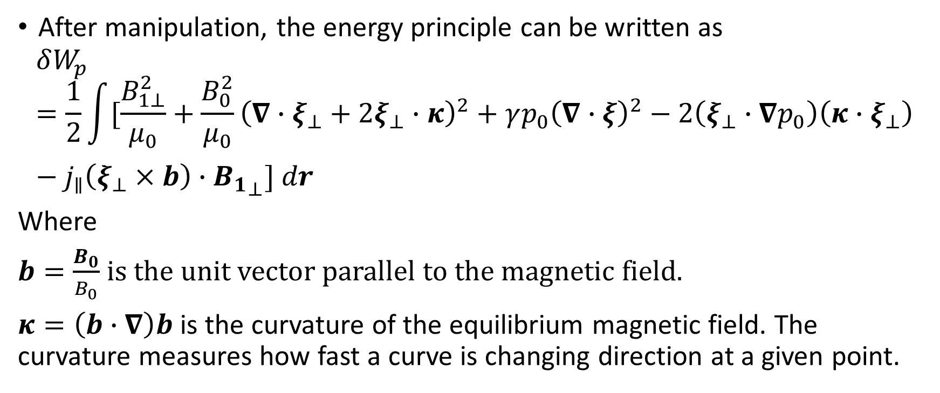
4. Energy principle
After manipulation, the energy principle can be written as
$$δW_{p}=\frac{1}{2}\int{[\frac{B_{1⊥}^{2}}{μ_{0}}}+\frac{B_{0}^{2}}{μ_{0}}{\left(∇∙ξ_{⊥}+2ξ_{⊥}∙κ\right)}^{2}+γp_{0}{\left(∇∙ξ\right)}^{2}−2\left(ξ_{⊥}∙∇p_{0}\right)\left(κ∙ξ_{⊥}\right)−j_{∥}\left(ξ_{⊥}×b\right)∙{B_{1}}_{⊥}] dr$$
Where
$b=\frac{B_{0}}{B_{0}}$ is the unit vector parallel to the magnetic field.
$κ=\left(b∙∇\right)b$ is the curvature of the equilibrium magnetic field. The curvature measures how fast a curve is changing direction at a given point.

Slide 34
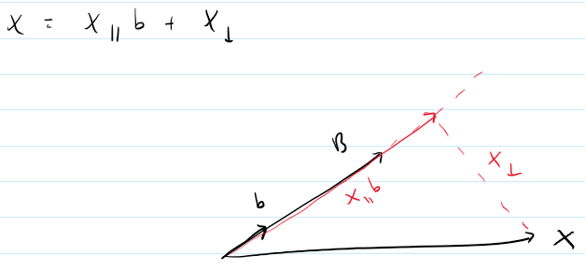

4. Energy principle
Vector quantities have been separated into parallel and perpendicular components relative to $b$, i.e. $X=X_{∥}b+X_{⊥}$.

Slide 35
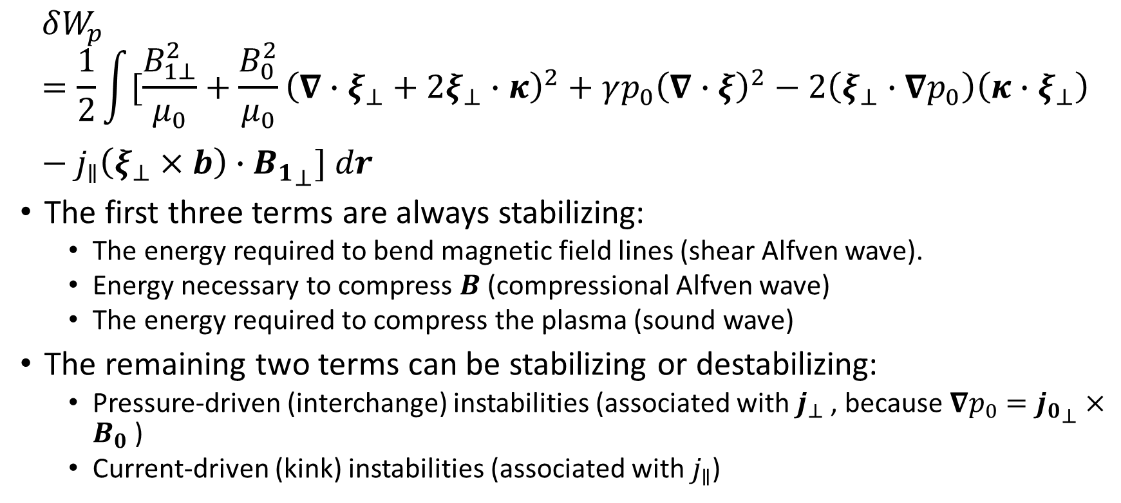
4. Energy principle
$$δW_{p}=\frac{1}{2}\int{[\frac{B_{1⊥}^{2}}{μ_{0}}}+\frac{B_{0}^{2}}{μ_{0}}{\left(∇∙ξ_{⊥}+2ξ_{⊥}∙κ\right)}^{2}+γp_{0}{\left(∇∙ξ\right)}^{2}−2\left(ξ_{⊥}∙∇p_{0}\right)\left(κ∙ξ_{⊥}\right)−j_{∥}\left(ξ_{⊥}×b\right)∙{B_{1}}_{⊥}] dr$$
The first three terms are always stabilizing:
The energy required to bend magnetic field lines (shear Alfven wave).
Energy necessary to compress $B$ (compressional Alfven wave)
The energy required to compress the plasma (sound wave)
The remaining two terms can be stabilizing or destabilizing:
Pressure-driven (interchange) instabilities (associated with $j_{⊥}$ , because $∇p_{0}={j_{0}}_{⊥}×B_{0}$)
Current-driven (kink) instabilities (associated with $j_{∥}$)

Slide 36
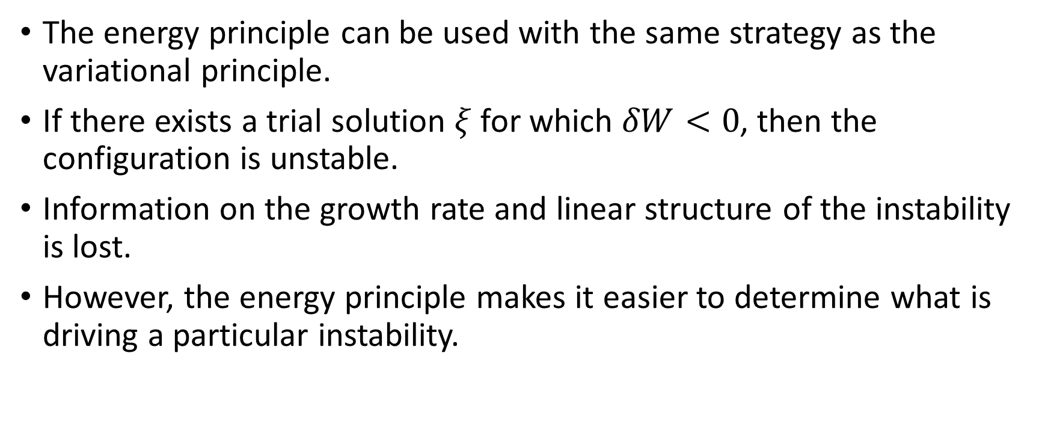
Strategy for using the energy principle
The energy principle can be used with the same strategy as the variational principle.
If there exists a trial solution $ξ$ for which $δW<0$, then the configuration is unstable.
Information on the growth rate and linear structure of the instability is lost.
However, the energy principle makes it easier to determine what is driving a particular instability.

Slide 37
Summary
There are several different formulations for gauging MHD stability.
Initial value formulation provides the most information but typically requires the most effort
The normal mode formulation is more amenable to linear analysis but not nonlinear analysis.
The variational approach retains information about stability and provides limits on the growth rate.
The energy principle is the most elegant method for determining stability and provides insight into the mechanisms behind instabilities, but does not help up determine the growth rate.

Slide 38

Plasma Instabilities
Of course it depends on its shape configurations
Z pinches
$θ$ pinches
Toroidal pinches

Slide 39
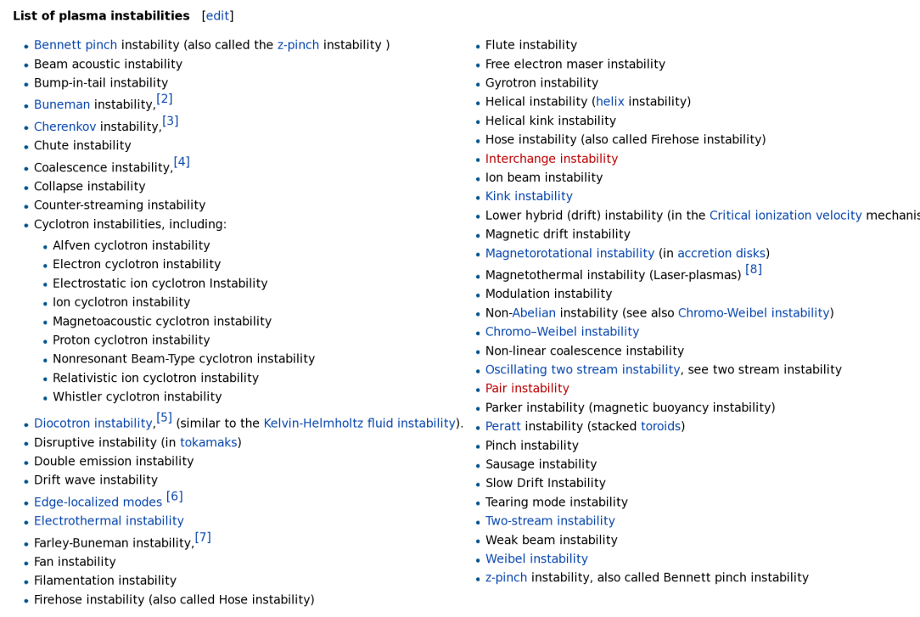
Another instabilities

Slide 40
Another “Math” research about MHD

Slide 41
What’s next?
Deep dive to several types of instability
Numerical computation of initial value formulation. (find the instabilities and its growth rate) → how to find the equilibrium?
Solve MHD equation numerically.
Using physics-informed neural network to solve MHD equations.
Control MHD instabilities. (robust control and reinforcement learning)

