Slide 1
PINNs

Slide 2
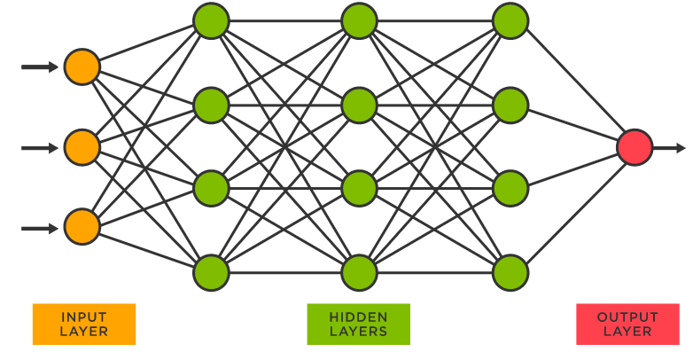
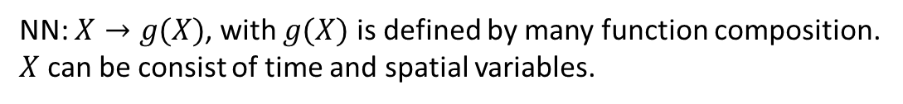

Neural Networks
NN: $X→g(X)$, with $g(X)$ is defined by many function composition.
$X$ can be consist of time and spatial variables.
$$X→z_{1}=W_{1}X+b_{1}→a_{1}=f\left(z_{1}\right)→…→z_{n}=W_{n}z_{n−1}+b_{n}→u=f(z_{n})$$
$x$: input
$u$: output
$W_{i},b_{i}$: weight and bias
$f$: activation function

Slide 3
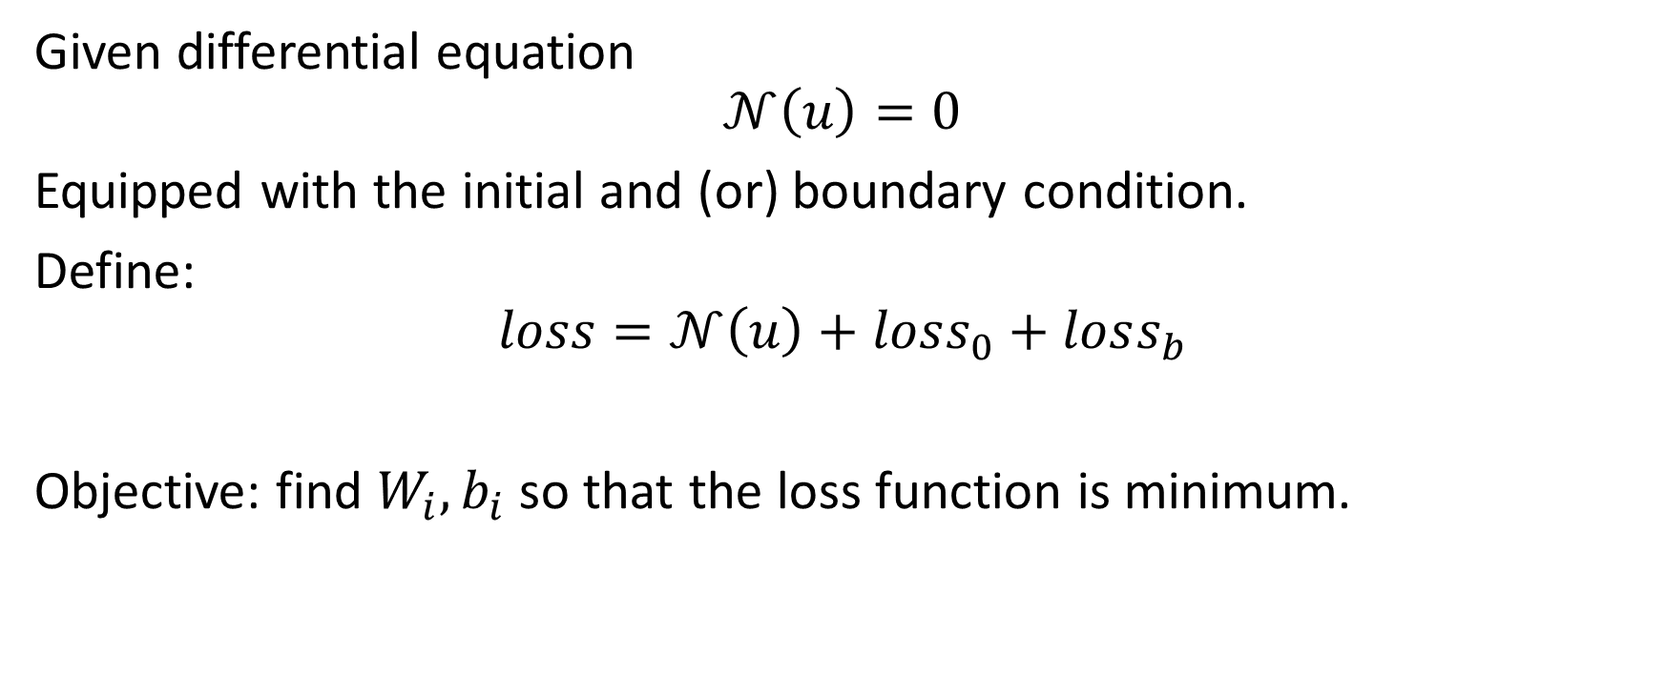
PINN
Given differential equation
$$𝒩\left(u\right)=0$$
Equipped with the initial and (or) boundary condition.
Define:
$$loss=𝒩\left(u\right)+loss_{0}+loss_{b}$$
Objective: find $W_{i},b_{i}$ so that the loss function is minimum.

Slide 4
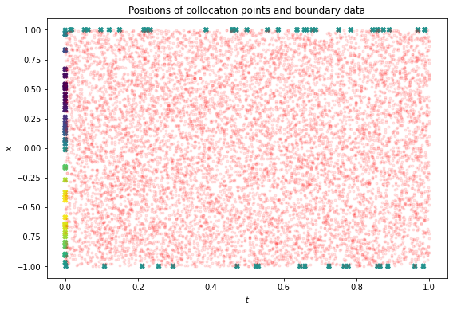
PINN
IDEA: with only several points in domain, hopefully can find approximate solution that satisfy the differential equation and its boundary/initial condition at all points.

Slide 5
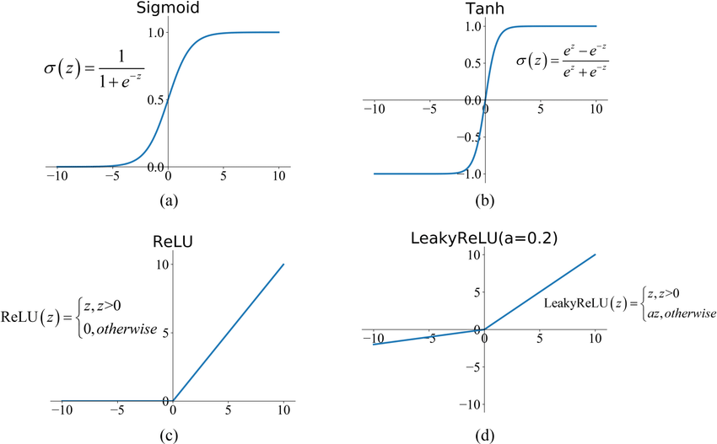
Activation function

Slide 6
Logistic equation
Regular perturbation
Logistic equation with carrying capacity > 1
Regular perturbation with analytical solution > 1
Singular perturbation with single boundary layer

Slide 7
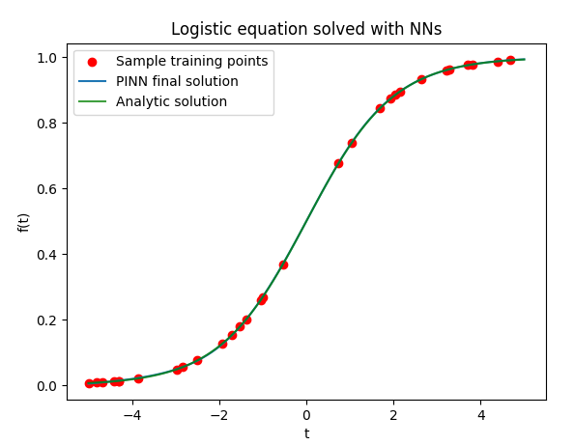
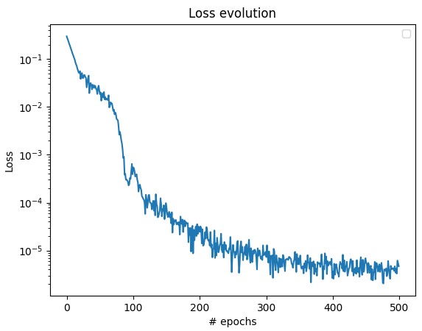

Logistic equation
$$y^{′}=ky\left(1−\frac{y}{L}\right)$$
$$y\left(0\right)=0.5$$

Slide 8
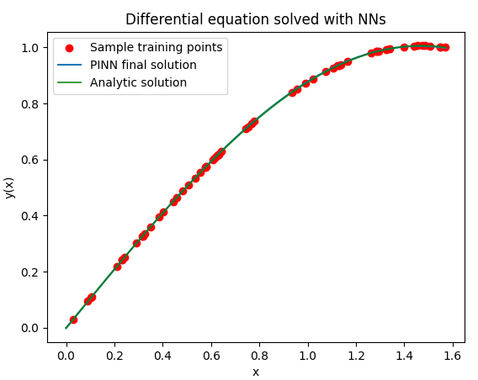
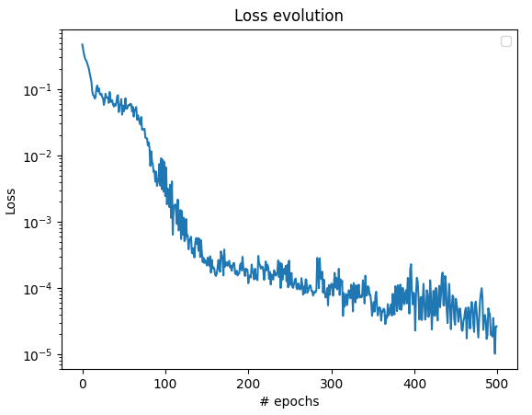

Regular perturbation
$${y"+y+y}^{3}=0$$
$$y\left(0\right)=0,y\left(\frac{π}{2}\right)=ε$$

Slide 9

Singular perturbation
$$εy"+2y′+2y=0$$
$$y\left(0\right)=0,y\left(1\right)=1$$

