Slide 1
Ads-b plane tracking using rtl-sdr

Slide 2
ADS-B
Modern planes carry on board something called an Automatic Dependent Surveillance-Broadcast(ADS-B) Mode-S transponder.
This transponder periodically broadcasts location and altitude information to air traffic controllers and other aircraft.
ADS-B signals can be found at a frequency of 1090 MHz or less commonly in some places at 978MHz.
ADS-B uses PPM(Pulse position modulation) to transmit data
Aircraft position, velocity, together with identification are transmited through Mode-S Extended Squitter (1090 MHz).

Slide 3
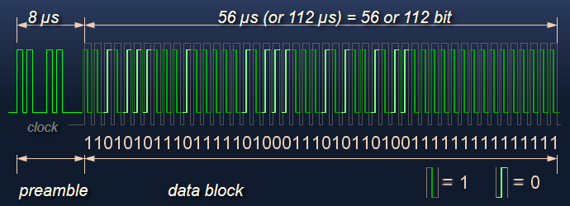
Message Structure
An ADS-B message is 112 bits long, and consists of 5 parts.
+--------+--------+-----------+--------------------------+---------+
| DF 5 | ** 3 | ICAO 24 | DATA 56 | PI 24 |
+--------+--------+-----------+--------------------------+---------+

Slide 4
Downlink Format
The format number defines 25 coding formats. Each Mode S downlink format has a particular purpose.
The formats DF0, DF4, DF5, DF11, DF16, DF20, DF21 and DF24 are used in civil aviation at present.
The format DF0 provides informations for ACAS. The DF17 format is used for the ADS-B system .
ICAO address
In each ADS-B message, the sender (originating aircraft) can be identified using the ICAO address.
It is located from 9 to 32 bits in binary (or 3 to 8 in hexadecimal).
An unique ICAO address is assigned to each Mode-S transponder of an aircraft.
Thus this is a unique identifier for each aircraft.

Slide 5
ADS-B message types
To identify what information is contained in an ADS-B message, we need to take a look at the Type Code of the message, indicated at bits 33 - 37 of the ADS-B message (or first 5bits of the DATA segment).
Type Code | Content
1 - 4 | Aircraft identification
5 - 8 | Surface position
9 - 18 | Airborne position
19 | Airborne velocities
20 - 22 | Airborne position (w/ GNSS Height)
28 | Reserved
31 | Aircraft operation status

Slide 6
ADS-B Checksum
ADS-B uses a cyclic redundancy check to validate the correctness of the received message,
where the last 24 bits are the parity bits.
The following pseudo-code describes the CRC process:
    GENERATOR = 1111111111111010000001001
    MSG = binary("8D4840D6202CC371C32CE0576098") # total 112 bits
    FOR i FROM 0 TO 88: # 112 - 24 parity bits
    if MSG[i] is 1:
    MSG[i:i+24] = MSG[i:i+24] ^ GENERATOR
    CRC = MSG[-24:] # last 24 bits
    IF CRC not 0:MSG is corrupted

Slide 7
ADS-B Listening and Decoding Software
Currently, there are multiple software options available for listening and decoding ADS-B signals with the RTL-SDR. All software is free.
RTL1090
dump1090
Modesdeco
Graphical ADS-B RADAR Display Software
The decoders mentioned above all send the decoded ADS-B data through a local (or public if desired) network connection. There are a few software options available for receiving this network data and displaying it.
adsbSCOPE
PlanePlotter

Slide 8
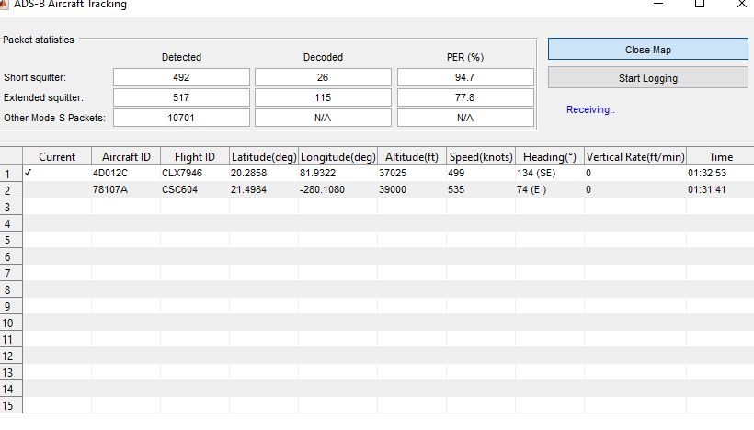
We are using MATLAB RTL-SDR addon to decode and display ADS-B Data.

Slide 9
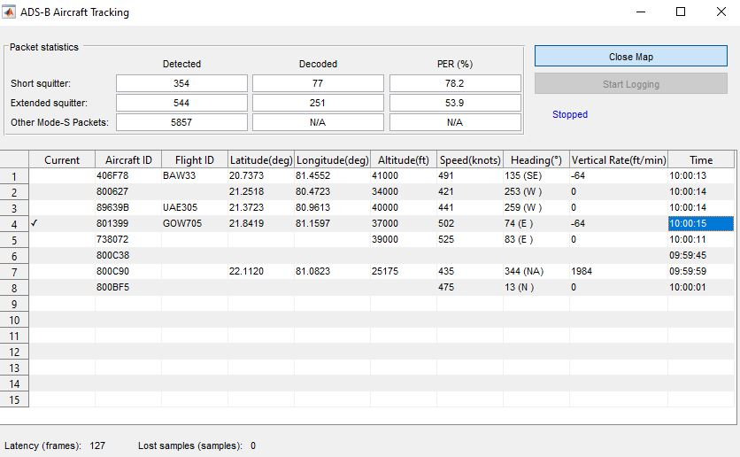
Tracked Air Traffic

Slide 10
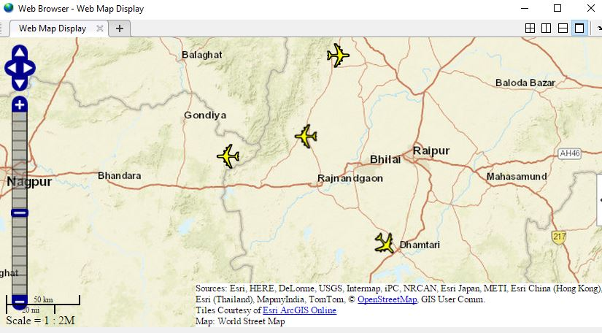

Slide 11
