Slide 1
CUSTOMER SHOPPING BEHAVIOR
Customer shopping behavior points to three growth levers
3,900 purchases reveal a loyal base, underdeveloped subscriptions, and clear opportunities to improve acquisition and discount discipline.

Slide 2
The business already has a strong revenue base
A sizable revenue base with a consistent average order value.
Metric | Value
Total revenue | $233,081 across 3,900 purchases
Average purchase | $59.76
Average rating | 3.75
Revenue is broad-based across four product categories and four age groups.
02

Slide 3
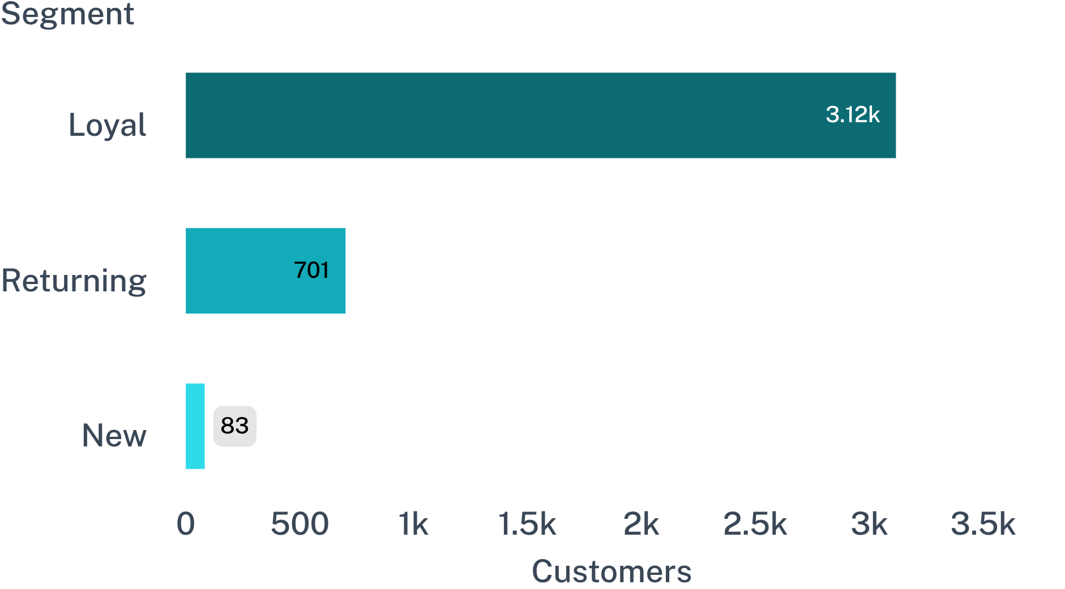
Loyalty is the engine, but acquisition is the gap
CUSTOMER MIX
The customer base is overwhelmingly loyal, with very few new customers entering.
79.9%
3,116 loyal customers
2.1%
83 new customers
Protect the loyal base while building a stronger flow of first-time customers.
03

Slide 4
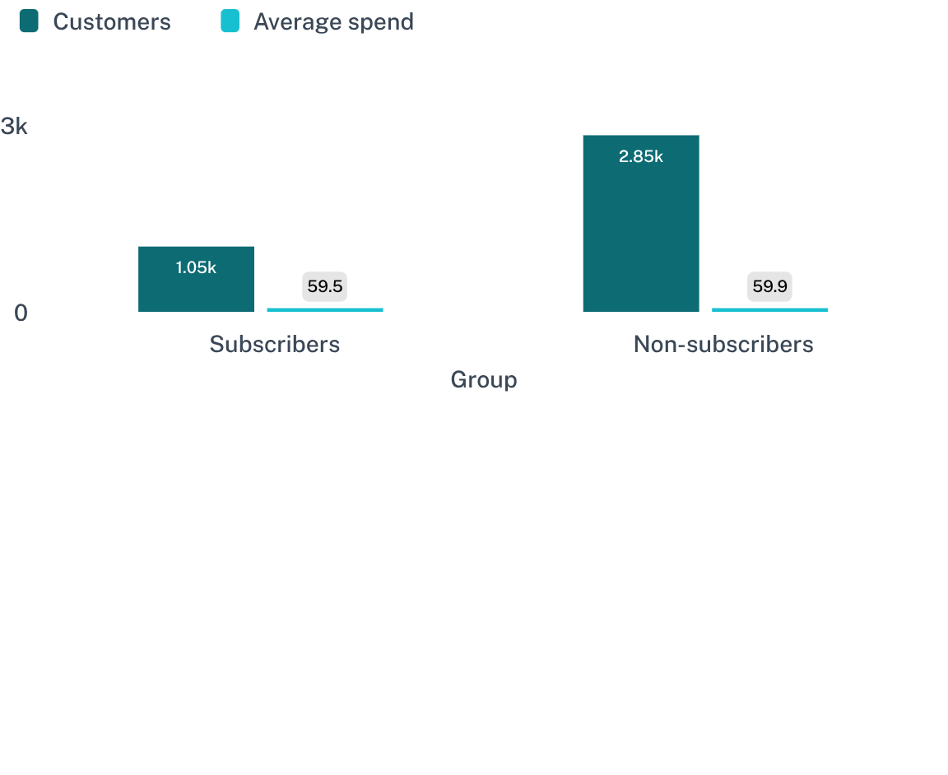
Subscriptions are underpenetrated and not yet differentiated
SUBSCRIPTION PENETRATION
27%
Subscriptions reach 27% of customers but do not yet increase average spend.
1,053 customers subscribe.
Subscribers average $59.49 versus $59.87 for non-subscribers.
Repeat buyers are only slightly more likely to subscribe, so loyalty alone is not converting. Subscription growth will require benefits customers can feel, not just a recurring billing option.
04

Slide 5
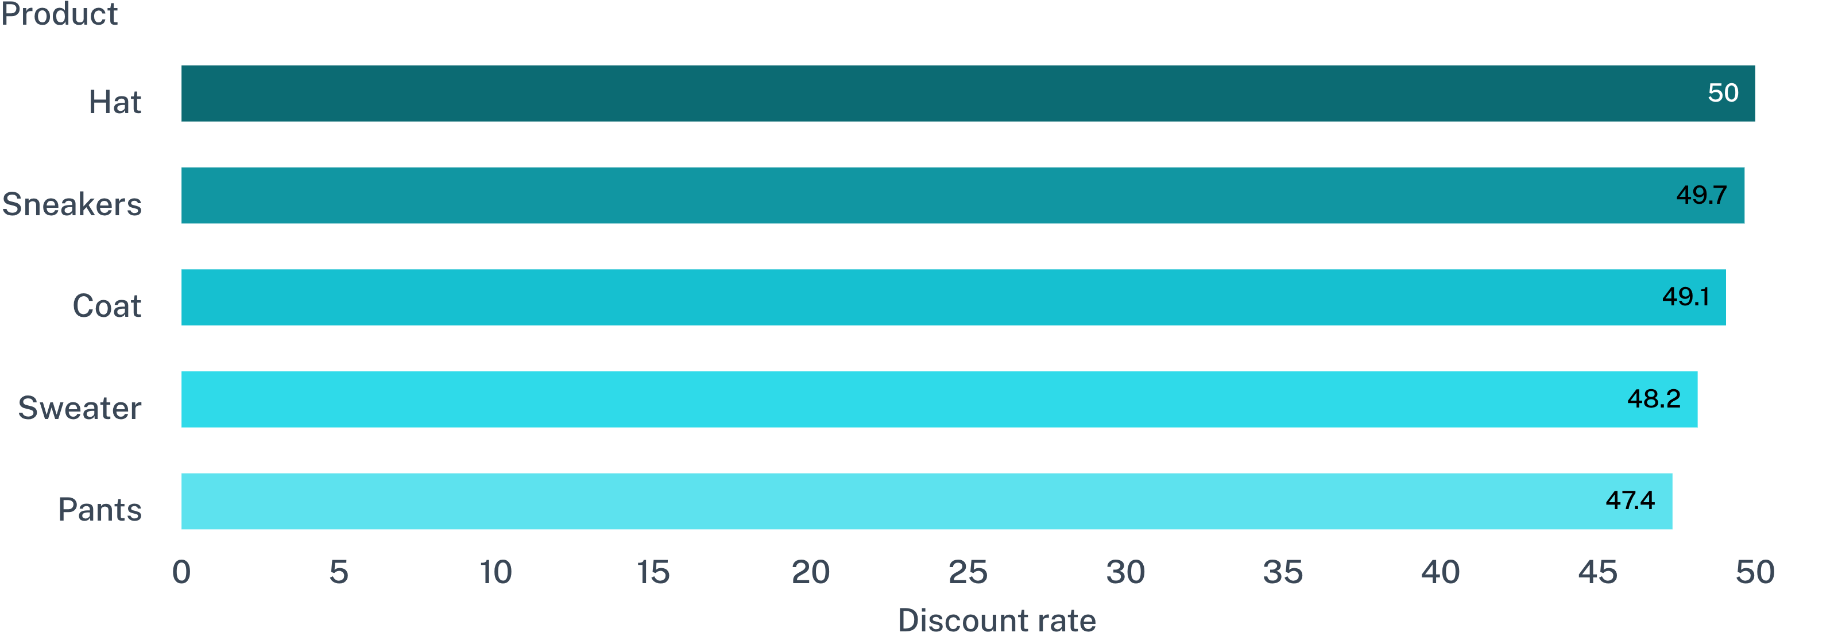
Discounts are working hardest on a handful of products
Discounting is concentrated near 50% of purchases for the most dependent products.
These products may be relying on price cuts to convert, creating a margin and positioning question.
05

Slide 6
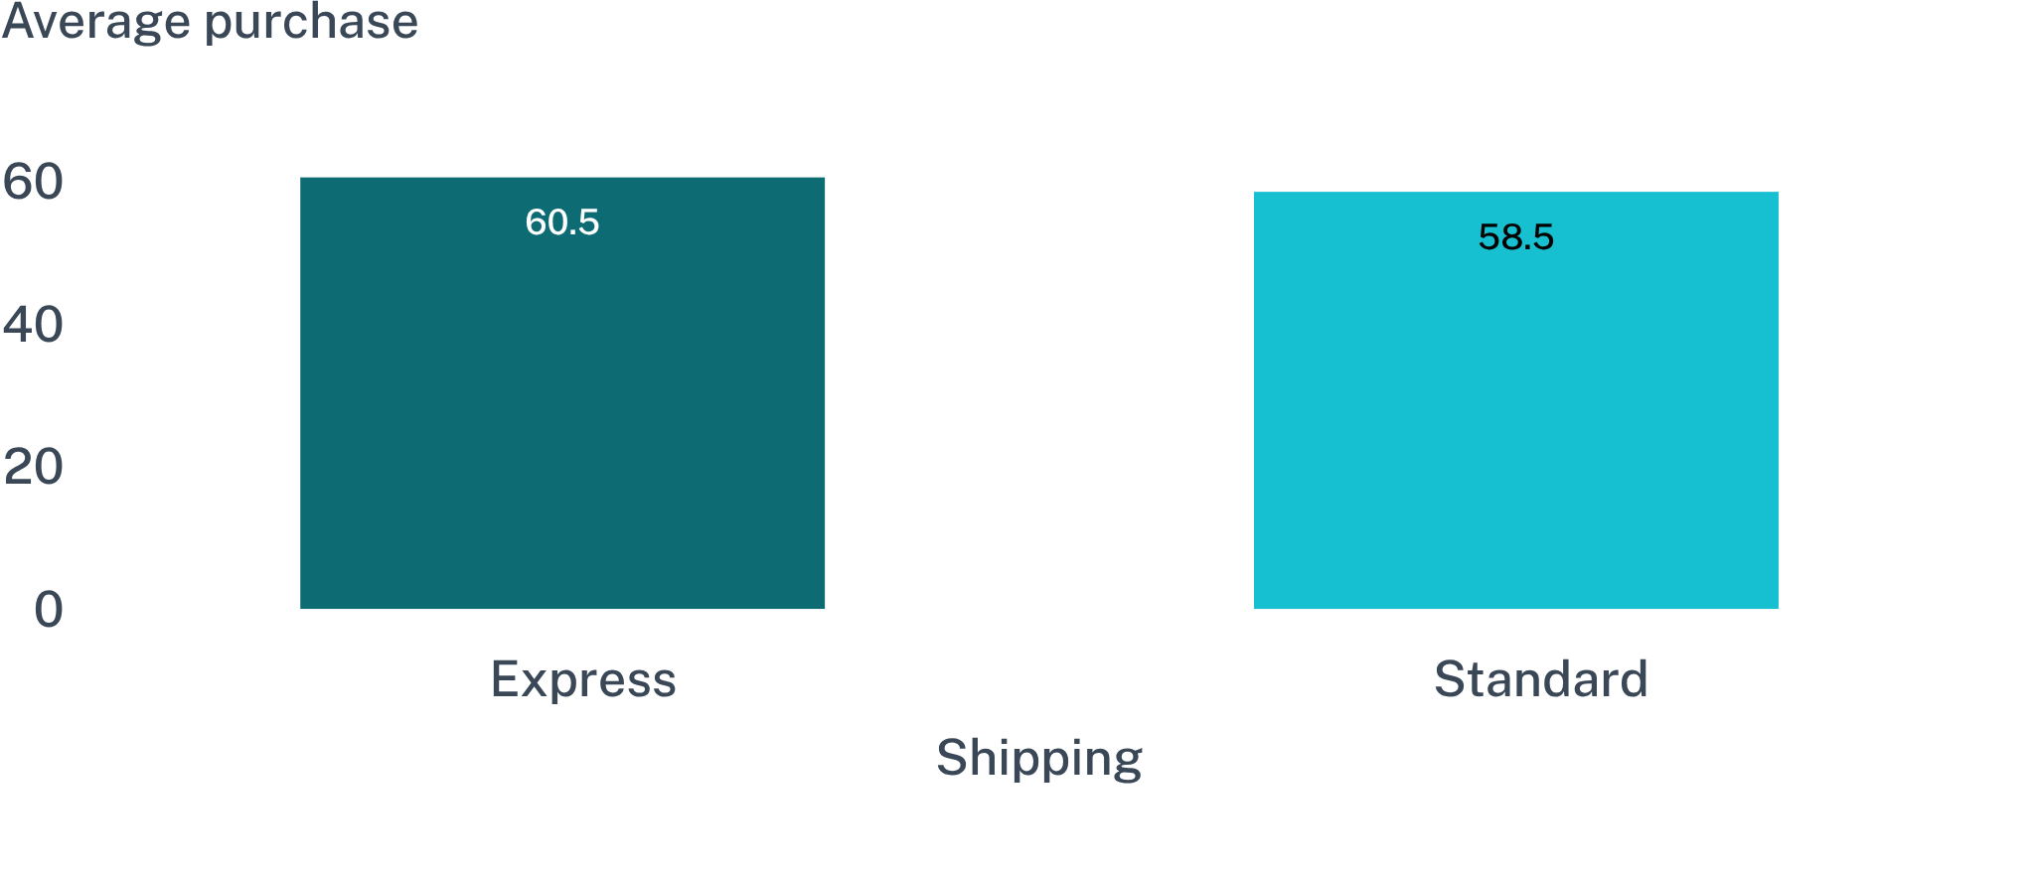
Express shoppers signal willingness to spend slightly more
AVERAGE PURCHASE
Shipping speed can be positioned as a premium convenience benefit.
$60.48
Express shipping
+$2.02 versus standard shipping
Express customers spend about $2 more per purchase, roughly 3.5%.
06

Slide 7
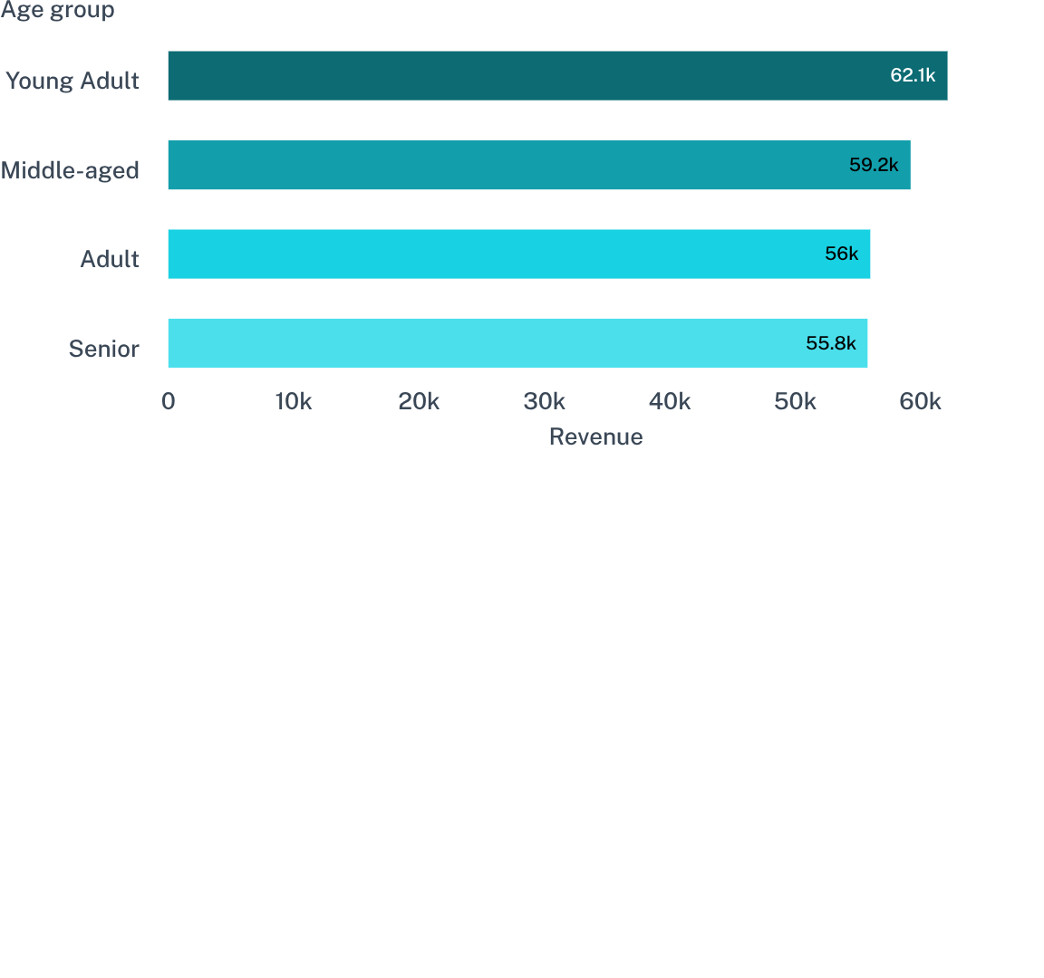
Revenue is spread across age groups, with Young Adults narrowly ahead
Revenue is balanced across age groups, with Young Adults slightly ahead.
SHARE OF REVENUE
26.7%
Young Adult
Middle-aged 25.4%
Adult 24.0%
Senior 23.9%
The opportunity is broad targeting with tailored messages, not overcommitting to one age segment.
07

Slide 8
Product demand is distributed rather than concentrated
Ratings and order counts are tightly grouped, so no single product dominates.
TOP-RATED
TOP ORDER LEADERS
IMPLICATION
Gloves 3.86
Jewelry
Blouse · Pants
Sandals · Jacket
Use a portfolio approach
Sandals 3.84
Boots 3.82
Spotlight proven products while testing broader merchandising stories.
08

Slide 9
The analytics workflow makes the findings actionable
The value is the chain from clean data to decisions, not any single tool.
03
01
02
Python
SQL Server
Power BI
Cleaned 3,900 rows, filled 37 missing ratings, standardized fields and engineered age/frequency features.
Answered 10 business questions across revenue, products, shipping, subscriptions and segments.
Translated the findings into KPIs, slicers and category, age and subscription views.
Clean data → business questions → decision-ready views
09

Slide 10
Prioritize subscription value, acquisition, and margin discipline
The near-term play is to convert existing loyalty into higher-value relationships while rebuilding the top of the funnel.
01
02
03
04
05
Boost subscriptions
Build acquisition
Protect loyalty
Review discount policy
Use targeted positioning
Add exclusive benefits for loyal repeat buyers.
Create a deliberate path from new to returning customers.
Reward the 80% of customers already in the Loyal segment.
Combine top-rated products, broad age appeal and premium shipping cues.
Test alternatives on products discounted in about half of purchases.

