Slide 1
TAXI DEMAND PREDICTION
Harsh Bhardwaj (20BEC0198)

Slide 2
PROBLEM STATEMENT
New York City has one of the busiest roads and highest demands for taxis. Despite the availability of a large amount of taxi trip data in New York City, there is still a lack of accurate and efficient methods for predicting the demand for yellow taxis. This presents a challenge for taxi companies and drivers who want to optimize their resources and provide better service to customers. Therefore, the aim of this project is to develop a machine learning model that can accurately predict the demand for yellow taxis in New York City based on historical trip data.

Slide 3
RESEARCH GAP
Many projects have been made for predicting taxi demands, however, very few focus on a single city. Furthermore, the most suitable machine learning algorithm has not been identified.
Our project uses Linear Regression, Random Forest and Gradient Boosting for calculating the demand for taxis within areas in New York City.

Slide 4
OBJECTIVE
The project aims to build a machine learning model to accurately predict the demand for taxis across various areas in New York City.
This will be of utmost importance for ridesharing apps to allocate more vehicles to areas or times with greater demand and increase the ride prices at peak hours.

Slide 5
BLOCK DIAGRAM
Data Cleaning and Pre-processing
Model Training
Data Collection
K- means clustering
Model Evaluation
Testing
Visualization

Slide 6
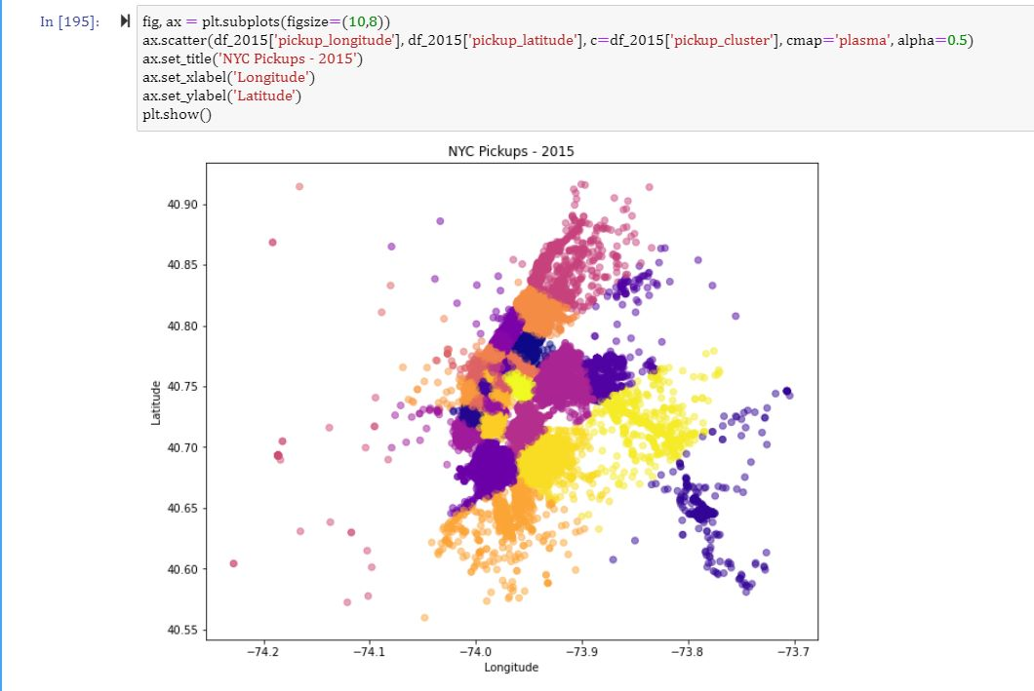
RESULTS
K- means clusters for the years 2015 and 2016 respectively

Slide 7
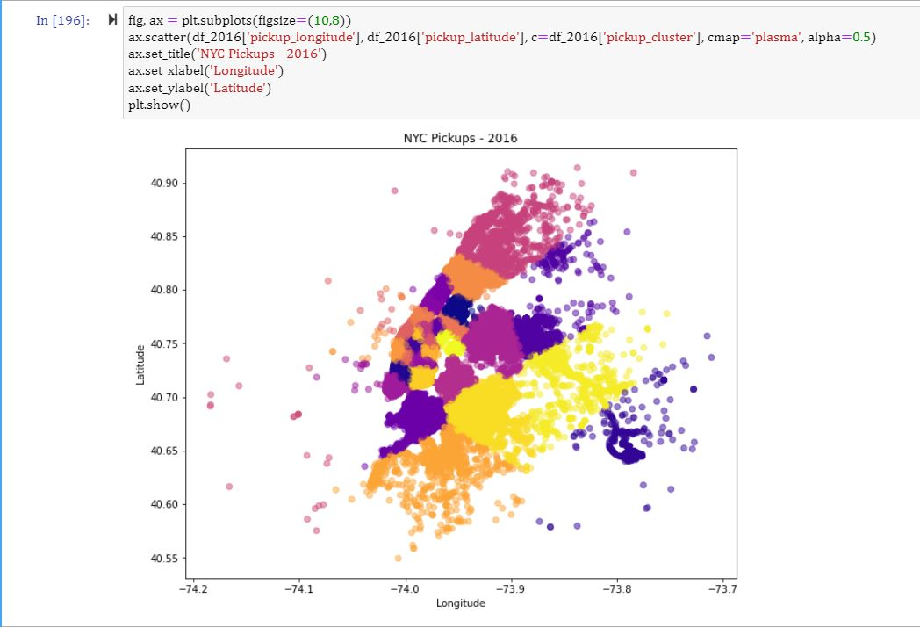

Slide 8
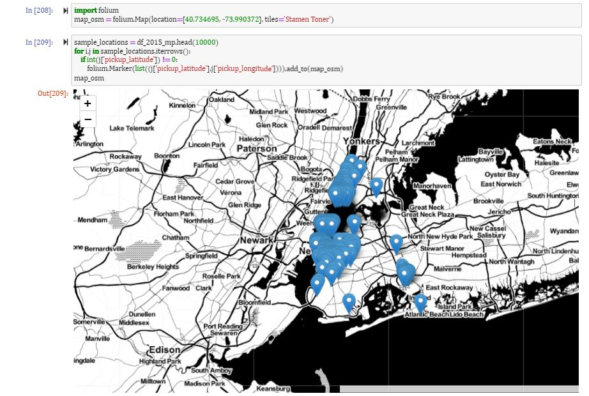
Pickup locations in NYC after outlier removal

Slide 9
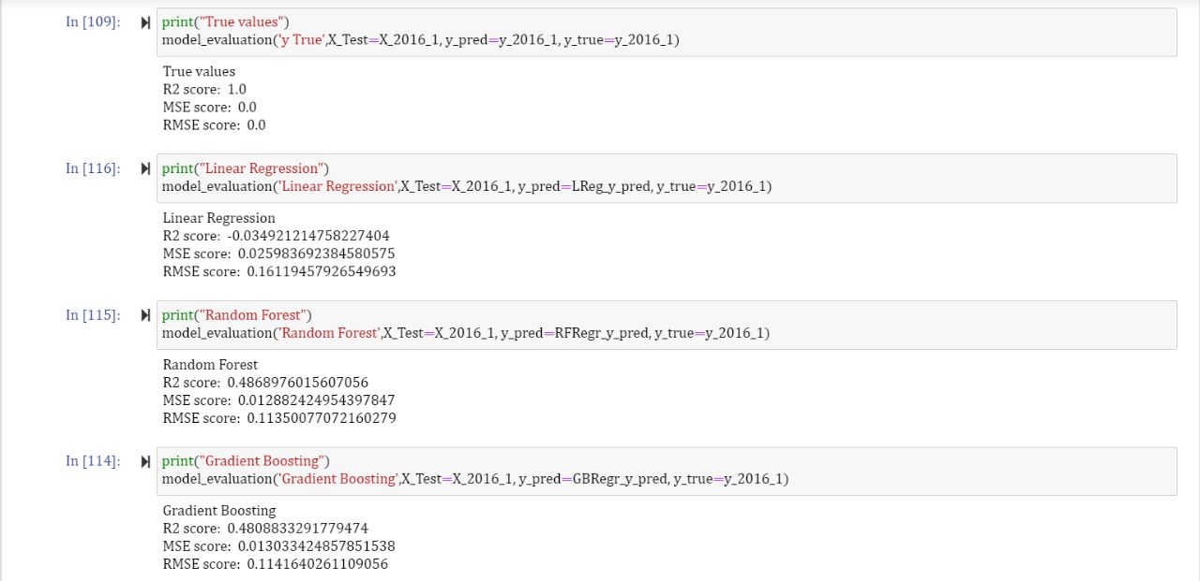
RESULTS
Out of Linear Regression, Random Forest and Gradient Boosting; Random Forest had the best coefficient of regression and least error and will be used for making the ML model to predict taxi demand in NYC.

Slide 10
THANK YOU

