Slide 1
SLIDE 1
The ask
Signups, 1 Jan – 15 Jun 2026 | 22,561 (~4,140 a month)
Approved — Acquisition to Onboarded | 17.6% (728 a month)
Approved captains who go on to drive | 98.7%, median 1.4 days
Recoverable with no new spend | +183 to +344 approvals a month
Three decisions I need today
• Fund one product squad for six weeks on in-app document capture → +81 to +134 approvals a month
• Decline the 5x budget for CAMP_WA_002 → the win is mostly who was on the list, and 5x is arithmetically impossible
• Decline airport-catchment acquisition → fund a night-window incentive instead
Registered-to-Active looks after itself. Onboarding is the whole game.
Captain Acquisition, Supply — 30 June 2026
1 / 6

Slide 2
SLIDE 2
Nine in ten captains we lose were never rejected. They stopped.
Where the loss sits | Lost | Share |  | How the 18,180 dropouts left | Captains | Share
Registration Certificate | 5,433 | 29.9% |  | Passed one document, never started the next | 9,727 | 53.5%
Insurance | 3,309 | 18.2% |  | Rejected once, never tried again | 6,791 | 37.4%
Fitness Certificate | 2,669 | 14.7% |  | Never uploaded anything | 1,425 | 7.8%
Permit (Auto/Cab) | 2,630 | 14.5% |  | Ran out of their 3 attempts | 237 | 1.3%
Driving Licence | 2,594 | 14.3%
Aadhaar | 1,546 | 8.5%
Only 1.3% of the captains we lose are a policy decision. The other 98.7% is friction we control.
The Registration Certificate is the worst step in the business — 17% of submissions fail there. Insurance is second, and hurts more, because those captains had already cleared everything else.
Captain Acquisition, Supply — 30 June 2026
2 / 6

Slide 3
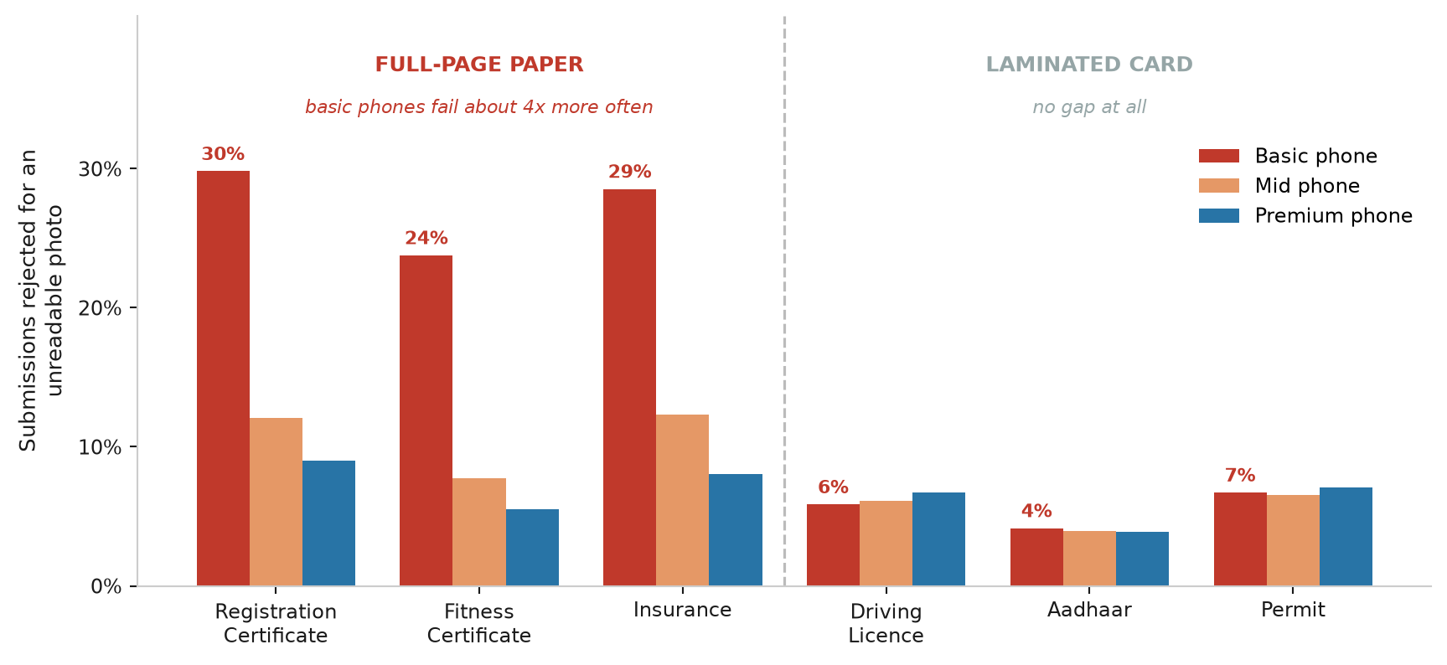
SLIDE 3
Cheap phones fail on paper documents, not on cards
The three affected documents are full-page paper covered in small print. The three unaffected ones are pocket-sized laminated cards. 46% of our signups are on basic handsets.
• Captains who try again mostly get through — 79% eventually pass the Registration Certificate
• Our rejection message does no work: captains retry about 62% of the time whichever of the seven reasons they were given. "Blurred photo" and "document expired" produce identical behaviour.
• Tested and rejected: verification speed is not the problem. Checked within 2 hours, captains continue at 84.0%; after more than a day, 84.1%. Do not fund a queue-speed project.
Captain Acquisition, Supply — 30 June 2026
3 / 6

Slide 4
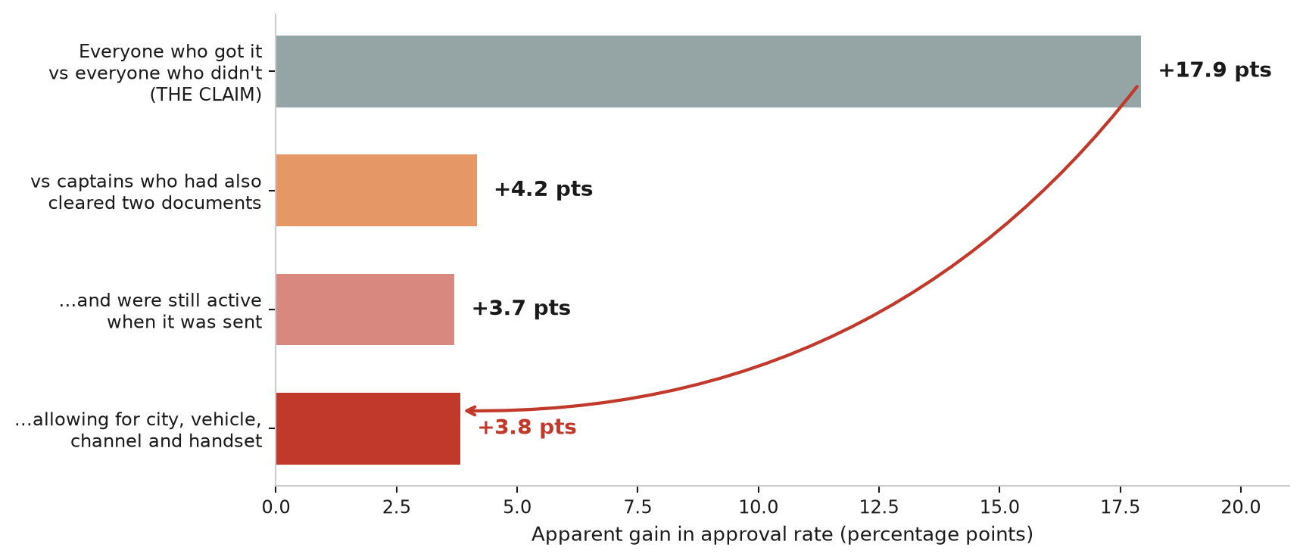
SLIDE 4
CAMP_WA_002 is not an 18-point win. It is a list of survivors.
It only goes out once a captain has cleared two documents — none of the 7,981 recipients got it earlier, and clearing the Licence and Registration Certificate is where 44% of our loss happens.
Two checks a real message effect must pass | Approved
Message delivered | 31.5% | ← no difference vs...
Message failed to send | 31.8%
Tapped the message | 30.8% | ← no dose-response vs...
Ignored it | 32.0%
On 5x: it already reaches 55% of everyone eligible — full coverage is <2x, not 5x. Extend it (WhatsApp is nearly free), but hold 20% back as a control.
Captain Acquisition, Supply — 30 June 2026
4 / 6

Slide 5
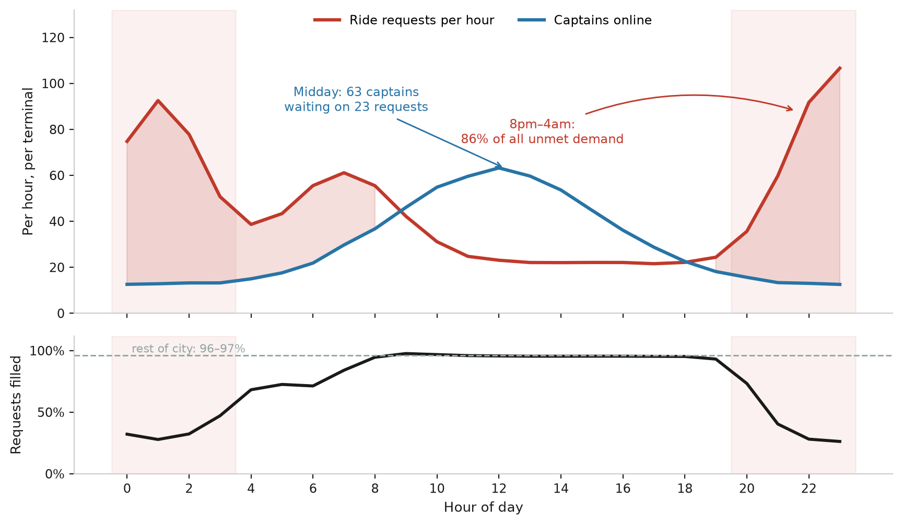
SLIDE 5
The airport isn't short of captains. It's short of captains at night.
• Terminals fill 59.8% of requests against 96–97% everywhere else in the city — but 86% of that shortfall is 8pm–4am
• 48,720 captain-hours going spare in hours already covered, against a 17,979-hour shortfall at night — three times more waste than shortage
• One extra captain online at night converts to 1.31 extra rides; at midday, 0.19
And more captains would worsen why they stay away. Four in ten airport trips end in a suburb 23 km out:
Airport trip ends in | Share | Another fare within 20 min | Captain declines | Pay per hour it ties them up
City centre | 42% | 53% | 8.6% | ₹263
Suburb (23 km out) | 41% | 17% | 21.0% | ₹176
Acquisition buys headcount; it cannot buy hours — and ~a quarter of "unmet" airport demand is a captain who accepted, then cancelled.
Captain Acquisition, Supply — 30 June 2026
5 / 6

Slide 6
SLIDE 6
What starts Monday, and how we'll know it worked
# | Action | Worth | Cost & lead time | How we'll know
1 | In-app capture for the three paper documents: auto-capture, on-device blur check, worked example | +81–134 approvals/mo | 1 squad, 6 weeks | Unreadable-photo rejections per submission, by handset
2 | Chase stalled captains; start with the 2,500 who cleared all but Insurance; pair with financed insurance | +90–181 approvals/mo | CRM + 1 partner | Approval rate against a 20% holdout
3 | Move half the paid digital budget to referral — judged on orders per 100 signups, not approvals | +18 approvals/mo, more orders | Reallocation | Orders per 100 signups by channel
4 | Pay existing captains to work the terminals 8pm–4am | 232–387 rides/day | ₹2.9–7.2 lakh/mo = ₹41–62 per ride vs ₹279 fare | Terminal fill rate 8pm–4am, one terminal only at first
5 | Guarantee a suburban-drop captain a ride waiting back at the terminal | ₹176 → ₹216 per hour occupied | No cash cost, 4–8 weeks | Suburban decline rate
Not doing: activation work (98.7% already drive) • verification speed (tested, no effect) • city programmes (2.9 points apart, vs 8.8 across handsets) • a blanket suburban bonus (nine to twelve times the fare per extra ride) • airport-catchment acquisition
Total onboarding prize: +183 to +344 approvals a month on a base of 728 — and every point converts almost one-for-one into a driving captain.
Captain Acquisition, Supply — 30 June 2026
6 / 6

