Slide 1

Employee Management System
The Employee Management System is a comprehensive web-based application designed to efficiently manage employee data. It supports CRUD operations with role-based access control, leveraging a microservices architecture for scalability and robustness.
M23AID018 || M23AID023 || M23AID057

Slide 2
Overview
CRUD Operations
The system allows for creating, reading, updating, and deleting employee records.
Role-Based Access
Access is controlled based on user roles, ensuring security and appropriate permissions.
Scalable Architecture
Built on a microservices architecture, the system ensures scalability and robustness.

Slide 3
Technologies Used
Frontend
Backend
Database & Cloud
Angular is used for a responsive and interactive user interface.
Spring Boot provides a Java-based REST API for business logic management.
H2 Database is used for development, and AWS handles deployment.

Slide 4



Features and Functionalities
User Interface
Includes navigation links, search bar, sorting, and pagination.
Employee Operations
Allows adding, viewing, editing, and deleting employee records.
Role-Based Access Control
Admins have full access, while users can only view details.

Slide 5
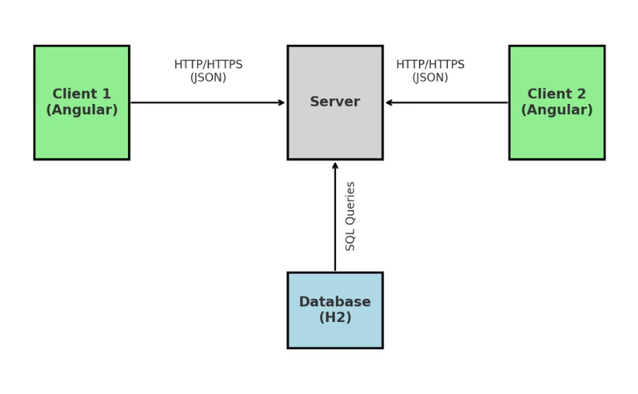
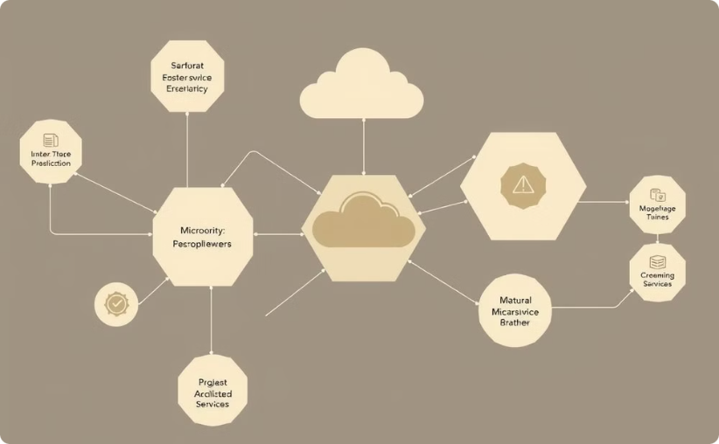
Architecture and Design
Client-Server Architecture
Microservices
Ensures separation of concerns and scalability.
Separates authentication, employee management, and access control services.

Slide 6
User Flows
1
Sign-Up
New users can register by providing their credentials.
2
Login
Registered users log in to access the system based on roles.
3
Admin Operations
Admins can add, view, edit, and delete employee records.
4
User Operations
Users can view employee details but cannot modify them.

Slide 7




Security and Authorization
Authentication
Ensures secure login for admin and users.
Role-Based Access
Operations differentiated based on user roles.
API Security
Secured APIs using JWT (JSON Web Tokens).

Slide 8
Deployment Details
Hosting Platform
AWS is used for deployment, scaling, and monitoring.
Containerization
Dockerized microservices ensure isolated deployment.
CI/CD
Automated testing and deployment via configured pipelines.

Slide 9
Development and Testing Workflow
1
Agile Methodology
Regular sprints for incremental feature development and delivery.
2
Unit Testing
Comprehensive tests for both frontend and backend components.
3
Integration Testing
Ensures seamless communication between microservices.
4
UI Testing
Verifies functionality of navigation, form validation, and role-specific actions.

Slide 10
Thank You

