Slide 1
STOCK PORTFOLIO SUGGESTION ENGINE
Guided By: Prof. Richard Sinn
Team Members:
Harsh Vardhan Ande - 017549857
Vamsi Agnihotram - 016920709
Chaitanya Naidu - 017518761
Samrudh Sivva - 017520659

Slide 2
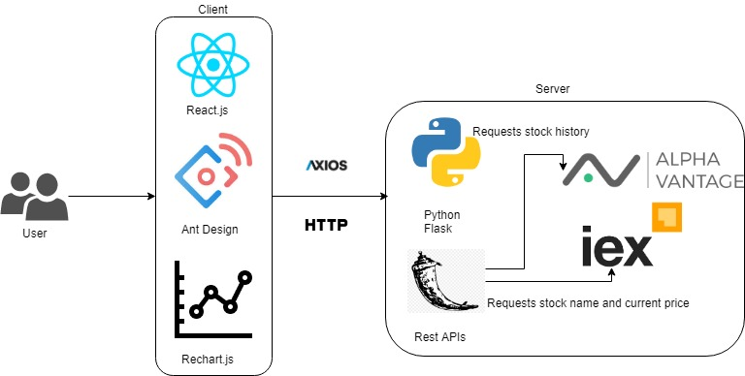
HIGH-LEVEL ARCHITECTURE

Slide 3





FEATURES:
Suggest users the stocks to invest their money in.
Provides a brief introduction to each investment strategy.
Allows users to select different strategies to invest their money.
Divide the investment amount based on the stocks and strategy/s suggested.
Shows current price of each stock suggested

Slide 4
EXTRA FEATURES:
Used real time stock prices to suggest stocks for different strategies.
Used Ant Design for developing a clean UI.
Allows users to look at the trend for the last 50 days of each stock suggested.
Used Rechart.js for easy and clean integration with React.js
All the graphs shows the highest price and lowest price that the stock hit on any particular day.
Graphs allow users to study the data properly by showing them the tooltip containing data at every point.
Allows user to save the charts and tabular data.

Slide 5

CHALLENGES:
Researching about different investment strategies and gaining the required financial knowledge to carry out the project
Exploring the free APIs that can provide historical and real time stock data.
Preparing the chart data to give to Rechart.js

Slide 6
TEST CASES:
Test Case No | Test Case Scenario | Expected Output
TC_001 | When invest amount is empty | User should see error message to enter amount greater than 5000
TC_002 | When invest amount is less than 5000 | User should see error message to enter amount greater than 5000
TC_003 | When invest amount is greater than 5000 | User should be able to select strategies and invest
TC_004 | When user selected Investment Strategy | User should be able to invest amount based on selected strategy
TC_005 | When user selected Growth Investment Strategy | User should be able to invest amount based on selected strategy
TC_006 | When user selected Index Investment Strategy | User should be able to invest amount based on selected strategy
TC_007 | When user selected Quality Investment Strategy | User should be able to invest amount based on selected strategy
TC_008 | When user selected Value Investment Strategy | User should be able to invest amount based on selected strategy
TC_009 | When user selected 2 strategies | User should be able to invest amount based on 2 selected strategy
TC_010 | When user selected 3 strategies | Prompt should display error to select at most 2 strategies

Slide 7
Thank you!!

