Slide 1
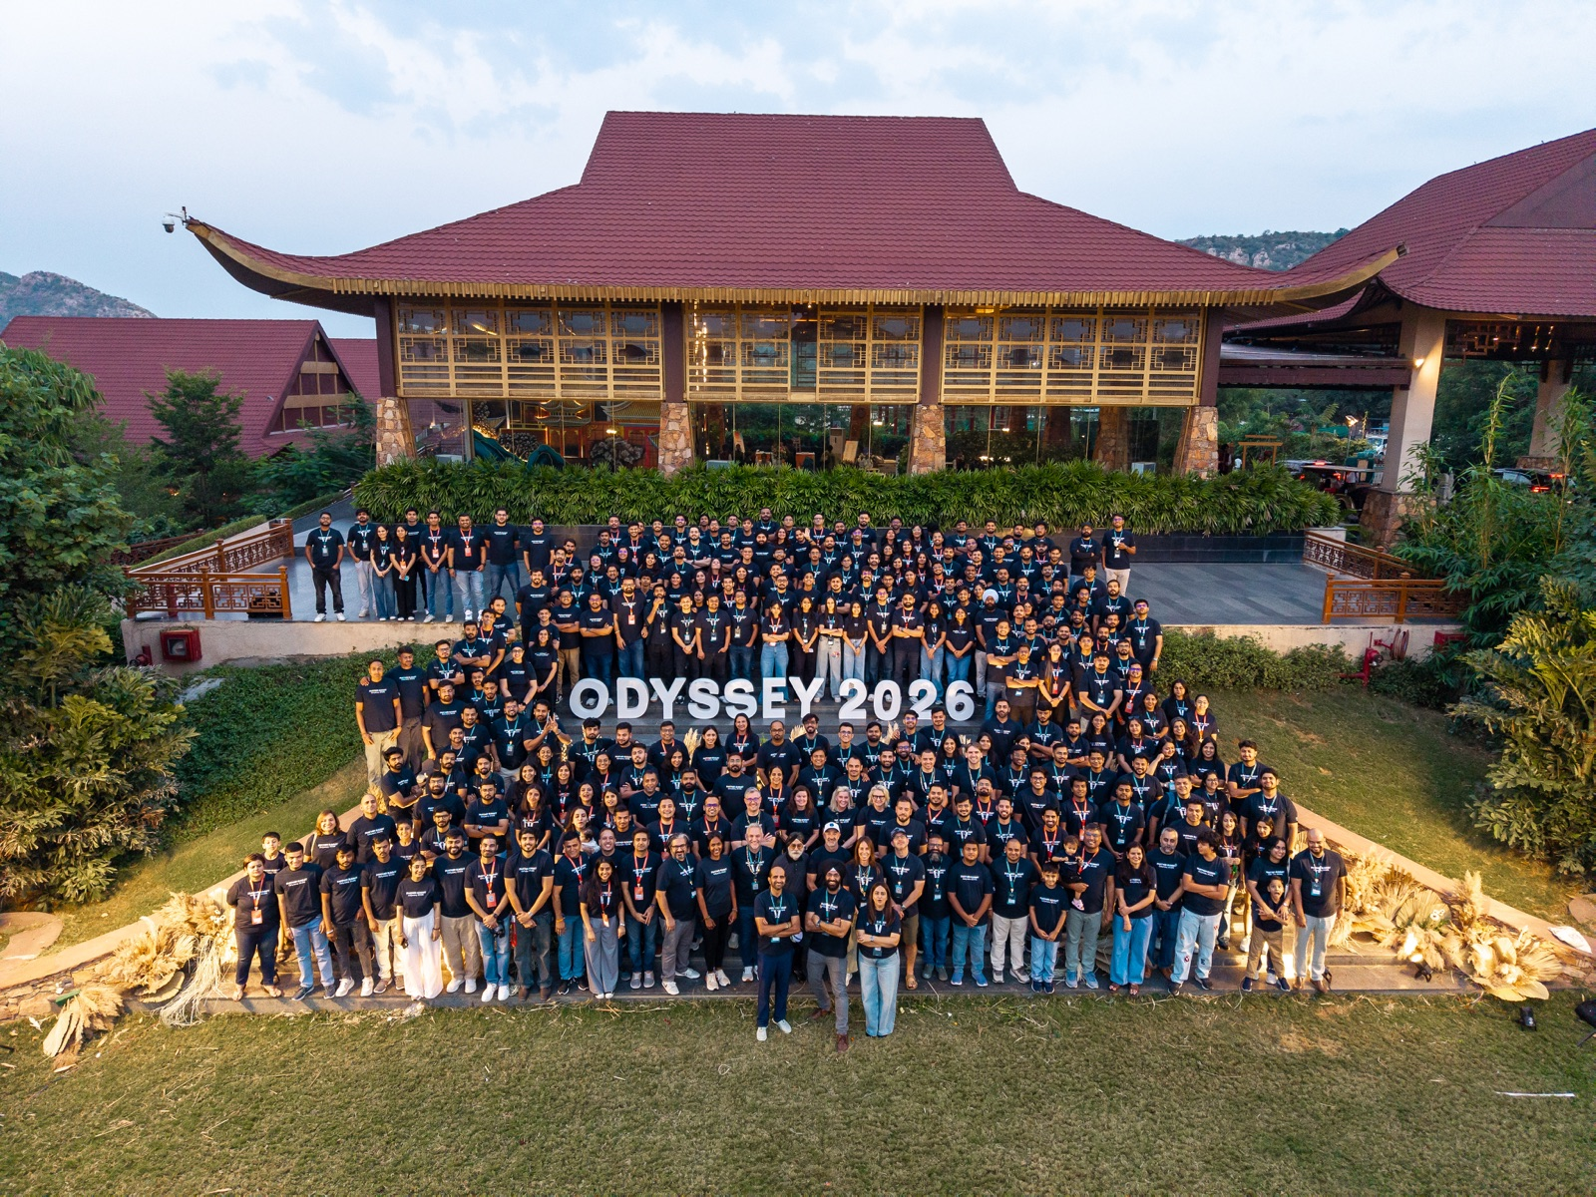
BOT CONSULTING
POST-EVENT EXECUTIVE REPORT
Odyssey
Partner Summit ’26
23–25 October 2026
Ananta Spa & Resorts, Jaipur
THE IDEAS TRAVELLED. THE PEOPLE MADE IT MATTER.
Notes:
Sources: Event photograph supplied by the user (Odyssey_26 Team Image.jpg). BOT Consulting Brand Guideline (supplied). Event details supplied by the user.

Slide 2
BOT CONSULTING
EXECUTIVE SUMMARY
One summit. A lasting signal.
Odyssey brought together BOT Consulting’s partners, teams and guests in Jaipur for three days of ideas, recognition and practical conversation. Across technology, Global Capability Centers and leadership, the summit returned to one recurring question: how do we apply new capability without losing human judgment?
PEOPLE
GUEST SPEAKERS
GCC TEAMS
350+
16
8
DATA AND AI SESSIONS
YEARLY R&R
ŚRĪ VOLUNTEER ACTIVITY
4
12
90 min
What the conversations made clear
• AI becomes durable when it works inside governed systems, not beside them.
• GCC value is built through integration, ownership and a consulting mindset.
• Leadership remains a practice of judgment, connection and decisive action.
ODYSSEY, PARTNER SUMMIT ’26
02
Notes:
Sources: Event statistics supplied by the user. Narrative synthesis based on PS’26 Sessions.pdf (supplied), pp. 1–20.

Slide 3
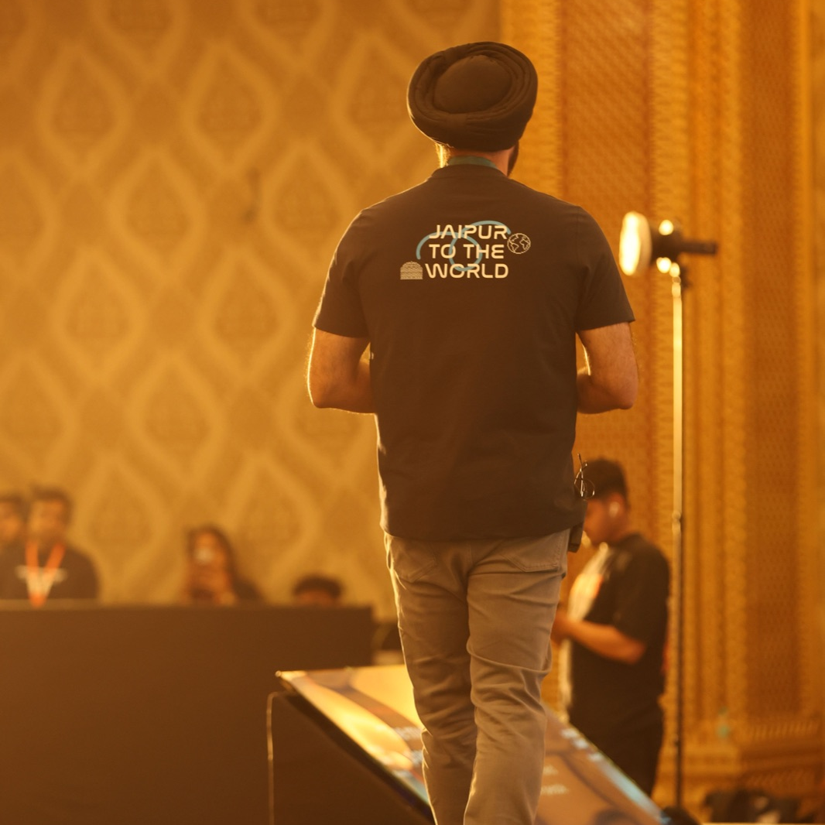
SESSION HIGHLIGHTS / 01
Turning AI into operating capability
Four sessions moved the conversation from potential to the systems that make it dependable.
TECHNOLOGY AND AI
How AI Learned to Use Your Tools
MCP and specialised agents can connect AI to enterprise tools with clearer boundaries, shared context and approval for consequential actions.
TECHNOLOGY AND AI
AI-Driven SDLC
Autonomous workflows can accelerate delivery when design and post-test gates keep accountability with experienced engineers.
TECHNOLOGY AND AI
Headless 360
Salesforce can act as a governed, context-rich backend for people and AI systems working through the interfaces that fit the work.
TECHNOLOGY AND AI
Production-Grade AgentCore
Live telemetry, limited tools and policy guardrails make multi-agent operations safer and more useful during production incidents.
ODYSSEY, PARTNER SUMMIT ’26
03
Notes:
Sources: PS’26 Sessions.pdf (supplied), pp. 1–8. Event photograph supplied by the user (I91A8509.jpg). The session summaries are editorial syntheses, not verbatim reproductions.

Slide 4
SESSION HIGHLIGHTS / 02
Building GCCs with intent
Partner and BOT perspectives placed integration and real business value ahead of novelty.
GCC AND BUSINESS
GCC Panel: AllCloud and Cloudsmith
High-performing GCCs combine deep capability with customer proximity, learning culture and shared leadership across geographies.
GCC AND BUSINESS
What Odyssey Is
BOT’s operating system connects people, processes and platforms, using AI for heavy lifting while keeping final judgment close to the work.
GCC AND BUSINESS
Pilot to P&L
A promising pilot becomes durable only when total cost, data readiness, adoption and a clear business case are addressed together.
THE OPERATING QUESTION
Does this release capacity to create measurable value?
ODYSSEY, PARTNER SUMMIT ’26
04
Notes:
Sources: PS’26 Sessions.pdf (supplied), pp. 11–16. The operating question is an editorial synthesis of the supplied session notes.

Slide 5
SESSION HIGHLIGHTS / 03
Leadership, in the conversations that matter
The main stage made room for context: the personal stories and hard choices behind leadership practice.
LEADERSHIP
Same Seat, Different Lengths
Five CEOs reflected on hiring, capital, culture and AI, showing that good judgment depends on the stage of the business as much as a leader’s conviction.
LEADERSHIP
The Untold Chapters
Pivotal choices, mentors and difficult people decisions reminded the room that a meaningful career is rarely a straight line.
LEADERSHIP
The C-Brows Journey
A reflection on endurance and connection reframed support systems as practical infrastructure for the long term.
Connection is not soft. It is how good work holds.
ODYSSEY, PARTNER SUMMIT ’26
05
Notes:
Sources: PS’26 Sessions.pdf (supplied), pp. 5–6, 17–20. The C-Brows reference is intentionally non-sensitive and uses only the broad leadership theme from the supplied notes.

Slide 6
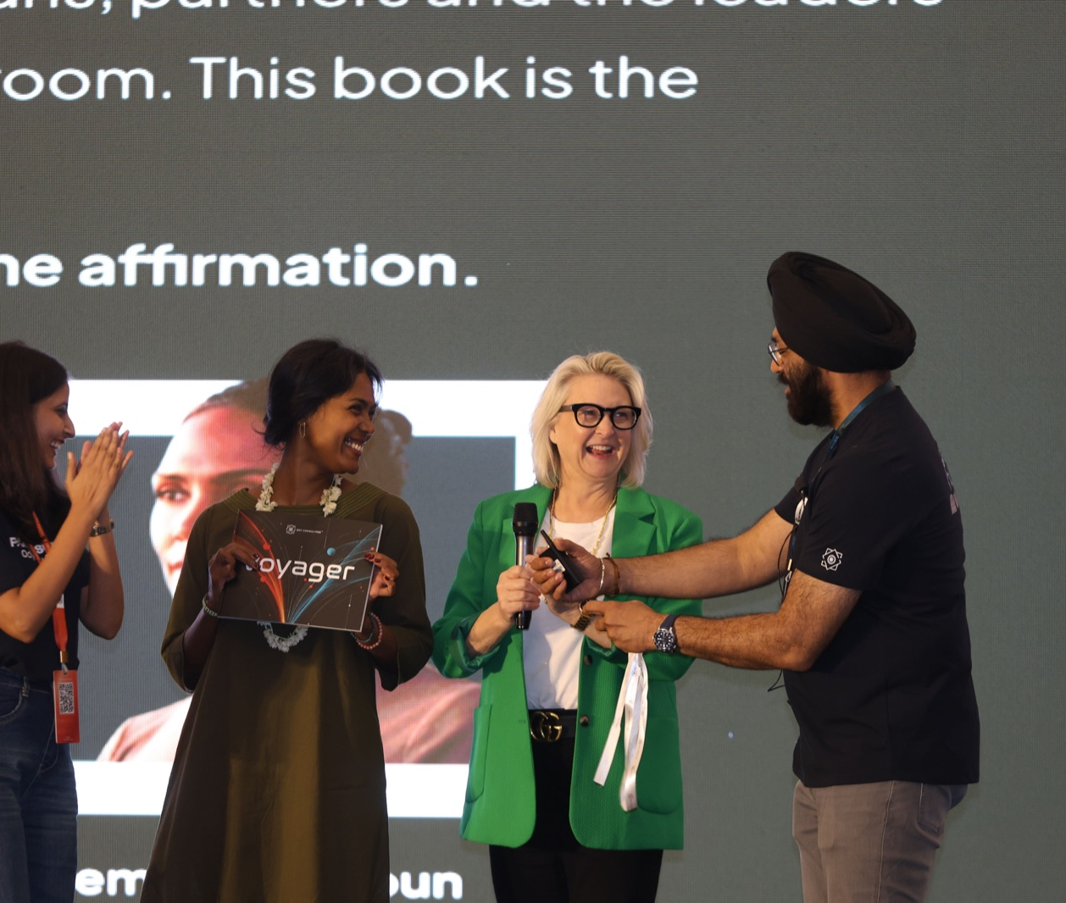
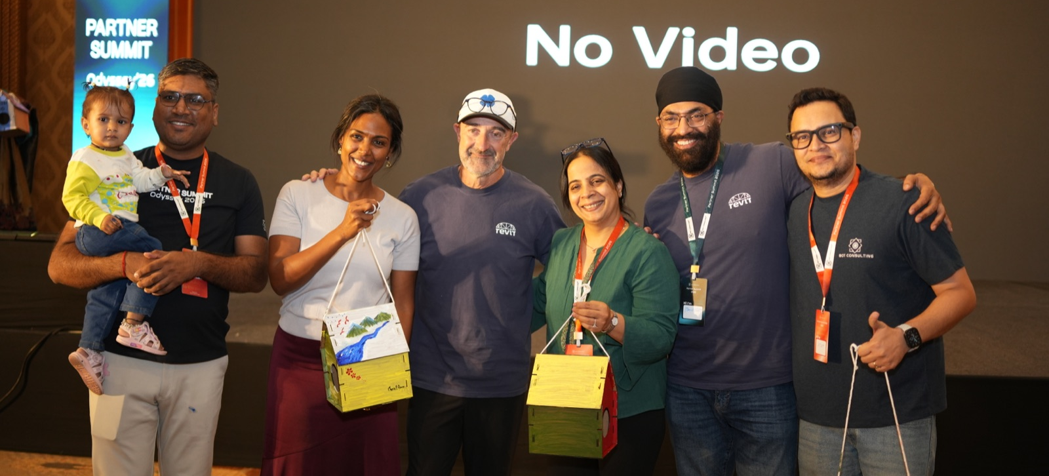
BOT CONSULTING
THE MOMENTS THAT MADE IT MATTER
People, purpose and a shared table
The summit’s real record is not only the agenda. It is the people exchanging perspectives, taking the stage, celebrating each other and giving time to the Śrī volunteer activity.
350+ people. One shared story.
ODYSSEY, PARTNER SUMMIT ’26
06
Notes:
Sources: Event photographs supplied by the user: DJI_20261023174823_0019_D.jpg, I91A8715.jpg and DSC05517.JPG. Event statistic supplied by the user.

Slide 7
WHAT WE CARRY FORWARD
From conversations to next steps
The work after a summit is to turn the strongest signals into everyday practice.
01
Build for governed action
Design AI systems that can explain their evidence, respect policy boundaries and keep people responsible for consequential decisions.
02
Measure value beyond the pilot
Treat cost, data readiness, adoption and margin or growth impact as part of the same business case.
03
Make the GCC a connected venture
Invest in a culture where technical capability, consulting instincts and shared ownership reinforce one another.
04
Keep connection in the system
Use leadership conversations and support networks to make sustained performance more human and more resilient.
ODYSSEY, PARTNER SUMMIT ’26
07
Notes:
Sources: Editorial synthesis based on PS’26 Sessions.pdf (supplied), pp. 1–20, and event discussions summarized in the supplied report brief.

Slide 8
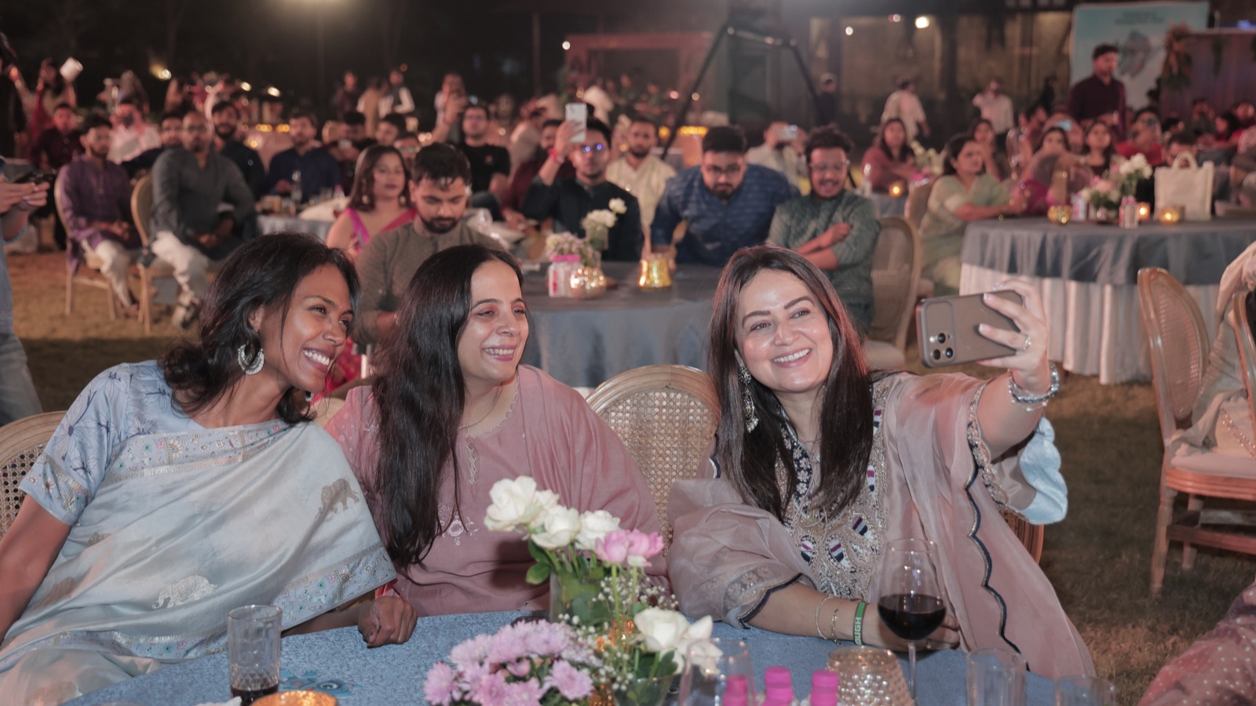
BOT CONSULTING
ODYSSEY 2026
The ideas travelled.
The people made it matter.
Thank you to our partners, speakers, teams and guests for making Odyssey, Partner Summit ’26 a generous, grounded and forward-looking gathering.
botconsulting.io
partnersummit@botconsulting.io
Ananta Spa & Resorts, Jaipur
Notes:
Sources: Event photograph supplied by the user (AJAY3447.JPG). Event details supplied by the user. BOT Consulting Brand Guideline (supplied).

