Slide 1
Project 2: Analyzing Green House Gases (GHG) Generated from Various sources
Morgan Clark
Harshad Patil
Georgia Tech - Data Analytics Bootcamp – June 11 2022

Slide 2
Background
Greenhouse Gases surely have increased earth’s surface temperatures in the last couple decades.
GHG (Green House Gases) are a mixture of CO2, CH4, N2O and other gases such as Hydrofluorocarbons, sulfur hexafluoride & water vapor.
These gases absorb the heat radiated from Earth’s surface and bounce some of it back on earth, eventually heating earth’s surface.
Apparently, it was found that these gases have differing global warming potentials when compared with CO2 (as CO2 is a direct by-product of burning O&G) – viz:
CH4 (Methane) molecule – 25 times the global warming potential of a CO2 molecule
N2O (Nitrous Oxide) - 298 times the global warming potential of a CO2 molecule
HFC (Hydrofluorocarbons) – 1430-14800 times the global warming potential of a CO2 molecule
Sulfur Hexafluoride – 22800 times the global warming potential of a CO2 molecule
CH4, N2O and other gases like HCF etc. are a by-product of agriculture & Farming and are not directly related to burning of fossil fuels.
Source: https://climatechange.lta.org/get-started/learn/co2-methane-greenhouse-effect/

Slide 3
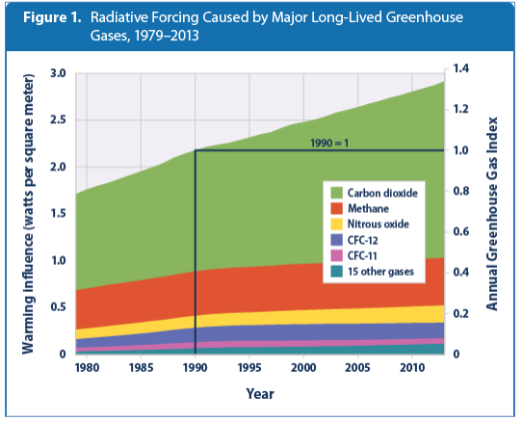
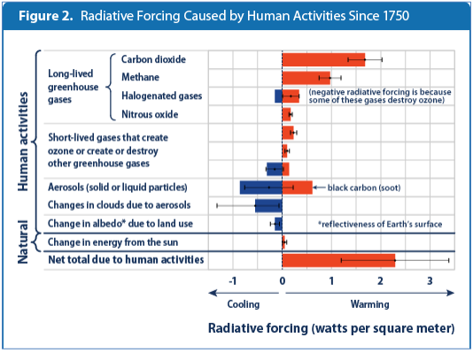
Project Proposal - Summary
Per the graph published in the report (*source), the GHG have more or less doubled from 1980 to 2014 when this report was published.
The Primary Project task is to:
Identify & Display the major “Specific” sources of emissions in agriculture & farming sector from data available from 1990 to 2019. (CH4 & N2O)
Identify & Display global GHG emissions to understand the Agricultural & Farming aspect from separate dataset.
Use Global Oil demand as a vague indicator to CO2 emissions for comparison purposes
*Source: https://climatechange.lta.org/wp-content/uploads/cct/2015/02/EPA-climate-forcing-2014.pdf/

Slide 4
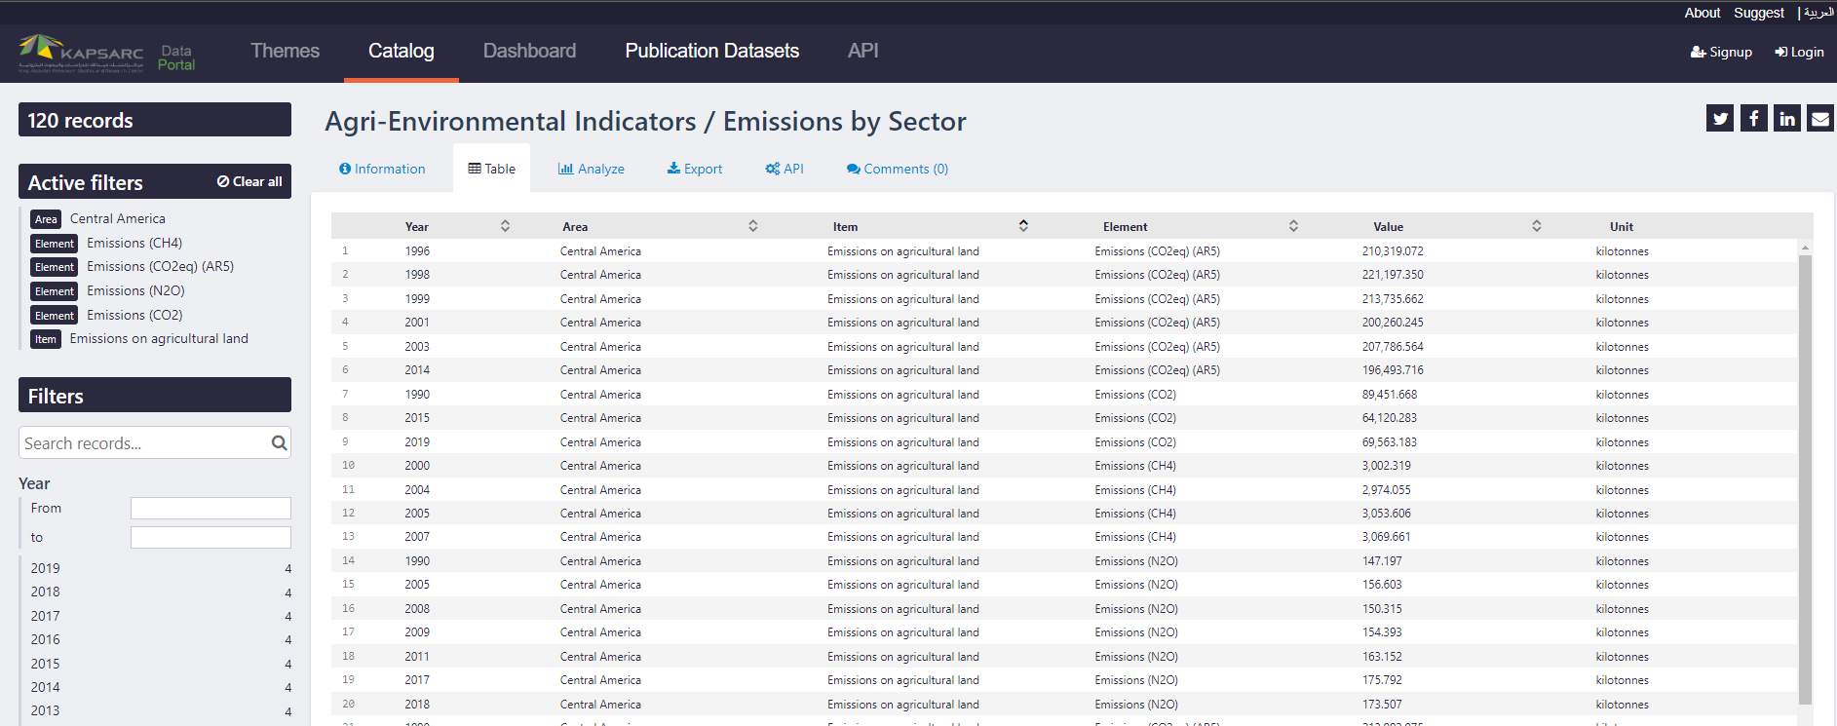
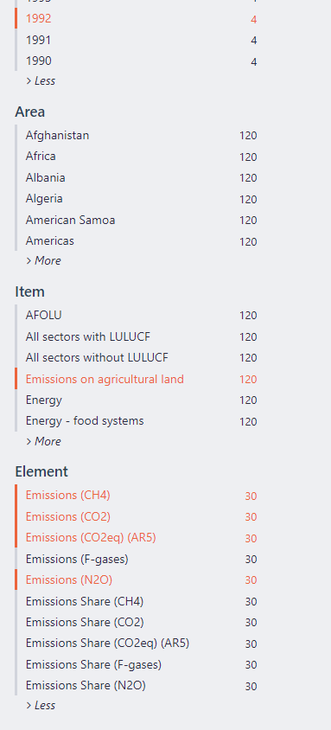
Data1 – Agriculture Emissions per sector
DATA1: Available as CSV,JSON file or API with a html interactive page (We plan on using JSON file for the project)
https://datasource.kapsarc.org/explore/dataset/agri-environmental-indicators-emissions-by-sector/table/?disjunctive.area&disjunctive.item&disjunctive.element&sort=-item
Data can be sorted with – Year
Area (Major countries)
Items (Emission Sources or sectors)
Elements (Specific Greenhouse Gases)
Annual dataset with 6 columns which could be sorted by columns on right.
This is the primary task for understanding Methane emissions from Agri & farming

Slide 5
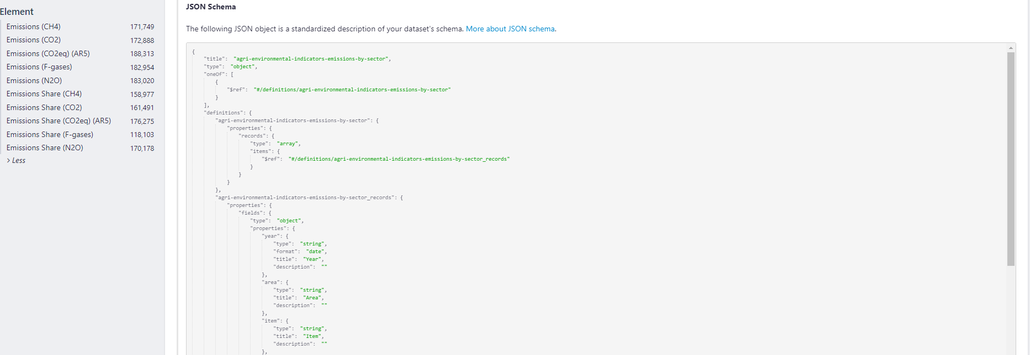
Data1– Emissions per sector
DATA1: Available as CSV,JSON file or API with a html interactive page (We plan on using JSON file for the project)
https://datasource.kapsarc.org/explore/dataset/agri-environmental-indicators-emissions-by-sector/table/?disjunctive.area&disjunctive.item&disjunctive.element&sort=-item

Slide 6
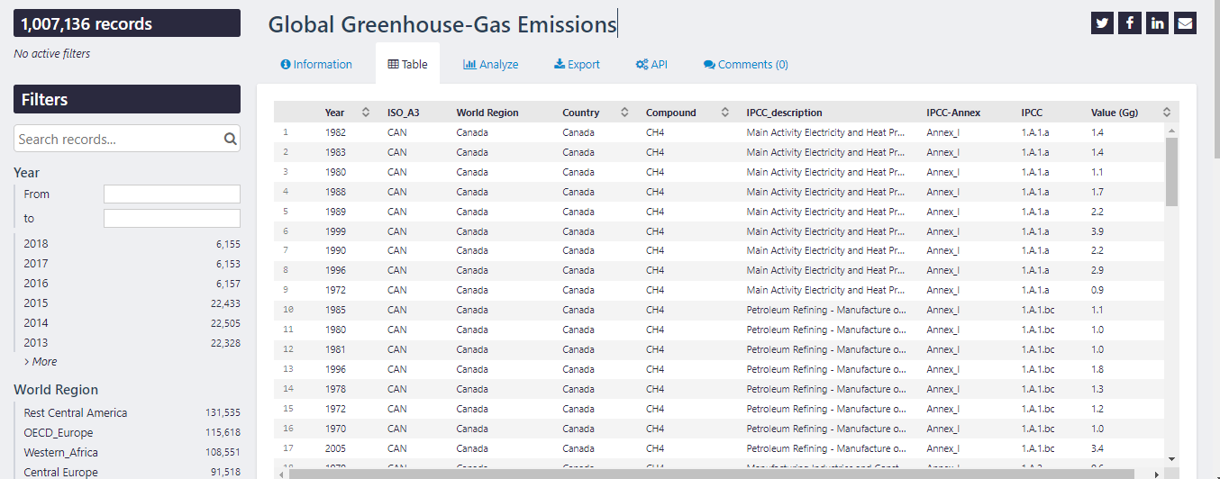
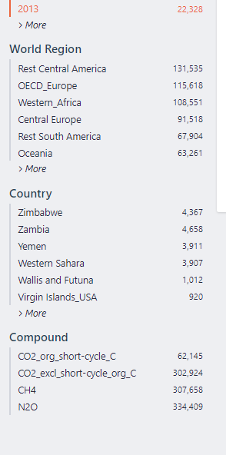
Data2– Global Greenhouse Emissions
DATA2: Available as CSV, JSON file or API with a html interactive page
We plan to use JSON
https://datasource.kapsarc.org/explore/dataset/emissions_agriculture_energy_e_all_data_norm/table/?disjunctive.item&disjunctive.element
Data can be sorted with – Year
World Region
Country
Elements (Specific Greenhouse Gases)
The IPCC_Description column provides sector
Annual dataset with 9 columns which could be sorted by columns on right.
This data helps understand global emissions from all industries to compare with Agri industry

Slide 7
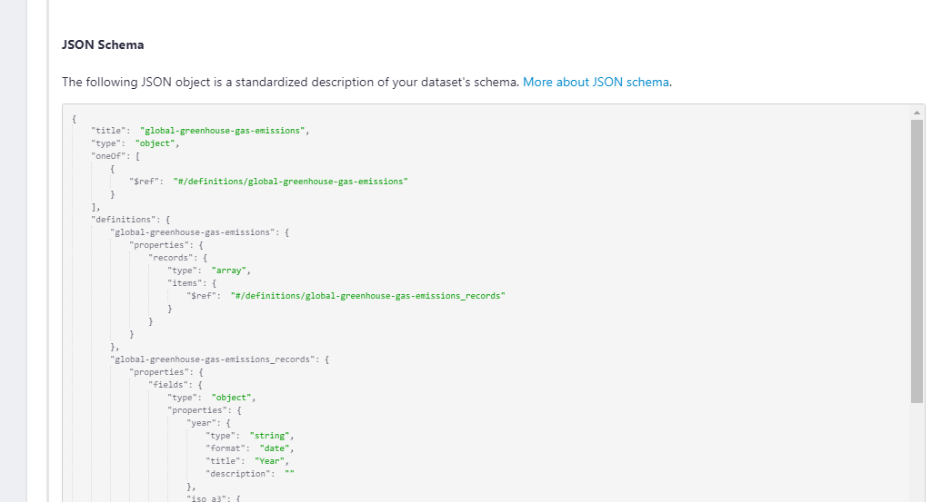
Data 2– Global Greenhouse Emissions
DATA2: Available as CSV, JSON file or API with a html interactive page
We plan to use JSON (Schema is provided in Introduction Tab)
https://datasource.kapsarc.org/explore/dataset/emissions_agriculture_energy_e_all_data_norm/table/?disjunctive.item&disjunctive.element

Slide 8
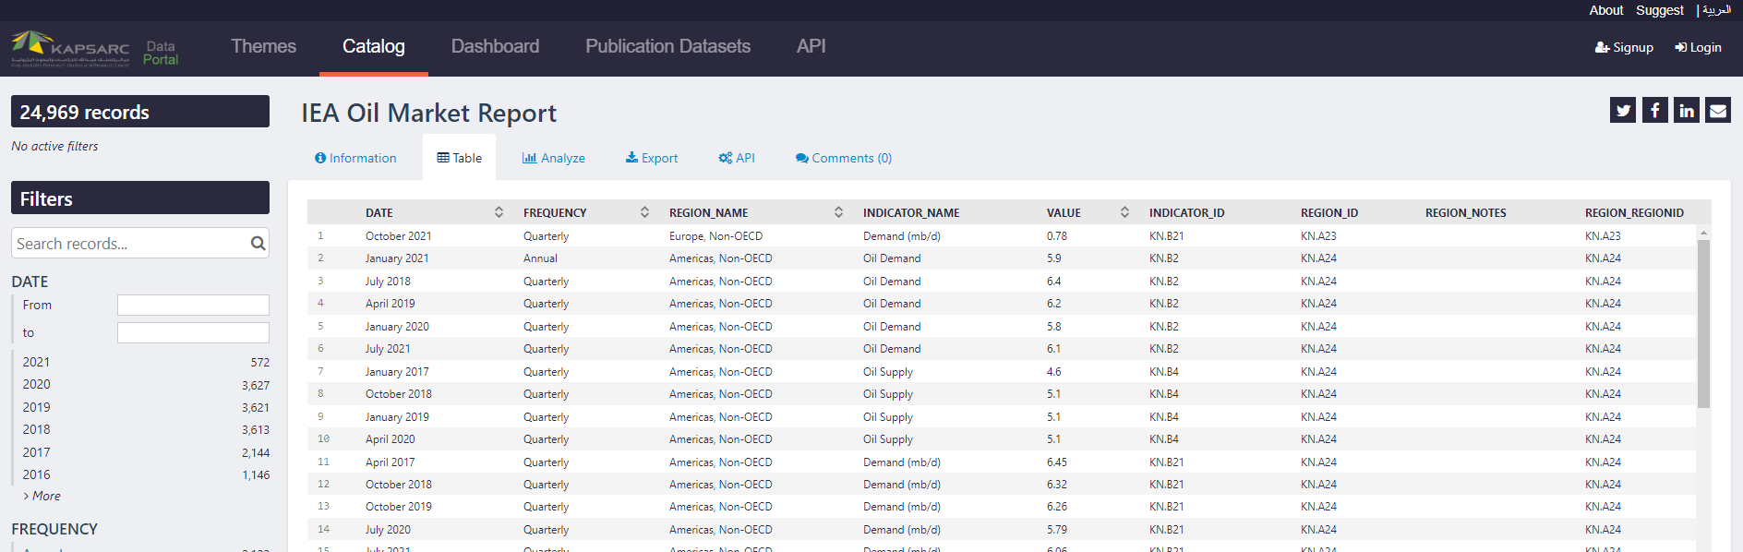
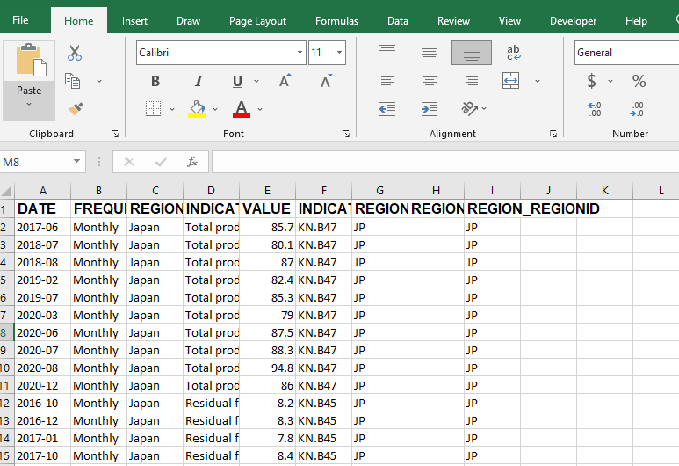
Data 3– Global Oil& Gas Demand
DATA3: Available as CSV, JSON file or API with a html interactive page
We plan to use CSV (Convert xls to CSV)
https://datasource.kapsarc.org/explore/dataset/iea-oil-market-report-2001-2016/information/?disjunctive.frequency&disjunctive.region_name&disjunctive.indicator_name

Slide 9
Project Proposed Tasks / strategy
Identify major countries with max GHG emissions (select globally)
Understand total emissions per year for all sectors
Work with dataset with Agriculture & farming for those countries and identify total emissions of methane, nitrous oxide and other gases
Display with graphs (optional – depending on available time)
Work with oil Demand CSV to generate yearly oil demand got the selected countries.
Load the data into SQL database – as many tables required depending on find…

