Slide 1
Google PageRank
developed by Larry Page and
Sergey Brin, the founders of Google

Slide 2
Intresting fact
“We chose our system name, Google, because it is a common spelling of googol, or 10 ¹⁰⁰ and fits well with our goal of building very large-scale search engines.”
- Sergey Brin and Larry Page

Slide 3
Content
Mid Report
1 Introduction
2 Related Works
3 Problem Statement
4 Use Case of Linear Algebra in the Projet
6 Conclusion
Final Report
BUILDUP OF GOOGLE PAGERANK
Background Mathematics
GRAPH THEORY
STOCHASTIC MATRIX
MARKOV CHAINS

Slide 4
Contents-continuied.....
MARKOV CHAINS
Transition Matrix
Probability Matrix
Long-term Iteration
Eigenvector and Eigenvalue
Developing a formula to rank pages
Final Formula formed
Iterative Method to calculate PageRank scores
Dangling Nodes
Further points- Web Search Algorithms
Damping factor

Slide 5
BUILDUP OF GOOGLE PAGERANK
Google PageRank was a milestone at that time as it ”quantitatively” rated the importance of each page on web, allowing Google to rank the pages and thereby present to the user the more relevant and important pages first. This ranking of pages is termed as ”Google PageRank”
Automated search engines that rely on keyword matching usually return too many low quality matches. To make matters worse, some advertisers attempt to gain people’s attention by taking measures meant to mislead automated search engines(Google page rank prevented this)

Slide 6
3 Major task of Google
Search engines such as Google have to do three basic
things:
1. Crawl the web and locate all web pages with public access.
2. Index the data from step 1, so that it can be searched efficiently for relevant keywords or phrases.
3. Rate the importance of each page in the database, so that when a user
does a search and the subset of pages in the database with the desired information has been found, the more important pages can be presented first.
This paper will focus on step 3.(Mostly On Ranking Part Only)

Slide 7
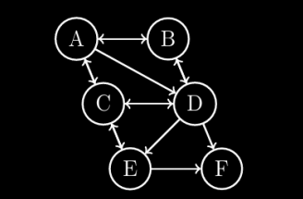
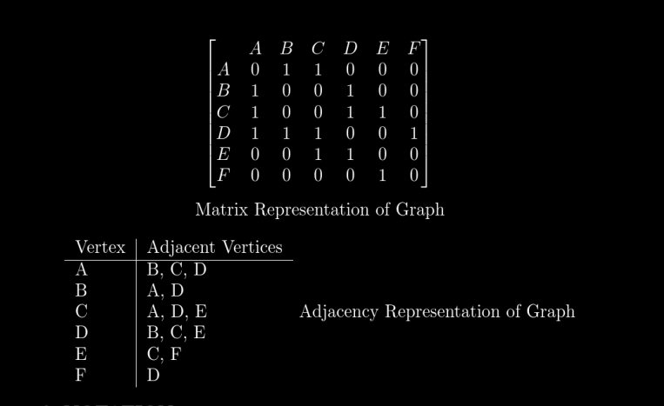
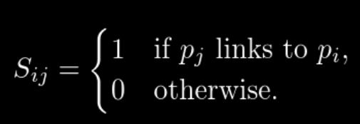
Graph Theory
VERTEX (G) = {A, B, C, D, E, F}
EDGES(G) ={(A, B),(A, C),(A, D),(B, A),(B, D),(C, A),(C, D), (C, E),(D, B),(D,
C),(D, E),(E, C),(E, F),(F, D)}
In the figure, A,B,C,D,E,F can be WEB PAGES on Internet. The → in graph from X to Y indicate webpage X contains link which links it to webpage Y.

Slide 8
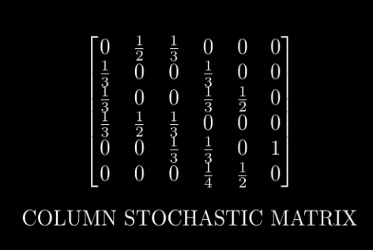
STOCHASTIC MATRIX
Sum of all elements of each column equal to one
In a stochastic matrix, its eigenvalues are guaranteed to have a maximum magnitude of 1, or have a complex number as an eigenvalue with a magnitude less than or equal to 1.
Av = λv
As λ = 1, Av = v
called Transition
Matrix in MarkovChain

Slide 9
Markov Chain
Transition Matrix- P, is an n × n matrix where Pij represents the probability of transitioning from state sj to state si . The elements of each Collum of P must sum to 1.(a stochastic Matrix with probablity as P_{ij})
Probability VECTOR-The probability matrix, denoted as X, represents the probabilities of being in each state at a specific time step. It is typically a row vector of probabilities.
X = [x₁ x₂ · · · x_{n}]
Long-term Iteration- we iterate the transition matrix P and the probability matrix X over multiple time steps until
convergence to the stationary distribution. This process can be represented as:
X^{(t)}= P.X^{(t-1)}
· P

Slide 10
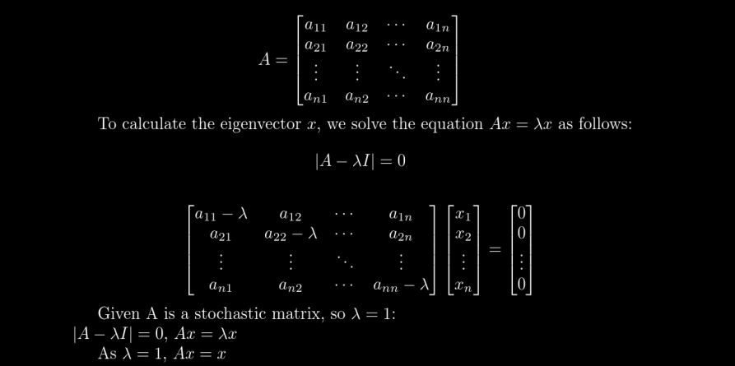
Eigenvector and Eigenvalue

Slide 11
Developing a formula to rank pages
A core idea in assigning a score to any given web page is that the page’s
score is derived from the links made to that page from other web pages. The
links to a given page are called the backlinks for that page. The web thus
becomes a democracy where pages vote for the importance of other pages by
linking to them
A web is Represented in form of graph. Each webpage as vertex and Each Backlink
is Edge of Graph so Is represented as Adjecency Matrix
We’ll use X_{k} to denote the importance score of page k in the web and
X_{k} = No of backlinks on page k (Not correct)
Disadvantage:- That a link to page k from an important page should
boost page k’s importance score more than a link from an unimportant page.
SO backlink from More Important page has higher score

Slide 12
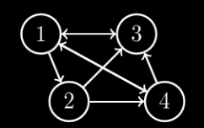
CORRECTION-
First compute the score of page k as the sum of the scores of all pages linking to page k.
eg= X₁=X₄+X₃ if page 4,3 send outlink to page 1 where X₄ , X₃
are Respective Score of page 4,3
this scheme seems strangely self-referential ( Since X₃ and X₄ will depend on X₁)
but it is the approach we will use, with one more modification.

Slide 13

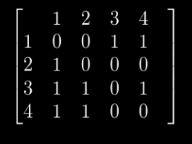
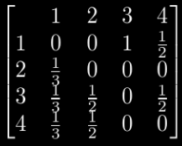

MODIFICATION-
what if One Webpage votes to many?
we don’t want a single individual to gain influence merely by casting multiple votes. So we decrease its Value of vote by Dividing each vote(1) by total no of Votes. In this scheme, each web page gets a total of one vote,
So we Convert Adjecency matrix to stochastic Matrix
In our example
==>

Slide 14
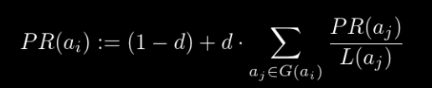
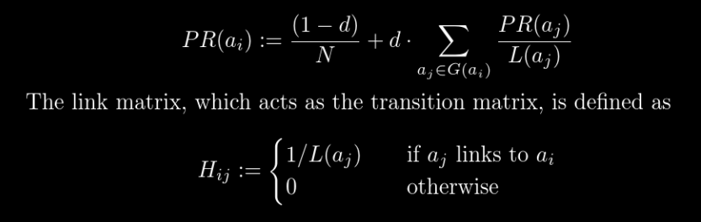
Final Formula formed
The following is the definition of the PageRank of a webpage, as given by Brin and Page in their original 1998 paper.
PageRanks of all webpages do not form a probability distribuition (they don’t add up to 1) with this definition, and the (1 − d) term must be divided by the total number of webpages, N, to achieve this.

Slide 15
Damping Factor
The damping factor, denoted by d,. It represents the probability that a user will continue following the links on the current page, rather than randomly jumping.
A higher damping factor assigns more weight to following links, meaning
that the user is more likely to continue exploring the web by following the links on the pages they visit. On the other hand, a lower damping factor assigns more weight to random jumping, indicating that the user is more likely to randomly jump to different pages.
The choice of an optimal damping factor depends on the characteristics of the
web graph and the behavior of users. Google typically uses a damping factor
of 0.85, which has been found to yield good results in practice

Slide 16

Iterative Method to calculate PageRank
we iteratively multiply the link matrix H with the PageRank vector from the previous iteration. We desire to arrive at the steady state PageRank vector, i.e. to compute
where P₀ is the initial PageRank vector with equal ranks to all the webpages.In practice, we iterate till we obtain only a marginal difference, say ϵ, between two successive iterations. Also, to account for the damping factor, in each iteration, we multiply the matrix-vector product with it, and add another factor that accounts for random jumps to any page in the web the user may take if they are bored of surfing

Slide 17
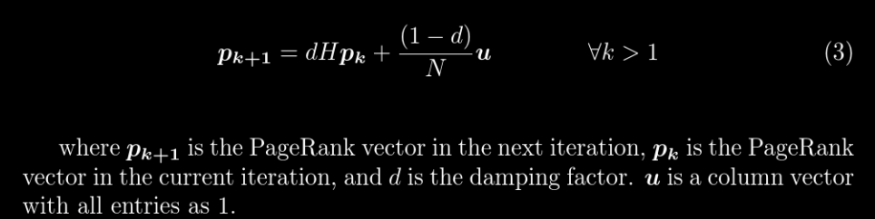
Iterative Method-continuied
Convergence and Stability:- The fact that after a number of iterations,
the difference between the entries of successive PageRank vectors becomes neg_x0002_ligibly small, corresponds to the idea that a sequence of vectors, defined by a matrix transformation applied on the previous iteration to get the new itera_x0002_tion, converges to a final steady state vector, which is the principal eigenvector of the matrix. This convergence ensures PageRank scores reflect l importance of a page in the whole web graph, removing bias, instability and noise. Stable scores allow for fair comparison between webpages, providing a reliable means to rank them.

Slide 18
Dangling Nodes
So far the example has shown every webpage having an outgoing link. However, it is possible that there are webpages that do not link to any other page. Nodes representing such pages are called “Dangling” nodes. According to the original
definition of the link matrix, if ai is a dangling node, then the i
th column would be entirely zero, thus disobeying the stochastic matrix property. And if we compute the final PageRank now, the steady state vector’s entries would no
longer add up to one.
So To Correct it we fill that collum whose all entry are zero to 1/No of Nodes (assuming that a random walker so can go tho any if no OutLinks) so now it again become stochastic so
no problem now

Slide 19
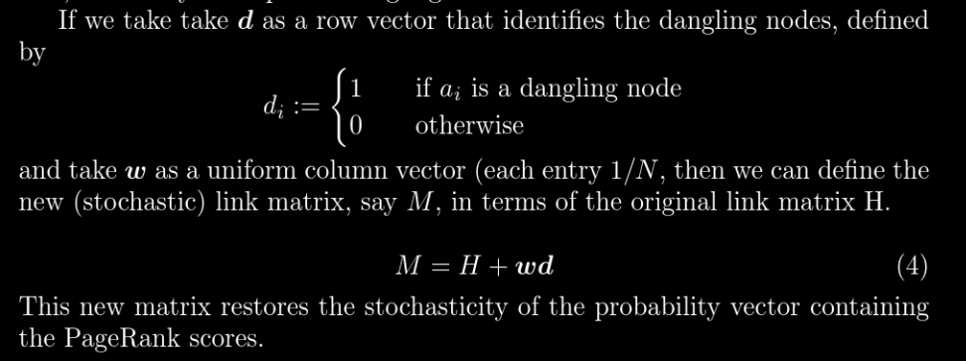
Dangling Nodes-continued...

Slide 20

Personalization in PageRank
To incorporate personalization into PageRank, we introduce a personalized vec_x0002_tor V . This vector represents the user’s preferences and biases towards specific
pages.
Vp is the value in the personalized vector V for page p
We multiply each PageRank score with the corresponding value from
the personalized vector
PR_{personalized}(p) = PR_{Basic}(p) · Vp
Then we normalizes the elements of this PRpersonalizedV ector

Slide 21
A working simulation of working of Google PageRank algoritham

