Slide 1

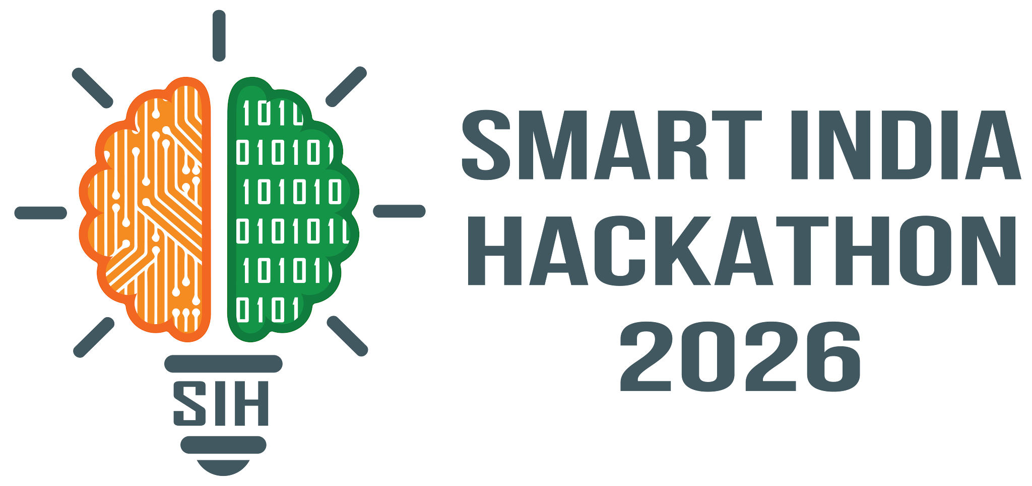

SMART INDIA HACKATHON 2026
Problem Statement ID – 26038
Problem Statement Title -
Explainable AI for Diabetic Retinopathy Screening in Rural India
Theme - MedTech / BioTech / HealthTech
PS Category - Software
Team ID - SW-17
Team Name – RetiNova
SIH 2026 | Problem statement-26038 | RetiNova

Slide 2
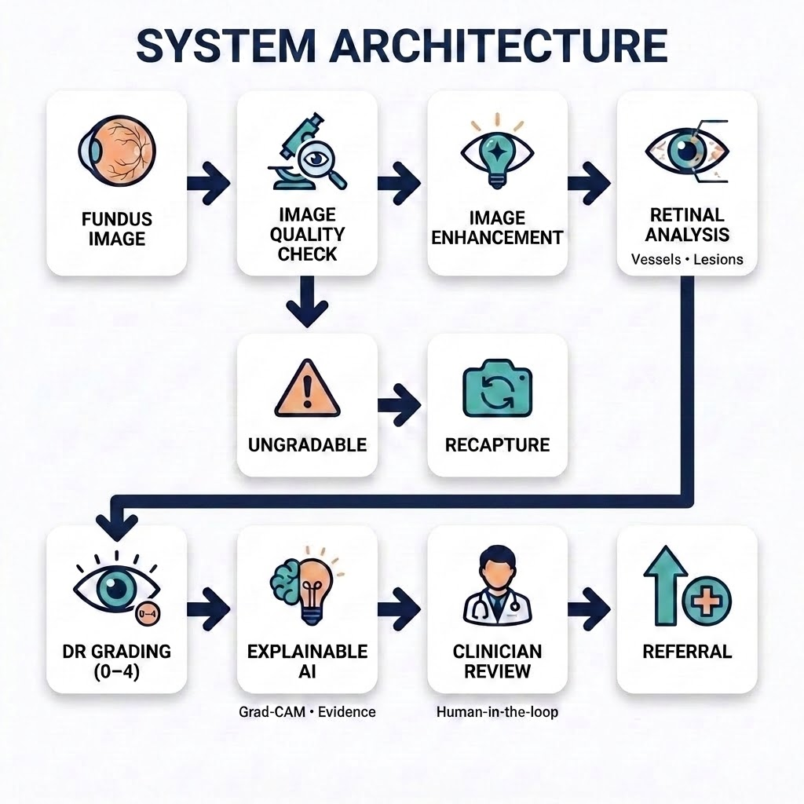
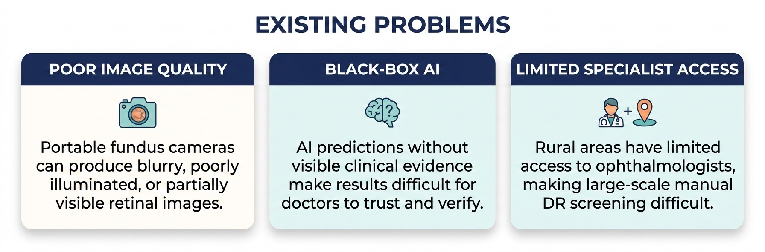
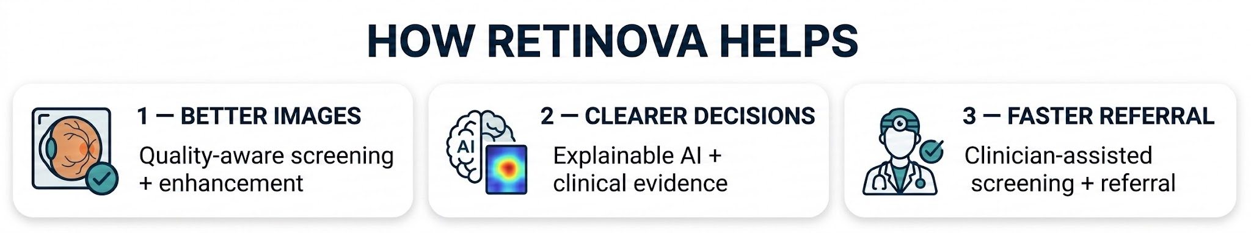

PROPOSED SOLUTION

Slide 3
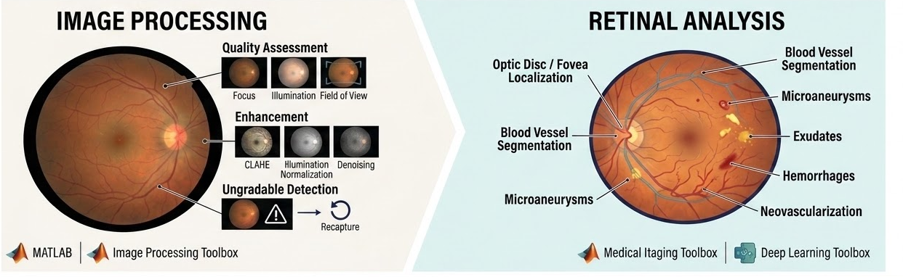
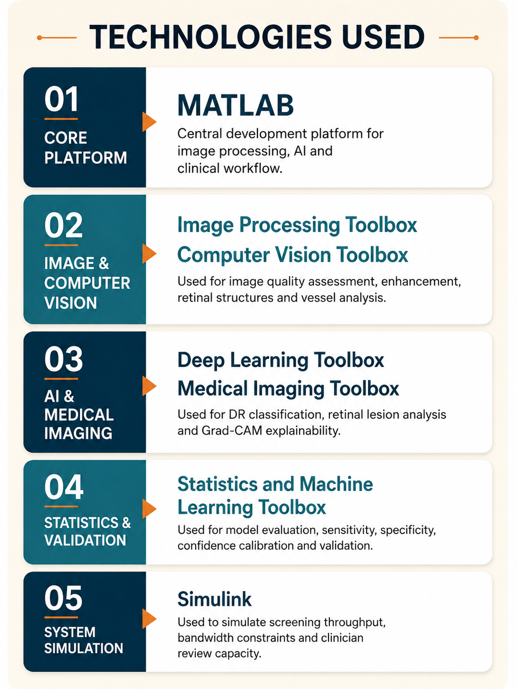

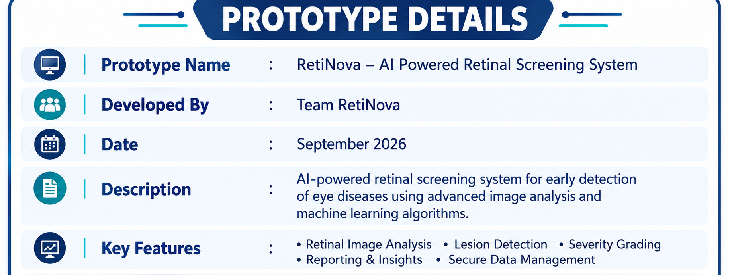
TECHNICAL APPROACH

Slide 4
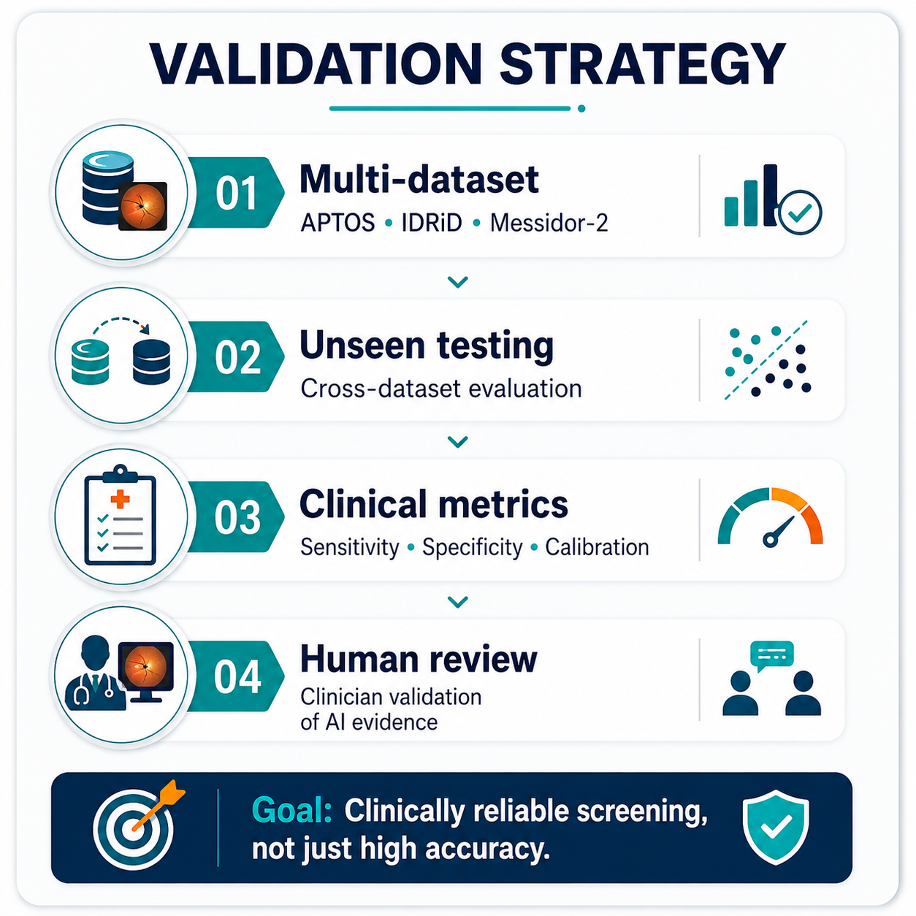
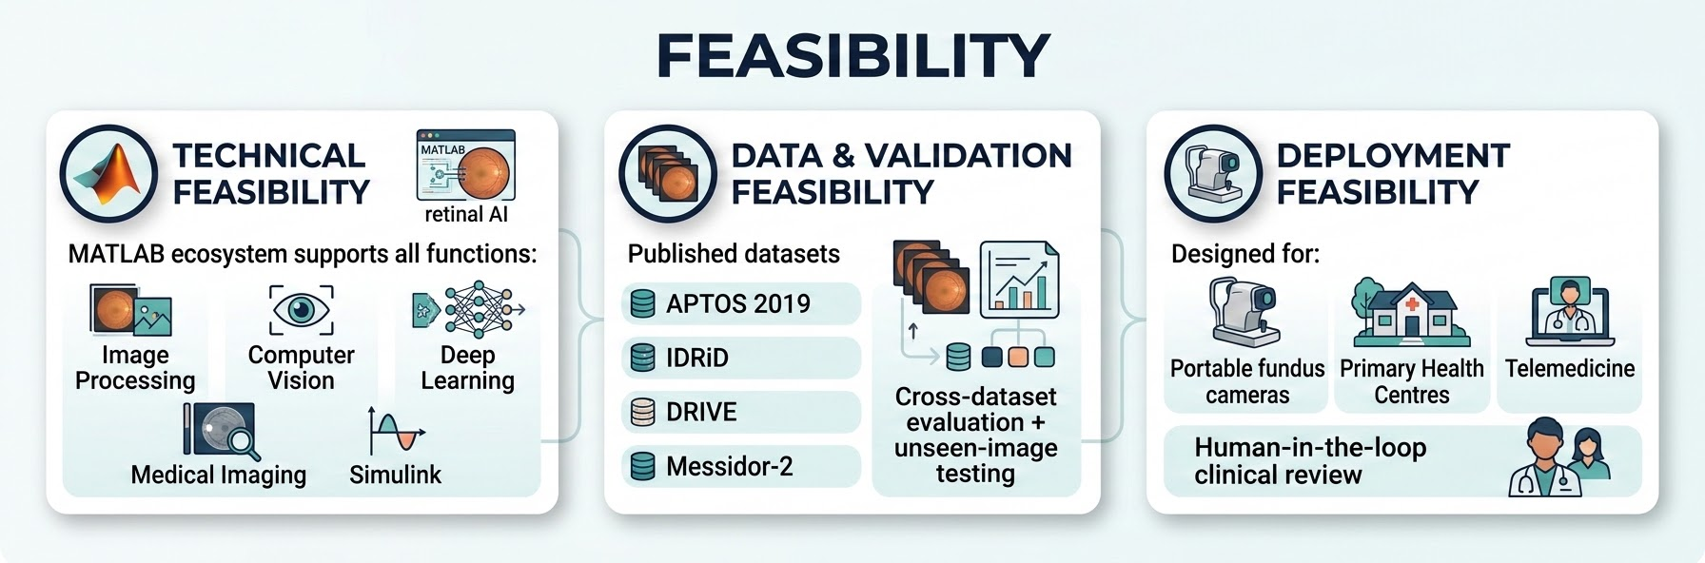
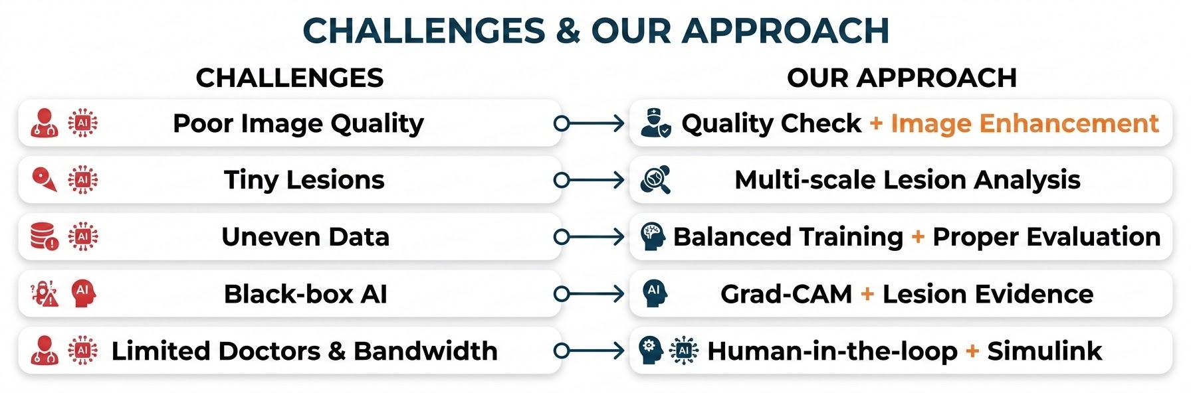
FEASIBILITY AND VIABILITY

Slide 5
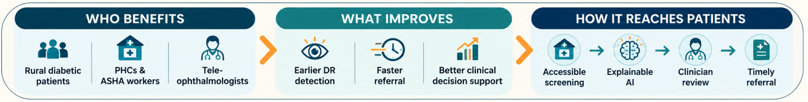
IMPACT AND BENEFITS
Rural Diabetic Patients
PHCs & ASHA Workers
Tele-Ophthalmologists
District Health Programs
👁️Patient
Impact
Earlier DR detection
Faster referral
Timely treatment
Reduced vision loss risk
🏥 Healthcare
Impact
AI-assisted screening
Doctors focus on high-risk cases
Enables telemedicine
🤖 Technology Impact
Explainable AI
Faster result verification
Evidence-based decisions
📊 System-Level Impact
Simulink-based resource planning
Better bandwidth usage
Better doctor workload planning

Slide 6
RESEARCH AND REFERENCES
Datasets Used or Training & Validation
Research and Existing Solutions
1. APTOS 2019 Blindness Detection
kaggle.com/c/aptos2019-blindness-detection
2. IDRiD – Indian Diabetic Retinopathy Image Dataset
https://ieeedataport.org/open-access/indian-diabetic-retinopathy-image-dataset-idrid
3. DRIVE – Digital Retinal Images for Vessel Extraction
drive.grand-challenge.org
4. Messidor-2
adcis.net/en/third-party/messidor2
🔗Research
Explanatory artificial intelligence for diabetic retinopathy diagnosis (August 2021)
Diabetic Retinopathy – Segmentation and Grading Challenge (January 2020)
Explainable CNN-Based Framework for Diabetic Retinopathy (September 2025)
🔗Existing AI Screening
Luminetics Core® - Digital Diagnostics
AEYE Health

