Slide 1

MINI PROJECT
Department of Computer Engineering & Application
Institute of Engineering & Technology PROJECT: COMIC ADDA
GLA University Mathura - 281406

Slide 2
Our Team Member
are!
Name | University Roll No.
1. OM CHAUHAN HARSH KUMAR ANKIT DUBEY 4. VIRAT MISHRA | 201500456 201500267 201500099 201500790

Slide 3
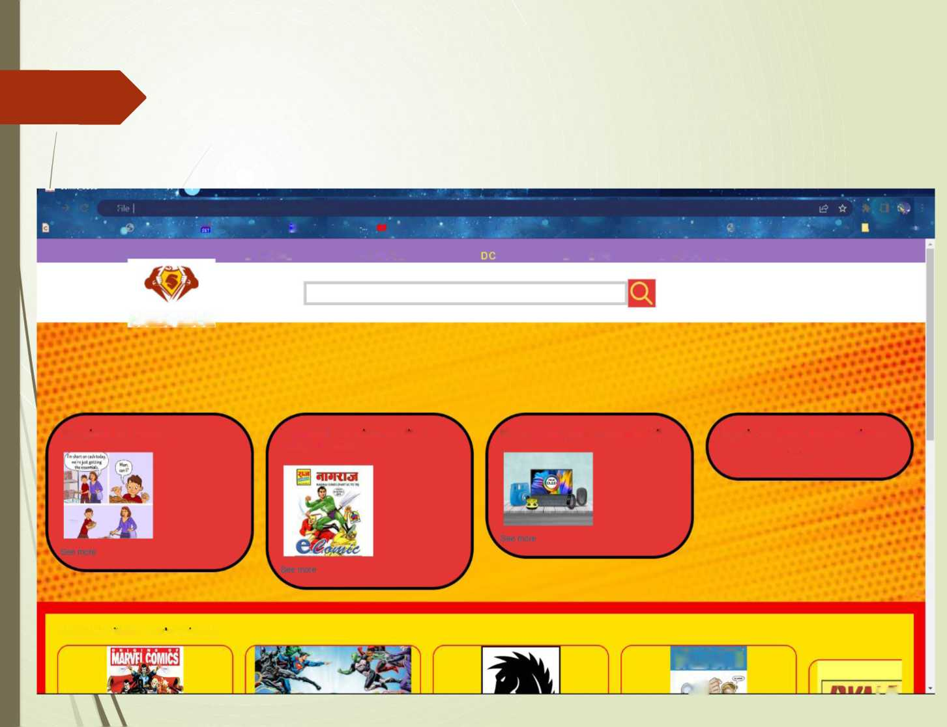
COMIC ADDA WEB APPLICATION
O ■ C:/Users/omcha/Onet>ivp/De5ktop/jhaalu/indcx.html
call lot paper 0 hps. Publications “ .IQCNMC 2013 - InL.. | ^ Radtoengineenng* 0 O^ineOpac | Delhi... @ Low.Voltage,.Low P... 0 WCEEE2013 [J 2013 ICSC »Intern^. f IEEE - Call for Paper...
Otha bookit jiki
□ HOME
MARVEL
□ ITEMS
□ ABOUT US
COMIC ADDA
. ■
Top picks for Teens
Top rated, premium quality |
Shop & Pay | Earn rewards daily
Sign in for your best experience
Indian Comics
sign in securely
• •
. 4 • *
• • '
‘
• *
Related to items you ve viewed
UALIANTl
M
1 i/k'

Slide 4
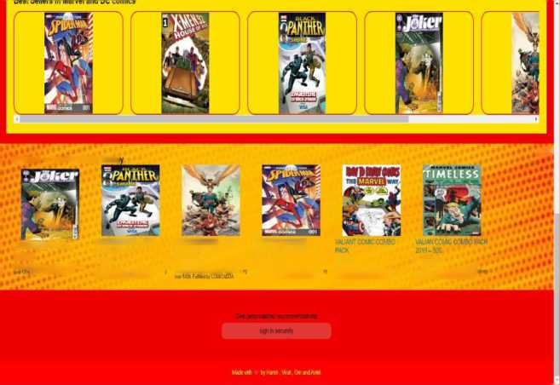
INTRODUCTION
Aur website is basically an E-commerce website which is made only to sell comic books. the customer can go through whole new and old collections on our website. our website which is called comic adda is a whole new experience for those who were a great addict of comic books in 90s but now cannot find any. Our website is a solution to that craving.
Inspired by your browsing histor
• ••
JOKER C0j.ilC20HJCC W99.00
3a It* SondM,Aiaiali2*t€E Difovy
F^iwt.raiCAim
BUCK PANTHER-NEW EDITION 2320 f 45.00
StHIK. MUmtoy. Auoal» FREF Del. a MIM» Fillet, CCMCATCA
JJSTICE LEAGUE -OLD EDITION 1999 W,000.00
Sail t. Mindly. AugM » =HFE tkl.i
SPIDERMAN MARVEL EDITION -STANLEE 2013 f 500.00
CM 41, llaiday Aural» ^BEE Dll-i Mfl« FidMbyCGMCADjA
f 499.00 f 1.200.00
CM I h ItmlM AIIUMU » :3FF Dilwy Ga 1!»• Uxulli Auguu » F3FF 6
mitt FuBWtgCOMCJDDA cwf CJKFufl.rr COMMIM
'e have used the technologies like 'ML, CSS, JS.

Slide 5
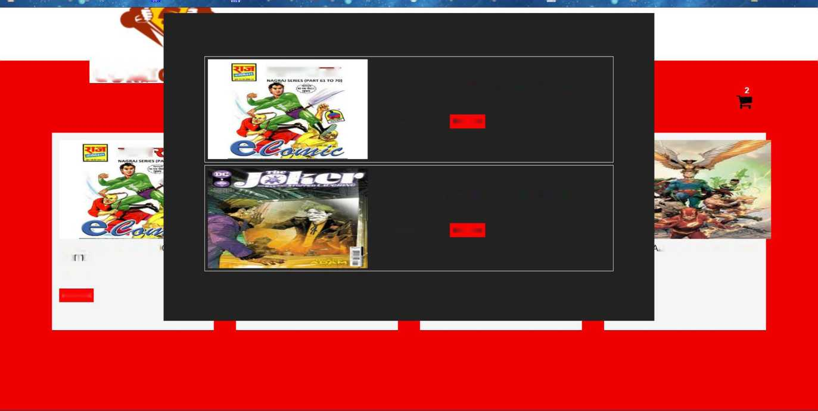
Add to cart-
COM!
dNItlol
JOKER - ALL NEW EDITION - 2019 EDITION
*499 Buy-now
cIRI
JOKER - ALL NEW EDITION - 2019 EDITION
*600 Buy-now
JOKER -ALL NEW EDITI
LL NEW EDITION-2019
ED T ON
F499
Add-cart

Slide 6
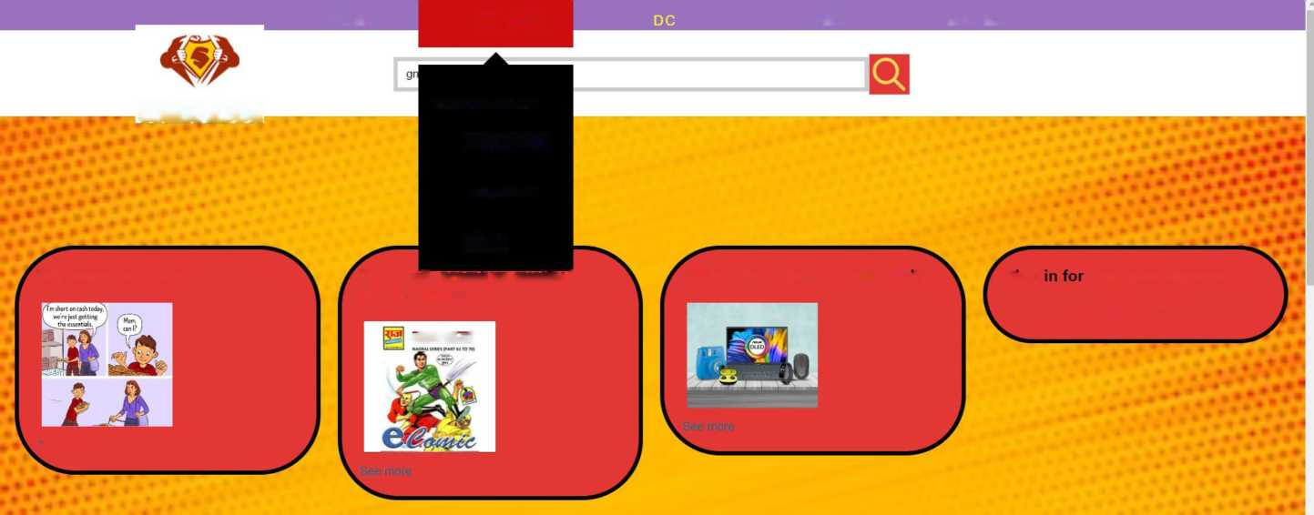
Drop down
menu by js.
HOME
MARVEL
ITEMS
MANGA
COMIC ADDA
SPIDERMAN
DEADPOOL
IRONMAN
HULK
Top picks for Teens
Top rated, premium quality |
Shop & Pay | Earn rewards daily
Sign
your best experience
Indian Comics
sign in securely
sian in securely
cIRRlol
See more

Slide 7
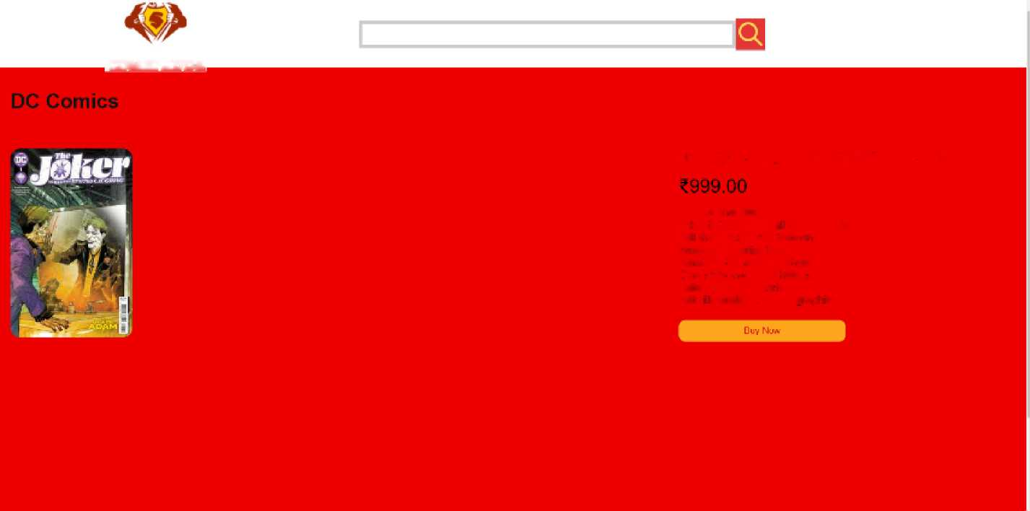
Product page:
COMIC ADDA
JOKER - ALL NEW EDITION - 2019
About tl'a item
■taker s back again a new episodes, 'j'ji Ms |flksi' rJefea.1 nalnra n Salman will si" fcc ™ck?
Wharf will 1ha fate of got"£ n Csma |o*i Ms era *1 karererJ Aclion jack na^v sa- HS Wlh ilusirstive Cast and cso¹" cs

Slide 8
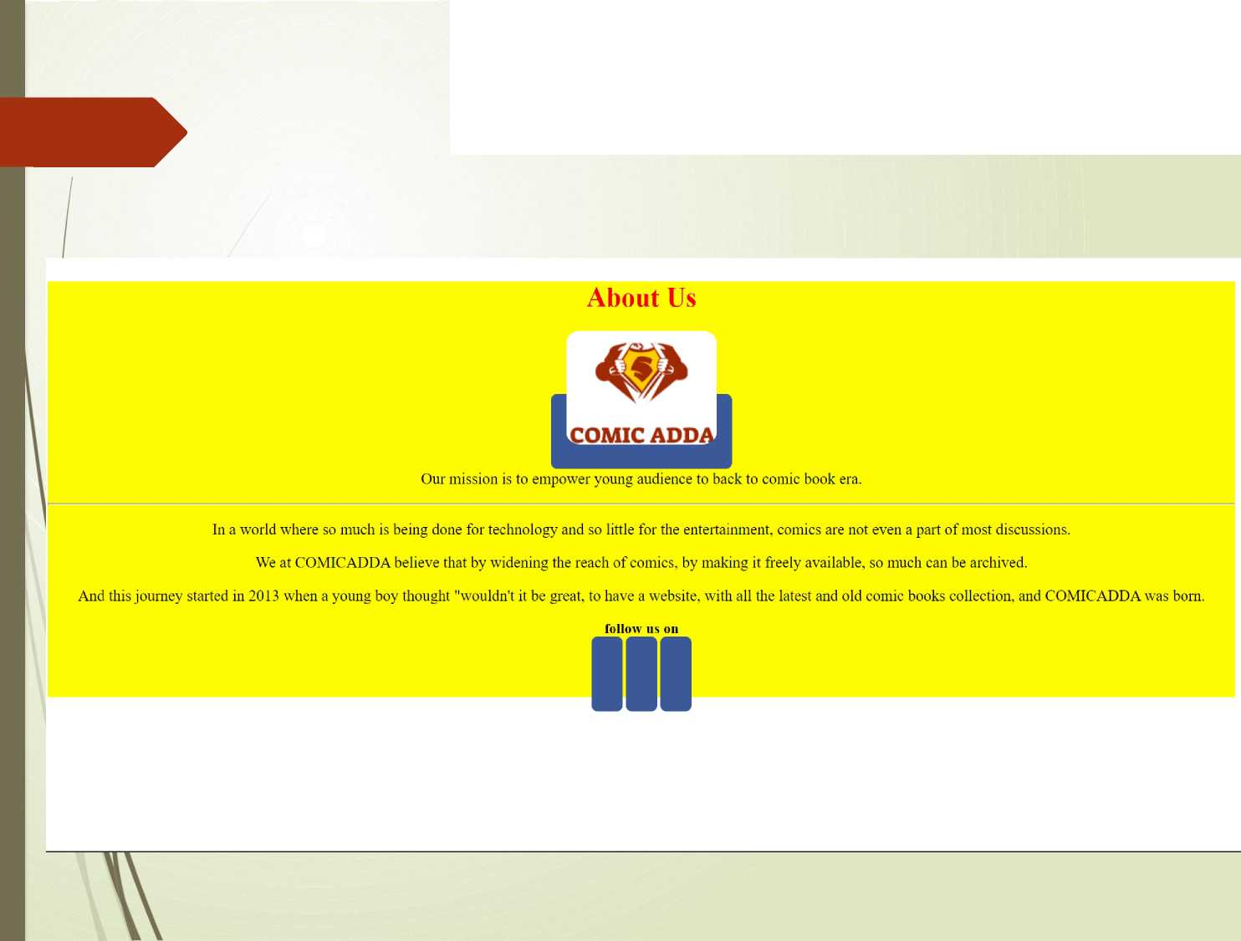
ABOUT US-:

Slide 9
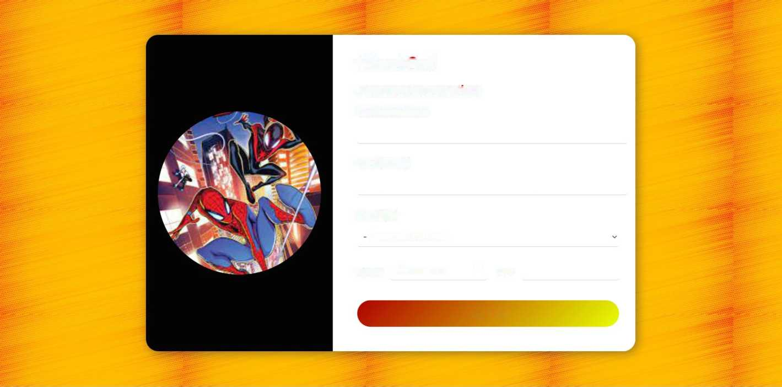
Checkout
Payment Information
Cardholder Name
Card Number
Card Type
-Select a Card Type-
Expiry dd-mm-yyyy □ CW
Pay Now

Slide 10

Working Code
<> index.html X
C: > Users > omcha > OneDrive > Desktop > jhaatu > <> index.html >...
1 <!DOCTYPE html>
2 <html lang="en">
3 <head>
4 cmeta charset=”UTF-8">
5 <meta http-equiv="X-UA-Compatible" content="IE=edge">
6 <meta name="viewport" content="width=device-width_{J} initial-scale=1.0">
<title>Con»ic_adda</title>
8 <link rel="shortcut icon" href="logol.png" type=^{,r}image/x-icon">
9 <link rel="stylesheet" href="https://cdnjs.cloudflare.com/ajax/libs/font-awesome/4.7,0/css/font-awesome.min.css">
10 <link rel="stylesheet^{,r} href="style.css">
11 <link rel="stylesheet" href="ff.css”>
12 </head>
13 <body>
14 <div class="wrapper">
15 <div class="navbar’'>
16 <ul>
17 <lixa href="#" class="a_parent^{,r}>
18 <div class="wrap">
19 <span class="icon">
29 <i class="fas fa-home" aria-hidden="true"x/i>
21 </span>
22 <span class=”text">Home</span>
23 | </div>
24 </ax/li>
25 <lixa href="#" class=^{n}a_parent">
26 <div class="wrap">
27 <span class="icon">
28 | <i class="fas fa-volleyball-ball" aria-hidden="true"></i>
29 </span>
30 <span class="text">Marvel</span>
31 </div>
32 </a>
<div class="dd menu">
<a href="#" class="dd_menu_a">
<div class="wrap">
<span class="icon">
<i class="far fa-futbol" aria-hidden="true"x/i>

Slide 11
CONCLUSION
Outcomes
This is a E-Commerce website
In this website we can use different features.
Time saving
High availability
can add the products to the cart Simple Interface

Slide 12

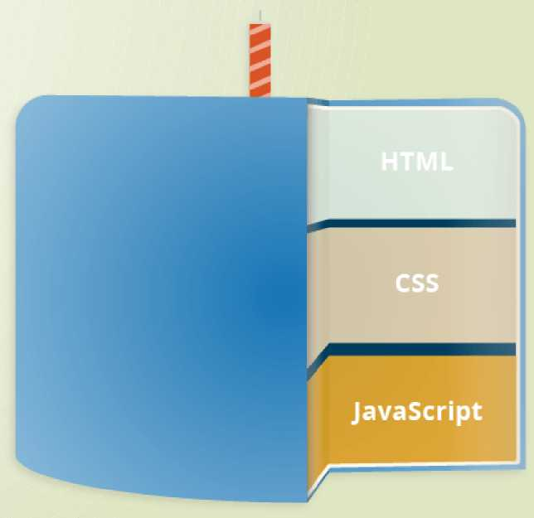
Technologies that are used to develop the website are:
L
avaScript

Slide 13
How to view website or code:
Website: https://qithub.com/harsh-kumar-cs20
Code: https://github.com/harsh-kumar-cs20/mini project.git

Slide 14
Website features
Add a product to cart. Check the product details.
Checkout page to buy a product.

Slide 15


