Slide 1
Presented By :
Harsh Vardhan

Slide 2
Introduction
C is a general purpose language which is very closely associated with UNIX for which it was developed in Bell Laboratories.
Most of the programs of UNIX are written and run with the help of 'C'.
Many of the important ideas of 'c' stem are from BCPL by Martin Richards.
In 1972, Dennies Ritchie at Bell Laboratories wrote C Language which caused a revolution in computing world .
From beginning C was intended to be useful for busy programmers to get things done easily because C is powerful,dominant and supple language.

Slide 3

Why Name 'C' was given to this
language?
Many of the ideas of C language were derived and taken from 'B' language.
BCPL and CPL are previous versions of 'B' language.
As many features came from B it was named as 'C'.

Slide 4
ABOUT “C”
C programming language
program design.
- Structured and disciplined approach to
C is a structured programming language
C supports functions that enables easy maintainability of code, by
breaking large file into smaller modules
Comments in C provides easy readability
C is a powerful language.
C programs built from
Variable and type declarations
Functions
Statements
Expressions

Slide 5


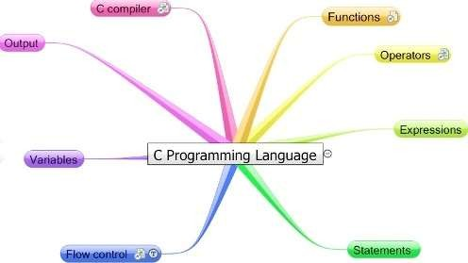

Slide 6
Structure Of “C” Programs
Before going and reading the structure of C programs we need to have a basic knowledge of the following:
C's Character Set
C's Keywords
The General Structure of a 'C' Program
How To End A Statement
Free Format Language
Header Files & Library Functions

Slide 7

C 's Character Set
C does not use every character set and key found on
modern computers . The only characters that C - Language uses for its programs are as follows:
A-Z all alphabets
a-z all alphabets
0-9
# % & ! _ {} [] () $$$$ &&&& |
space . , : ; ' $ "
✓ + - / * =

Slide 8
The keywords
"Keywords" are words that have special meaning to the C compiler.
Their meaning cannot be changed at any instance.
Serve as basic building blocks for program statements.
All keywords are written in only lowercase.

Slide 9
Basic Structure Of “C” Programs
#include<stdio.h> #include<conio.h>
Header Files
Entry Point Of Program
void main()
{
Indicates Starting of Program
-- other statements
}

Slide 10
Header files
The files that are specified in the include section is called as Header File.
These are precompiled files that has some functions defined in them.
We can call those functions in our program by supplying parameters.
Header file is given an extension .h .
C Source file is given an extension .c .

Slide 11
Main function
This is the “Entry Point” of a program.
When a file is executed, the start point is the main function.
From main function the flow goes as per the programmers choice.
There may or may not be other functions written by user in a program.
Main function is compulsory for any C program.

Slide 12
Running a ‘C’ Program
Type a program.
Save it.
Compile the program – This will generate an .exe file (executable)
Run the program (Actually the exe created out of compilation will run and not the .c file)
In different compiler we have different option for compiling and running.

Slide 13













“C” language TOKENS
The smallest individual units in a C program are known as tokens. In a C source program, the basic element recognized by the compiler is the "token." A token is source-program text that the compiler does not break down into component elements.
C has 6 different types of tokens viz.
Keywords [e.g. float, int, while]
Identifiers [e.g. main, amount]
Constants [e.g. -25.6, 100]
Strings [e.g. “SMIT”, “year”]
Special Symbols [e.g. {, }, [, ] ]
Operators [e.g. +, -, *]
C - programs are written using these tokens and the general syntax
Strin gs

Slide 14
Keywords in Ansi “C”
auto | double | register | switch
break | else | return | typedef
case | enum | short | union
char | etern | signed | unsigned
const | float | sizeof | void
continue | for | static | volatile
default | goto | struct | while
do | if | int | long

Slide 15
The Identifiers
They are programmer-chosen names to represent parts of the program: variables, functions, etc.
Cannot use C keywords as identifiers
Must begin with alpha character or _, followed by alpha, numeric, or _
Upper- and lower-case characters are important (case-
sensitive)
Must consist of only letters, digits or underscore ( _ ).
Only first 31 characters are significant.
Must NOT contain spaces ( ).

Slide 16
Constants
Constants in C are the fixed values that do not change during the execution of a program.
CONSTANTS
Numeric constants
Character constants
Integer
Constants
Real Constants
Single Character
Constants
String
Constants

Slide 17






Constants Examples
Integer Constants
Refers to sequence of digits such as decimal integer, octal integer and hexadecimal integer.
Some of the examples are 112, 0551, 56579u, 0X2 etc.
Real Constants
The floating point constants such as 0.0083, -0.78, +67.89 etc.
Single Character Constants
A single char const contains a single character enclosed within pair of single quotes [ ‘ ’ ]. For example, ‘8’, ‘a’ , ‘i’ etc.
String Constants
A string constant is a sequence of characters enclosed in double quotes [ “ ” ]; For example, “0211”, “Stack Overflow” etc.

Slide 18
DECLARATIONS
Constants and variables must be declared before they can be used.
A constant declaration specifies the type, the name and the value of the constant.
any attempt to alter the value of a variable defined
as constant results in an error message by the compiler
A variable declaration specifies the type, the
name and possibly the initial value of the
variable.
When you declare a constant or a variable, the compiler:
Reserves a memory location in which to store the value of the constant or variable.
Associates the name of the constant or variable with the memory location.

Slide 19
What Are Variables in C?
A Variable is a data name that is used to store any data value.
Variables are used to store values that can be changed during the program execution.
Variables in C have the same meaning as variables in algebra. That is, they represent some unknown, or variable, value.
x = a + b
z + 2 = 3(y - 5)
Remember that variables in algebra are represented by a single alphabetic character.

Slide 20
Naming Variables
Variables in C may be given representations containing multiple characters. But there are rules for these representations.
Variable names in C :
May only consist of letters, digits, and underscores
May be as long as you like, but only the first 31 characters are significant
May not begin with a number
May not be a C reserved word (keyword)
Should start with a letter or an underscore(_)
Can contain letters, numbers or underscore.
No other special characters are allowed including space.

Slide 21
Case Sensitivity
C is a case sensitive language.
It matters whether an identifier, such as a variable name, is uppercase or lowercase.
Example:
area Area AREA
ArEa
are all seen as different variables by the compiler.

Slide 22
Declaring Variables
Before using a variable, you must give the compiler some information about the variable; i.e., you must declare it.
The declaration statement includes the data type of the
variable.
Examples of variable declarations: int length ;
float area ;
Variables are not automatically initialized. For example, after declaration
int sum;
the value of the variable sum can be anything (garbage).
Thus, it is good practice to initialize variables when they are
declared.
Once a value has been placed in a variable it stays there until the program alters it.

Slide 23
Data types in ‘ansi c’
There are three classes of data types here::
Primitive data types
int, float, double, char
Aggregate OR derived data types
Arrays come under this category
Arrays can contain collection of int or float or char or double data
User defined data types
Structures and enum fall under this category.

Slide 24
Data Types- different attributes
Type | Size | Representation | Minimum range | Maximum range
char, signed char | 8 bits | ASCII | -128 | 127
unsigned char | bool 8 bits | ASCII | 0 | 255
short, signed short | 16 bits | 2's complement | -32768 | 32767
unsigned short | 16 bits | Binary | 0 | 65535
int, signed int | 16 bits | 2's complement | -32768 | 32767
unsigned int | 16 bits | Binary | 0 | 65535
long, signed long | 32 bits | 2's complement | -2,147,483,648 | 2,147,483,647
unsigned long | 32 bits | Binary | 0 | 4,294,967,295
float | 32 bits | IEEE 32-bit | 1.175495e-38 | 3.4028235e+38
double | 32 bits | IEEE 32-bit | 1.175495e-38 | 3.4028235e+38
long double | 32 bits | IEEE 32-bit | 1.175495e-38 | 3.4028235e+38

Slide 25

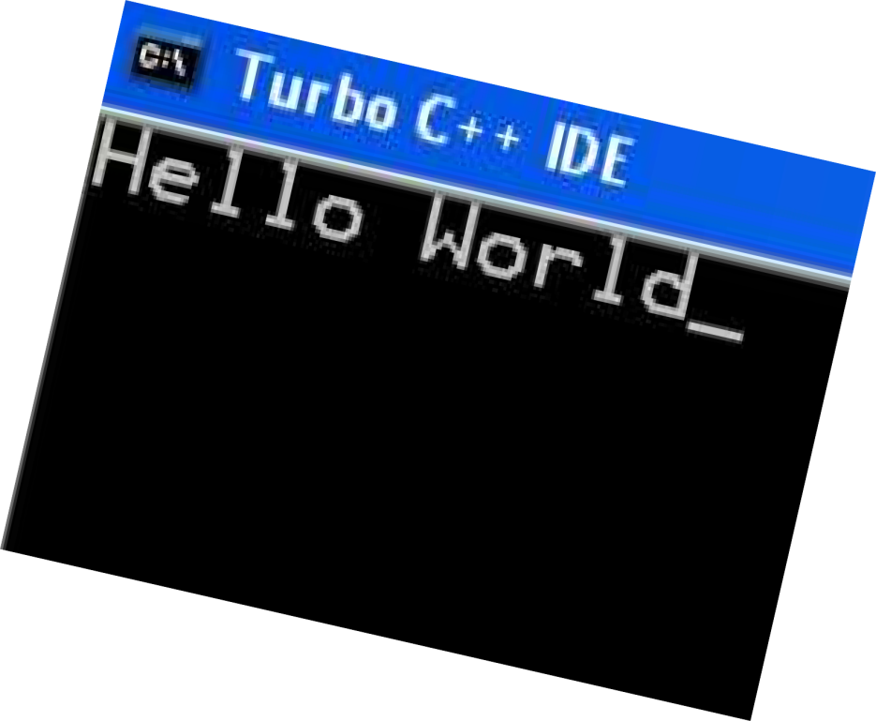
Example of “C” Program
/* HELLO.C -- Hello, world */
#include <stdio.h> Void main()
{
printf("Hello, world\n");
Getch();
}

Slide 26
FAQ ?

Slide 27
Thank You

