Slide 1
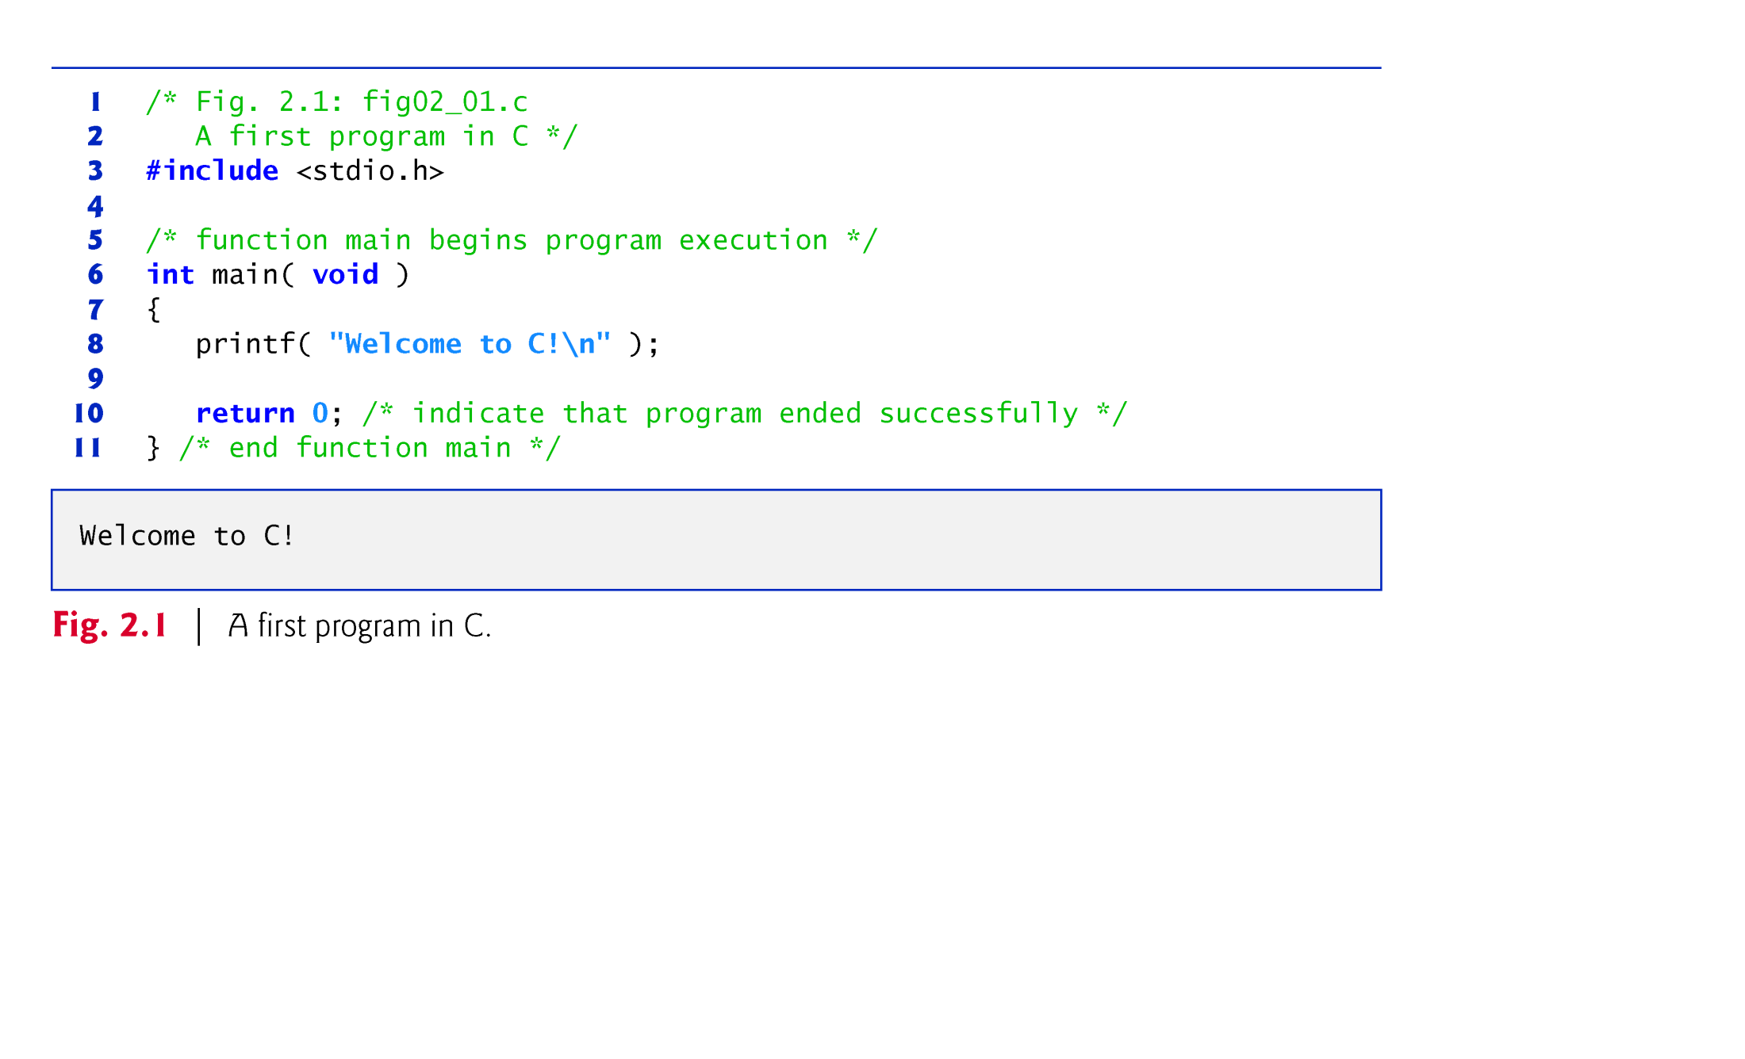

Slide 2
2.2 A Simple C Program: Printing a Line of Text (Cont.)
Lines 1 and 2
/* Fig. 2.1: fig02_01.c A first program in C */
begin with /* and end with */ indicating that these two lines are a comment.
You insert comments to document programs and improve program readability.
Comments do not cause the computer to perform any action when the program is run.

Slide 3
2.5 Arithmetic in C (Cont.)
The arithmetic operators are all binary operators.
For example, the expression 3 + 7 contains the binary operator + and the operands 3 and 7.
Integer division yields an integer result.
For example, the expression 7 / 4 evaluates to 1 and the expression 17 / 5 evaluates to 3.
C provides the remainder operator, %, which yields the remainder after integer division.
The remainder operator is an integer operator that can be used only with integer operands.
The expression x % y yields the remainder after x is divided by y.
Thus, 7 % 4 yields 3 and 17 % 5 yields 2.

Slide 4
2.2 A Simple C Program: Printing a Line of Text (Cont.)
Comments are ignored by the C compiler and do not cause any machine-language object code to be generated.
Comments also help other people read and understand your program.

Slide 5
2.2 A Simple C Program: Printing a Line of Text (Cont.)
C99 also includes the C++ language’s // single-line comments in which everything from // to the end of the line is a comment.
These can be used as standalone comments on lines by themselves or as end-of-line comments to the right of a partial line of code.
Some programmers prefer // comments because they’re shorter and they eliminate the common programming errors that occur with /* */ comments.
Line 3
#include <stdio.h>
is a directive to the C preprocessor.

Slide 6
2.2 A Simple C Program: Printing a Line of Text (Cont.)
Lines beginning with # are processed by the preprocessor before the program is compiled.
Line 3 tells the preprocessor to include the contents of the standard input/output header (<stdio.h>) in the program.
This header contains information used by the compiler when compiling calls to standard input/output library functions such as printf.
Line 6
int main( void )
is a part of every C program.
The parentheses after main indicate that main is a program building block called a function.

Slide 7
2.2 A Simple C Program: Printing a Line of Text (Cont.)
C programs contain one or more functions, one of which must be main.
Every program in C begins executing at the function main.
The keyword int to the left of main indicates that main “returns” an integer (whole number) value.
We’ll explain what it means for a function to “return a value” when we demonstrate how to create your own functions in Chapter 5.

Slide 8
2.2 A Simple C Program: Printing a Line of Text (Cont.)
For now, simply include the keyword int to the left of main in each of your programs.
Functions also can receive information when they’re called upon to execute.
The void in parentheses here means that main does not receive any information.

Slide 9
2.2 A Simple C Program: Printing a Line of Text (Cont.)
A left brace, {, begins the body of every function (line 7).
A corresponding right brace ends each function (line 11).
This pair of braces and the portion of the program between the braces is called a block.
Line 8
printf( "Welcome to C!\n" );
instructs the computer to perform an action, namely to print on the screen the string of characters marked by the quotation marks.
A string is sometimes called a character string, a message or a literal.

Slide 10
2.2 A Simple C Program: Printing a Line of Text (Cont.)
The entire line, including printf, its argument within the parentheses and the semicolon (;), is called a statement.
Every statement must end with a semicolon (also known as the statement terminator).
When the preceding printf statement is executed, it prints the message Welcome to C! on the screen.
The characters normally print exactly as they appear between the double quotes in the printf statement.
Notice that the characters \n were not printed on the screen.
The backslash (\) is called an escape character.
It indicates that printf is supposed to do something out of the ordinary.

Slide 11
2.2 A Simple C Program: Printing a Line of Text (Cont.)
When encountering a backslash in a string, the compiler looks ahead at the next character and combines it with the backslash to form an escape sequence.
The escape sequence \n means newline.
When a newline appears in the string output by a printf, the newline causes the cursor to position to the beginning of the next line on the screen.
Some common escape sequences are listed in Fig. 2.2.

Slide 12
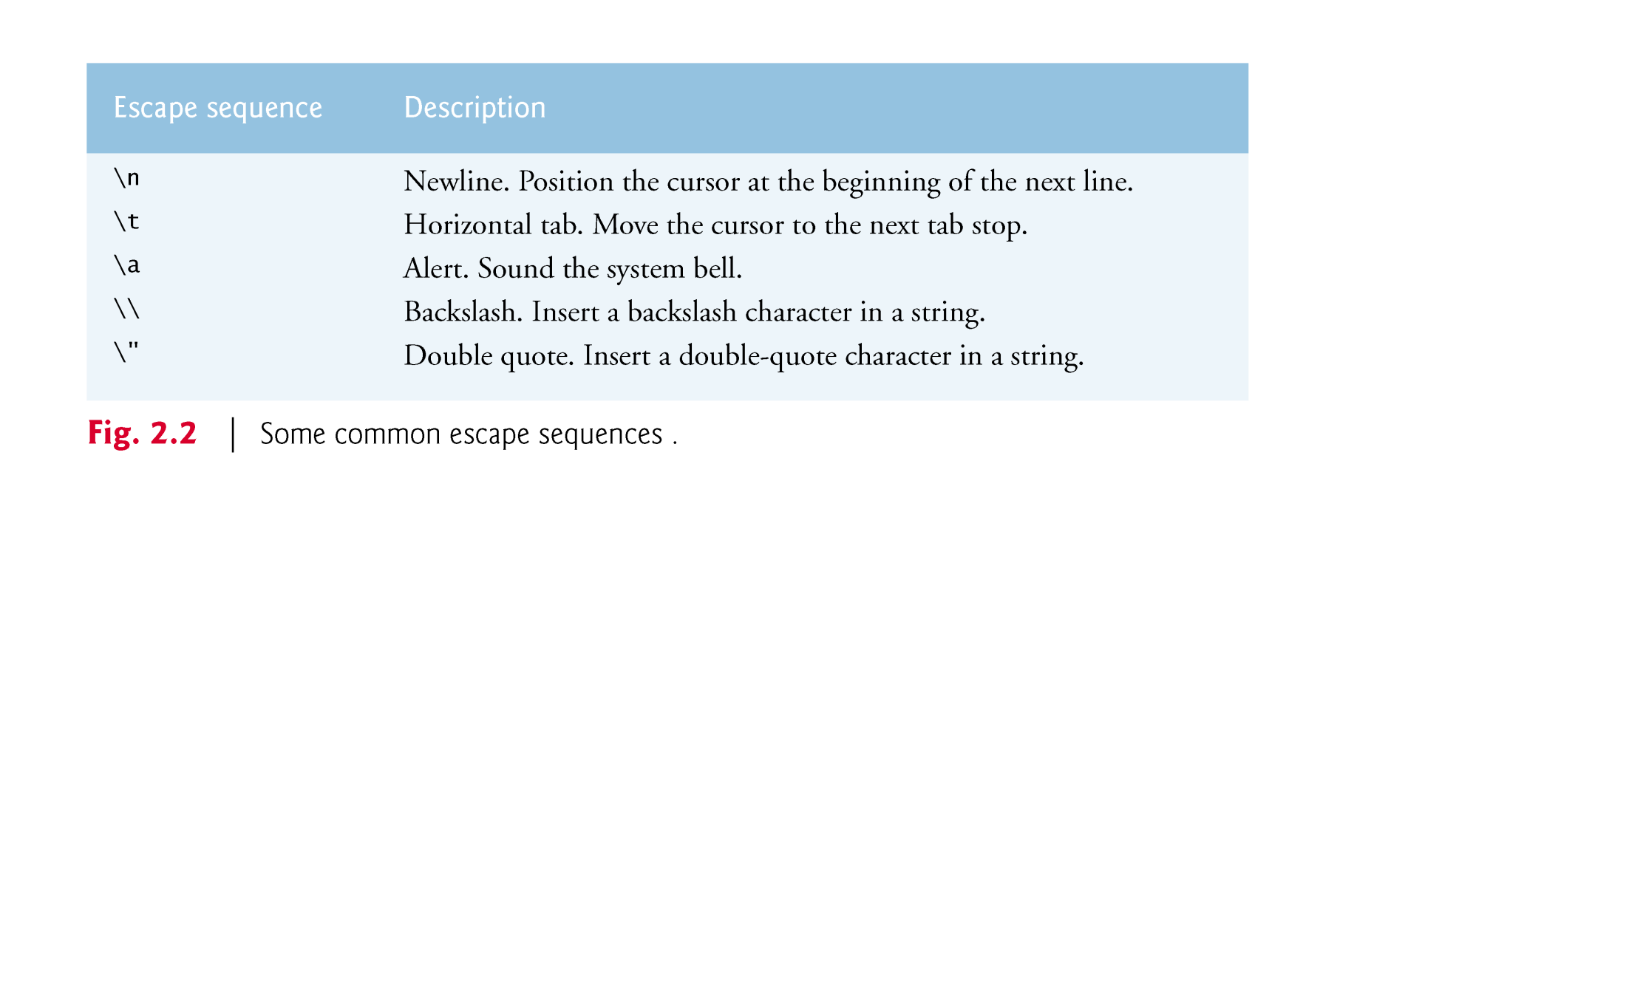

Slide 13
2.2 A Simple C Program: Printing a Line of Text (Cont.)
Because the backslash has special meaning in a string, i.e., the compiler recognizes it as an escape character, we use a double backslash (\\) to place a single backslash in a string.
Printing a double quote also presents a problem because double quotes mark the boundary of a string—such quotes are not printed.
By using the escape sequence \" in a string to be output by printf, we indicate that printf should display a double quote.

Slide 14
2.2 A Simple C Program: Printing a Line of Text (Cont.)
Line 10
return 0; /* indicate that program ended successfully */
is included at the end of every main function.
The keyword return is one of several means we’ll use to exit a function.
When the return statement is used at the end of main as shown here, the value 0 indicates that the program has terminated successfully.
The right brace, }, (line 12) indicates that the end of main has been reached.

Slide 15
2.2 A Simple C Program: Printing a Line of Text (Cont.)
The printf function can print Welcome to C! several different ways.
For example, the program of Fig. 2.3 produces the same output as the program of Fig. 2.1.
This works because each printf resumes printing where the previous printf stopped printing.
The first printf (line 8) prints Welcome followed by a space and the second printf (line 9) begins printing on the same line immediately following the space.

Slide 16
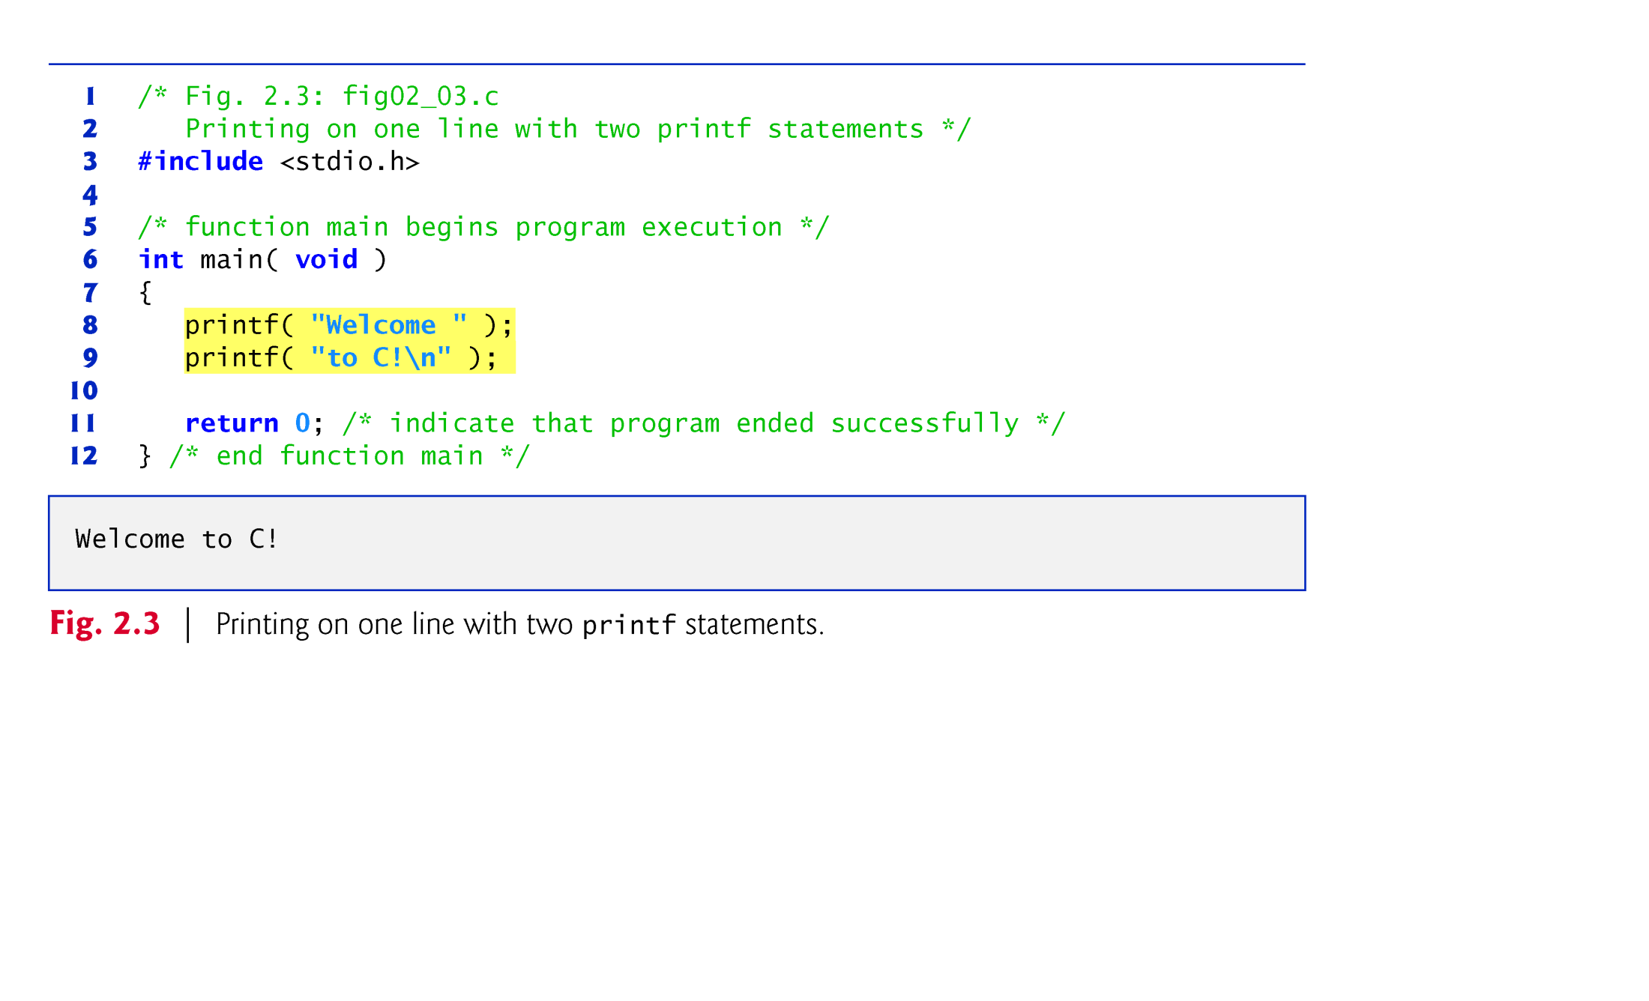

Slide 17
2.2 A Simple C Program: Printing a Line of Text (Cont.)
One printf can print several lines by using additional newline characters as in Fig. 2.4.
Each time the \n (newline) escape sequence is encountered, output continues at the beginning of the next line.

Slide 18
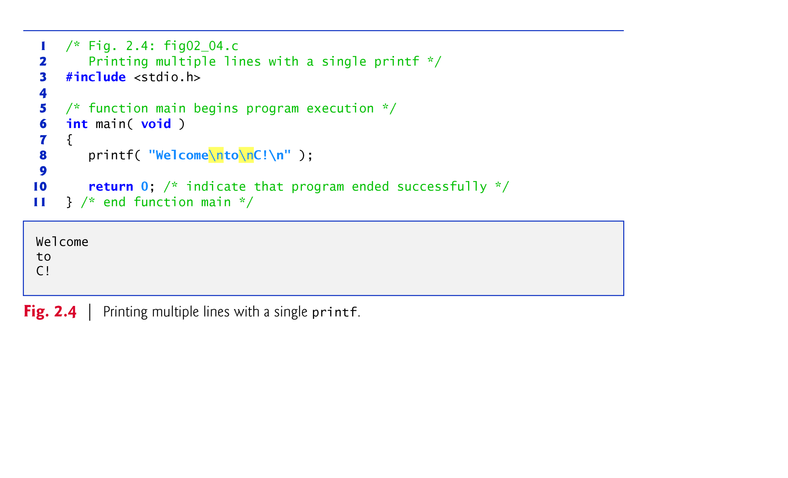

Slide 19
2.3 Another Simple C Program: Adding Two Integers
Our next program (fig. 3.8) uses the Standard Library function scanf to obtain two integers typed by a user at the keyboard, computes the sum of these values and prints the result using printf.
[In the input/output dialog of Fig. 2.8, we emphasize the numbers input by the user in bold.]

Slide 20
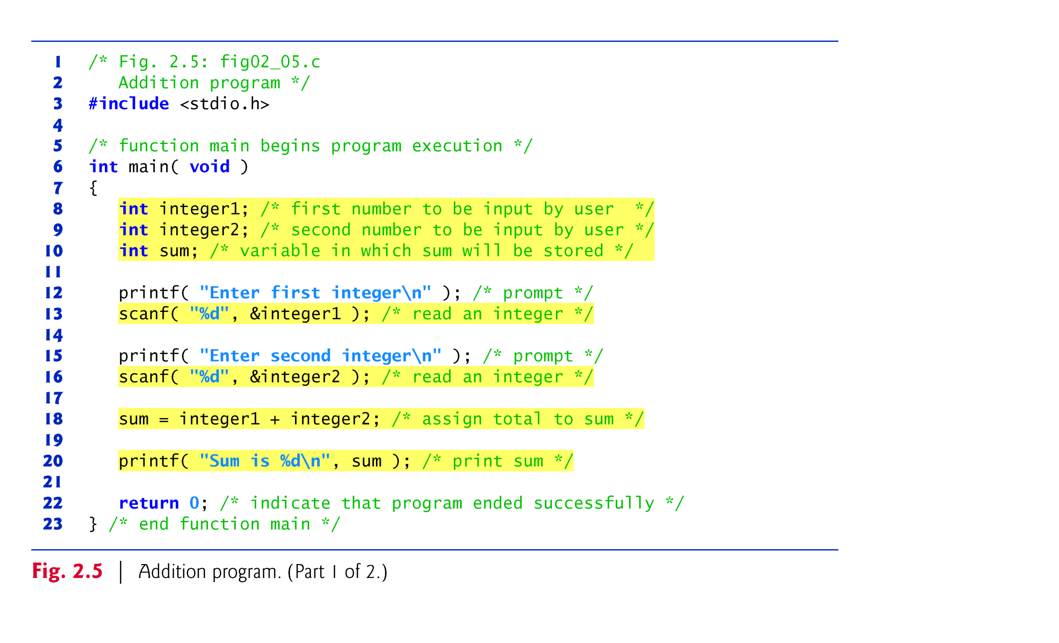

Slide 21
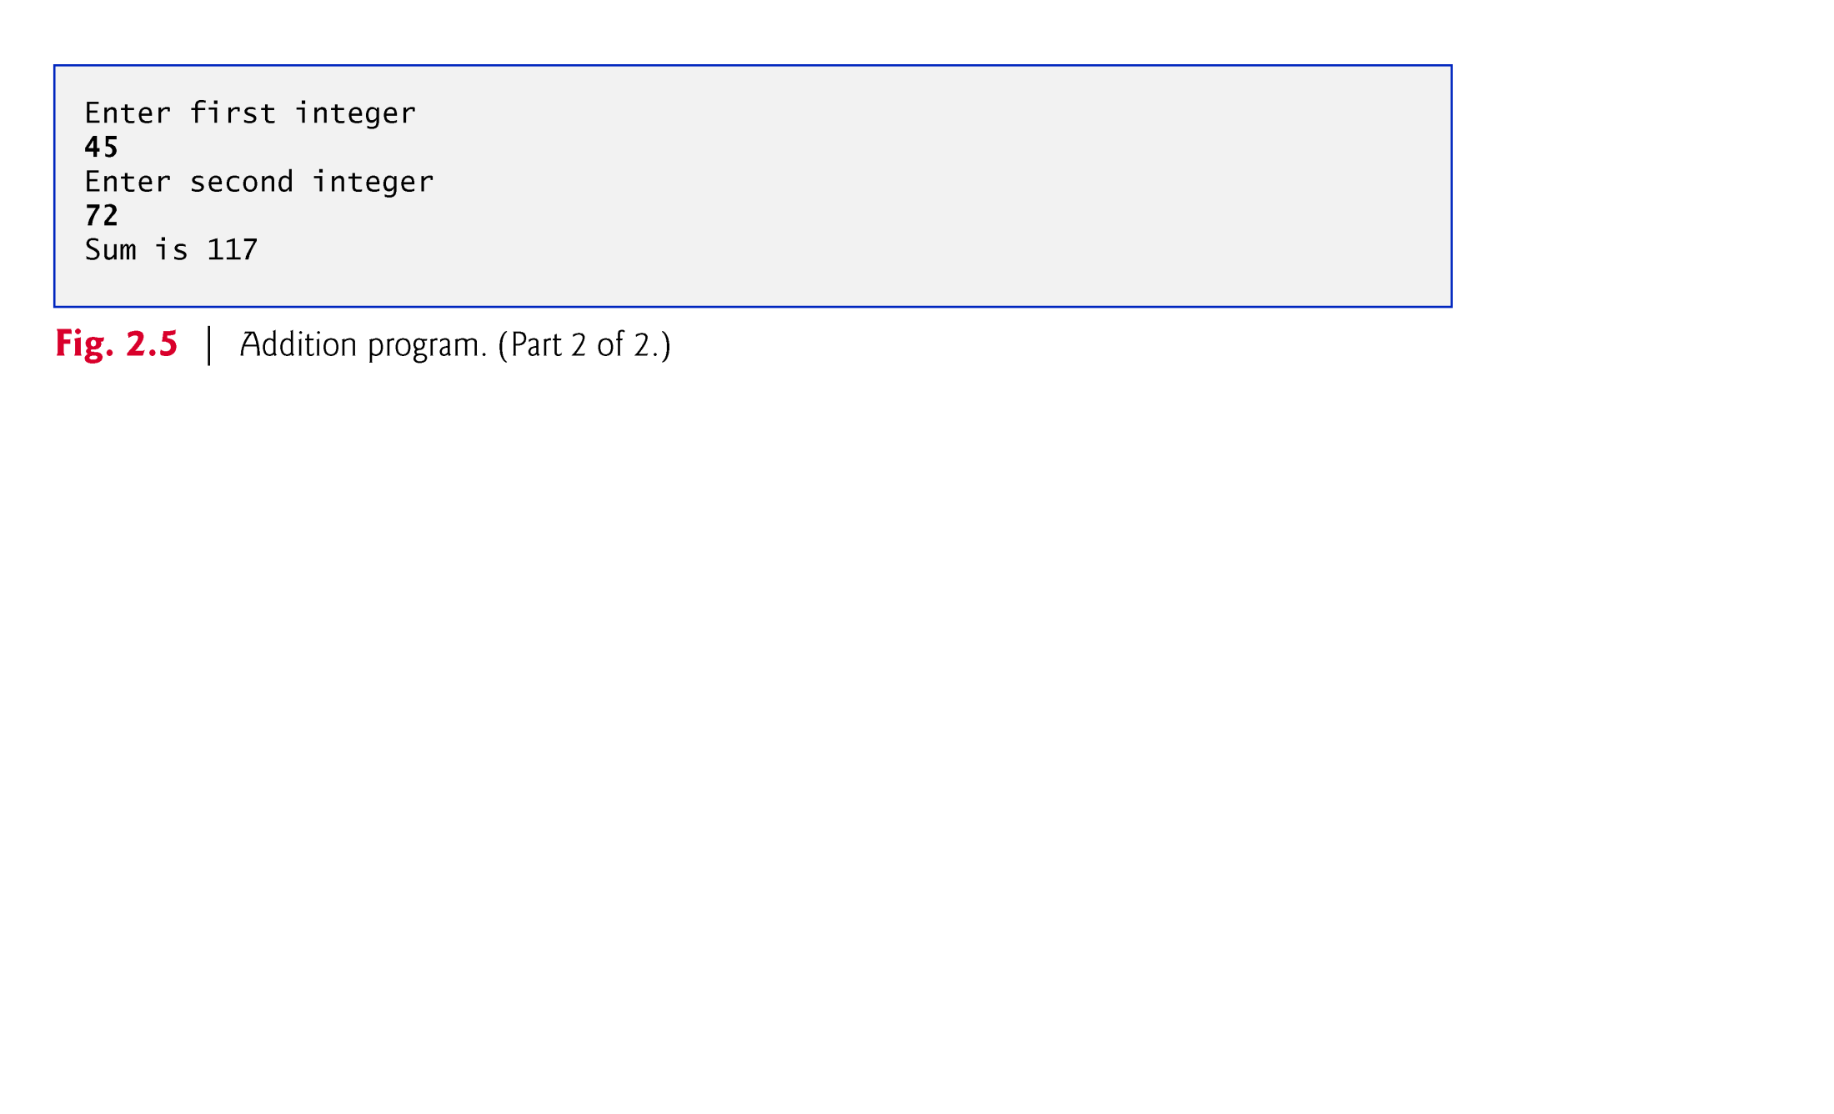

Slide 22
2.3 Another Simple C Program: Adding Two Integers (Cont.)
Lines 8–10
int integer1; /* first number to be input by user */ int integer2; /* second number to be input by user */ int sum; /* variable in which sum will be stored */
are definitions.
The names integer1, integer2 and sum are the names of variables.
A variable is a location in memory where a value can be stored for use by a program.
These definitions specify that the variables integer1, integer2 and sum are of type int, which means that these variables will hold integer values, i.e., whole numbers such as 7, –11, 0, 31914 and the like.

Slide 23
2.3 Another Simple C Program: Adding Two Integers (Cont.)
All variables must be defined with a name and a data type immediately after the left brace that begins the body of main before they can be used in a program.
The preceding definitions could have been combined into a single definition statement as follows:
int integer1, integer2, sum;
but that would have made it difficult to describe the variables in corresponding comments as we did in lines 8–10.
A variable name in C is any valid identifier.
An identifier is a series of characters consisting of letters, digits and underscores (_) that does not begin with a digit.

Slide 24
2.3 Another Simple C Program: Adding Two Integers (Cont.)
An identifier can be of any length, but only the first 31 characters are required to be recognized by C compilers according to the C standard.
C is case sensitive—uppercase and lowercase letters are different in C, so a1 and A1 are different identifiers.

Slide 25
2.3 Another Simple C Program: Adding Two Integers (Cont.)
Line 12
printf( "Enter first integer\n" ); /* prompt */
prints the literal Enter first integer on the screen and positions the cursor to the beginning of the next line.
This message is called a prompt because it tells the user to take a specific action.
The next statement
scanf( "%d", &integer1 ); /* read an integer */
uses scanf to obtain a value from the user.
The scanf function reads from the standard input, which is usually the keyboard.

Slide 26
2.3 Another Simple C Program: Adding Two Integers (Cont.)
This scanf has two arguments, "%d" and &integer1.
The first argument, the format control string, indicates the type of data that should be input by the user.
The %d conversion specifier indicates that the data should be an integer (the letter d stands for “decimal integer”).
The % in this context is treated by scanf (and printf as we’ll see) as a special character that begins a conversion specifier.
The second argument of scanf begins with an ampersand (&)—called the address operator in C—followed by the variable name.

Slide 27
2.3 Another Simple C Program: Adding Two Integers (Cont.)
The ampersand, when combined with the variable name, tells scanf the location (or address) in memory at which the variable integer1 is stored.
The computer then stores the value for integer1 at that location.
The use of ampersand (&) is often confusing to novice programmers or to people who have programmed in other languages that do not require this notation.
For now, just remember to precede each variable in every call to scanf with an ampersand.

Slide 28
2.3 Another Simple C Program: Adding Two Integers (Cont.)
When the computer executes the preceding scanf, it waits for the user to enter a value for variable integer1.
The user responds by typing an integer, then pressing the Enter key to send the number to the computer.
The computer then assigns this number, or value, to the variable integer1.
Any subsequent references to integer1 in this program will use this same value.
Functions printf and scanf facilitate interaction between the user and the computer.
Because this interaction resembles a dialogue, it is often called conversational computing or interactive computing.

Slide 29
2.3 Another Simple C Program: Adding Two Integers (Cont.)
Line 20
printf( "Sum is %d\n", sum ); /* print sum */
calls function printf to print the literal Sum is followed by the numerical value of variable sum on the screen.
This printf has two arguments, "Sum is %d\n" and sum.
The first argument is the format control string.
It contains some literal characters to be displayed, and it contains the conversion specifier %d indicating that an integer will be printed.
The second argument specifies the value to be printed.
Notice that the conversion specifier for an integer is the same in both printf and scanf.

Slide 30
2.3 Another Simple C Program: Adding Two Integers (Cont.)
We could have combined the previous two statements into the statement
printf( "Sum is %d\n", integer1 + integer2 );
Line 22
return 0; /* indicate that program ended successfully */
passes the value 0 back to the operating-system environment in which the program is being executed.
This value indicates to the operating system that the program executed successfully.
For information on how to report a program failure, see the manuals for your particular operating-system environment.
The right brace, }, at line 24 indicates that the end of function main has been reached.

Slide 31
2.3 Another Simple C Program: Adding Two Integers (Cont.)
Line 15
printf( "Enter second integer\n" ); /* prompt */
displays the message Enter second integer on the screen, then positions the cursor to the beginning of the next line.
This printf also prompts the user to take action.
The statement
scanf( "%d", &integer2 ); /* read an integer */
obtains a value for variable integer2 from the user.

Slide 32
2.3 Another Simple C Program: Adding Two Integers (Cont.)
The assignment statement in line 18
sum = integer1 + integer2; /* assign total to sum */
calculates the sum of variables integer1 and integer2 and assigns the result to variable sum using the assignment operator =.
The statement is read as, “sum gets the value of integer1 + integer2.” Most calculations are performed in assignments.
The = operator and the + operator are called binary operators because each has two operands.
The + operator’s two operands are integer1 and integer2.
The = operator’s two operands are sum and the value of the expression integer1 + integer2.

Slide 33
2.4 Memory Concepts
Variable names such as integer1, integer2 and sum actually correspond to locations in the computer’s memory.
Every variable has a name, a type and a value.
In the addition program of Fig. 2.5, when the statement (line 13)
scanf( "%d", &integer1 ); /* read an integer */
is executed, the value typed by the user is placed into a memory location to which the name integer1 has been assigned.
Suppose the user enters the number 45 as the value for integer1.
The computer will place 45 into location integer1 as shown in Fig. 2.6.

Slide 34
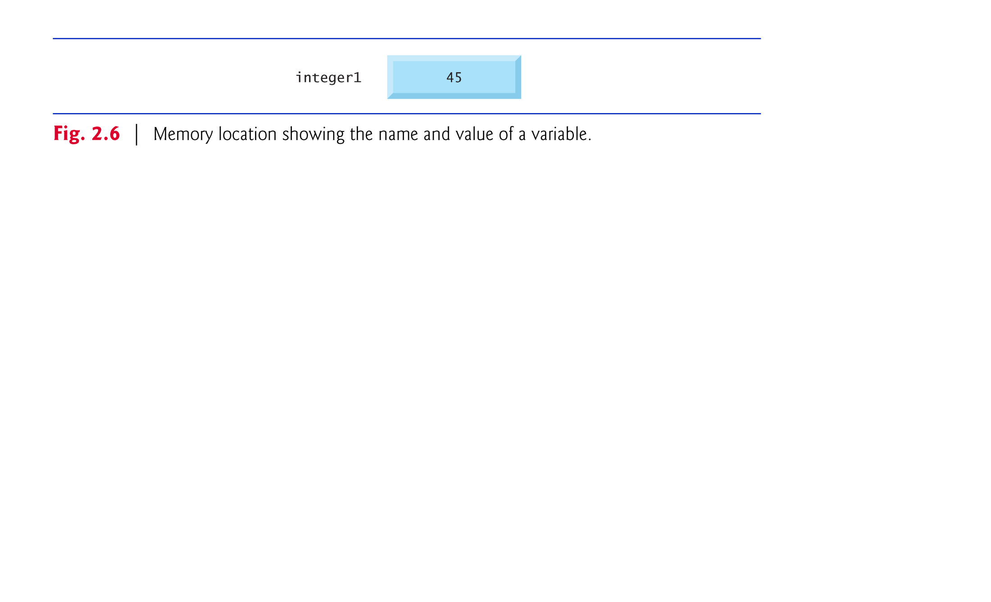

Slide 35
2.4 Memory Concepts (Cont.)
Whenever a value is placed in a memory location, the value replaces the previous value in that location; thus, placing a new value into a memory location is said to be destructive.
Returning to our addition program again, when the statement (line 16)
scanf( "%d", &integer2 ); /* read an integer */
executes, suppose the user enters the value 72.
This value is placed into location integer2, and memory appears as in Fig. 2.7.
These locations are not necessarily adjacent in memory.

Slide 36
2.4 Memory Concepts (Cont.)
Once the program has obtained values for integer1 and integer2, it adds these values and places the sum into variable sum.
The statement (line 18)
sum = integer1 + integer2; /* assign total to sum */
that performs the addition also replaces whatever value was stored in sum.

Slide 37
2.4 Memory Concepts (Cont.)
This occurs when the calculated sum of integer1 and integer2 is placed into location sum (destroying the value already in sum).
After sum is calculated, memory appears as in Fig. 2.8.
The values of integer1 and integer2 appear exactly as they did before they were used in the calculation.

Slide 38
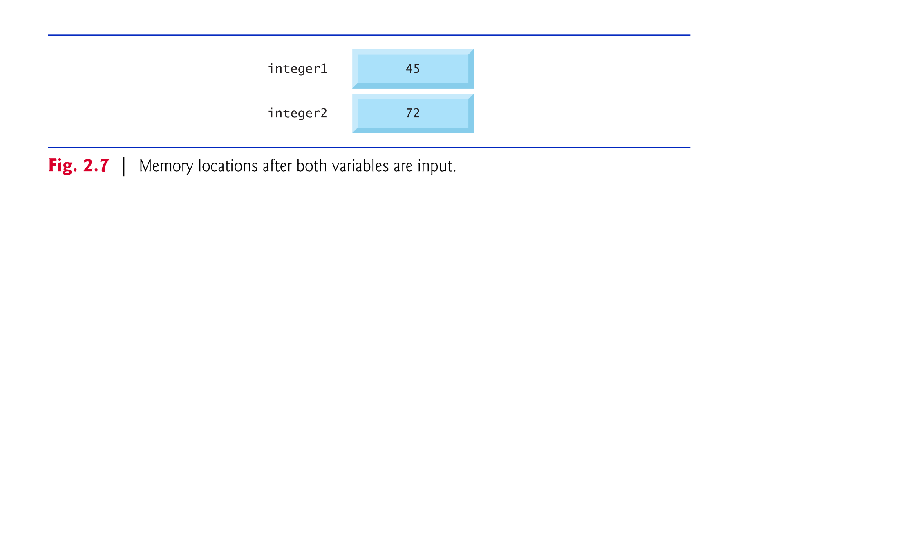

Slide 39
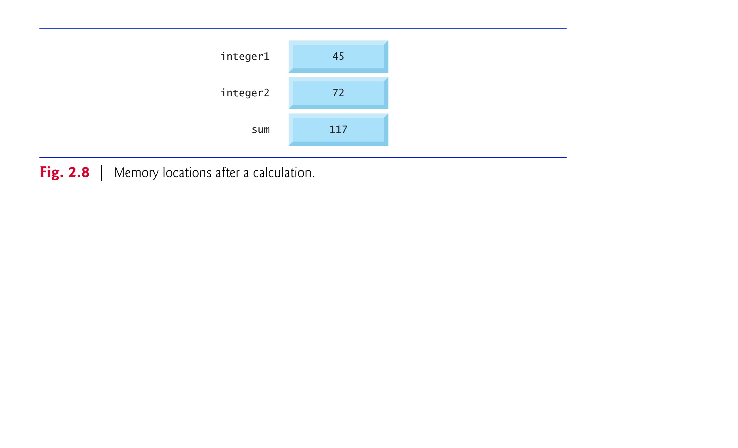

Slide 40
2.4 Memory Concepts (Cont.)
They were used, but not destroyed, as the computer performed the calculation.
Thus, when a value is read from a memory location, the process is said to be nondestructive.

Slide 41
2.5 Arithmetic in C (Cont.)
Arithmetic expressions in C must be written in straight-line form to facilitate entering programs into the computer.
Thus, expressions such as “a divided by b” must be written as a/b so that all operators and operands appear in a straight line.
The algebraic notation
is generally not acceptable to compilers, although some special-purpose software packages do support more natural notation for complex mathematical expressions.

Slide 42
2.5 Arithmetic in C (Cont.)
Parentheses are used in C expressions in the same manner as in algebraic expressions.
For example, to multiply a times the quantity b + c we write a * ( b + c ).

Slide 43
2.5 Arithmetic in C (Cont.)
C applies the operators in arithmetic expressions in a precise sequence determined by the following rules of operator precedence, which are generally the same as those in algebra:
Operators in expressions contained within pairs of parentheses are evaluated first. Thus, parentheses may be used to force the order of evaluation to occur in any sequence you desire. Parentheses are said to be at the “highest level of precedence.” In cases of nested, or embedded, parentheses, such as
( ( a + b ) + c )
the operators in the innermost pair of parentheses are applied first.

Slide 44
2.5 Arithmetic in C (Cont.)
Multiplication, division and remainder operations are applied first. If an expression contains several multiplication, division and remainder operations, evaluation proceeds from left to right. Multiplication, division and remainder are said to be on the same level of precedence.
Addition and subtraction operations are evaluated next. If an expression contains several addition and subtraction operations, evaluation proceeds from left to right. Addition and subtraction also have the same level of precedence, which is lower than the precedence of the multiplication, division and remainder operations.

Slide 45
2.5 Arithmetic in C (Cont.)
The rules of operator precedence specify the order C uses to evaluate expressions. When we say evaluation proceeds from left to right, we’re referring to the associativity of the operators.
We’ll see that some operators associate from right to left.
Figure 2.10 summarizes these rules of operator precedence.

Slide 46
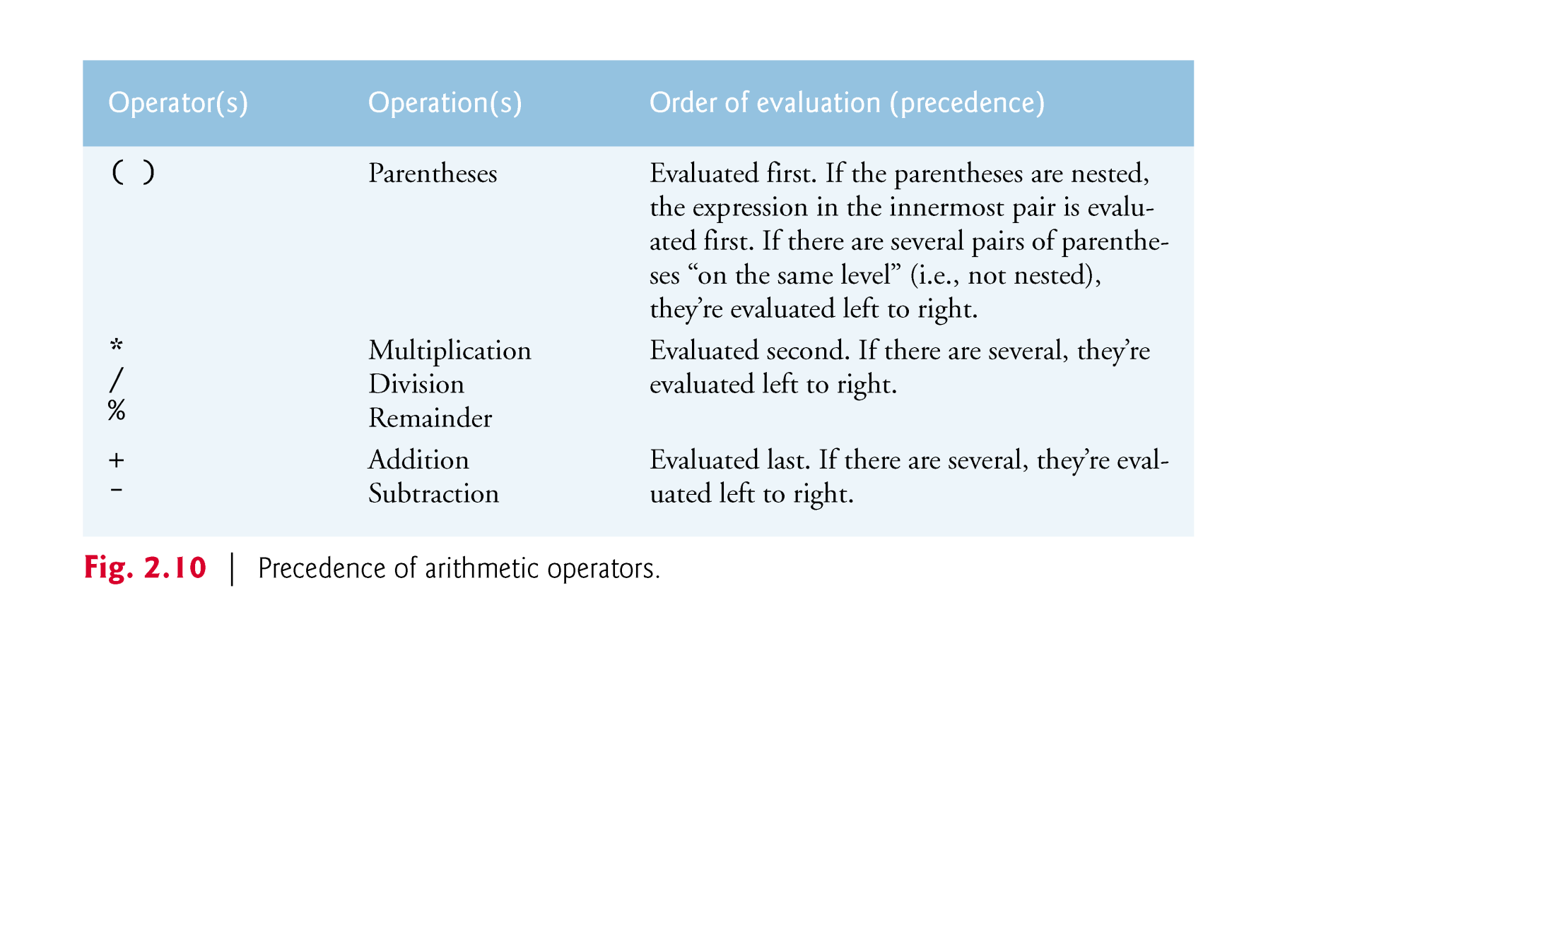

Slide 47
2.5 Arithmetic in C (Cont.)
Figure 2.11 illustrates the order in which the operators are applied.

Slide 48
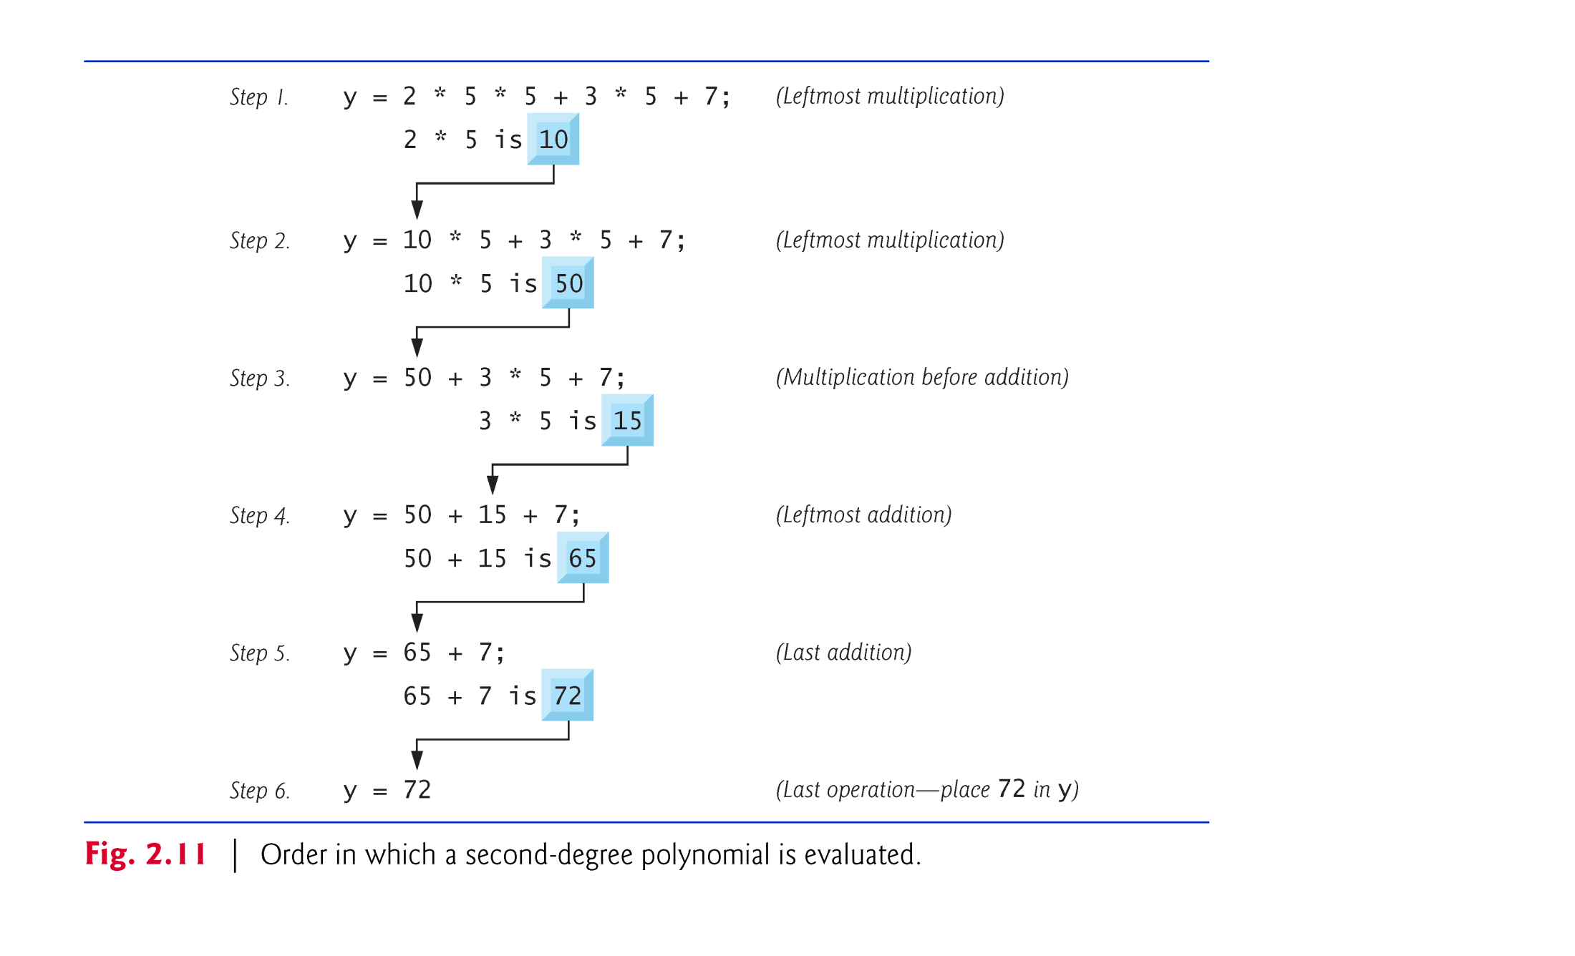

Slide 49
2.5 Arithmetic in C (Cont.)
As in algebra, it is acceptable to place unnecessary parentheses in an expression to make the expression clearer.
These are called redundant parentheses.

Slide 50
Decision making structures require that the programmer specifies one or more conditions to be evaluated or tested by the program, along with a statement or statements to be executed if the condition is determined to be true, and optionally, other statements to be executed if the condition is determined to be false.
Show below is the general form of a typical decision making structure found in most of the programming languages −

Slide 51
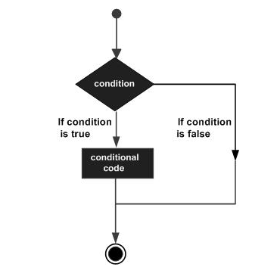
Decision Making:

Slide 52
Decision Making:
C programming language assumes any non-zero and non-null values as true, and if it is either zero or null, then it is assumed as false value.
C programming language provides the following types of decision making statements.
Sr.No.Statement & Description
if statementAn if statement consists of a boolean expression followed by one or more statements.
if...else statementAn if statement can be followed by an optional else statement, which executes when the Boolean expression is false.
nested if statementsYou can use one if or else if statement inside another if or else ifstatement(s).
switch statementA switch statement allows a variable to be tested for equality against a list of values.
nested switch statementsYou can use one switch statement inside another switchstatement(s).

Slide 53
2.6 Decision Making: Equality and Relational Operators
Executable C statements either perform actions (such as calculations or input or output of data) or make decisions (we’ll soon see several examples of these).
We might make a decision in a program, for example, to determine if a person’s grade on an exam is greater than or equal to 60 and if it is to print the message “Congratulations! You passed.”
This section introduces a simple version of C’s if statement that allows a program to make a decision based on the truth or falsity of a statement of fact called a condition.

Slide 54
2.6 Arithmetic in C (Cont.)
If the condition is met (i.e., the condition is true) the statement in the body of the if statement is executed.
If the condition is not met (i.e., the condition is false) the body statement is not executed.
Whether the body statement is executed or not, after the if statement completes, execution proceeds with the next statement after the if statement.
Conditions in if statements are formed by using the equality operators and relational operators summarized in Fig. 2.12.

Slide 55
2.6 Arithmetic in C (Cont.)
The relational operators all have the same level of precedence and they associate left to right.
The equality operators have a lower level of precedence than the relational operators and they also associate left to right.
In C, a condition may actually be any expression that generates a zero (false) or nonzero (true) value.

Slide 56
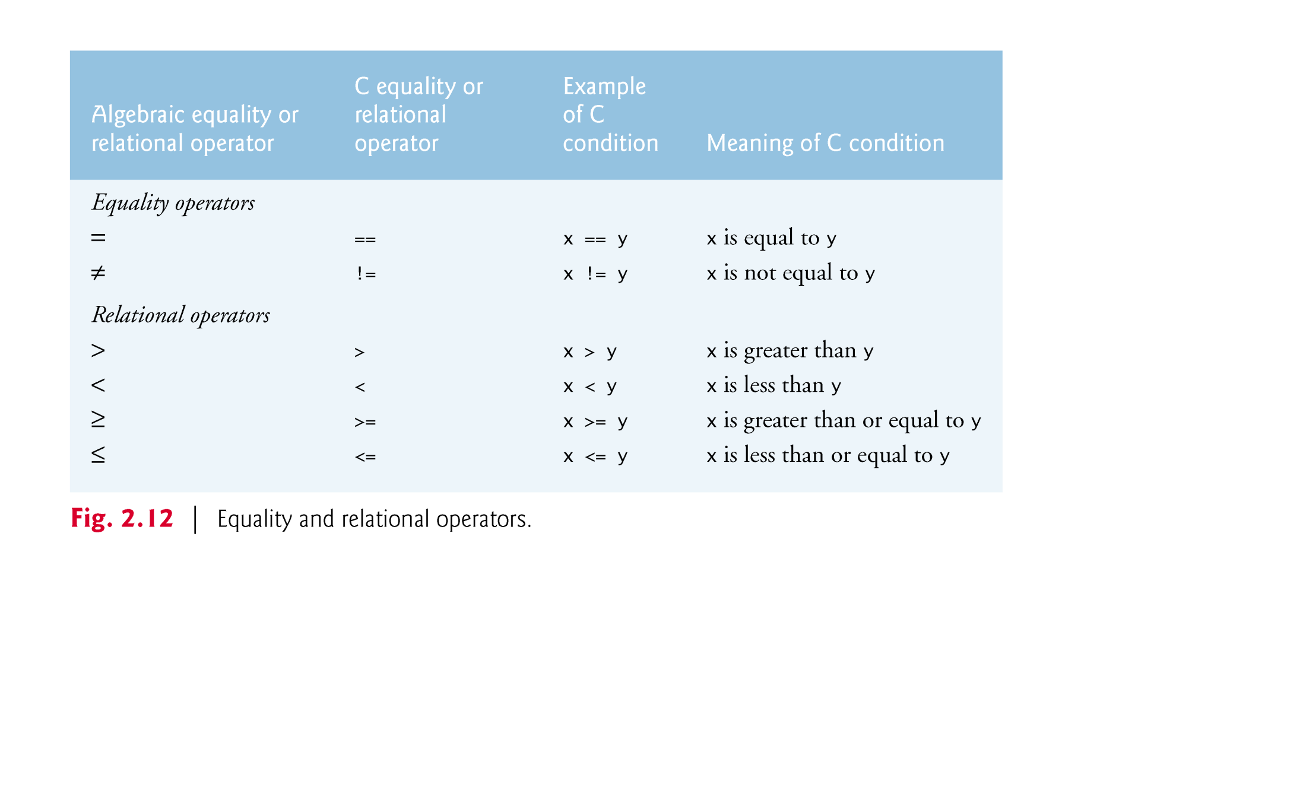

Slide 57
2.6 Arithmetic in C (Cont.)
Figure 2.13 uses six if statements to compare two numbers input by the user.
If the condition in any of these if statements is true, the printf statement associated with that if executes.

Slide 58
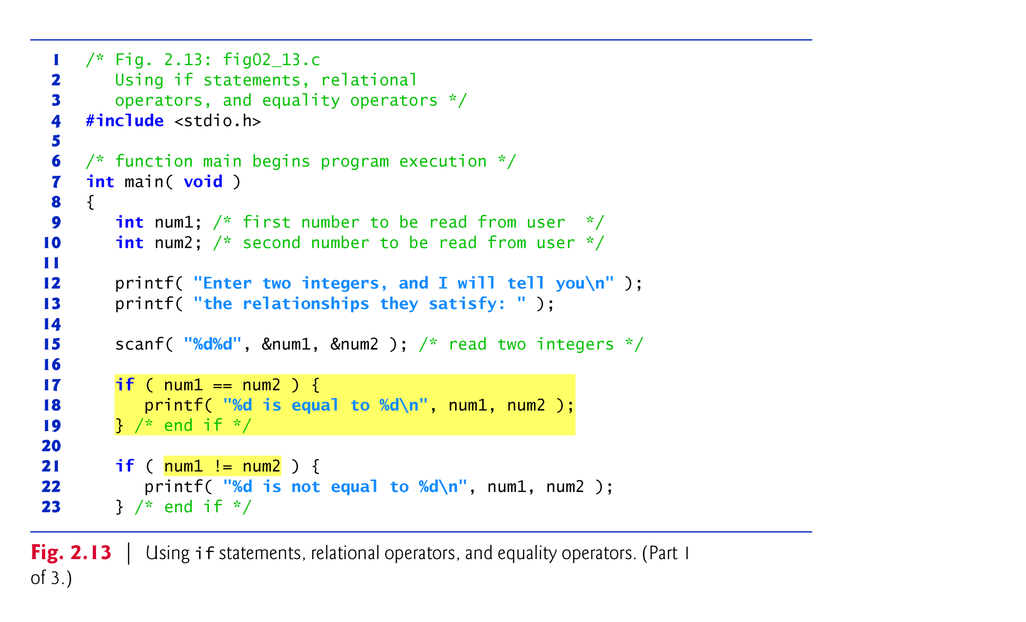

Slide 59
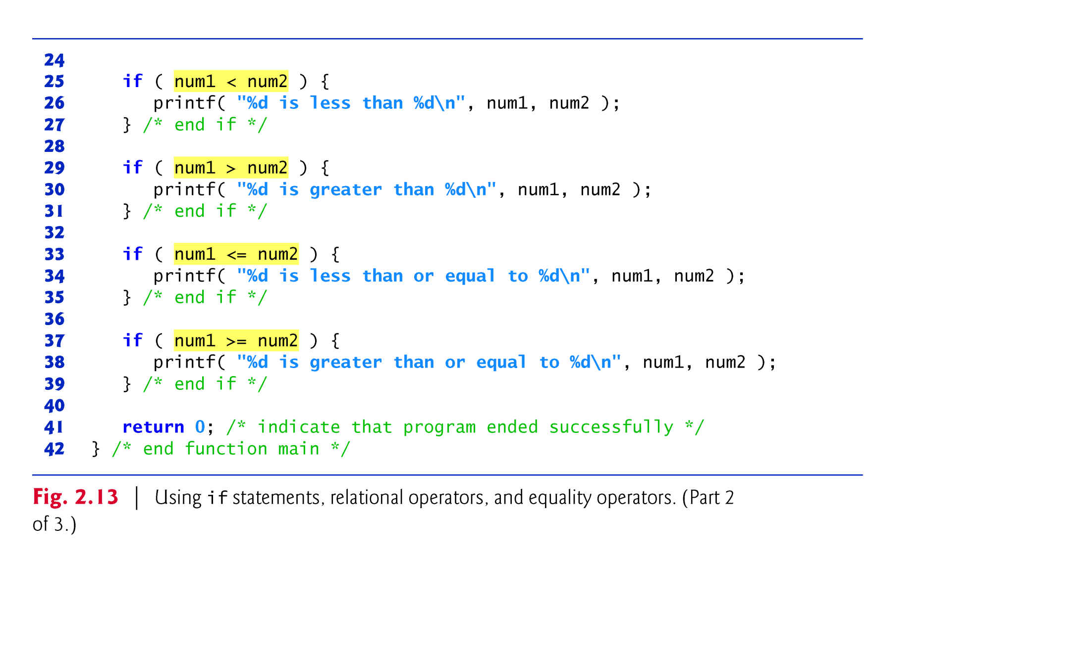

Slide 60
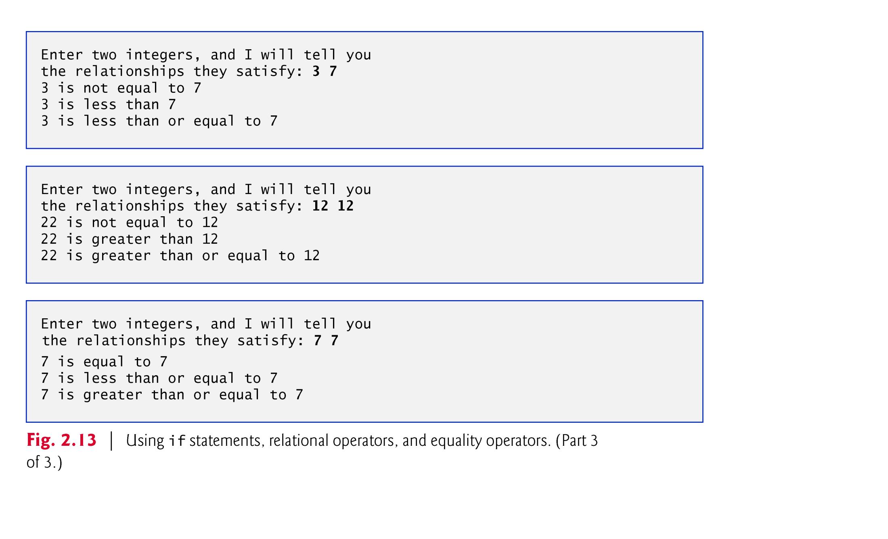

Slide 61
2.6 Arithmetic in C (Cont.)
The program uses scanf (line 15) to input two numbers.
Each conversion specifier has a corresponding argument in which a value will be stored.
The first %d converts a value to be stored in variable num1, and the second %d converts a value to be stored in variable num2.
Indenting the body of each if statement and placing blank lines above and below each if statement enhances program readability.

Slide 62
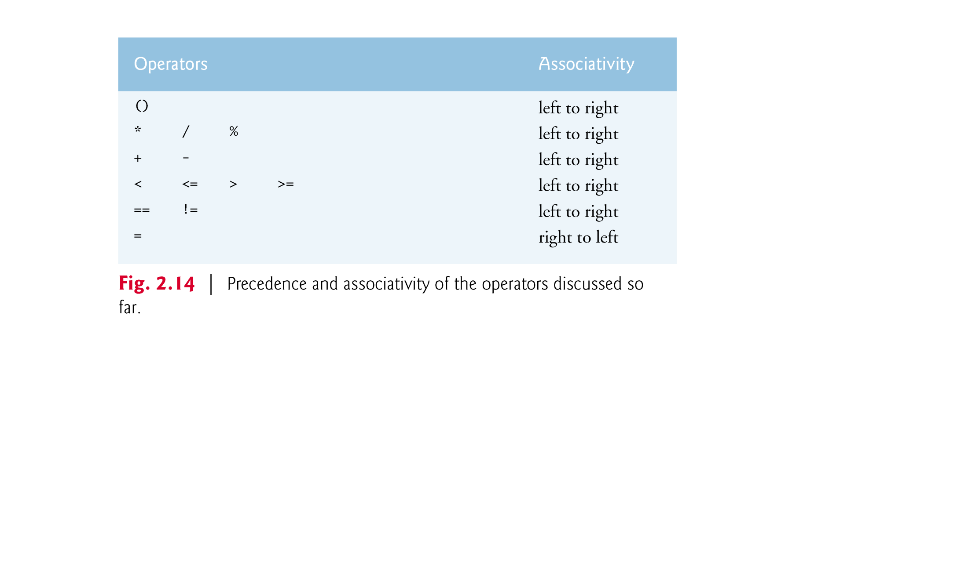

Slide 63
C - Loops
You may encounter situations, when a block of code needs to be executed several number of times. In general, statements are executed sequentially: The first statement in a function is executed first, followed by the second, and so on.
Programming languages provide various control structures that allow for more complicated execution paths.
A loop statement allows us to execute a statement or group of statements multiple times. Given below is the general form of a loop statement in most of the programming languages −

Slide 64
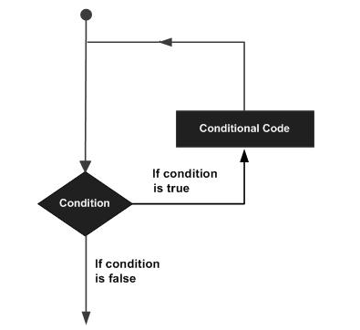
C - Loops

Slide 65
C - Loops
C programming language provides the following types of loops to handle looping requirements.
Loop Type & Description
while loopRepeats a statement or group of statements while a given condition is true. It tests the condition before executing the loop body.
for loopExecutes a sequence of statements multiple times and abbreviates the code that manages the loop variable.
do...while loopIt is more like a while statement, except that it tests the condition at the end of the loop body.
nested loopsYou can use one or more loops inside any other while, for, or do..while loop.

Slide 66
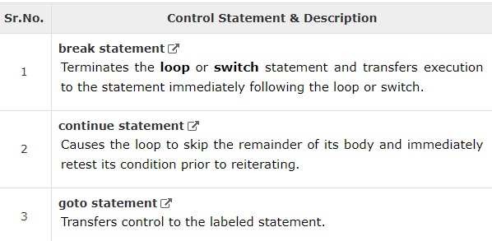
Loop Control Statements
Loop control statements change execution from its normal sequence. When execution leaves a scope, all automatic objects that were created in that scope are destroyed.
C supports the following control statements.

Slide 67
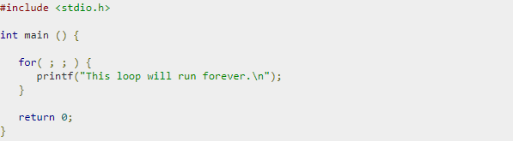
The Infinite Loop
A loop becomes an infinite loop if a condition never becomes false. The for loop is traditionally used for this purpose. Since none of the three expressions that form the 'for' loop are required, you can make an endless loop by leaving the conditional expression empty.
When the conditional expression is absent, it is assumed to be true. You may have an initialization and increment expression, but C programmers more commonly use the for(;;) construct to signify an infinite loop.
NOTE − You can terminate an infinite loop by pressing Ctrl + C keys.

Slide 68
Strings
Strings are actually one-dimensional array of characters terminated by a nullcharacter '\0'. Thus a null-terminated string contains the characters that comprise the string followed by a null.
The following declaration and initialization create a string consisting of the word "Hello". To hold the null character at the end of the array, the size of the character array containing the string is one more than the number of characters in the word "Hello.“
char greeting[6] = {'H', 'e', 'l', 'l', 'o', '\0'};

Slide 69
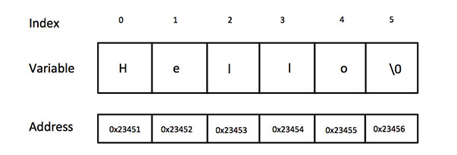
Strings
Following is the memory presentation of the above defined string in C/C++ −
Actually, you do not place the null character at the end of a string constant. The C compiler automatically places the '\0' at the end of the string when it initializes the array.

Slide 70
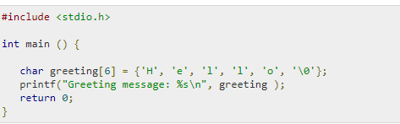
Let us try to print the above mentioned string −
When the above code is compiled and executed, it produces the following result −
Greeting message: Hello

