Slide 1
ONEIRIC COIN (Cryptocurrency Powered by Blockchain)
Group 44

Slide 2
Our Team
Harsh Mody
69
Harsh Parikh
79
Neeraj Patil
84

Slide 3
SURVEY OF EXISTING FINANCIAL SYSTEM
Currently most of the digital transactions in India utilize some mode of payment which goes through some centralized servers of banks.
It is not a very safe method since despite safe measure implemented by the banks, many hackers are able to get access to this servers which contain crucial financial information about millions of customers.
Hence cryptocurrencies become an good alternate way of making secure payments because of being decentralized and not being owned by a single entity. They become an obvious secure choice .
Traditional banking system require a lot of infrastructure and maintenance in form of ATMs, employees, etc. These cryptocurrencies avoid these charges totally.

Slide 4

PROBLEM STATEMENT

Slide 5
TECHSTACK
REACT JS
NODE JS
EXPRESS JS
We will be using React JS libraries for the frontend of the system.
Node.js is an cross-platform, back-end JavaScript runtime environment that executes JavaScript code outside a web browser.
Express is a minimal and flexible Node.js web application framework that provides a robust set of features for web and mobile applications.

Slide 6
BUSINESS MODEL
It is a Peer to Peer (P2P) business model in which a peer who wants to buy/transfer or sell cryptocurrency can directly buy/transfer or sell from another peer.
The business will make profit by taking haircut fee on the transactions for providing the above service.

Slide 7

COST EFFECTIVENESS
The cryptocurrencies have single valuation globally, and the transaction fee is extremely low, being as low as 1% of the transaction amount.
Cryptocurrencies eliminate third party clearinghouses or gateways, cutting down the costs and time delay. All the transactions over cryptocurrency platforms, whether domestic or international, are equal.

Slide 8
CRYPTOGRAPHY
HASHING
AUTHENTICATION
SHA-256
DIGITAL SIGNATURE
WITH RSA

Slide 9
Societal Impact
RELIABLE
CORRUPTION REMOVAL
DECENTRALISED SYSTEM
EASY TRANSACTIONS

Slide 10
HOW WILL WE PROCEED
BLOCKCHAIN
PROOF OF
WORK
API AND
NETWORK
WALLET AND KEYS
TRANSACTION POOL
MINE TRANSACTION

Slide 11
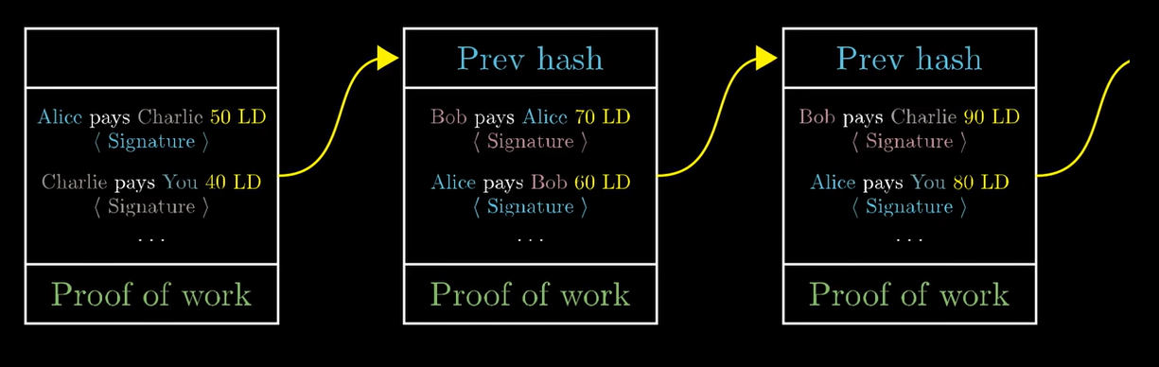

Slide 12
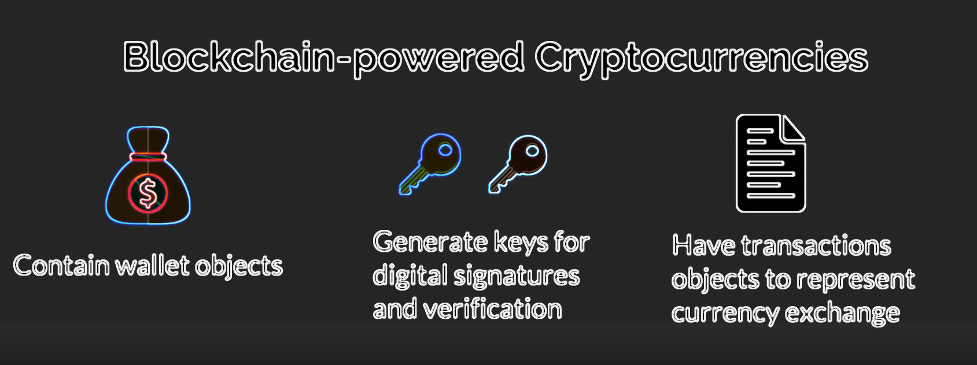

Slide 13
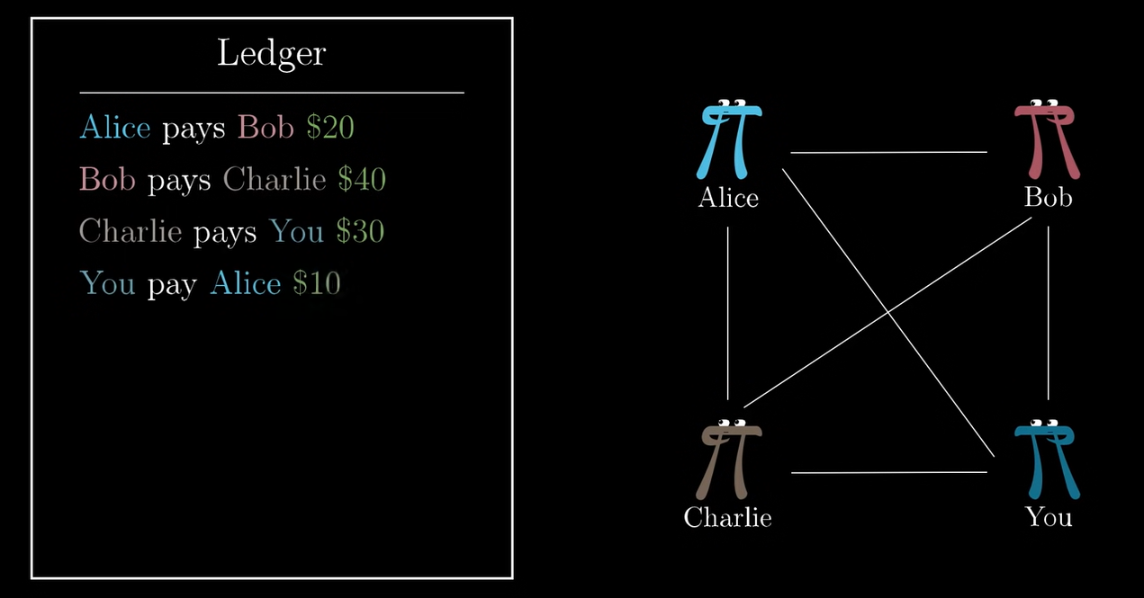
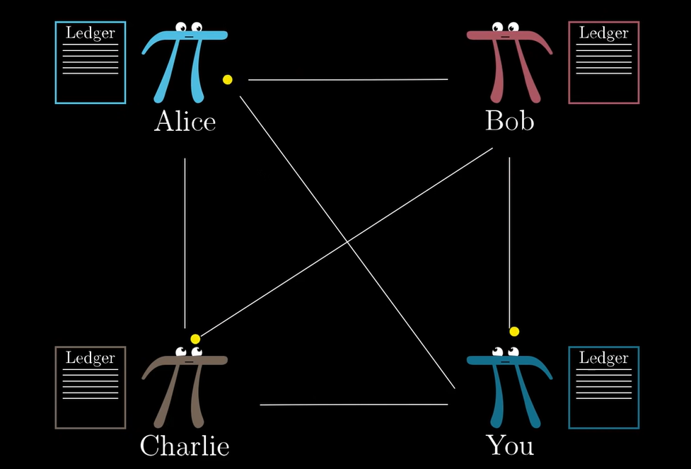

Slide 14
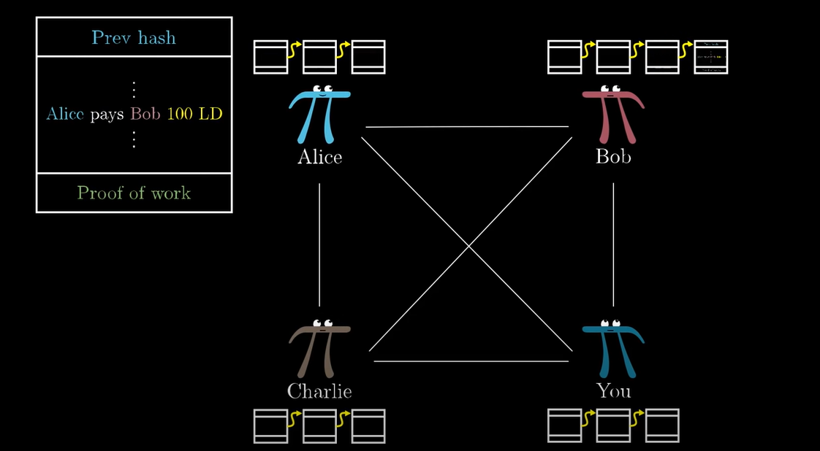

Slide 15
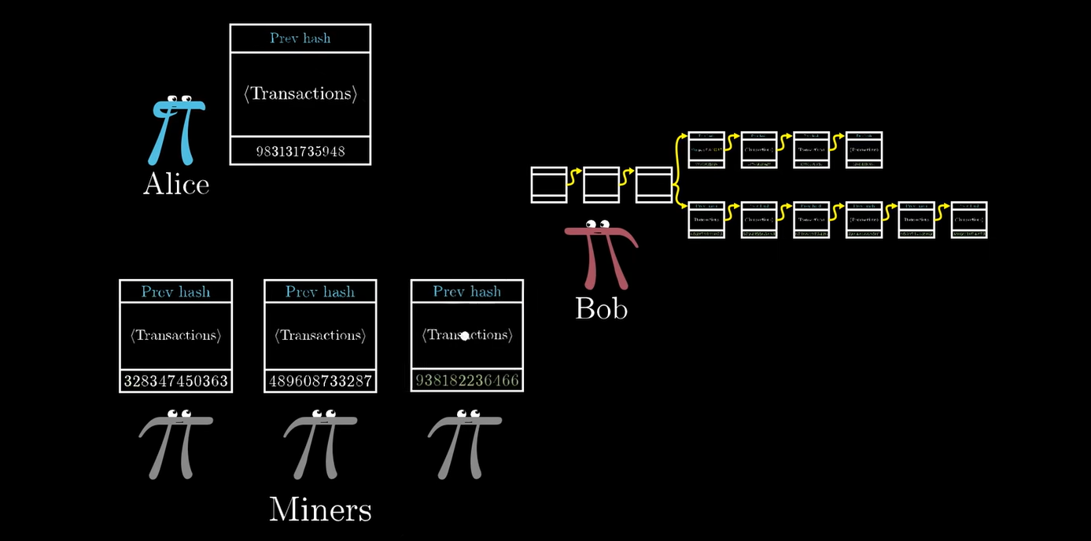

Slide 16
IMPLEMENTATION
Now we would be Demonstrating the app and explaining the features alongside in detail

Slide 17
FUTURE SCOPE
Payment Gateway
Make proof of work transaction eco friendly
Robust Algo so that POW works faster

Slide 18


