Slide 1

NexusFlow
Enterprise Project & Team Collaboration Platform
PRESENTED BY
Harsh Mishra
ENROLLMENT NO.
04613702025
GUIDED BY
Linux Mantra
Notes:
Introduce yourself, the project name, and the one-line pitch: NexusFlow is a full-stack enterprise project and task collaboration platform built solo, end to end. Mention the guide's name and thank the mentor for their time before moving to the problem statement.

Slide 2


THE PROBLEM
Why NexusFlow Was Built
Existing System Problems
Why NexusFlow
Tools scattered across chat, sheets, and docs
One workspace, one workflow
No single source of truth for project status
Projects, tasks, and discussion in a single system
Tasks assigned with no follow-through
Every notification is actionable
Assignment ends at a message — no defined next step
Clicking one opens the exact task it's about
Notifications are dead-ends
A defined task lifecycle
An alert with nowhere to click and nothing to act on
Assign → Accept → Clarify → Update → Complete
No audit trail
Built-in accountability
Who changed what, and when, is impossible to reconstruct
A real activity timeline for every task, from creation to close
NexusFlow — Summer Training Review
2
Notes:
Keep this brief — the mentor already knows the general pain points of scattered tooling. The key point to land: NexusFlow's actual differentiator isn't the CRUD (any project has that) — it's that a task assignment leads somewhere, not just a notification with no follow-up.

Slide 3





GOALS
Project Objectives
Centralized Project Management
Single place to create, track, and manage projects and their tasks
Workflow-Driven Task Collaboration
Every assignment carries a defined path: accept, clarify, update, complete
Actionable Real-Time Notifications
Notifications deep-link straight to the task they're about
Full Accountability
An audit-backed activity timeline for every task
Secure, Role-Aware Access
JWT authentication with a 4-role model: Admin, Project Manager, Team Member, Client
NexusFlow — Summer Training Review
3
Notes:
Five objectives, each one maps directly to a module you'll show later. Emphasize objective 2 — workflow-driven collaboration — since that's the core thing that separates this from a basic CRUD project management app.

Slide 4






TECH STACK
Tools & Technologies
Frontend
Backend
Database
Angular 20 (Standalone)
TypeScript
Angular Material
ASP.NET Core (.NET)
C#
Entity Framework Core
SQL Server
Code-First Migrations
Authentication
Architecture
Supporting Libraries
JWT Bearer Tokens
Role-based claims
Clean Architecture
Repository + Unit of Work
AutoMapper
FluentValidation
Chart.js
NexusFlow — Summer Training Review
4
Notes:
Straight technical inventory. If asked why Clean Architecture for a solo project — the honest answer is it kept the 4-layer separation enforceable even while working alone, and made the later workflow-feature addition a contained change instead of a rewrite.

Slide 5

ARCHITECTURE
System Architecture
Presentation
Angular 20 · Standalone Components · Angular Material
Repository Pattern
API
ASP.NET Core Controllers · JWT Middleware · Validation Filter
Generic data access, decoupled from EF Core specifics
Application
Services · DTOs · AutoMapper · FluentValidation
Domain
Entities · Enums · Business Rules
Unit of Work
One transaction boundary across multiple repositories per request
Infrastructure
EF Core · Repository Pattern · Unit of Work · SQL Server
NexusFlow — Summer Training Review
5
Notes:
Walk top to bottom: a request enters through Angular, hits an API controller, flows into an Application service, which operates on Domain entities via the Infrastructure layer's repositories — all coordinated through one Unit of Work per request so a partial failure can't leave the database half-updated.

Slide 6



WHAT'S BUILT
Core Modules
Authentication
Dashboard
Project Management
Task Management
JWT login, register, secured routes
Live stats, task & project charts
Create, edit, track progress
Full lifecycle, priority, due dates
Comments & Collaboration
Notifications
Workflow Engine
Threaded discussion per task
Real-time, clickable, deep-linked
Accept · Clarify · Update · Log
NexusFlow — Summer Training Review
6
Notes:
Seven modules, all working end to end. Workflow Engine (highlighted) is the newest and most substantial addition — it's what turns Task Management from a CRUD list into an actual collaboration loop. Happy to open the live app and demo any one of these on request.

Slide 7





THE CORE LOOP
Task Lifecycle Workflow
Project
Create Task
Assign User
Notification
Accept Task
Request Clarification
Completed
Activity Timeline
Work Log
Update Status
Manager Response
Notes:
This is the loop that answers the review question 'what happens after you assign a task?' Walk it left to right, top row then bottom row: a task is created under a project, assigned to a user, who gets a clickable notification, accepts it, can request clarification if the brief is unclear, the manager responds, status updates flow through with an optional work-log note, every step is captured in the Activity Timeline, and it ends Completed.

Slide 8
RESULTS
Key Implemented Features
Deep-Linked Notifications
Clicking a notification opens the exact task, not just a message
Accept / Clarify / Respond
Ownership-checked actions — only an assignee can accept or ask a question
Real Activity Timeline
Every status change and action is logged and visible per task
Live Dashboard
Task-status and project-split charts driven by real data
Project Progress Tracking
Completion percentage computed from actual task counts
NexusFlow — Summer Training Review
8
Notes:
These five are the features most worth demoing live if there's time. The ownership checks point is worth emphasizing — it's enforced server-side in the service layer, not just hidden in the UI, so a user can't call the API directly to bypass it.

Slide 9
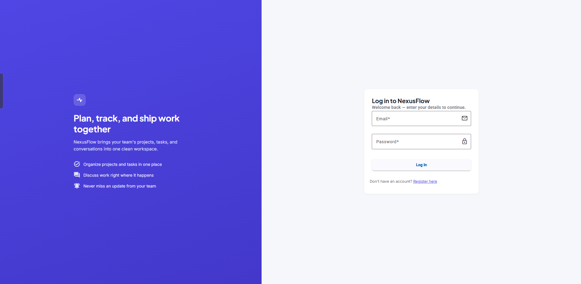
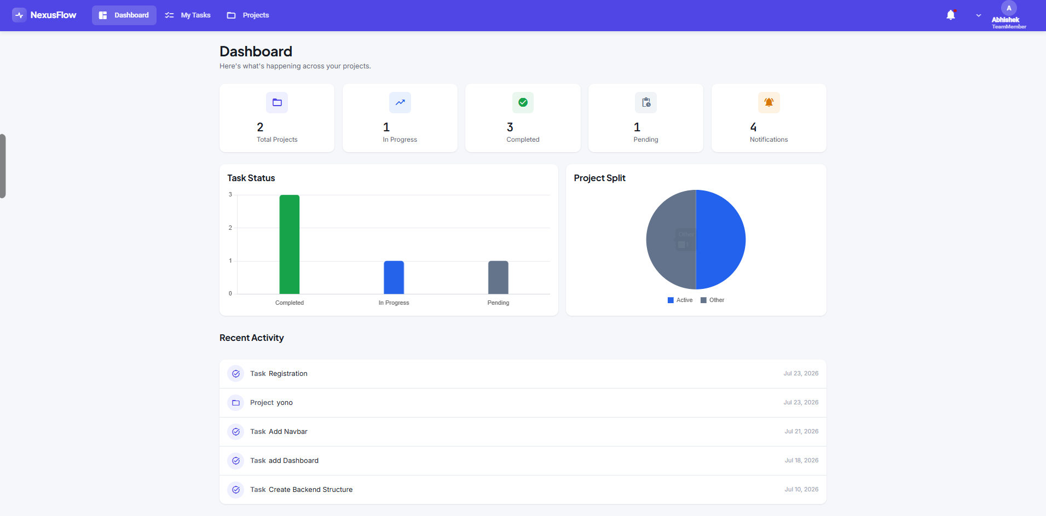
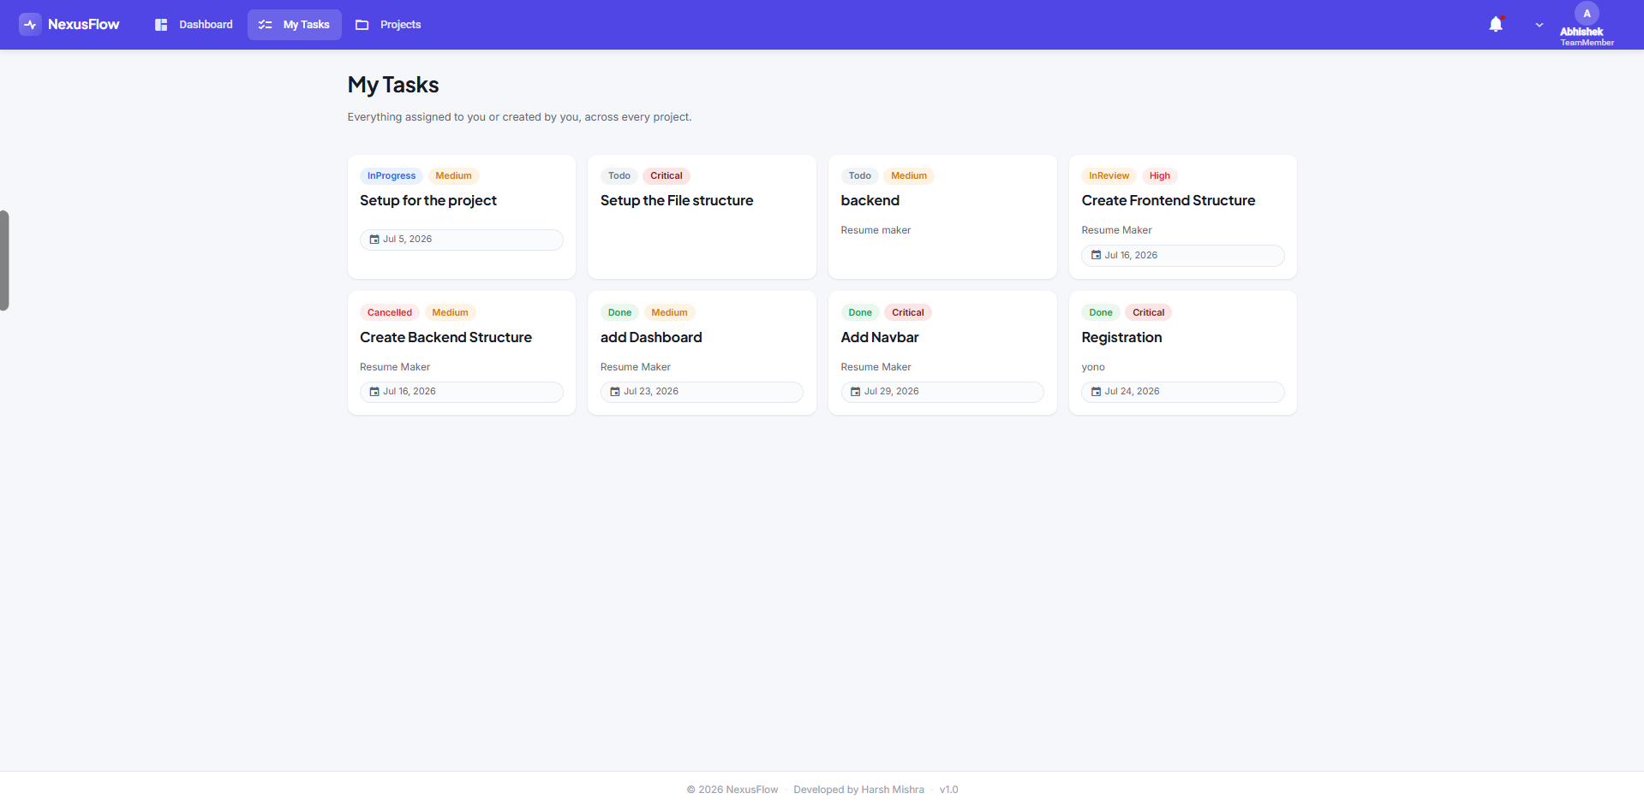
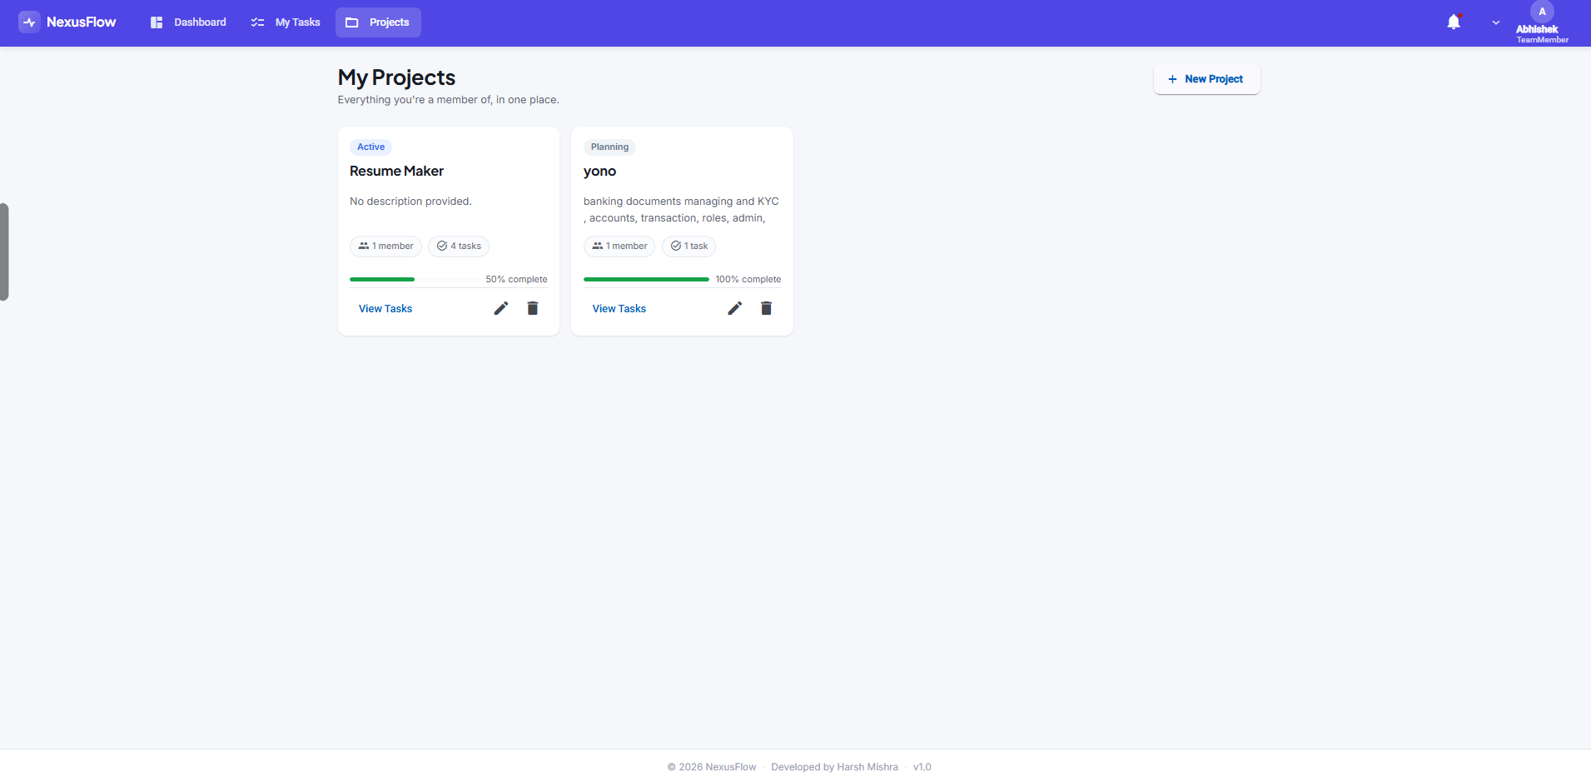
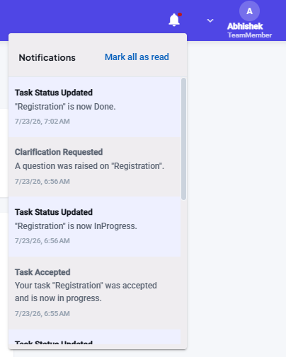
RESULTS
Application Screenshots
Login
Dashboard
My Tasks
Projects
Notifications
NexusFlow — Summer Training Review
9
Notes:
Live screenshots from the running application, not mockups. Point out the notification panel specifically — the entries visible there ('Task Accepted', 'Clarification Requested', 'Task Status Updated') are the workflow engine's actual output, captured mid-testing.

Slide 10
RESULTS
Benefits & Target Users
Benefits
Target Users
Single source of truth
Admin
One system instead of scattered chats and sheets
Full system oversight and user management
Faster task turnaround
Project Manager
A clear next action at every stage of a task
Creates projects, assigns tasks, responds to clarifications
Built-in transparency
Team Member
Every change is attributable and time-stamped
Accepts tasks, updates status, logs work
Enterprise-grade foundation
Client
Clean Architecture makes future features low-risk to add
Views project progress and outcomes
NexusFlow — Summer Training Review
10
Notes:
The 4-role model exists in the schema and JWT claims today; enforcement of role-specific restrictions on every endpoint is still being tightened — worth mentioning proactively if asked, rather than letting it surface as a gap during questions.

Slide 11


WRAPPING UP
Conclusion & Future Scope
Conclusion
Future Scope
End-to-end system, built solo
Full role-based access control
Angular frontend, ASP.NET Core backend, SQL Server — fully working
Enforce the 4-role model on every endpoint, not just some
A real workflow, not just CRUD
Organization management UI
Assign, accept, clarify, update, and track — with an audit trail
Admin-managed departments and teams
Production-oriented practices
Calendar & meeting scheduling
Clean Architecture, Repository + Unit of Work, DTO validation
Deadlines and events in a shared calendar view
File manager & advanced reports
Document sharing, PDF/Excel exports
NexusFlow — Summer Training Review
11
Notes:
Future scope items are listed honestly as not-yet-built, matching what's in the project report's own Limitations chapter — don't oversell any of these as already done if asked directly.

Slide 12



Thank You
Questions & Discussion
https://github.com/harsh-nix
www.linkedin.com/in/harsh-nix
harshmishra85@yahoo.com
NexusFlow · Harsh Mishra · 04613702025
Notes:
Close, invite questions. Have the live app ready in a browser tab in case the mentor wants a live walkthrough of the Accept -> Clarify -> Respond loop instead of just the workflow slide.

