Slide 1
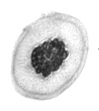
Plankton Classification
Predict ocean health, one plankton at a time
Using Machine Learning Techniques
HARSH PARIKH 2011CS10240
SAHIL LOOMBA 2012CS10114

Slide 2

About the Challenge
Plankton are critically important to our ecosystem.
Traditional methods for measuring and monitoring plankton populations are time consuming. Improved approaches are needed.
One such approach is through the use of an underwater imagery sensor.
Need for automated algorithms to classify captured images.
Data Source: National Data Science Bowl
Notes:
Accounting for more than half the primary productivity on earth and nearly half the total carbon fixed in the global carbon cycle.
And cannot scale to the granularity or scope necessary for large-scale studies.

Slide 3



Getting acquainted with the Data
Data is in the form of low-resolution grayscale images.
Training data: 30,366 images
121 classes: planktons(116) + unknown(3) + artifacts/junk(2).
Test data: 1,30,400 unlabelled images.
Training data is skewed: disproportionate number of images across classes
from as low as 9 to as high as 1979.
amphipod
unknown blob
artifact

Slide 4
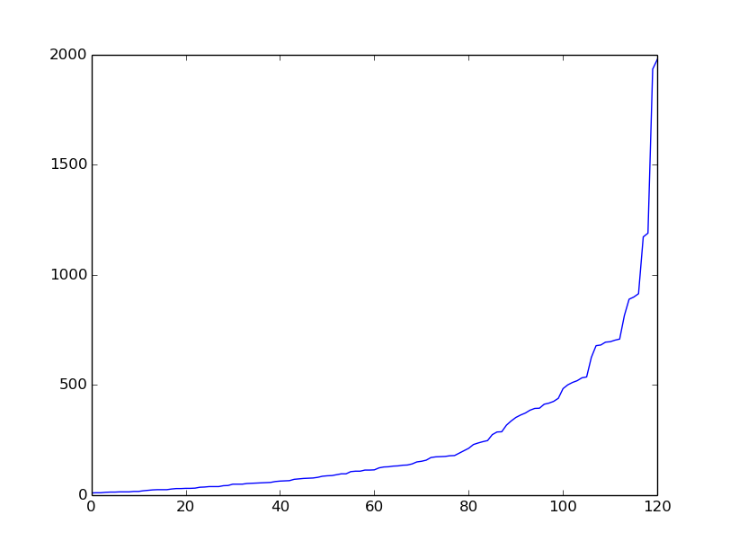
Skewed Data Distribution across classes

Slide 5
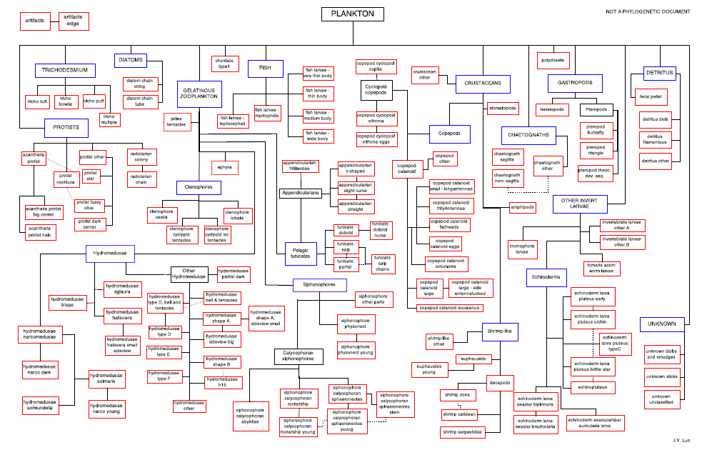
Hierarchy of Classes
Root
Class
Subclass

Slide 6
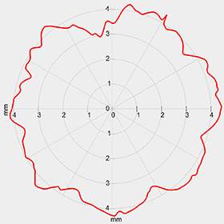
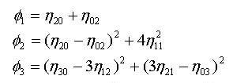
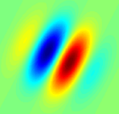
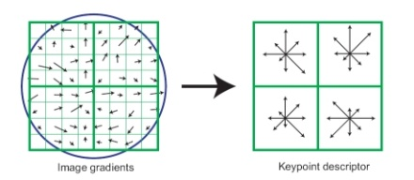
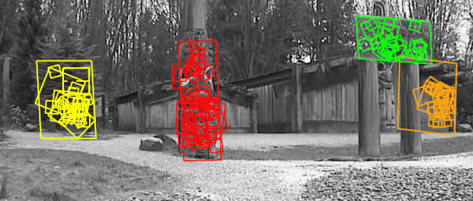
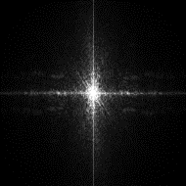
Data Features
Raw pixel data
Shape Descriptors
Circularity Constant
Hu Moments
Orientation Descriptors
Gabor Filtered Data
HoG Vectors
Feature Descriptors
SIFT
Information Descriptors
Fourier Analysis

Slide 7
ML Techniques
Classical Techniques:
Logistic Regression
Multiclass SVM with Gaussian Kernel
Holds well for Orientation and Feature Descriptors
Random Forests
Deep Learning:
Artificial Neural Networks
Convolutional Neural Networks

Slide 8
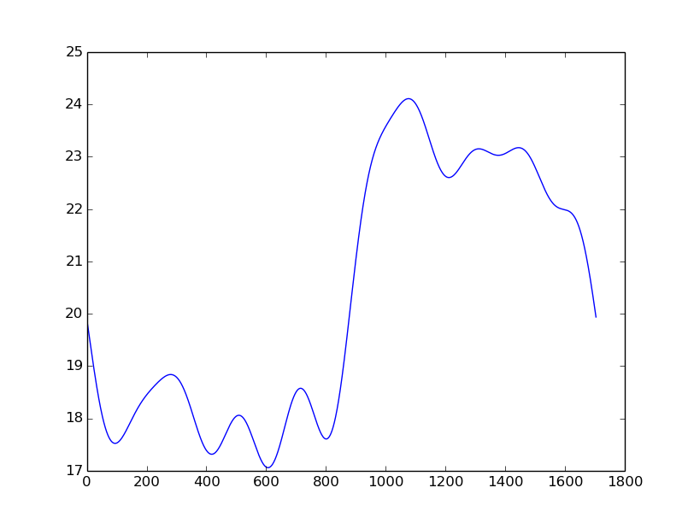


Shape Descriptors Analysis – 1
Acantharia protist
Chaetognath non sagitta
Circularity Constant for acantharia protist images and chaetognath non sagitta images

Slide 9
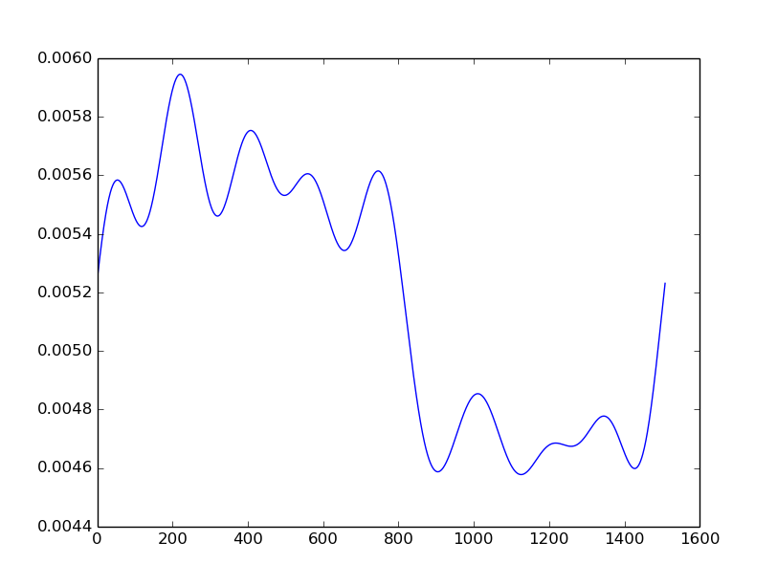

Shape Descriptors Analysis – 2
Chaetognath sagitta
Chaetognath non sagitta
Hu Moment-1 for chaetognath sagitta images and chaetognath non sagitta images
Notes:
Where do we plan to use these?

Slide 10
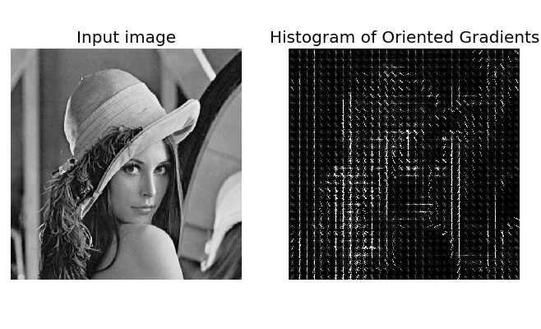
Orientation Descriptors Analysis - 1
HoG (Histogram of Oriented Gradients) data.
Vector (size 64) fed to a multiclass SVM with a Gaussian Kernel. (60% Training + 40% Validation.)
Best parameters led to a maximum mean accuracy of 25.90%.
Notes:
HoG vector (of size 64) of each image was generated. Training data was inflated after orthogonal rotation to reduce the effect of orientation of shapes along one of the perpendicular axes.

Slide 11
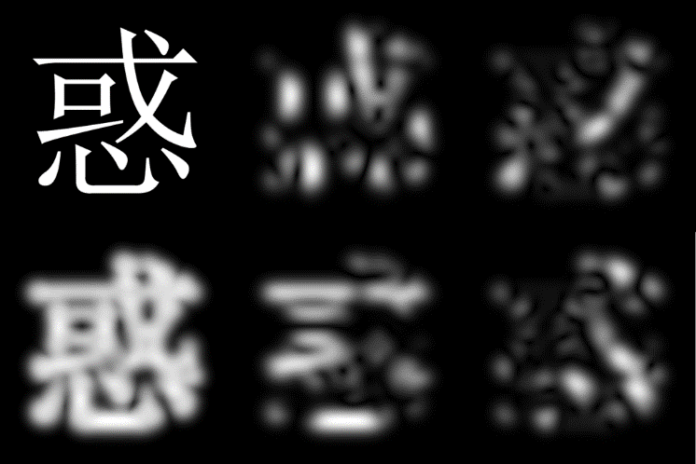
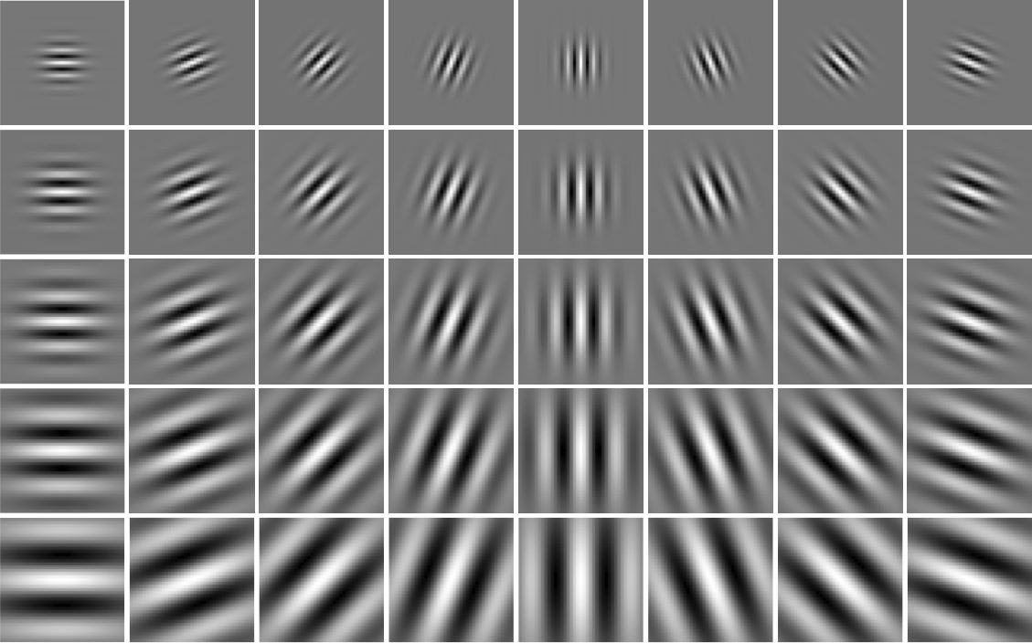
Orientation Descriptors Analysis - 2
Gabor Filter data.
Using Gabor Bank.
Vector (size 70) fed to a multiclass SVM with a Gaussian Kernel. (60% Training + 40% Validation.)
Best parameters led to a maximum mean accuracy of 49.88%.
Notes:
Gabor filters are used for edge detection across various orientations, with the process being closely related to that followed in the primary visual cortex. Training data was inflated and each image was passed through a Gabor bank, with 5 different theta (orientation) values and 7 different lambda (frequency) values. Mean and Standard deviation where the final parameters extracted from each filter of each bank, giving a feature vector of size 70.

Slide 12
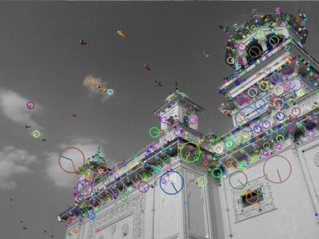
Feature Descriptors Analysis - SIFT
Raw Images
SIFT
Bag of Key Point Vectors
K-means
Vector of size 16 for each image
SVM: 39.92%
ANN: 19.23%
Training

Slide 13
Training on Raw Pixel Data
Training Dataset 60% + Validation Dataset 40%
Model | Validation Log Loss | Validation Accuracy (Top-1)
Crude ANN | 20.38 | 32%
Crude CNN | 4.18 | 56%
ANN → SVM | 2.38 | 58%

Slide 14
Future Work – 1
Revision Theory
Reiterate over data with larger deviation from the true value.
Augmenting Multiple Feature Vectors
For example: Matrix Product of Gabor and SIFT vectors.
Random Forest for Image Classification
Large-Scale Object Classification using Label Relation Graphs http://web.eecs.umich.edu/~jiadeng/paper/deng2014large.pdf
Hierarchy and Exclusion (HEX) graphs, a new formalism that captures semantic relations between any two labels applied to the same object.

Slide 15
Future Work – 2: Hierarchical Paradigm
Data
First –level classification
Class1
Class3
Class2
Subclass1.1
Subclass1.2
Second-level classification
Second-level classification
Subclass3.1

Slide 16
Thank You. Questions?

