Slide 1




Fired Chat
Department of Computer Science & engineering IET Lucknow
Under the guidance of :
Dr. Natthan Singh
Dr. Pawan Kumar Tiwari
Submitted By:
Ankit Sahu | 2200520100013
Harsh Shukla | 2200520100026
Karnakant Pandey | 2200520100032

Slide 2
Agenda
Introduction
Motivation
Objectives
Background
Literature Survey
Feature Comparison
Unique Selling Points
Methodology
Implementation
Results
Conclusion
Future Scope
References

Slide 3





Introduction
Fired Chat is a revolutionary privacy-centric web-based communication platform designed for secure and private text messaging and video interactions. It leverages modern technologies to ensure user privacy by storing data locally in the browser, eliminating risks associated with centralized servers and databases. This platform not only facilitates seamless communication but also integrates AI features for enhanced user engagement. By prioritizing user control and data security, Fired Chat sets a new standard for real-time communication tools in today's digital landscape.

Slide 4



Motivation
USER-CENTRIC COMMUNICATION NEED
As digital interactions grow, users increasingly seek platforms that prioritize their privacy and control over personal data, ensuring a secure communication environment.
PRIVACY BREACH CONCERNS
Traditional platforms often store user data on centralized servers, leading to significant privacy risks, including unauthorized access and data breaches that undermine user trust.
DEMAND FOR DATA CONTROL
Users are demanding more control over their data, seeking platforms that allow them to manage, store, and delete their information without relying on external servers.
AI INTEGRATION FOR ENGAGEMENT
The integration of AI in communication tools enhances user engagement, providing instant support and explanations, thereby improving overall user experience and satisfaction.

Slide 5
Objectives
1. Real-Time, Privacy Centric Communication
Develop a real-time chat platform that prioritizes user privacy by eliminating server-side message storage, ensuring secure and instant communication.
2. Dynamic Room Management
Implement features for dynamic room creation and deletion, allowing users to manage their communication spaces effortlessly and intuitively.
3. Cross-Device Compatibility
Ensure a responsive design that provides seamless access across various devices, enhancing user experience on both desktop and mobile platforms.
4. AI-Powered Interactions
Utilize AI to enhance user interactions, including a chatbot for assistance and a built-in tool for explaining complex terms instantly.

Slide 6
Background
Privacy Risks of Centralization
Rising Demand for Decentralization
Technologies Enabling Peer-to-Peer
Centralized servers & databases often store user messages, increasing risks of data breaches and unauthorized access, leading to growing concerns over user privacy.
Users increasingly seek decentralized communication platforms that prioritize privacy and control over their data, reflecting a significant shift in user expectations.
WebRTC and WebSockets facilitate low-latency, peer-to-peer connections, allowing real-time communication without relying on centralized servers for data storage.

Slide 7
Literature Survey
B. Gupta & M. P. Vani (IRJET, 2018) WebSockets: The Future of Real-Time Communication
→ Demonstrated that WebSockets outperform traditional HTTP polling by enabling full-duplex channels, drastically reducing overhead for chat applications.
R. Deshmukh et al. (ICSCDS, IEEE 2023) Video Conferencing Using WebRTC
→ Showed that browser-native WebRTC peer connections eliminate intermediary media servers, reducing round-trip latency by up to 40 % compared to server-relayed solutions.
S. Kumar & A. Jeyaram (ACCAI, IEEE 2022) Signalling Service for WebRTC with Node.js & Socket.IO
→ Validated a lightweight Node.js + Socket.IO signaling architecture that maintains sub-100 ms call-setup time while keeping the server stateless and horizontally scalable.
M. Bawane et al. (IJRASET, 2022) Technologies Used in MERN Stack
→ Confirmed that the MERN stack enables rapid iteration on full-stack applications, with React's virtual DOM providing performant UI re-renders for high-frequency data like chat messages.
K. Gouda & K. Babu (IJCA, 2018) WebRTC-Based Systems: Security & Performance Analysis
→ Found that WebRTC's built-in DTLS-SRTP encryption provides adequate data security for peer-to-peer communications without additional overhead.
R. Narula, S. Agarwal & A. Gupta (ACM, 2018) Client-Side Storage Techniques for Secure Web Apps
→ Established that IndexedDB and LocalStorage, when used without server sync, prevent third-party data collection and support GDPR-aligned, privacy-by-design architectures.

Slide 8
Feature Comparison
METRIC | CONVENTIONAL | FIRED CHAT
App Startup Latency | 500ms - 2s | <50ms
Message Delivery | 200-500ms | 50-150ms
Bandwidth Usage | High | Low
Data Privacy | Server stored | Client-side
Server Load | High | Minimal
Scalability Cost | High | Low
Single Point Failure | Yes | No
Database Calls at Startup | 1-5 queries | 0 queries

Slide 9
Unique Selling Points
Latency Analysis
Startup Time:
███████████ 1s (Conventional) ██ 50ms (Local-First) ⚡ 20x faster
Message Delivery:
████████ 300ms (Conventional)
██ 100ms (Local-First) ⚡ 3x faster
Bandwidth at Startup:
█████████ 2MB (Conventional)
██ 100KB (Local-First) ⚡ 20x less
Privacy Centric:
Fired Chat keeps all your messages on your device, with no centralized storage, no data tracking, and end-to-end encryption, giving you complete control over your conversations.
In-built AI Chatbot:
Get instant, clear explanations of messages, complex terms or topics, right inside the chat, without switching apps.

Slide 10
Methodology
1. Requirement Analysis
Identified key features such as real-time chat, video calling, dynamic room management, and AI chatbot support to enhance user experience.
2. Decentralized Architecture
Designed a privacy-centric architecture that eliminates server-side storage, ensuring user data remains secure and under individual control.
3. Real-Time Communication
Used protocols like Socket.IO and WebRTC for instant messaging and peer-to-peer video calls, ensuring low latency and high performance.
4. User Interface Development
Developed a responsive UI using Tailwind CSS, focusing on a seamless experience across devices and intuitive navigation for users.

Slide 11
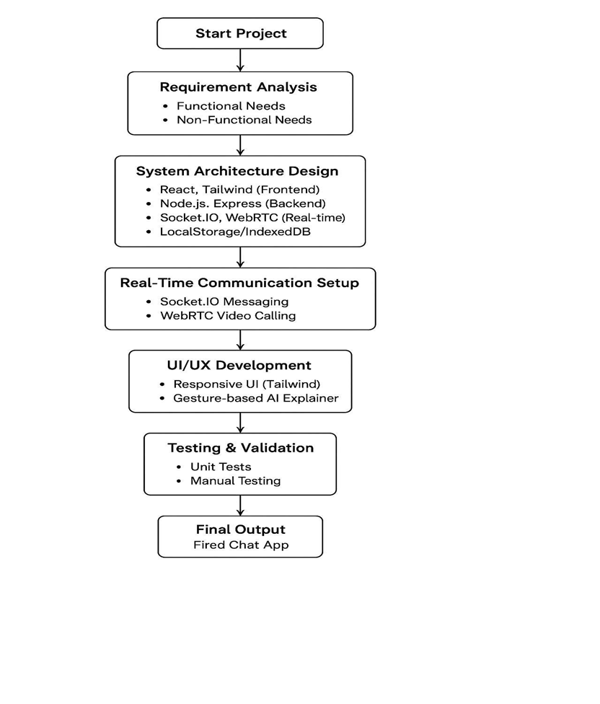
Flowchart

Slide 12
Implementation
01
Frontend – React.js & Tailwind CSS
02
Backend – Node.js & Express.js
Built with React.js for component-based UI and Tailwind CSS for responsive, mobile-friendly styling. Routing handled via React Router for seamless single-page navigation.
Express.js server manages room lifecycle and acts as the signaling relay. No user data is persisted on the server; all business logic stays stateless.
03
Real-Time Messaging – Socket.IO
04
Video Calling – WebRTC
Socket.IO enables bidirectional, event-driven communication. Messages are broadcast to room participants in real time and stored only in client-side IndexedDB / LocalStorage.
Peer-to-peer video sessions are established via WebRTC with the server acting purely as a signaling channel. This eliminates media relay latency and reduces server load.
05
Client-Side Storage
06
AI Chatbot Integration
Chat history is retained in the browser using IndexedDB and LocalStorage, giving users full control. Clearing the browser data completely erases all message history.
An embedded AI chatbot answers questions and explains terms directly inside the chat room. Users can also select any message text to trigger an instant AI-powered explanation.

Slide 13
Results
•
Seamless Chat Experience
Fired Chat delivers a seamless real-time messaging experience, with messages transmitted/broadcasted instantly across users, ensuring low latency and stable communication.
•
Local Data Retention
User data is securely stored locally within the browser, enhancing privacy and eliminating risks associated with server-side data storage, thus ensuring complete user control over their information.
•
Stable Video Calling
The integration of WebRTC provides stable peer-to-peer video calling, ensuring quick session establishment and consistent audio-visual quality, even with moderate bandwidth fluctuations.
•
AI Chatbot Interaction
An AI-powered chatbot enriches user engagement within chat rooms, allowing for meaningful interactions and instant responses, enhancing the overall user experience and support.

Slide 14
Conclusion
✓
Privacy-First Communication Platform
Fired Chat successfully demonstrates that real-time communication can be achieved without centralized data storage, eliminating privacy risks and giving users complete control over their messages.
✓
Proven Performance Advantage
By leveraging WebRTC and Socket.IO with a local-first architecture, Fired Chat achieves faster startup, faster message delivery, and lower bandwidth usage compared to conventional platforms.
✓
AI Integration & Future Scalability
The embedded AI chatbot and term-explainer enrich user engagement, while the MERN stack foundation and planned enhancements - multi-user video, encrypted storage, and a mobile app - position Fired Chat for robust, real-world deployment.

Slide 15
Future Work
Multi-User Video Conferencing
Enhanced AI Capabilities
Encrypted Local Storage
Explore options for multi-user video conferencing to enhance group communication, enabling seamless interactions among multiple participants in real-time.
Develop advanced AI features for improved user support, including personalized responses and context-aware assistance to enrich user interactions.
Implement encrypted local storage solutions to further safeguard user data, ensuring that sensitive information remains protected even on user devices.
Mobile Application
Built Mobile Application For Android and iOS devices to ensure quick access and for simplicity

Slide 16

REFERENCES
B. Gupta and M. P. Vani, "An overview of WebSockets: The future of real-time communication," International Research Journal of Engineering and Technology (IRJET), vol. 5, no. 12, 2018.
R. Deshmukh et al., "Video conferencing using WebRTC," in Proc. 2023 International Conference on Sustainable Computing and Data Communication Systems (ICSCDS), IEEE, 2023.
S. Kumar and A. Jeyaram, "Building a signalling service for WebRTC applications using Node.js and Socket.IO," in Proc. 2022 International Conference on Advances in Computing, Communication and Applied Informatics (ACCAI), IEEE, 2022.
M. Bawane et al., "A review on technologies used in MERN stack," International Journal of Research in Applied Science and Engineering Technology, vol. 10, no. 1, pp. 479-488, 2022.
Tailwind Labs, "Tailwind CSS documentation," Accessed: Nov. 2023. [Online]. Available: https://tailwindcss.com/docs
K. Gouda and K. Babu, "WebRTC-based real-time communication systems: A security and performance analysis," International Journal of Computer Applications, vol. 179, no. 34, pp. 1-7, 2018.
R. Narula, S. Agarwal, and A. Gupta, "Client-side storage techniques for secure web applications," ACM Computing Surveys, vol. 51, no. 1, Article 15, 2018.
Socket.IO Documentation, "Socket.IO official documentation," Accessed: Nov. 2023. [Online]. Available: https://socket.io/docs/v4

Slide 17
THANK YOU !

