Slide 1
DTJ social media
Posts for 26 Oct to 01 Nov 2026
7 posts · 7 pass every check · week 2026-W44
Every number on these posts comes from DTJ's proof list.

Slide 2
The calendar (India time)
Day | Instagram | Facebook | LinkedIn | X
Mon 26 Oct | p1 19:00 client-result | p1 19:00 client-result | p1 19:00 client-result | p1 19:00 client-result
Tue 27 Oct | p2 19:00 founder-pain | p2 19:00 founder-pain | p2 19:00 founder-pain | p2 19:00 founder-pain
Wed 28 Oct | p3 19:00 before-after | p3 19:00 before-after | p3 19:00 before-after | p3 19:00 before-after
Thu 29 Oct | p4 19:00 client-result | p4 19:00 client-result | p4 19:00 client-result | p4 19:00 client-result
Fri 30 Oct | p5 19:00 founder-pain | p5 19:00 founder-pain | p5 19:00 founder-pain | p5 19:00 founder-pain
Sat 31 Oct | p6 19:00 client-result | p6 19:00 client-result | p6 19:00 client-result | p6 19:00 client-result
Sun 01 Nov | p7 19:00 client-result | p7 19:00 client-result | p7 19:00 client-result | p7 19:00 client-result

Slide 3
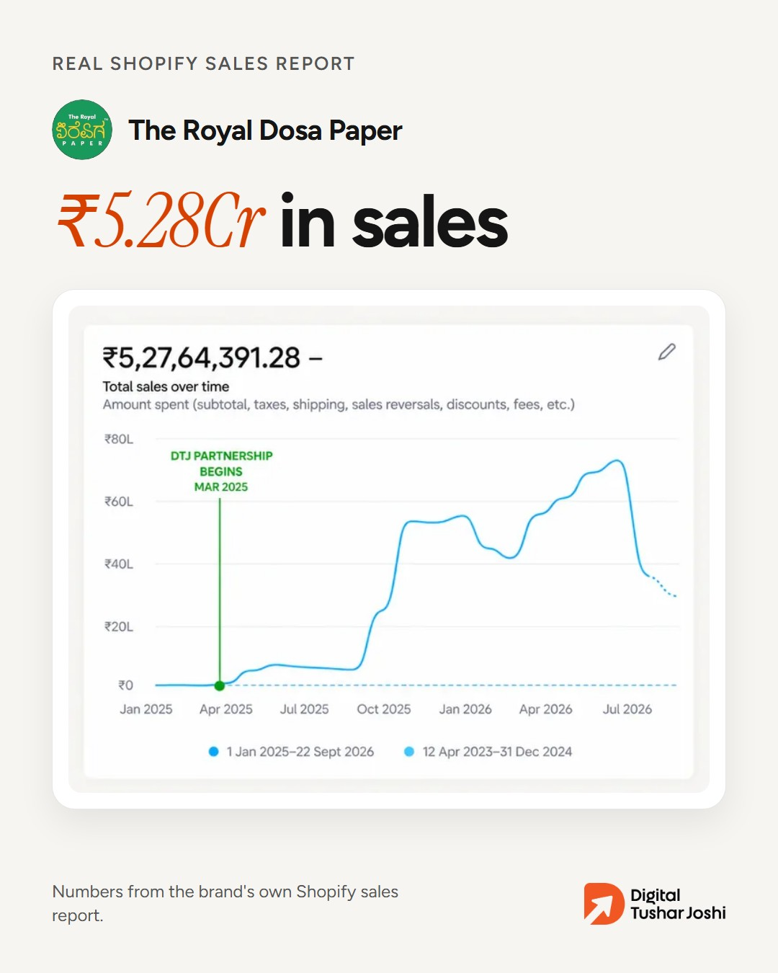
P1 · Mon 26 Oct, 19:00 IST · client-result · image
Instagram
The Royal Dosa Paper had almost no sales when we started working together in March 2025.
Today their own Shopify report shows ₹5.28Cr in sales and 75,000 orders.
Want to know what's holding your sales back? Get a free growth audit. Link in bio.
#D2C #Shopify #IndianBrands
Facebook
The Royal Dosa Paper had almost no sales when we started working together in March 2025.
Today their own Shopify report shows ₹5.28Cr in sales and 75,000 orders.
Want to know what's holding your sales back? Get a free growth audit: [audit link]
LinkedIn
The Royal Dosa Paper had almost no sales when we started working together in March 2025.
Today their own Shopify report shows ₹5.28Cr in sales and 75,000 orders.
We find what's holding a brand's sales back. Then we fix it.
Free growth audit for founders: […
X
The Royal Dosa Paper: almost no sales in March 2025. Today ₹5.28Cr in sales and 75,000 orders, from their own Shopify report.
Where are your sales leaking? Free growth audit: [audit link]
Proof: sales-royal-dosa-paper
Checks: all pass

Slide 4
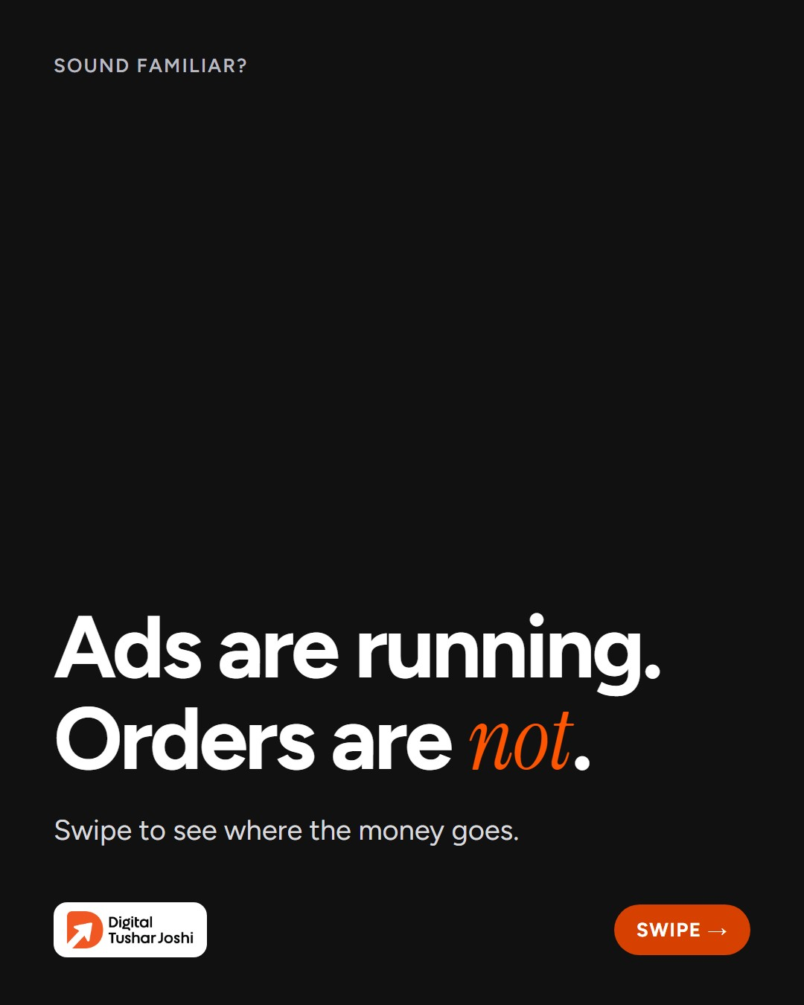
P2 · Tue 27 Oct, 19:00 IST · founder-pain · carousel
Instagram
Ads running, but no orders coming in?
It's not always the ad. The leak is often somewhere on the path from your ad to a paid order.
We look at the whole journey, from your ads to your website, product pages and checkout, and find where you're losing buyers.…
#D2C #FacebookAds #Shopify
Facebook
Ads running, but no orders coming in?
It's not always the ad. The leak is often somewhere on the path from your ad to a paid order.
We look at the whole journey, from your ads to your website, product pages and checkout, and find where you're losing buyers.…
LinkedIn
Ads running, but no orders coming in?
It's not always the ad. The leak is often somewhere on the path from your ad to a paid order.
We look at the whole journey, from ads to website, product pages and checkout, to find where buyers drop off.
Free growth au…
X
Ads running, but no orders?
It's not always the ad. The leak is often somewhere between your ad and a paid order: the website, the product page, the checkout.
Find your leak with a free growth audit: [audit link]
Proof: no numbers
Checks: all pass
+ 4 more slides in this carousel

Slide 5
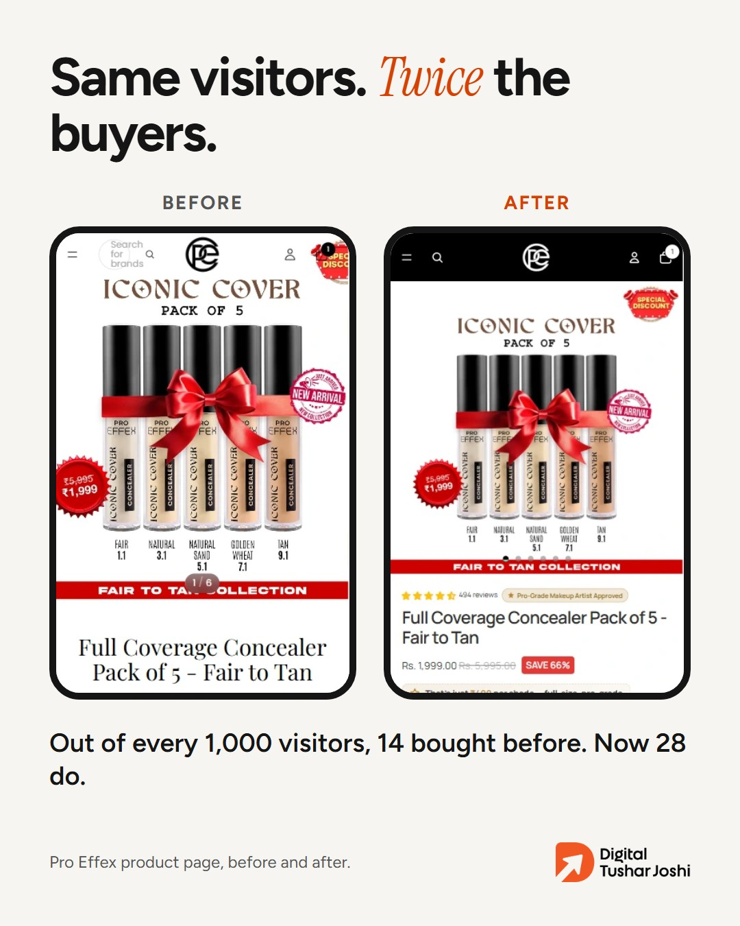
P3 · Wed 28 Oct, 19:00 IST · before-after · image
Instagram
Pro Effex didn't need more visitors. Their product page needed to give visitors a reason to buy.
Out of every 1,000 visitors, 14 bought before. After the new product page, 28 do.
Same traffic. More customers.
Free growth audit. Link in bio.
#D2C #Shopify #ProductPage
Facebook
Pro Effex didn't need more visitors. Their product page needed to give visitors a reason to buy.
Out of every 1,000 visitors, 14 bought before. After the new product page, 28 do.
Same traffic. More customers.
Free growth audit: [audit link]
LinkedIn
Pro Effex didn't need more visitors. Their product page needed to give visitors a reason to buy.
Out of every 1,000 visitors, 14 bought before. After the new product page, 28 do.
Same traffic. More customers.
Free growth audit for founders: [audit link]
X
Same visitors, twice the buyers.
Pro Effex product page: out of every 1,000 visitors, 14 bought before. After the rebuild, 28 do.
Free growth audit: [audit link]
Proof: pdp-proeffex
Checks: all pass

Slide 6
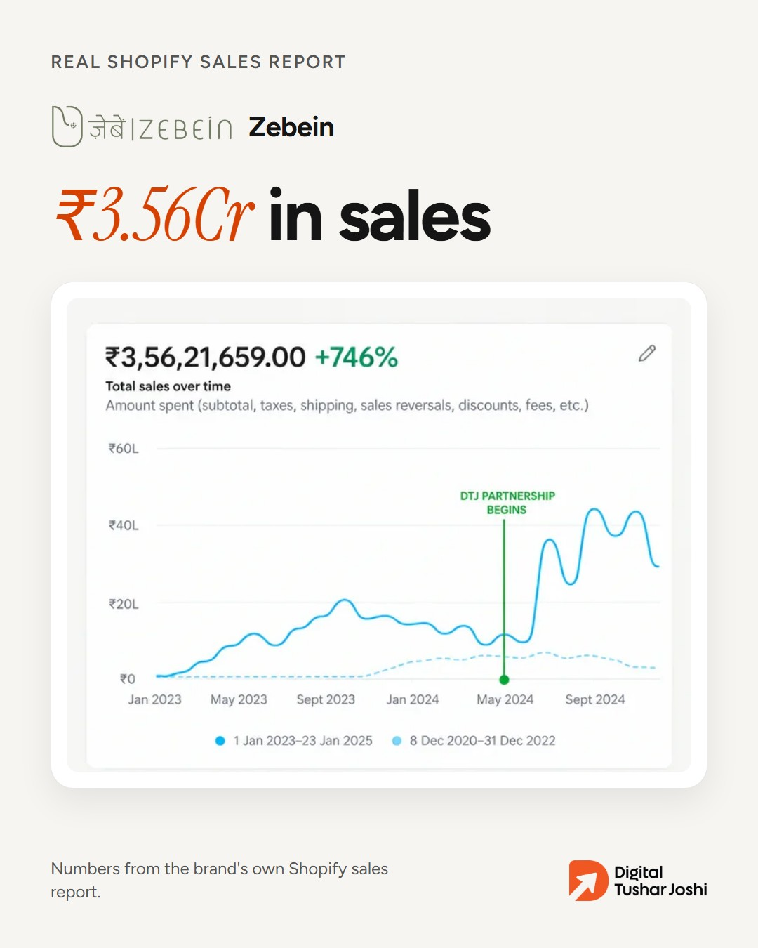
P4 · Thu 29 Oct, 19:00 IST · client-result · image
Instagram
Zebein: ₹3.56Cr in sales and 4,213 orders, straight from their own Shopify report.
We find what's holding your sales back. Then we fix it.
Free growth audit. Link in bio.
#D2C #Shopify #IndianBrands
Facebook
Zebein: ₹3.56Cr in sales and 4,213 orders, straight from their own Shopify report.
We find what's holding your sales back. Then we fix it.
Free growth audit: [audit link]
LinkedIn
Zebein: ₹3.56Cr in sales and 4,213 orders, straight from their own Shopify report.
We find what's holding a brand's sales back. Then we fix it.
Free growth audit for founders: [audit link]
X
Zebein: ₹3.56Cr in sales and 4,213 orders, from their own Shopify report.
We find what's holding your sales back. Then we fix it. Free growth audit: [audit link]
Proof: sales-zebein
Checks: all pass

Slide 7
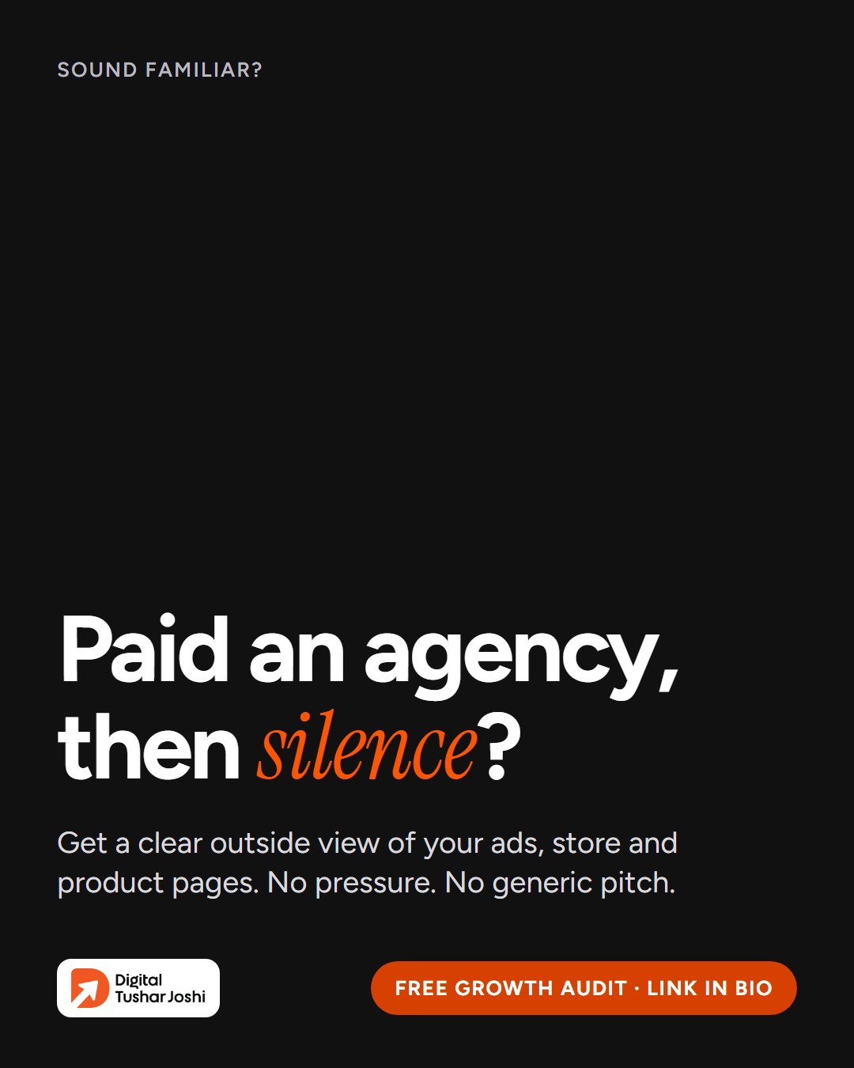
P5 · Fri 30 Oct, 19:00 IST · founder-pain · image
Instagram
Paid an agency, then heard nothing back?
Get a clear outside view of your ads, your store and the path from your ad to a paid order, and know exactly what to fix first.
No generic pitch. No pressure. If we don't see a clear opportunity, we'll tell you.
Fre…
#D2C #Founders #Shopify
Facebook
Paid an agency, then heard nothing back?
Get a clear outside view of your ads, your store and the path from your ad to a paid order, and know exactly what to fix first.
No generic pitch. No pressure. If we don't see a clear opportunity, we'll tell you.
Fre…
LinkedIn
Paid an agency, then heard nothing back?
Get a clear outside view of your ads, your store and the path from your ad to a paid order, and know exactly what to fix first.
No generic pitch. No pressure. If we don't see a clear opportunity, we'll tell you.
Fre…
X
Paid an agency, then silence?
Get a clear outside view of your ads and store, and know what to fix first. If we don't see a clear opportunity, we'll tell you.
Free growth audit: [audit link]
Proof: no numbers
Checks: all pass

Slide 8
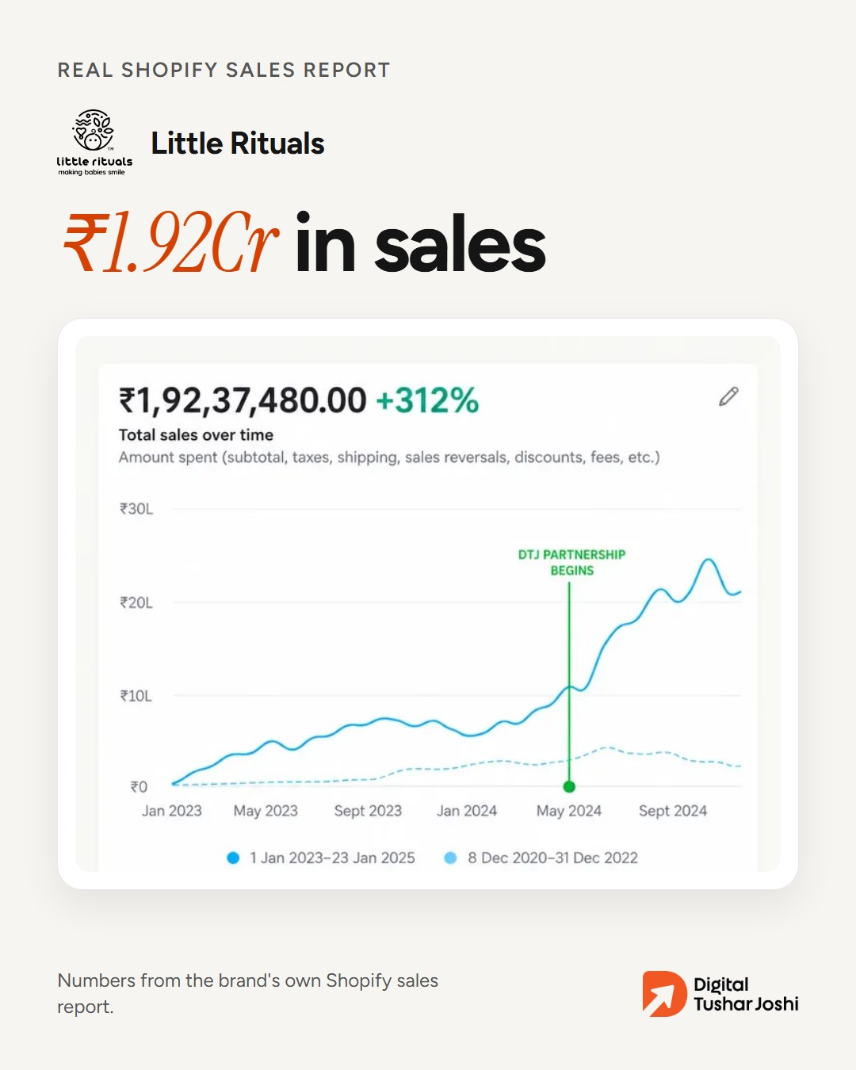
P6 · Sat 31 Oct, 19:00 IST · client-result · image
Instagram
Little Rituals: ₹1.92Cr in sales and 13,334 orders, from their own Shopify report.
You already paid to bring people to your website. We build and improve your Shopify store and product pages so more of them have a reason to buy.
Free growth audit. Link in b…
#D2C #Shopify #IndianBrands
Facebook
Little Rituals: ₹1.92Cr in sales and 13,334 orders, from their own Shopify report.
You already paid to bring people to your website. We build and improve your Shopify store and product pages so more of them have a reason to buy.
Free growth audit: [audit li…
LinkedIn
Little Rituals: ₹1.92Cr in sales and 13,334 orders, from their own Shopify report.
You already paid to bring people to your website. We build and improve Shopify stores and product pages so more of those visitors have a reason to buy.
Free growth audit for…
X
Little Rituals: ₹1.92Cr in sales and 13,334 orders, from their own Shopify report.
More of your visitors can buy. Free growth audit: [audit link]
Proof: sales-little-rituals
Checks: all pass

Slide 9
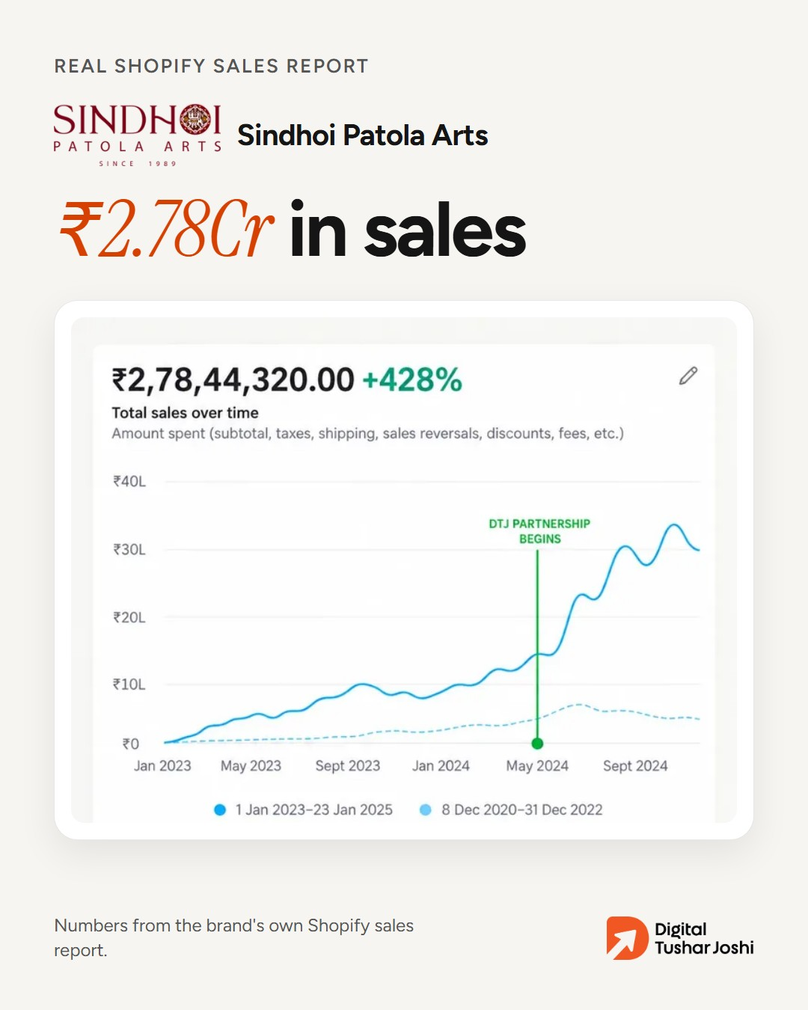
P7 · Sun 01 Nov, 19:00 IST · client-result · image
Instagram
Sindhoi Patola Arts: from ₹52.7L to ₹2.78Cr in sales, in their own Shopify report.
Tell us about your brand and we'll show you what to fix first, whether it's ads, your store, Google search or Amazon.
Free growth audit. Link in bio.
#D2C #Shopify #Patola
Facebook
Sindhoi Patola Arts: from ₹52.7L to ₹2.78Cr in sales, in their own Shopify report.
Tell us about your brand and we'll show you what to fix first, whether it's ads, your store, Google search or Amazon.
Free growth audit: [audit link]
LinkedIn
Sindhoi Patola Arts: from ₹52.7L to ₹2.78Cr in sales, in their own Shopify report.
Tell us about your brand and we'll show you what to fix first, whether it's ads, your store, Google search or Amazon.
Free growth audit for founders: [audit link]
X
Sindhoi Patola Arts: ₹52.7L to ₹2.78Cr in sales, from their own Shopify report.
What should you fix first? Free growth audit: [audit link]
Proof: sales-sindhoi
Checks: all pass

Slide 10
What needs a yes
Ready to approve: p1, p2, p3, p4, p5, p6, p7
Say yes with the post numbers (for example 'yes p1-p7'). Each post is then posted at its time.
If Harsh can't be reached, a DTJ teammate may approve, by name.
Command: python -m smm approve --week 2026-W44 --posts p1-p7 --by "<name>"

