Slide 1
WEBSITE BRIEF
Hopenskin.com
The kind of Shopify store we want built: homepage and product page
Prepared by Digital Tushar Joshi

Slide 2
THE BRIEF
What we need from you
1
A Shopify store
Built on Shopify, so we can manage products, offers and content ourselves.
2
Premium and trust-led
A dark, polished look where the product, the people and the proof are clear at a glance.
3
Built around the reference pages
The next slides show the style we want, page by page. We are sharing the idea, not asking for a copy.

Slide 3
REFERENCE WEBSITES
More inspiration
Please browse these two live stores for more ideas on layout, sections and feel. Use them as a guide, not as something to copy.
Earth Rhythm
Perfora
earthrhythm.com/
perforacare.com/
Good for: Product page, offers, ingredients, how to use, FAQ, sticky Add to Cart
Good for: Homepage hero, categories, product showcase, trust section, reviews
Most reference screenshots in this deck come from these two sites. Hopenskin's own products, claims, offers and photos must replace theirs.

Slide 4
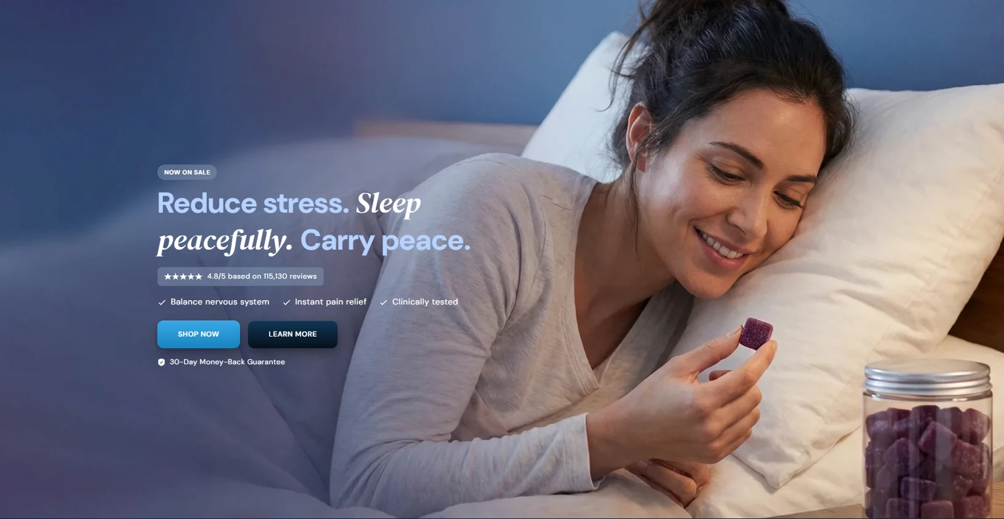
HOMEPAGE
Hero section
1
Full-width lifestyle photo
A real person using the product. Text sits on the plain left side.
2
Tag, headline and one italic word
Small “Now on sale” tag, then a big, short headline.
3
Rating and benefit ticks
Star rating with the real review count, then three one-line benefits.
4
Two buttons and a guarantee
Bright Shop Now, quieter Learn More, small guarantee line below.
Reference only. Wording, ratings and guarantee must be Hopenskin's own and confirmed. Do not copy the health claims shown (stress, pain relief).

Slide 5
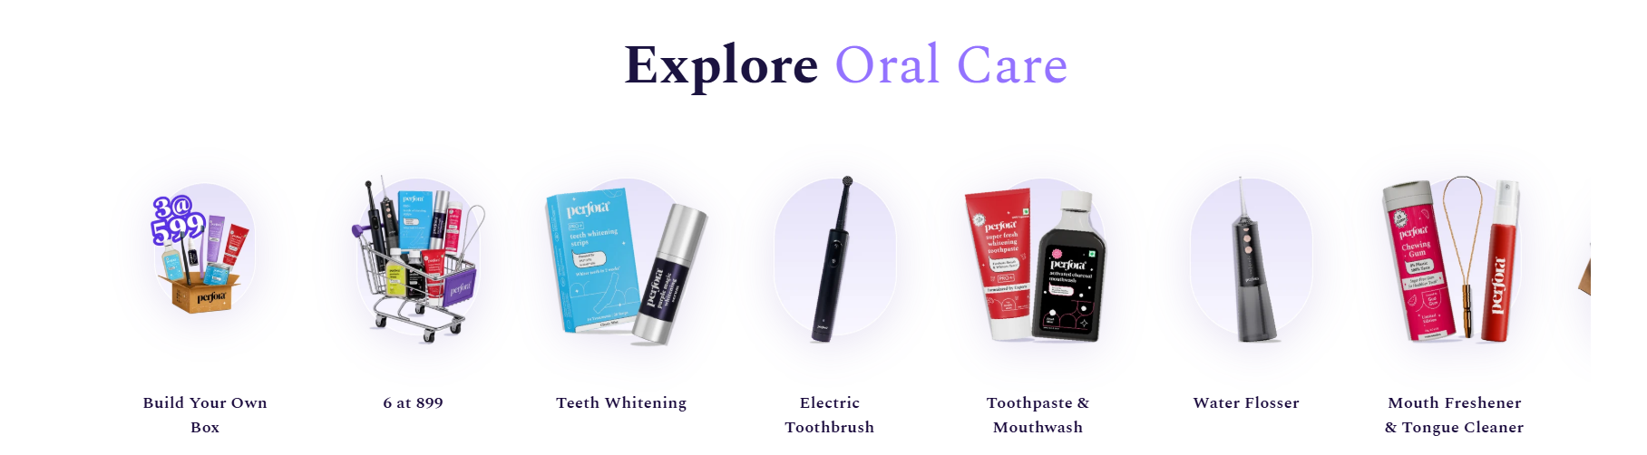
HOMEPAGE
Category section
1
Centered title with accent words
Category name in the brand accent colour.
2
Row of round-framed pictures
One clean product photo for each category, on a soft tinted shape.
3
Short label under each picture
Two lines at most, in the same font as the headings.
4
Optional offer tile
A bundle or “build your own box” tile in the same row.
5
Sideways scroll
The last tile is cut off so people know to swipe.
6
Every tile is a link
Tapping goes straight to that collection page.
Placed below the hero by default (it could also sit at the top). Reference only: Hopenskin's own categories, photos and offers must be used.

Slide 6
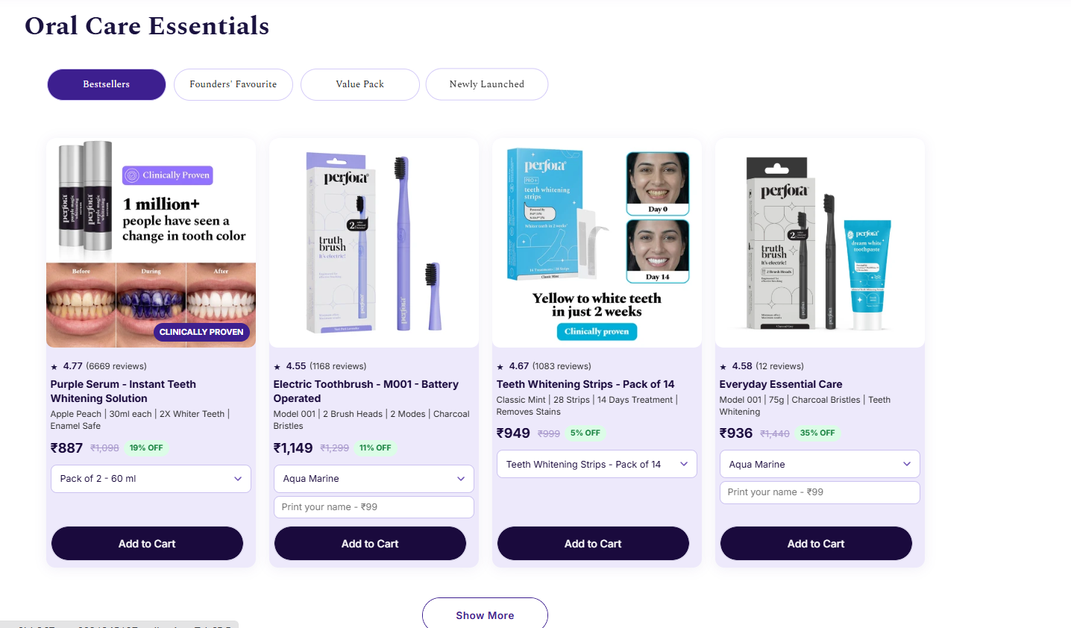
HOMEPAGE
Product showcase with tabs
1
Section title
A simple heading, e.g. “Essentials”.
2
Tabs to switch the list
Bestsellers, Value Pack, Newly Launched and similar.
3
Four product cards in a row
Large photo, rating, name, short details, price and discount.
4
Pack or colour picker on the card
Visitor chooses the option without opening the product.
5
Add to Cart on every card
One clear button on each card.
6
Show More button
Loads more products below.
Reference only. Tabs, products, prices and ratings must come from Hopenskin's own store data. The category section follows below this.

Slide 7
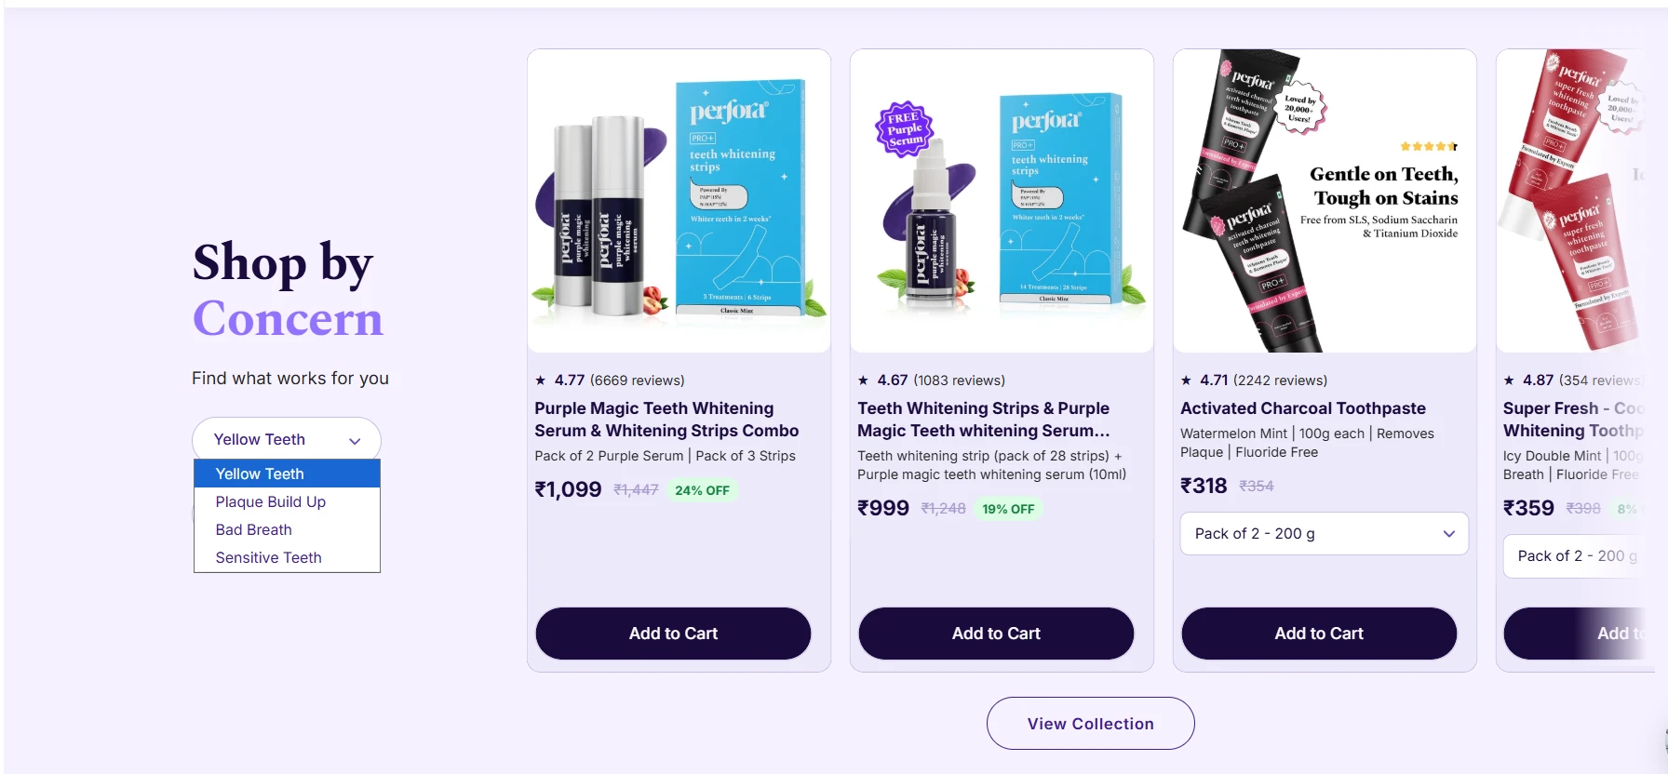
HOMEPAGE
Shop by concern
1
Heading and concern dropdown
Visitor picks a need and the products change.
2
Product cards in a row
Photo, rating, name, price and discount. Scrolls sideways.
3
Variant picker and Add to Cart
Choose the pack on the card and buy from it.
4
View Collection button
Leads to the full collection page.
Reference only. Concerns, products, prices and ratings must come from Hopenskin's own store data.

Slide 8
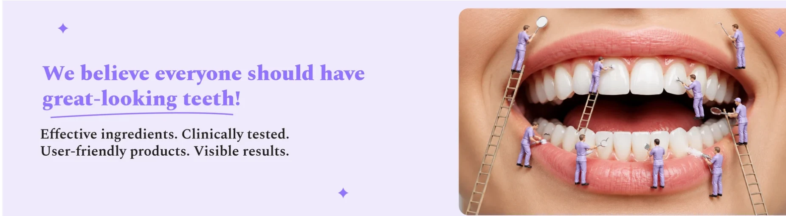
HOMEPAGE
Brand belief banner
1
Big belief statement
One bold line about what the brand stands for, with the key phrase underlined.
2
Four short proof phrases
Written as quick lines under the statement.
3
Creative, memorable image
A playful picture on the right that people remember.
4
Soft background with small sparkles
A calm colour block that breaks up the page.
Reference only. Write Hopenskin's own belief line and image. Do not reuse the reference wording.

Slide 9
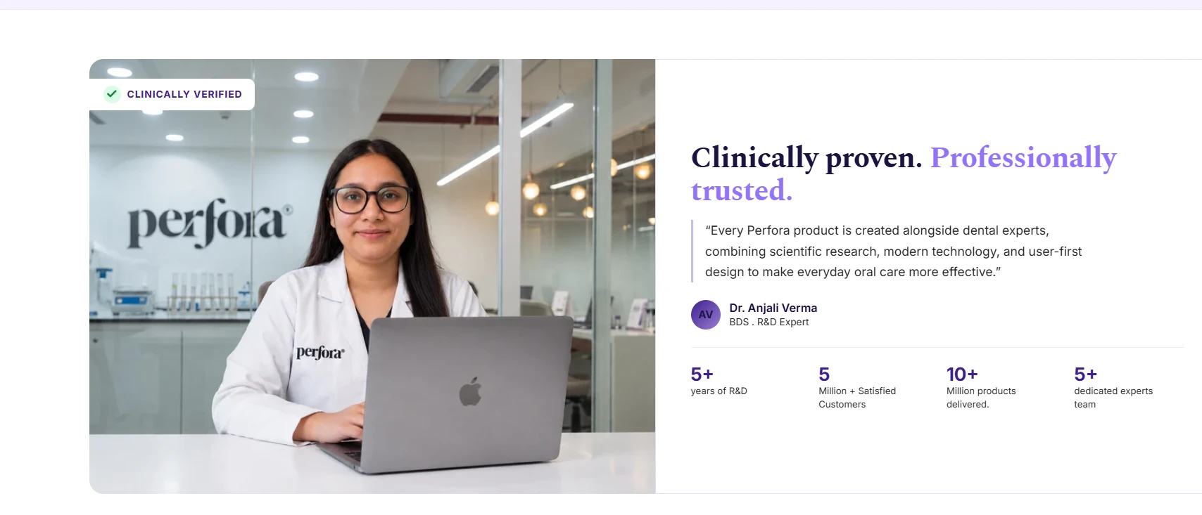
HOMEPAGE
Trust section
1
Expert photo with badge
A real team member in a lab, with a “verified” badge.
2
Headline with accent words
A strong promise, e.g. “proven” and “trusted”.
3
Short expert quote
One or two lines, with name and qualification.
4
Four proof numbers
Big figures with small labels, e.g. years and customers.
Reference only. Use Hopenskin's own experts, quotes and numbers. Only verified claims go on the page.

Slide 10
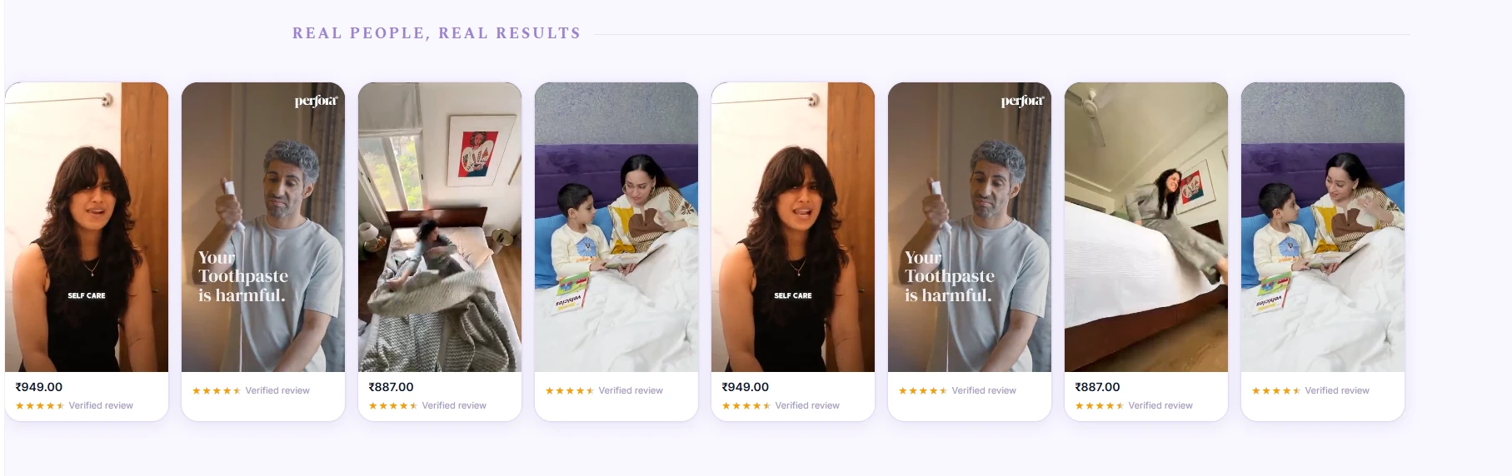
HOMEPAGE
Video reviews
1
Small section label
A quiet heading such as “Real people, real results”.
2
Row of tall video cards
Short customer videos in a sideways scroll.
3
Price under the video
Tapping goes to that product.
4
Stars and “Verified review”
A badge on every card to show it is real.
Reference only. Use Hopenskin's own customer videos, with the customer's permission.

Slide 11
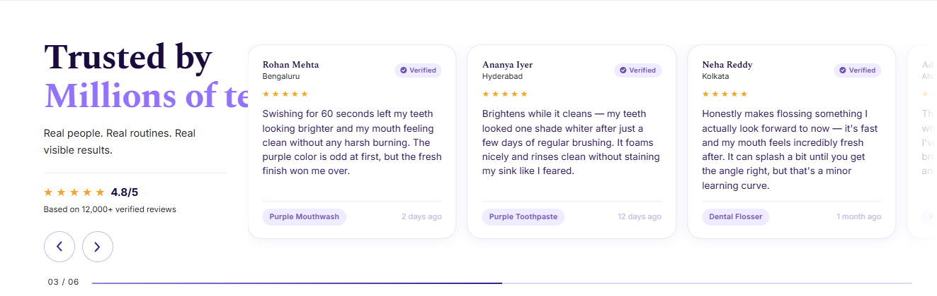
HOMEPAGE
Written reviews
1
Heading with accent words
Short title and a one-line promise under it.
2
Overall rating box
Star rating and total review count, using the real figures.
3
Review cards in a row
Name, city, “Verified” tag, stars and a short review.
4
Product tag and date
Shows which product was reviewed and when.
5
Arrows and progress bar
Visitor can move through the reviews.
Reference only. Show real, verified Hopenskin reviews only. Ratings and counts must come from the review app.

Slide 12
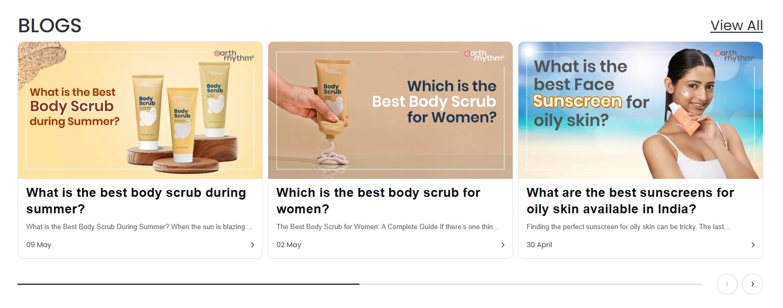
HOMEPAGE
Blogs section
1
Title and View All link
Title on the left, link to all articles on the right.
2
Three article cards
A branded cover image on top of each card.
3
Titles, teaser and date
Question-style titles, a two-line teaser, date and arrow.
4
Arrows and progress bar
Move through more articles.
Optional. Useful for search traffic and trust. Needs Hopenskin's own articles; we will confirm topics and who writes them.

Slide 13
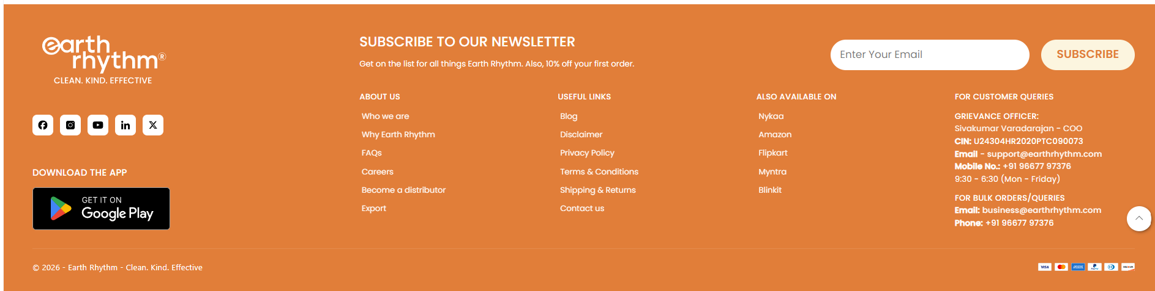
HOMEPAGE
Footer
1
Logo, tagline and social icons
Brand on the left, with links to its social pages.
2
Newsletter sign-up
Email box and a Subscribe button at the top of the footer.
3
Link columns
About, useful links (policies, shipping, contact) and where to buy.
4
Customer help and bulk orders
Support email, phone and working hours in one place.
5
Bottom bar
Copyright and the payment icons.
6
Back-to-top button
Round button at the corner.
Style reference with a request: make ours cleaner and easier to scan. Keep it to the links Hopenskin needs. Any offer in the newsletter text must be confirmed first.

Slide 14
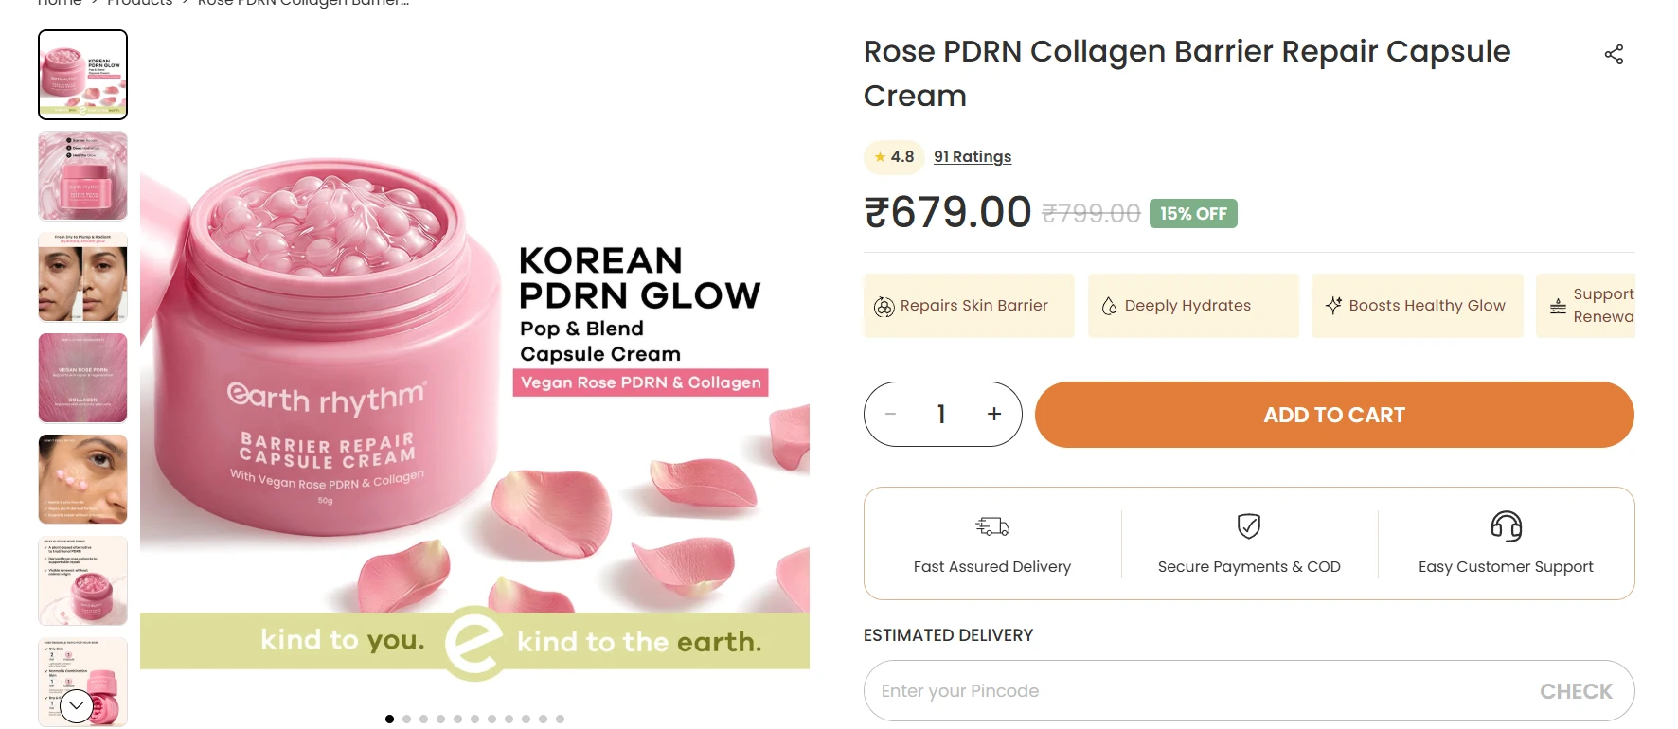
PRODUCT PAGE
Top of the product page (1 of 2)
1
Breadcrumb trail
Home > Products > product name.
2
Thumbnail strip
Tap a small picture to change the main image.
3
Large main image
Big picture, with dots to move through the gallery.
4
Product name and share icon
Large name with a share button at the right.
5
Rating chip
Stars and number of ratings. Tap to jump to reviews.
Reference only. Name, price, discount, rating and benefits must come from Hopenskin's own product data. Delivery promises must be confirmed first.

Slide 15
PRODUCT PAGE
Top of the product page (2 of 2)
6
Price row
Big price, old price struck through, green discount tag.
7
Benefit chips
3–4 short benefits with icons. Scrolls sideways on mobile.
8
Quantity and Add to Cart
Round quantity box and one wide, bold button.
9
Trust strip
Fast delivery, secure payment and COD, easy support.
10
Delivery check
Pincode box with a Check button for the delivery date.
Reference only. Name, price, discount, rating and benefits must come from Hopenskin's own product data. Delivery promises must be confirmed first.

Slide 16
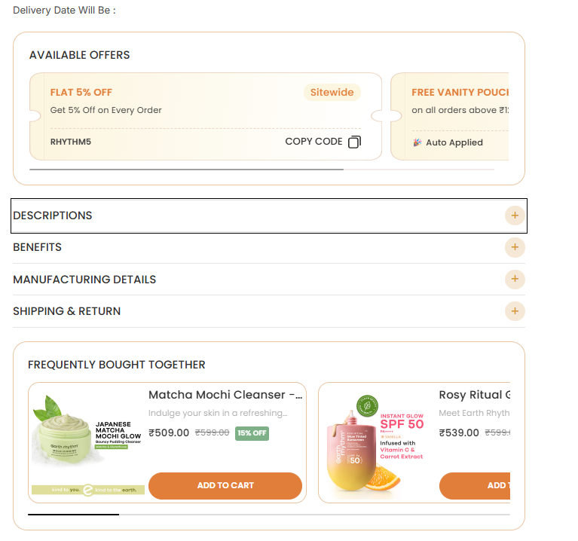
PRODUCT PAGE
Offers, details and add-ons
1
Delivery date line
Shows the delivery date right after the pincode check.
2
“Available offers” box
One rounded box with all current offers, just under the buy button.
3
Offer coupon cards
Ticket-style cards: title, short line, code with Copy Code button or “Auto applied”. Scrolls sideways.
4
Fold-out sections
Descriptions, Benefits, Manufacturing Details, Shipping & Return. Each opens with a plus sign.
5
“Frequently bought together” box
Suggests add-on products below the details.
6
Add-on product cards
Photo, name, teaser, price, discount tag and own Add to Cart. Scrolls sideways.
Reference only. Offers, codes and shipping text must be Hopenskin's own, confirmed by the brand. Do not copy the reference offers.

Slide 17
PRODUCT PAGE
Video reviews on the product page
1
Same video review row as the homepage
Placed below the offers and details on the product page.
2
Only videos for this product
Each product page shows the videos made for that product.
3
Tall video cards
Short customer videos in a sideways scroll. Tap to play.
4
Stars and “Verified review”
A badge on every card to show it is real.
Same style as the homepage slide. Use Hopenskin's own customer videos, with the customer's permission.

Slide 18
PRODUCT PAGE
Written reviews on the product page
1
Same review block as the homepage
Placed after the video reviews.
2
Overall rating box
Star rating and total number of reviews for this product.
3
Review cards in a row
Name, city, “Verified” tag, stars and a short review.
4
Photo reviews and filters
Nice to have: customer photos, and filters by star rating.
5
Arrows and progress bar
Visitor can move through the reviews.
Show real, verified Hopenskin reviews only. Ratings and counts must come from the review app.

Slide 19
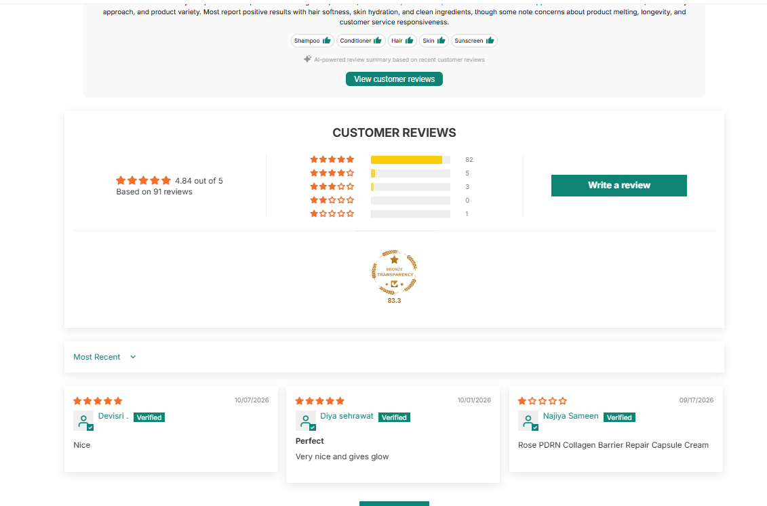
PRODUCT PAGE
Judge.me review block
1
Built with the Judge.me app
Install Judge.me on Shopify and use its review widget. Do not hand-build or type in reviews.
2
AI summary box on top
A short summary of what customers say, topic tags and a “View customer reviews” button.
3
Score and star bars
Overall score, review count, and a bar for each of 5 to 1 stars. Write a review button at the right.
4
Sort menu and review cards
“Most recent” sort, then cards with stars, name, Verified tag, date and text.
5
Load More button
Shows more reviews below without leaving the page.
Reference only. All scores, counts and reviews come from Hopenskin's own Judge.me account. Keep the page's colours consistent with the brand.

Slide 20
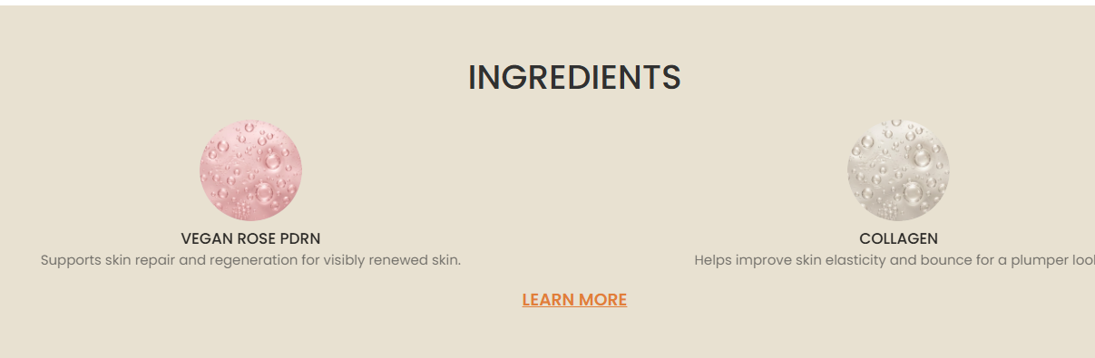
PRODUCT PAGE
Ingredients
1
Centered section title
Simple heading on a soft, plain background.
2
Round ingredient pictures
One round picture for each key ingredient.
3
Ingredient name
Short name in capitals under the picture.
4
One-line benefit
What the ingredient does, in plain words. Scrolls sideways if there are many.
5
Learn More link
Opens the full ingredient details.
Reference only. Ingredients and benefit lines must match Hopenskin's real product label and approved claims.

Slide 21
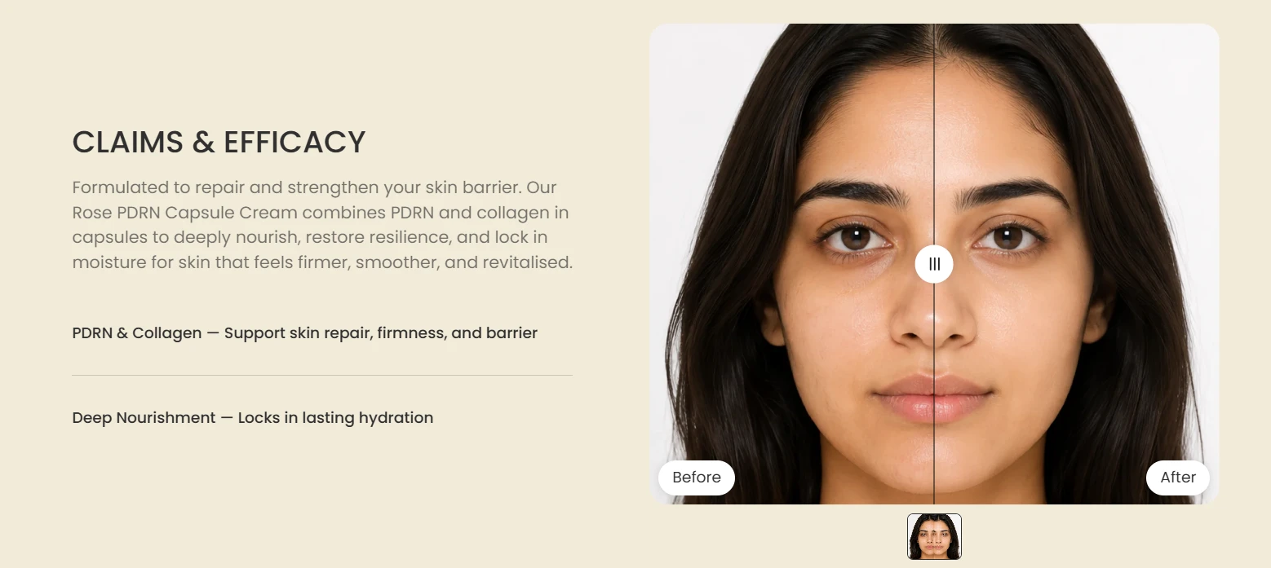
PRODUCT PAGE
Claims and before/after
1
Title and short intro
A plain heading and two to four lines on what it does.
2
Key claims as short lines
Ingredient or feature plus what it does.
3
Before and after slider
One face split in the middle. Drag the handle to compare.
4
Labels and thumbnails
“Before” and “After” tags, plus a strip to switch sets.
Reference only. Use only real, unedited customer or clinical photos, with consent, and only claims Hopenskin can prove. Do not use AI-made or retouched faces.

Slide 22
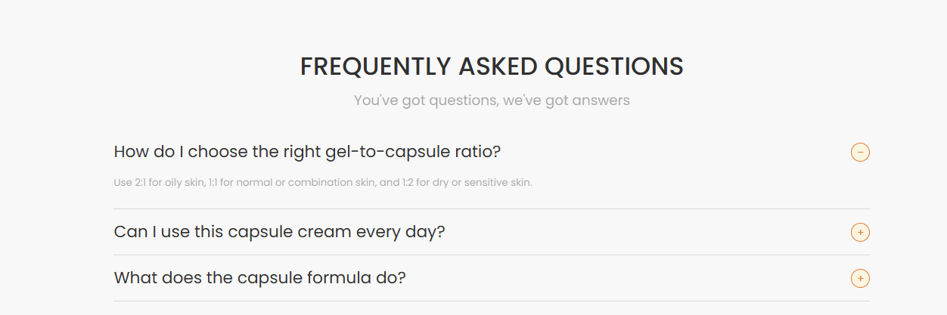
PRODUCT PAGE
FAQ
1
Title and friendly one-liner
Centered heading with a short, soft line under it.
2
Question rows
One question per row, separated by thin lines. Only the product's own questions.
3
Plus / minus button
Tap to open or close an answer. Only one open at a time keeps it tidy.
4
Short answer
One or two plain lines under the question when it is open.
Reference only. Questions and answers (usage, skin type, safety) must be written with Hopenskin and match the real product.

Slide 23
PRODUCT PAGE
Sticky Add to Cart bar
The page keeps scrolling here: details, reviews, FAQ
The bar stays fixed at the bottom of the screen
1
Appears when the buy button scrolls away
A bar fixed to the bottom of the screen. It stays visible while the visitor reads reviews and details.
2
Product mini-card
Small product picture, name, price, old price and discount tag, so the visitor always knows what they are buying.
3
Quantity and Add to Cart
The same quantity box and bold button as the top of the page. Must work on mobile too, full width.
Reference only. Product name, price and discount must update live with the chosen variant on Hopenskin's store.

