Slide 1

Web Automation Framework using Playwright and Pytest
Prepared by – Harsh Valecha

Slide 2
Objectives
Discussing Key Features of the Framework
File Structure Overview
Demo

Slide 3
Key Features of the Framework
Following are some features supported -
Page Object Model (POM) support for better test maintenance.
Automatically capturing screenshots on test failure.
Parallel execution of test cases to speed up testing.
Built-in automatic waits for stable test execution.
Debugging capabilities using Playwright's debugger.
Test script generation using Playwright’s codegen feature.
Easy identification of web elements using Playwright’s locator picker.
HTML reporting using allure report
Data-driven testing with support for database connectivity.

Slide 4
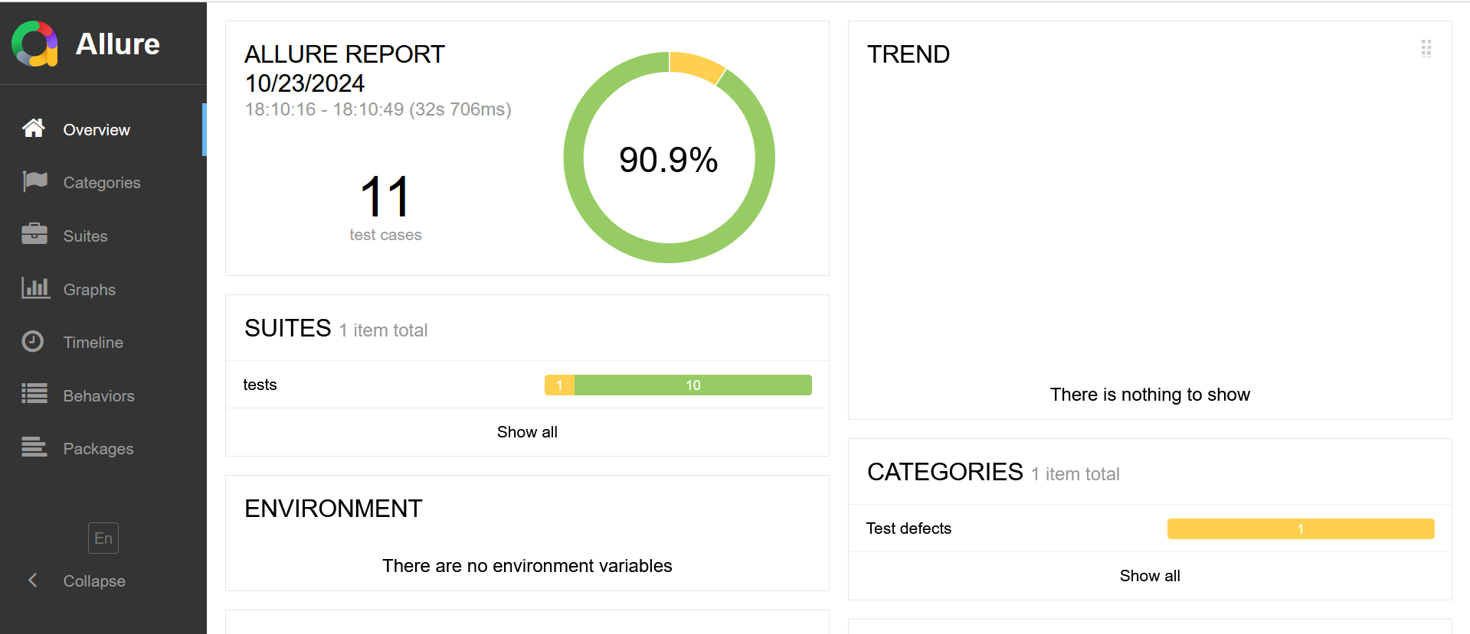
Automated Test Results - HTML Report

Slide 5
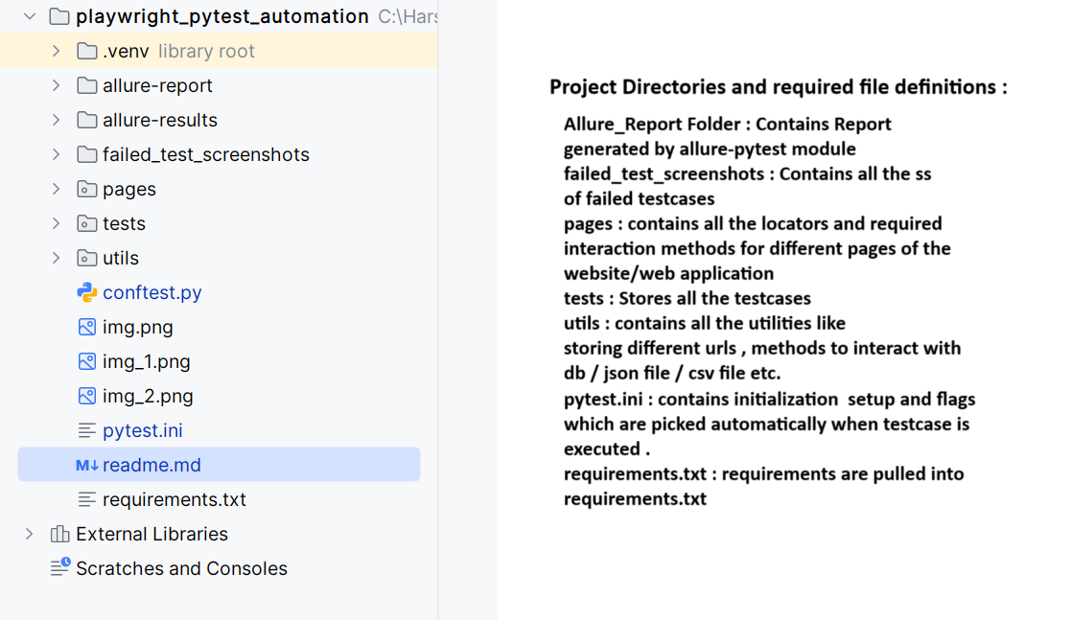
File Structure Overview

Slide 6
Setup and Installation
To Download all the required modules -
``` pip install –r requirements.txt ```
To Run the Project -
``` pytest ```
To Run a specific test file -
```pytest tests/filename.py```
To Run a testcase having a substring -
```pytest –k string_to_search```
To generate the allure Report of the test results -
```allure generate allure-results --clean -o allure-report```

Slide 7
Demo

Slide 8
Thanks !
Link for the Project - playwright_pytest_automation

