Slide 1


Clustering and segmenting new York counties to see Covid-19 Impact

Slide 2
Business problem
World has been facing an unprecedented threat of Covid-19.
In the United States, New York is one of the worst hit state by Covid-19.
The problem – To find top five venue categories in New York that must be responsible for the spread.
Intended audience for this analysis is common man who either resides in New York or is visiting New York.

Slide 3
Data preparation
For this project we need the following data:
United States’ confirmed COVID-19 cases data that contains list of counties (Admin2) of each state with their longitudes and latitudes. Data Source: https://raw.githubusercontent.com/CSSEGISandData/COVID-19/master/csse_covid_19_data/csse_covid_19_time_series/time_series_covid19_confirmed_US.csv
Venues in each county of New York
Data Source: Four-square APIs
The venue data includes venue name, venue categories and location coordinates.

Slide 4
Data cleaning:
Import libraries such as numpy, pandas, urllib.
Set parameters to make the output easier to read.
Load the data frame into pandas data frame to explore the data.
Urllib.request. is used to fetch URLs.
Once its loaded, we’ll remove information that is not required in our analysis.

Slide 5
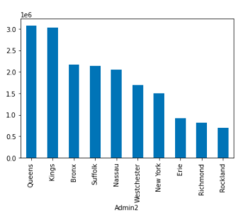
Data cleaning:
Feature Selection : Now we select required features like UID, Admin2(County), Provine_state, Lat(Lattitude),Long_(Longitude), total_confirmed_cases.
From the United states dataset, we have only data of New York state.
In New York, we take into account only 10 Admin2(counties) with most confirmed cases.

Slide 6
Methodology
Foursquare API Credentials and Version
Retrieve data from Foursquare APIs- venue name, category of venue, latitude and longitude of venues.
Combine New York dataset with the venues extracted from the Foursquare.
Analyze the New York dataset which contains top 10 highly confirmed cases of Covid-19 counties(Admin2).

Slide 7
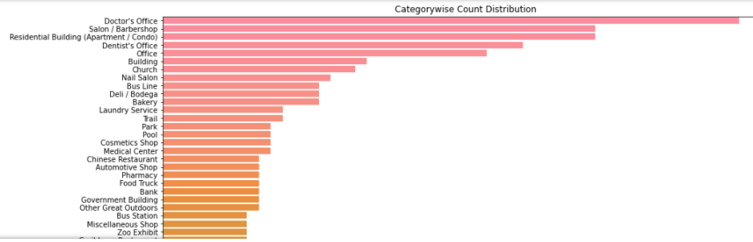
Analysis
Explore the venue categories by plotting the bar graph to see which categories has the most foot traffic and which categories has the low foot traffic by New Yorkers.
Doctor office, Salon/Barbershop, Residential buildings/condos, office have the maximum frequency of person visit.

Slide 8
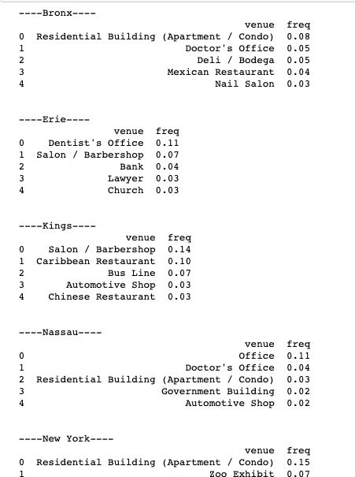
Visualization
Now, we are looking into the top 5 most common venues of each county(Admin2) and the frequency of visitors in each category. This would be a great step to visualize except resturants and bars which other categories contributing to Covid-19 spiking in beginning of this pandemic.

Slide 9
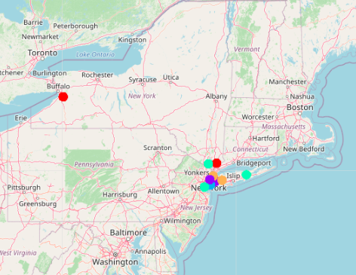
Visualization:
Cluster all the similar venues and the relationship amongst them.
Used Kmeans clustering machine algorithm.
Clustered into 5 groups shown in the map.

Slide 10
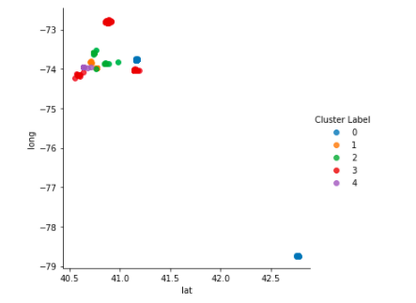
Results :
Cluster 0: Salon/Barbershops, Nail shops, college classroom and dentist office showing lot of foot traffic.
Cluster 1: Residential buildings/Condo, Deli, Doctor’s office, Bus line.
Cluster 3: Farm, Doctor’s office, other great outdoors, Bus station
Cluster 4: Residential Buildings/ condos, Doctor’s office, Deli, Resturants.

Slide 11
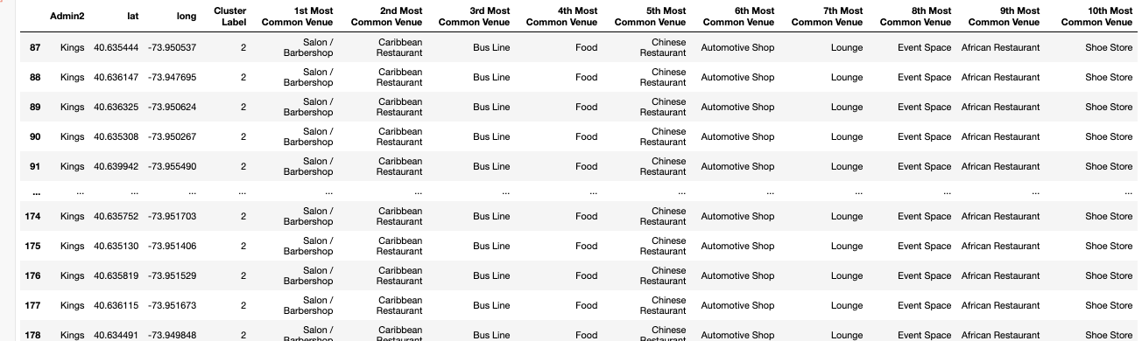
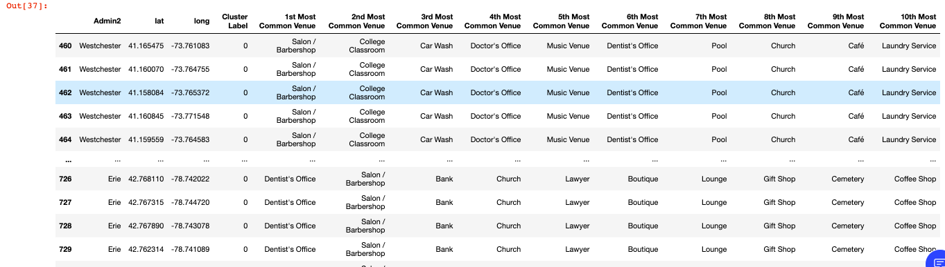
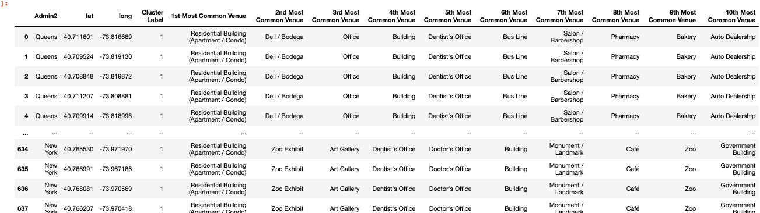
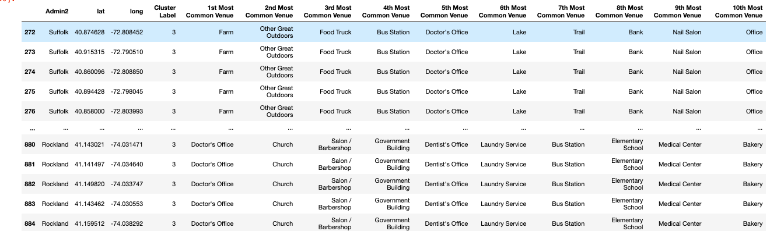
CLUSTERS: 0,1,2,3,4
.

Slide 12
DISCUSSION AND CONCLUSION
From the cluster analysis, we noticed some venues are quite common for visitations.
Revealed the missing top four categories while the restaurants and bars fall under the fifth and sixth category of this spread.
Conclusion:
The purpose of this project was to explore the most affected counties of New York and to get the rough idea of which places this virus has spread.
Nothing has fostered the increase of Covid-19 spread more than private family gatherings according to cluster analysis.
After merging data from the Four-Square API, I have the performed EDA to reveal a few interesting observations and I have also performed K means clustering on the data set based on different counties confirmed cases.
This revealed us possible hotspots for the spread of virus.

Slide 13

Thank you!

