Slide 1
IBM University Engagement Project Submission
“Exploring the Power of Agentic AI with IBM Watsonx Studio and IBM Bob”

Slide 2

Project Tile – [AI Chatbot for Admission Details and Student FAQs]
Domain of Project – [ Education ]
Student Name | Recent Passport Photo | Email ID | Mobile number [WhatsApp]
Harsh Sharma |  | harsh0012300@gmail.com | 9958227784
Recommended font style and size:
Font Style: Arial
Font Size (Heading): 28
Font Size (Content): 20

Slide 3
Problem Statement -
Problem Statement No.4 - College Admission Agent ( RAG Based )
The Challenge - A College Admission Agent, powered by RAG (Retrieval-Augmented Generation), streamlines the student admission process. It retrieves and summarizes admission policies, eligibility criteria, and FAQs from institutional databases and official sources. Prospective students can ask natural language questions and receive accurate, up-to-date responses instantly. The agent helps with course selection, application guidance, fee structure, and important deadlines. Using trusted, real-time data, it reduces manual inquiries and enhances applicant experience. This AI-driven assistant boosts transparency, accessibility, and efficiency in college admissions.
The Objective
To design, develop, and deploy a responsive, web-based Student Admission Support Chatbot using Node.js (Express) integrated with IBM Watson Assistant, providing prospective students with real-time, automated responses to queries regarding university programs, eligibility criteria, application deadlines, fee structures, and required documentation.
Key Highlights to Include in Your Project Report
Primary Purpose: Automate first-tier student admission support to handle repetitive inquiries 24/7.
Technology Stack: Node.js, Express.js, REST API, HTML/CSS/JavaScript, and IBM Watson Assistant v2 API.
Key Capabilities: Intent recognition, customized conversational dialog flows, quick-action prompts, and seamless frontend-backend API communication.

Slide 4
Proposed Solution -
Proposed Solution
To solve the challenge of managing high volumes of student admission inquiries and reducing manual response delays, this project proposes a web-based, conversational AI solution: the Student Admission Support Chatbot.
The solution combines a lightweight Node.js (Express) web server with the IBM Watson Assistant v2 API to provide instant, automated, and accurate responses to prospective students 24/7.
Solution Architecture & Components
Frontend Interface (public/)
  User-Friendly Chat Web UI: Built with HTML5, CSS3, and modern JavaScript to present a clean, intuitive chat interface accessible from any desktop or mobile browser.
  Interactive Quick Prompts: Includes visual quick-action chips (e.g., Deadlines, Fee Structure, CS Eligibility) allowing users to trigger popular queries with a single click.
Backend Application Server (server.js)
  Express REST API: Acts as a secure intermediary between the client browser and the cloud-hosted NLU service.
  Session Management: Dynamically creates and manages IBM Watson API session IDs to maintain seamless multi-turn conversation states per user.
  Environment Security: Uses .env configuration to keep API keys and Service URLs securely decoupled from the codebase.
Cognitive AI Engine (IBM Watson Assistant)
  Natural Language Understanding (NLU): Process user inputs to identify intent regardless of phrasing variations (e.g., recognizing "When is the deadline?" and "Last date to apply" as the same request).
  Custom Action Flows: Configured with domain-specific admission logic covering eligibility criteria, document requirements, tuition fee breakdowns, and enrollment deadlines.
Expected Outcomes & Business Value
24/7 Support Availability: Provides instant answers at any hour without requiring manual staff intervention.
Reduced Support Load: Automates repetitive tier-1 admission queries, allowing university administrators to focus on complex cases.
Scalable Infrastructure: Easily expandable to handle higher user concurrency during peak admission seasons or integrate additional channels (WhatsApp, Mobile Apps, SMS).

Slide 5
Technology Used
Frontend UI Layer
HTML5: Provides the semantic document structure for the chat interface, including header components, the conversation history container, quick-action chips, and user input fields.
CSS3: Controls visual styling, responsive design, color themes, flexbox/grid layouts, and distinct styling for user versus assistant message bubbles.
JavaScript (ES6): Manages frontend interactivity, DOM manipulation, quick-chip click handlers, and asynchronous fetch() API calls to communicate with the backend.
Backend Server Layer
Node.js: Serves as the cross-platform, server-side JavaScript execution runtime environment.
Express.js: Web framework used to serve static web assets from the public/ folder and expose API routes (/api/message) for messaging requests.
ibm-watson SDK: Official Node.js library used to instantiate the AssistantV2 client and handle session lifecycle management.
dotenv: Node environment manager used to load sensitive Watson API keys, Service URLs, and Assistant IDs securely from .env files.
Cognitive AI Layer
IBM Watson Assistant (watsonx Assistant): Cloud-hosted Natural Language Understanding (NLU) platform configured with custom Actions, intent training sets, user example phrases, and automated dialog responses.
Development & Runtime Tools
IBM Bob : Code editor and integrated development environment (IDE) used for writing code, configuring project files, and managing terminal sessions.
PowerShell / Windows Terminal: Command-line shell used for directory navigation, installing npm dependencies, and executing local development server scripts (node server.js / npm start).

Slide 6
Components Used -
Agents: The core AI assistant configuration defined via manifest files (such as agent.yaml) containing instructions, system prompts, model mappings, and behavior rules.
Tools: Python functions or external API integrations that enable the agent to query external systems, execute logic, or retrieve data.
Flows / Workflows: Multi-step orchestrated logic patterns built to handle complex decision trees, user data collection, or sequential processing tasks.
Knowledge Bases: Document repositories or vector data sources connected to the agent to provide grounded, context-specific answers regarding student admissions.
Connections: Authenticated credentials and service connectors required to securely link tools to external databases or APIs.
ADK CLI & Environment: The local development tools, command-line interface, and package manager (uv) used to test, activate environments, and push deployment assets.
IBM Bob: Used for AI-assisted code generation, rapid prototyping, and accelerating development tasks.
Watson Studio: Used for data preparation, building machine learning models, and orchestrating the creation and training of the chatbot.

Slide 7
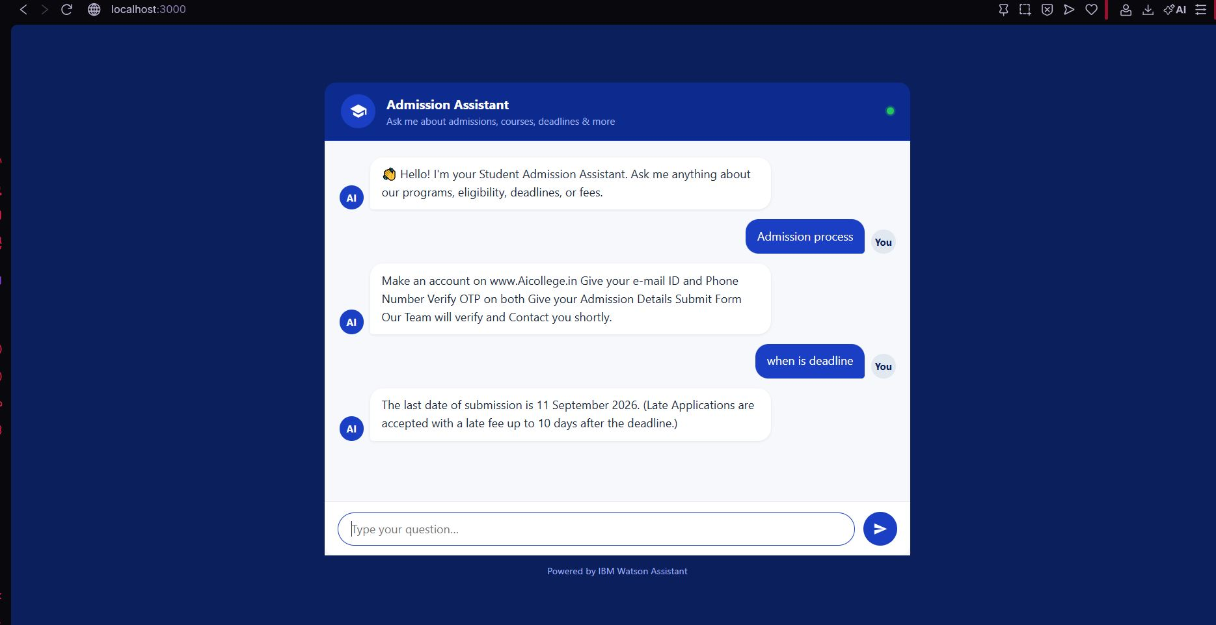
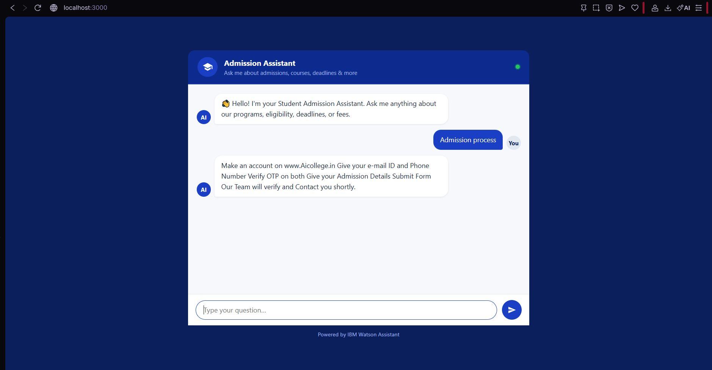
Diagrams-

Slide 8
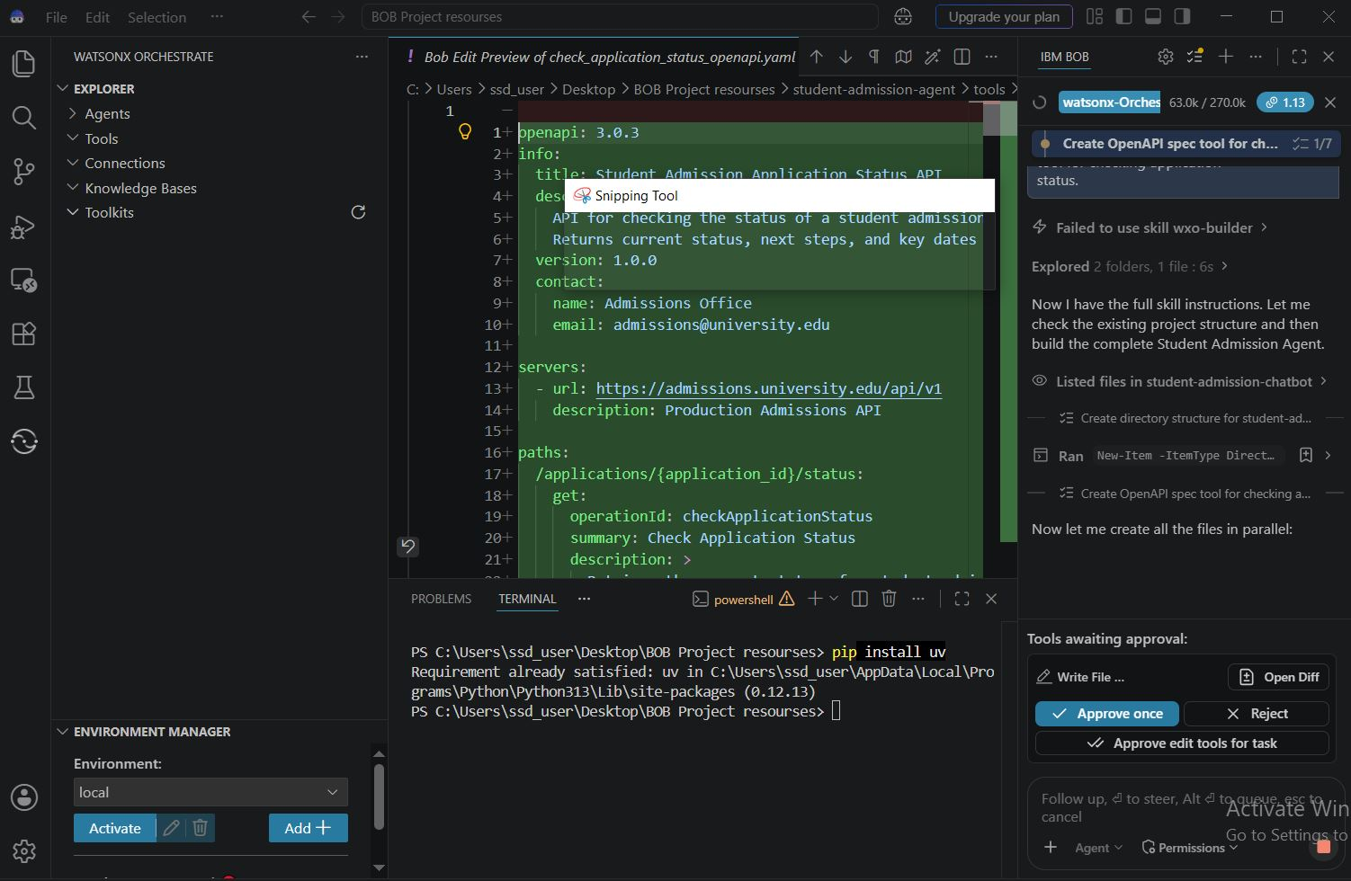
Code using IBM BOB AutoCode

Slide 9

Role of Agentic AI in the solution
Role of Agentic AI in Student Admission AI Helper
Agentic AI enables the Agent to function as an intelligent, autonomous system rather than a simple chatbot. Using IBM watsonx.ai, it coordinates multiple specialized agents to deliver useful answers.
Each agent performs a specific role—such as retrieving admission data, generating admission plans, providing info,while working collaboratively. This multi-agent approach ensures efficient task execution and accurate results.
Overall, Agentic AI makes the system proactive, personalized, and goal-driven, acting like a 24/7 smart digital query solver that helps students in admissions and FAQs.

Slide 10


Token Usage
11,761 token are used
Before Prompt
After the Prompt
·
·
·

Slide 11
Novelty and Uniqueness
AI-driven personalization: Unlike static FAQ pages, the chatbot adapts responses based on student queries, offering tailored information about fees, eligibility, and admission processes.
24/7 availability: Students can access admission details anytime, reducing dependency on office hours and manual staff intervention.
Natural language understanding**: IBM Watson’s NLP capabilities allow the chatbot to interpret varied student queries (e.g., “What’s the fee for Computer Science?” vs. “How much does Computer Science cost?”) and respond accurately.
Interactive guidance: Beyond FAQs, it can guide students step-by-step through admission forms, deadlines, and required documents.

Slide 12
Git Hub Link
Please create public github repository (Enable Add README button while creating repository) with format –
Please test and Paste the working Github URL – https://github.com/harsh0012300-cloud/AICTE-College-Admission-Agent-IBM-Bob
Make sure you have Uploaded following three files into your github repository
1) app.json file , 2) yourproblemstatement.pdf file 3) your projectpresntation.pptx file 4)any other files
·
·
·

Slide 13
Future Scope
- Integration with admission portals: Directly connect the chatbot with online application systems to allow students to fill forms, upload documents, and track status.
- Voice-enabled interaction: Adding speech recognition for students who prefer voice queries, making the system more accessible.
- Predictive analytics: Using AI to predict admission trends, student interests, and program demand based on chatbot interactions.
- Virtual counseling: Extending the chatbot to provide career guidance, course recommendations, and personalized counseling sessions.
- Integration with payment systems: Allowing students to check fee structures and even make secure payments directly through the chatbot.
- Continuous learning: With Watson’s machine learning, the chatbot can evolve to answer new queries and improve accuracy over time.
- Cross-platform deployment: Expanding availability across mobile apps, websites, WhatsApp, and social media to reach students on their preferred platforms.
·
·
·

Slide 14
Certificates Earned:
Please add your credly certificate

Slide 15
Certificates Earned:​
Add your IBM BOB Certificate

Slide 16


