Slide 1
Mini Project 3
Generative Adversarial Nets
Goodfellow, Pouget-Abadie, Mirza, Xu, Warde-Farley, Ozair, Courville, Bengio
NeurIPS (NIPS) 2014 · Advances in Neural Information Processing Systems 27 · Université de Montréal · arXiv:1406.2661
Research problem & motivation
Main contribution
Deep generative models relied on intractable likelihood computations and approximate inference
Hard to exploit the success of piecewise-linear units in generative models
Goal: a generator trained purely with backpropagation
Adversarial framework: generator G and discriminator D play a two-player minimax game
At the optimum, G matches the data distribution and D outputs ½ everywhere
No Markov chains or inference: sampling is a single forward pass
GitHub: [paste your repository link here]
Colab notebook: colab.research.google.com/drive/1E_9PuhEafMA9WoBxo3sg2rQIAdcJYwOK
Harsh Kukadiya (202311034)
Bhumit Solanki(202311081)
Abhi Virani (202311086)
Arun Prajapat(202311017)
Notes:
Overview of the paper (Goodfellow et al., NIPS 2014) and why it mattered: it introduced a generative model trained without Markov chains or approximate inference. The image is our own epoch-60 sample grid. Replace the GitHub placeholder with your repository link.

Slide 2
Methodology: Adversarial Training
Noise z
100-d vector, Uniform[−1, 1]
Generator G
100 → 512 → 512 → 784
BatchNorm + ReLU, Sigmoid out
Fake image G(z)
784 values = 28×28 pixels
Discriminator D
Maxout 784 → 240 → 240 → 1
5 pieces, dropout 0.2 / 0.5
Real / fake score
Logit → BCE loss
(real label 0.9, fake 0)
Minimax objective
min_{G} max_{D} V(D,G) = E[ log D(x) ] + E[ log(1 − D(G(z))) ]
Real image x
MNIST digit
Each iteration: one D update, then one G update (k = 1)
Dataset: MNIST
Key methodology steps
Key parameters & techniques
70,000 handwritten digits, 28×28 grayscale
Split: 50,000 train, 10,000 validation, 10,000 test
Pixels scaled to [0, 1] and flattened to 784-d vectors
Sample a minibatch of 128 real images and 128 noise vectors
Update D: real images → 0.9, generated images → 0
Draw fresh noise; update G so D labels its output real
Repeat for 60 epochs (390 iterations each)
Adam, lr 2e-4 for G and D, β1 = 0.5
Batch 128, 60 epochs, seed 0
Maxout units + dropout in D; BatchNorm in G
One-sided label smoothing; non-saturating G loss
Notes:
Workflow: noise goes through G to make a fake image; D sees both fake and real images and outputs a real/fake score. D is trained to separate them, G is trained to fool D. Explain the minimax objective, then the practical tweaks (non-saturating loss, label smoothing).

Slide 3
Reproduction & Implementation
Tools & technologies
Changes from the original paper
Python, PyTorch, torchvision, NumPy, Matplotlib
Google Colab with a CUDA GPU
Component | Original paper | This reproduction
Optimizer | SGD with momentum | Adam (lr 2e-4, β1 0.5)
Generator | Rectifier + sigmoid units | 512-512 MLP, BatchNorm + ReLU, sigmoid output
Discriminator | Maxout units + dropout | Maxout 240 units × 5 pieces, dropout 0.2 / 0.5
G loss | Minimise log(1 − D(G(z))) | Non-saturating: maximise log D(G(z))
Real labels | Hard label 1 | One-sided smoothing to 0.9
Evaluation | Parzen-window log-likelihood | Visual samples, loss curves, nearest neighbours, interpolation
Dataset preparation
MNIST loaded through torchvision
Pixels divided by 255, flattened to 784
50,000 / 10,000 / 10,000 train / val / test
In-memory TensorDataset, shuffled, drop_last
Approach & experimental setup
Custom Maxout layer: linear, reshape, max over pieces
Alternating updates, k = 1; 390 steps × 60 epochs
Fixed 100 noise vectors to track progress each epoch
Seed 0; batch 128; Adam lr 2e-4
Notes:
Be clear that the core architecture idea (maxout discriminator with dropout, MLP generator, k=1) follows the paper, while the optimizer, BatchNorm, non-saturating loss and label smoothing are modern stabilising practices. The Parzen-window metric was not reproduced.

Slide 4
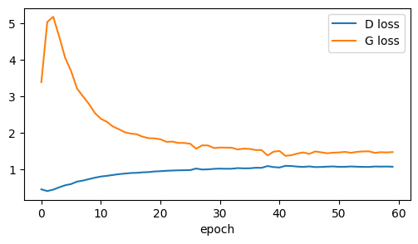
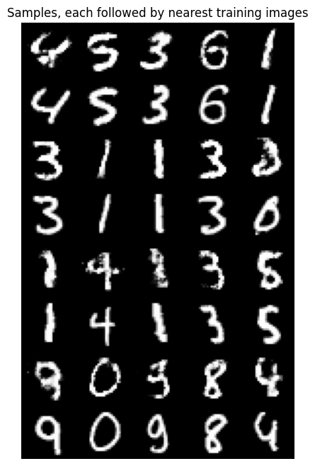
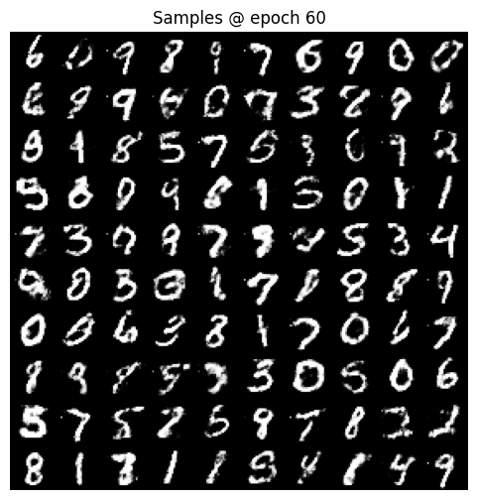
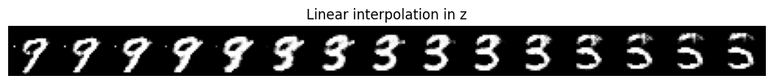
Results & Comparison
Paper: Parzen log-likelihood on MNIST (higher is better)
1.08
final D loss
1.48
final G loss
60
epochs
Losses plateau after ~epoch 40: stable training, no divergence
Aspect | Original paper | Our reproduction
Metric | 225 ± 2 (Parzen, MNIST) | Not computed; judged visually and from loss curves
Sample quality | Recognisable digits; top score of the four models | Clear digits of all 10 classes; some noisy or malformed
Novelty | Samples are not memorised training images | Nearest training images are cleaner; no exact copies
Latent space | Smooth interpolation between samples | Smooth morph 9 → 3 → 5
Nearest-neighbour check
Each generated digit is followed by its closest training image. Same class and similar shape, but the samples are noisier, so G is not copying the training set.
Notes:
Paper numbers are from Table 1 of Goodfellow et al. (Parzen-window estimates, MNIST). Our notebook did not compute Parzen log-likelihood, so the comparison is qualitative. D loss uses label smoothing, so its equilibrium reference value is 2 ln 2 = 1.386; we end at ~1.08 (D slightly ahead) and G at ~1.48.

Slide 5
Conclusion & Learning
Reproduced?
Major findings
Differences from the paper
Yes, qualitatively
Noise blobs at epoch 1, clear digits by epoch 10, sharper by 60
D ≈ 1.08 and G ≈ 1.48 plateau; no collapse
Smooth latent interpolation; no memorisation
Adam, BatchNorm, label smoothing, non-saturating loss
No Parzen log-likelihood
Some samples remain noisy or malformed
The adversarial setup learned to generate recognisable, diverse MNIST digits, matching the paper's main claim. The Parzen-window score (225 ± 2) was not reproduced, so the numerical comparison is still open.
Challenges faced
Future work
Loss values do not measure sample quality
Balancing D and G; tuned dropout, β1 and label smoothing
Paper omits some hyperparameters
Add Parzen-window evaluation and FID
Convolutional (DCGAN) and conditional GAN
Ablate BatchNorm, k and label smoothing
Key takeaway: two networks trained only with backpropagation can learn to generate realistic digits, but judging GAN quality still needs more than loss curves.
Notes:
Summarise honestly: qualitative reproduction succeeded; the quantitative Parzen-window metric was not evaluated. Future work would close that gap.

