Slide 1



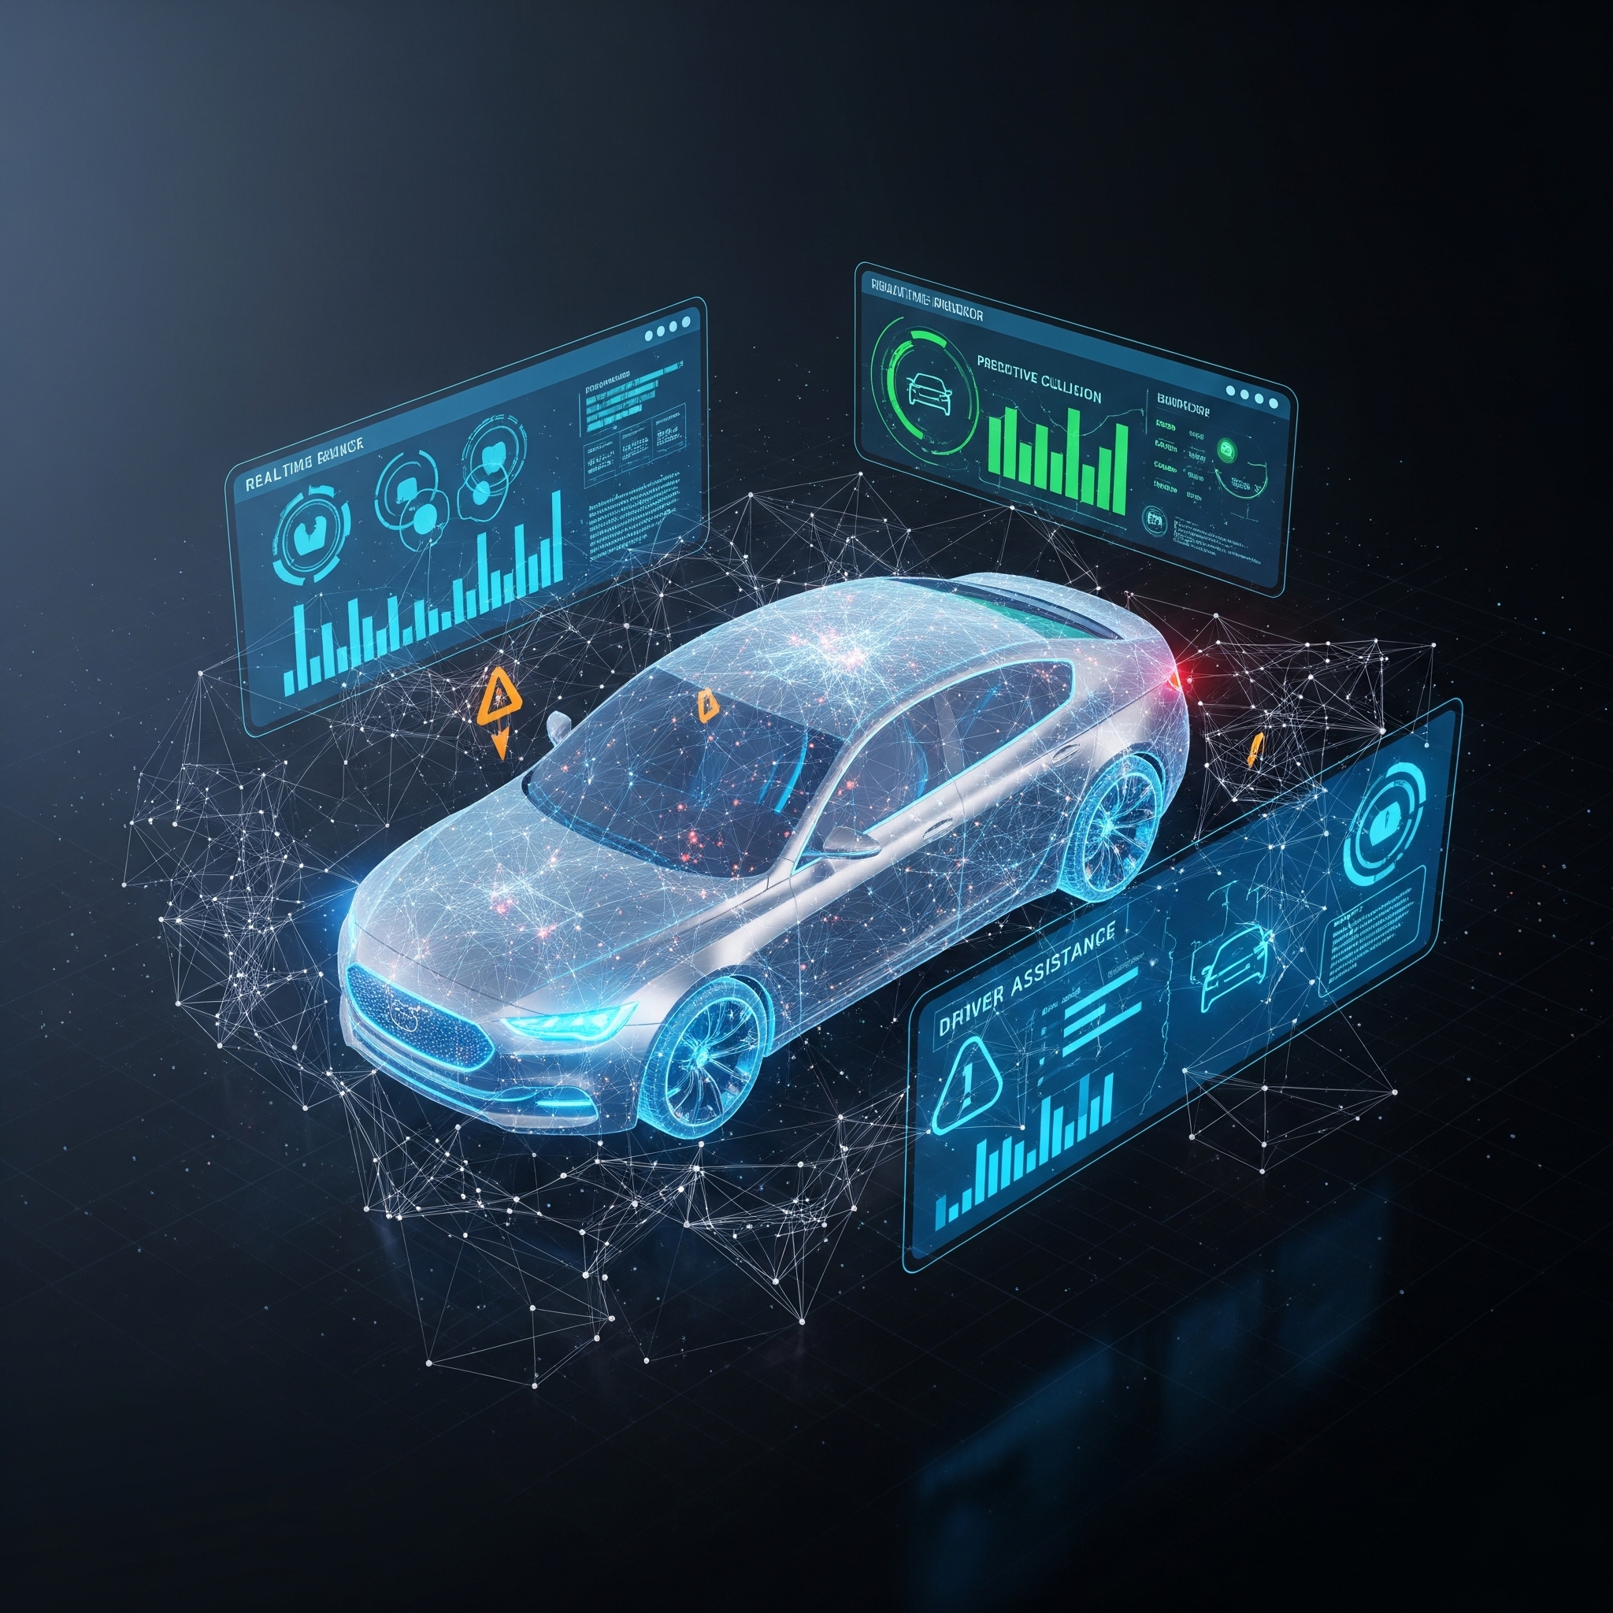

ET AutoTech
Hackathon 2026
AI for ADAS Adoption in India
Team Nivāra
Harsh Khandelwal

Slide 2
Project Nivāra: Brief Summary & Proposed Solution
THE PROBLEM: ALERT FATIGUE
Western-calibrated ADAS systems trigger constant panic beeps in Indian traffic (two-wheelers, proximity driving), leading drivers to permanently disable life-saving features like AEB and LKA.
THE SOLUTION: PROJECT NIVĀRA
A software-only middleware using Edge AI to learn driver baselines and local traffic context. It replaces binary panic beeps with a calm, 3-tier ambient visual and haptic language.
Innovation Status: Revolutionary Improvement
Nivāra fixes the broken Human-Machine Interface (HMI) without expensive new hardware. It acts as an intelligent silencer, ensuring alerts only trigger when they truly matter.
ET AutoTech Hackathon 2026 | Team Nivāra

Slide 3
IMPACT OF PROPOSED SOLUTION
IMPACT (SAFETY OUTCOMES)
Drastic Reduction in Alert Fatigue
Suppresses up to 85% of false-positive auditory alerts during dense city driving.
Maximized Feature Retention
Shifts driver response from frustration to trust, increasing ADAS retention from 15% to >70%.
Saved Lives
By keeping the system ON, Nivāra guarantees AEB remains active for actual emergencies.
SCALABILITY
Zero Hardware Cost: No new cameras/radar needed.
OTA Ready: Global deployment via software updates.
Agnostic: Compatible with AAOS & OEM stacks.
FEASIBILITY
Edge-Optimized: <5ms processing on existing vehicle SoCs.
Privacy-First: Entirely on-device, zero cloud required.
ET AutoTech Hackathon 2026 | Team Nivāra

Slide 4

PROPOSED TECH STACK & ARCHITECTURE
memory
dashboard
settings_input_component
EDGE AI / BACKEND
High-performance processing for driver profiling.
Python 3.11 & FastAPI
XGBoost & Pandas
Scikit-learn
Temporal Nuisance Filtering
HMI / FRONTEND
Fluid, ambient cluster UI with zero latency.
ReactJS 18
Tailwind CSS
Framer Motion
Low-Latency Rendering
DATA PIPELINE
Real-time telemetry streaming for instant response.
WebSockets
<10ms Streaming Latency
Vehicle CAN Bus Sync
Digital Cluster Bridge
ET AutoTech Hackathon 2026 | Team Nivāra

Slide 5
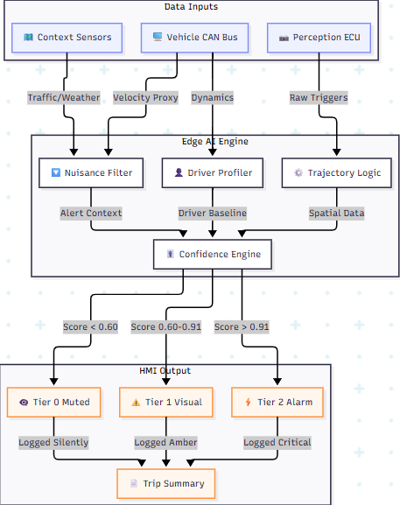
SYSTEM ARCHITECTURE
ET AutoTech Hackathon 2026 | Team Nivāra

Slide 6
WHY NIVĀRA?
error_outline
verified
THE PROBLEM
Traditional tech-first solutions build complex models for detection, but ignore the human element.
A perfect sensor is useless if the driver unplugs it because it gives them a headache.
THE SOLUTION
Nivāra tackles the human behavioral bottleneck by aligning with Indian regulations (GSR 188/AIS-184).
We offer OEMs a localized solution to consumer pushback, making cars culturally adaptable to India.
ET AutoTech Hackathon 2026 | Team Nivāra

Slide 7

ADDITIONAL INFORMATION
UX PHILOSOPHY: EXPLAINABILITY BY SUBTRACTION
Nivāra operates silently in the background, prioritizing driver trust without demanding cognitive attention.
Utilizes a unique "Explainability by Subtraction" UX framework.
Avoids distracting gamification or intrusive driving scores.
Provides a simple end-of-trip summary (e.g., "Silenced 12 nuisance alerts today").
Silently reinforces positive behavior through non-intrusive feedback.
info
ET AutoTech Hackathon 2026 | Team Nivāra

Slide 8

THANK YOU
Let's drive the future together.
ET AutoTech Hackathon 2026 | Team Nivāra

