Slide 1
A Mechanistic-Interpretability Metric for the
Hubble Unlearning Benchmark
D_mech — a logit-lens distance metric — and its head-to-head against the
OpenUnlearning metric suite under the SPID faithfulness meta-evaluation
Is a metric derived from internal representations more FAITHFUL than output/lexical metrics?
Hubble-8B · logit lens + tuned lens · SPID / OpenUnlearning protocol

Slide 2
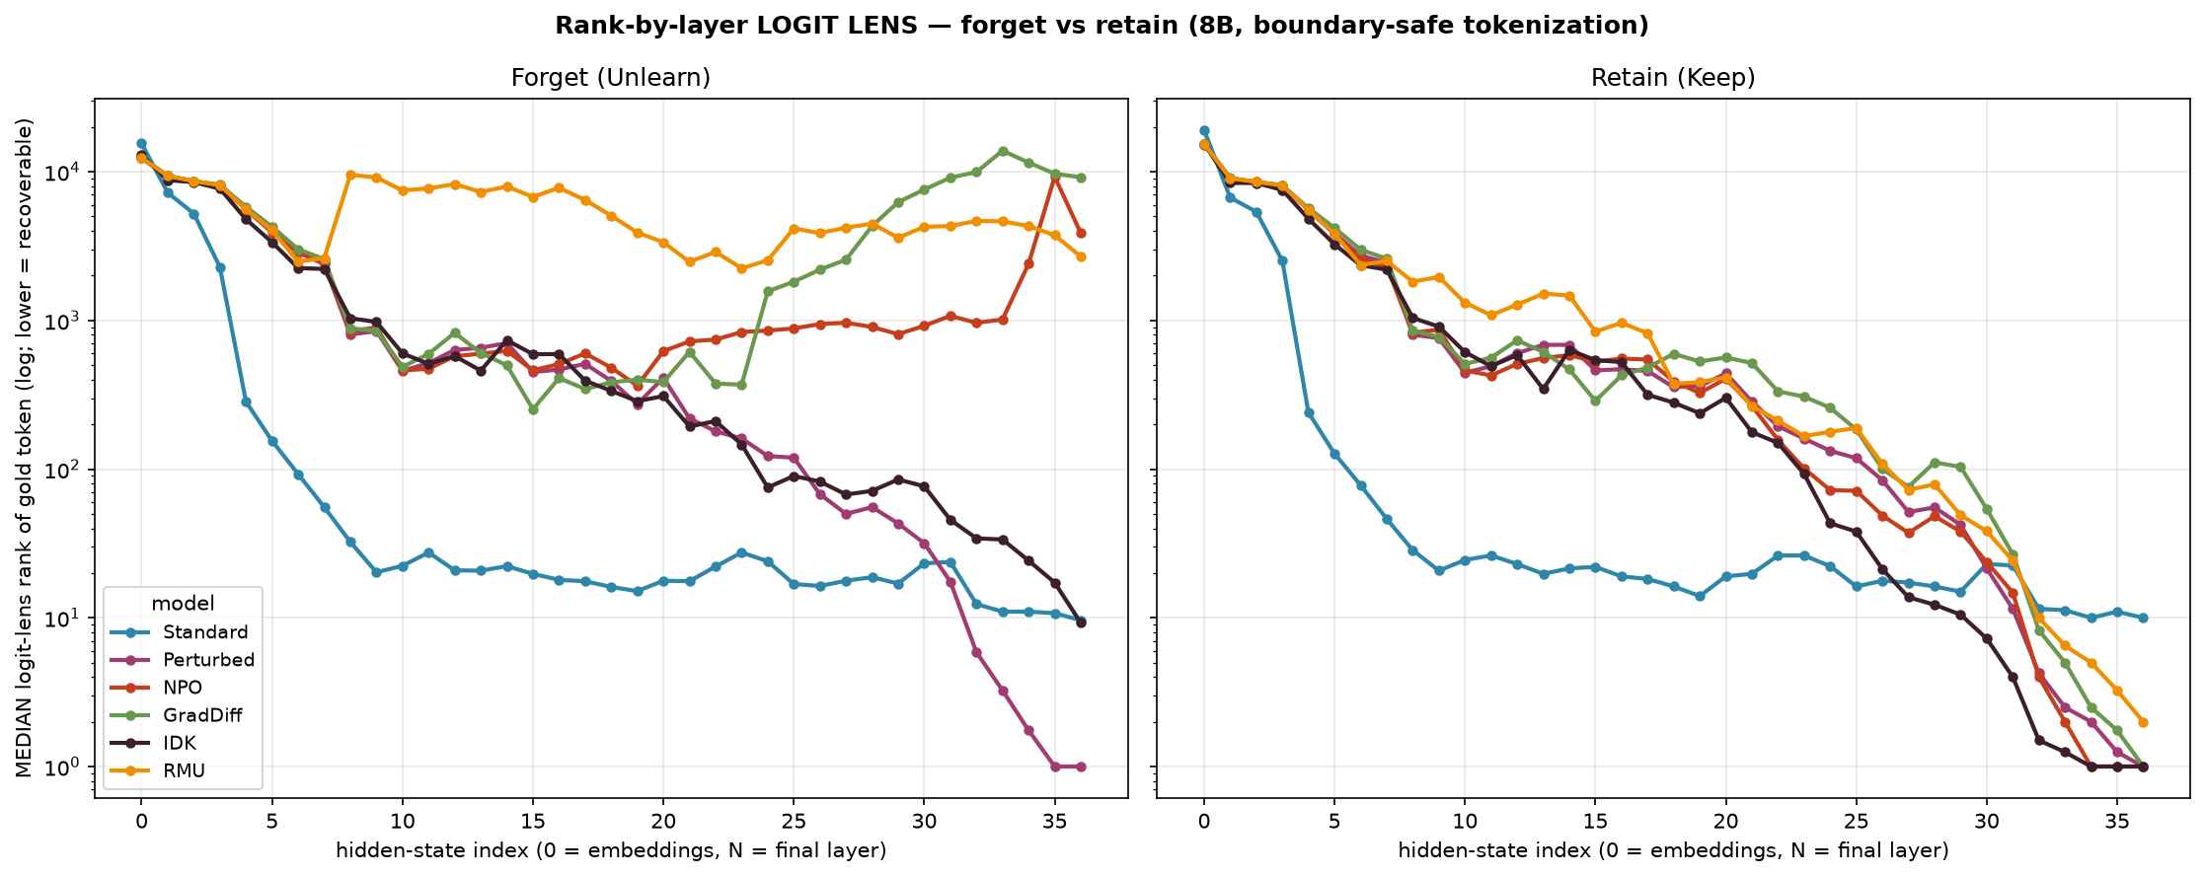
The problem: output metrics can't see inside
output says "forgotten" — but is the fact erased, or just gagged?
• At the OUTPUT, all unlearning methods look identical — every method scores near the never-knew floor on infill accuracy.
But the logit lens reads the gold token's rank at EVERY layer.
• Surface methods (NPO, GradDiff) keep the token recoverable mid-stack (rank ~365) then suppress it only at the output (→3.8k–9k).
• RMU alone buries it deep and early — genuine disruption, not an output mask.
Output suppression ≠ erasure — and only the internal readout can tell them apart.

Slide 3
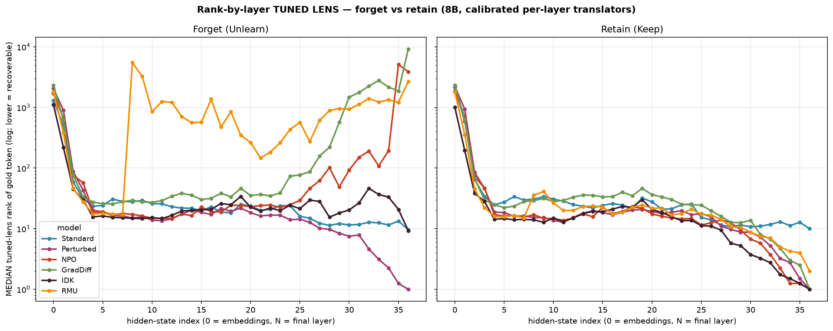
Not a readout artifact: the tuned lens agrees
calibrated per-layer translators reproduce the same ordering (Spearman 1.0)
• The raw logit lens is uncalibrated mid-stack — could the separation be an artifact?
• The tuned lens (Belrose et al.) trains a per-layer affine map so each layer's own readout matches the final distribution (KL/layer ≈ 0.04).
• It preserves the ordering exactly and makes every method MORE latent — so the mid-stack separation is a property of the representations, not the lens.
This validates using the logit lens as the basis for a metric.

Slide 4
The new metric: D_mech (dual-anchor logit-lens distance)
For a fact, the logit lens gives the gold token's rank trajectory across layers r = (r₀ … r₃₆).
With two anchor trajectories — K = Perturbed (knows) and Ø = Standard (never knew):
D_mech = mean |log r − log Ø| − mean |log r − log K| (over the mid/late band, layers 18–36)
D_mech > 0 ⇒ the internal computation looks like it KNOWS — regardless of what the output says.
• Anchors are leave-one-fact-out medians (a fact is never compared to itself).
• Boundary-safe tokenization (tracks ' May', not 'May').
• It is a RELATIVE quantity — "closer to knows or to never-knew?" — which is the key to its invariance (next slides).

Slide 5
Meta-evaluation design (SPID / OpenUnlearning)
build model pools with KNOWN knowledge states, see which metric behaves correctly
Four pool cells on Hubble-8B (n = 44 birthdate facts):
cell | pool / ground truth | how it is built
Full | Positive P — knows | Perturbed · canonical prompt · correct birthdate
Paraphrased | Positive P — knows | Perturbed · REWORDED prompt · correct birthdate
Retain | Negative N — absent | Standard (never trained) · correct birthdate
Perturbed | Negative N — absent | Perturbed · WRONG birthdate target (holds no such fact)
Two criteria a faithful metric must satisfy:
• Semantic Invariance — within P, Full vs Paraphrased must be EQUAL (reword ≠ forget). This is the hard one.
• Knowledge Discrimination — P vs N must DIFFER (knows vs absent). Necessary but easy — most metrics pass.

Slide 6
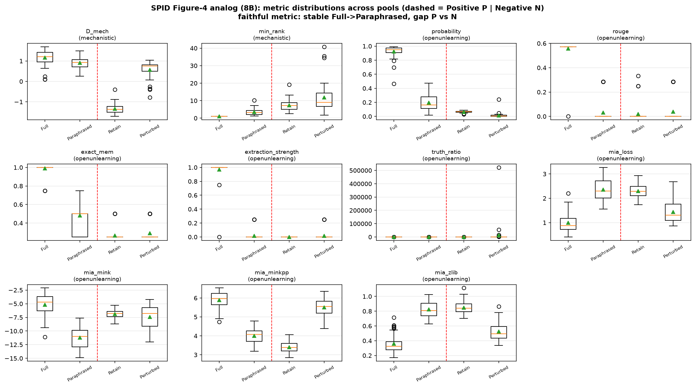
Result — metric distributions across the four pools
faithful metric: stable Full→Paraphrased (within P), clear gap P vs N
D_mech keeps BOTH positive cells high; probability / rouge / extraction_strength let the Paraphrased cell collapse toward the negatives.

Slide 7
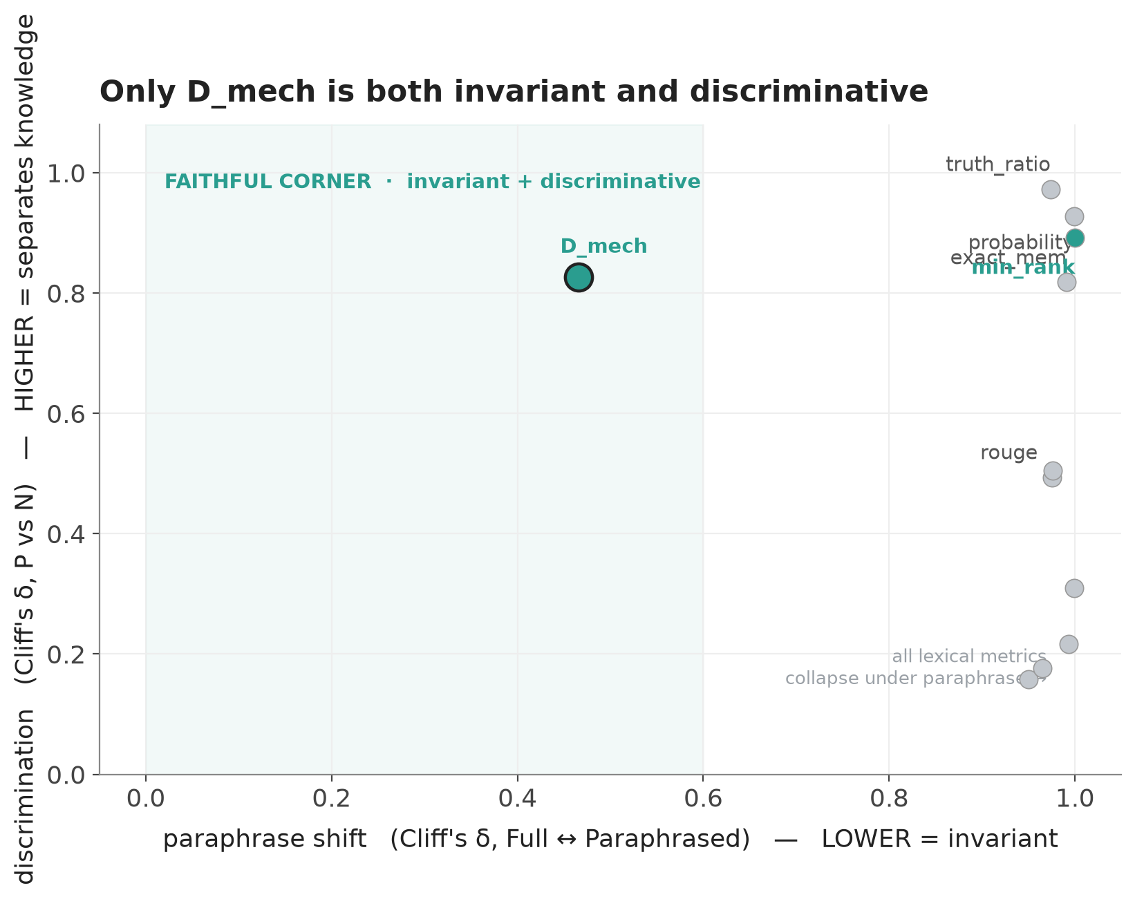
The comparison: invariance × discrimination
the only metric in the faithful corner
• Discrimination (y): almost every metric separates knows from absent — it is NOT where faithfulness is decided.
• Invariance (x): under a meaning-preserving reword, every lexical metric collapses to the right (shift ≈ 0.95–1.0).
D_mech sits alone at low shift (0.466) AND high discrimination (0.827).
• Nuance: raw min_rank — also mechanistic — FAILS invariance. It's the DISTANCE construction that wins, not "use internals."

Slide 8
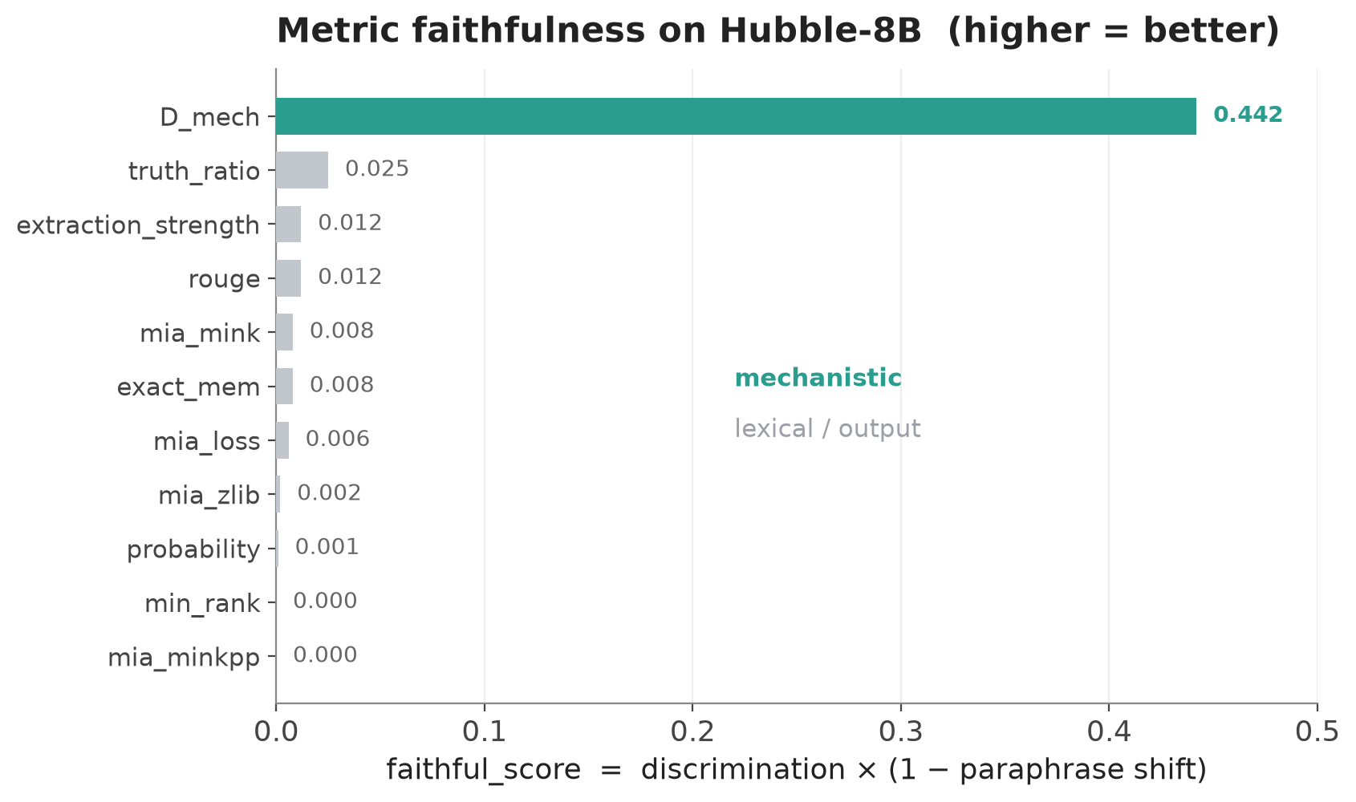
Faithfulness ranking — D_mech vs the OpenUnlearning suite
faithful_score = discrimination × (1 − paraphrase shift)
D_mech: 0.442 — ~18× the best lexical metric (truth_ratio 0.025).
• All 9 OpenUnlearning metrics (probability, ROUGE, exact-mem, extraction strength, truth-ratio, 4× MIA) score ≤ 0.025.
• They discriminate well but confuse phrasing with knowledge, so they fail on faithful_score.
• min_rank (naive mechanistic) also ≈ 0 — confirming the win is the anchored distance.

Slide 9
Why D_mech wins — and honest limits
Why it wins
• Discrimination is easy; invariance is the real test.
• D_mech is a RELATIVE distance: rewording moves the whole trajectory a little, but not across the knows / never-knew boundary.
• Subtracting the two anchor distances cancels the phrasing shift while keeping the knowledge signal.
• Empirical confirmation of a theoretical prior: output metrics measure words, the internal metric measures knowledge.
Honest limits
• 8B only, n = 44 YAGO birthdate facts.
• One paraphrase style + one wrong-target — n is over facts, not over paraphrases.
• Perturbed(wrong) leaks slightly on D_mech; the P–N gap is carried mainly by Retain.
• The per-fact RELEARNING route to faithfulness was a documented null — this SPID result + the rank-by-layer story carry the claim.
• faithful_score is a defined composite; invar_shift & discrim are the primary evidence.

Slide 10
Contribution
We add a mechanistic-interpretability metric to the Hubble unlearning benchmark and show,
under the field's own meta-evaluation (OpenUnlearning / SPID), that it is the only metric
that is both knowledge-discriminative AND paraphrase-invariant —
empirically confirming that output/lexical metrics conflate surface form with knowledge.

