Slide 1
Mechanistic Interpretability of Unlearning in Hubble-8B
Is it surface-level erasure, or actual knowledge removal?
Reading unlearning through the logit lens · YAGO biographies · NPO / GradDiff / IDK / RMU

Slide 2
Why we restructured the dataset
Goal: a clean mechanistic-interpretability signal
- Main goal: use mechanistic interpretability (the logit lens) to test whether an unlearning method truly REMOVES a fact or just SUPPRESSES the output.
- Problem seen in the 1B pilot with the original setup: forget and retain behaved almost identically under unlearning — both collapsed together.
  • So we could not separate “did it forget the target” from “did it just break the model” — no clean interpretability read.
- Hubble's original retain = out-of-domain WikiText (a general-capability anchor). Nothing protected the in-domain neighbours.
- Our change: make the retain signal the KEEP set (in-domain held-out biographies) — i.e. mix retain = Keep.
  • This turns retain into a proper CONTROL condition: forget should change, retain should not — exactly what a mechanistic claim needs.

Slide 3
Setup: dataset, splits, and two probe slots
- Data: YAGO biographies with Hubble's planted (perturbed) facts.
- Splits (seeded): Unlearn = forget (~44), Keep = retain (~45; a 50/50 shuffle of the memorised set), Unseen = control (250).
- Two probe slots, chosen for different jobs:
  • BIRTHDATE — unguessable, clean tokenisation → infill accuracy + logit-lens rank (is the fact still recoverable inside the network?).
  • OCCUPATION — synonym-rich / semantic → LSR (is the semantic concept still present?).
- Reference models bracket the scale: Standard = never learned the fact (“never-knew” floor); Perturbed = learned it (“knows” ceiling).

Slide 4
The question: surface-level or actual unlearning?
- Four methods compared: NPO, GradDiff (loss-based), IDK (refusal), RMU (activation steering).
- After unlearning, is the knowledge GONE, or just HIDDEN behind the output?
- Logit lens (rank-by-layer): decode every layer's hidden state → is the gold token still recoverable deep inside, even if the top-1 changed?
- LSR (semantic residual): does the concept cluster still hold probability mass?
- Selective unlearning = forget REMOVED and retain PRESERVED — read against the Standard/Perturbed baselines.

Slide 5
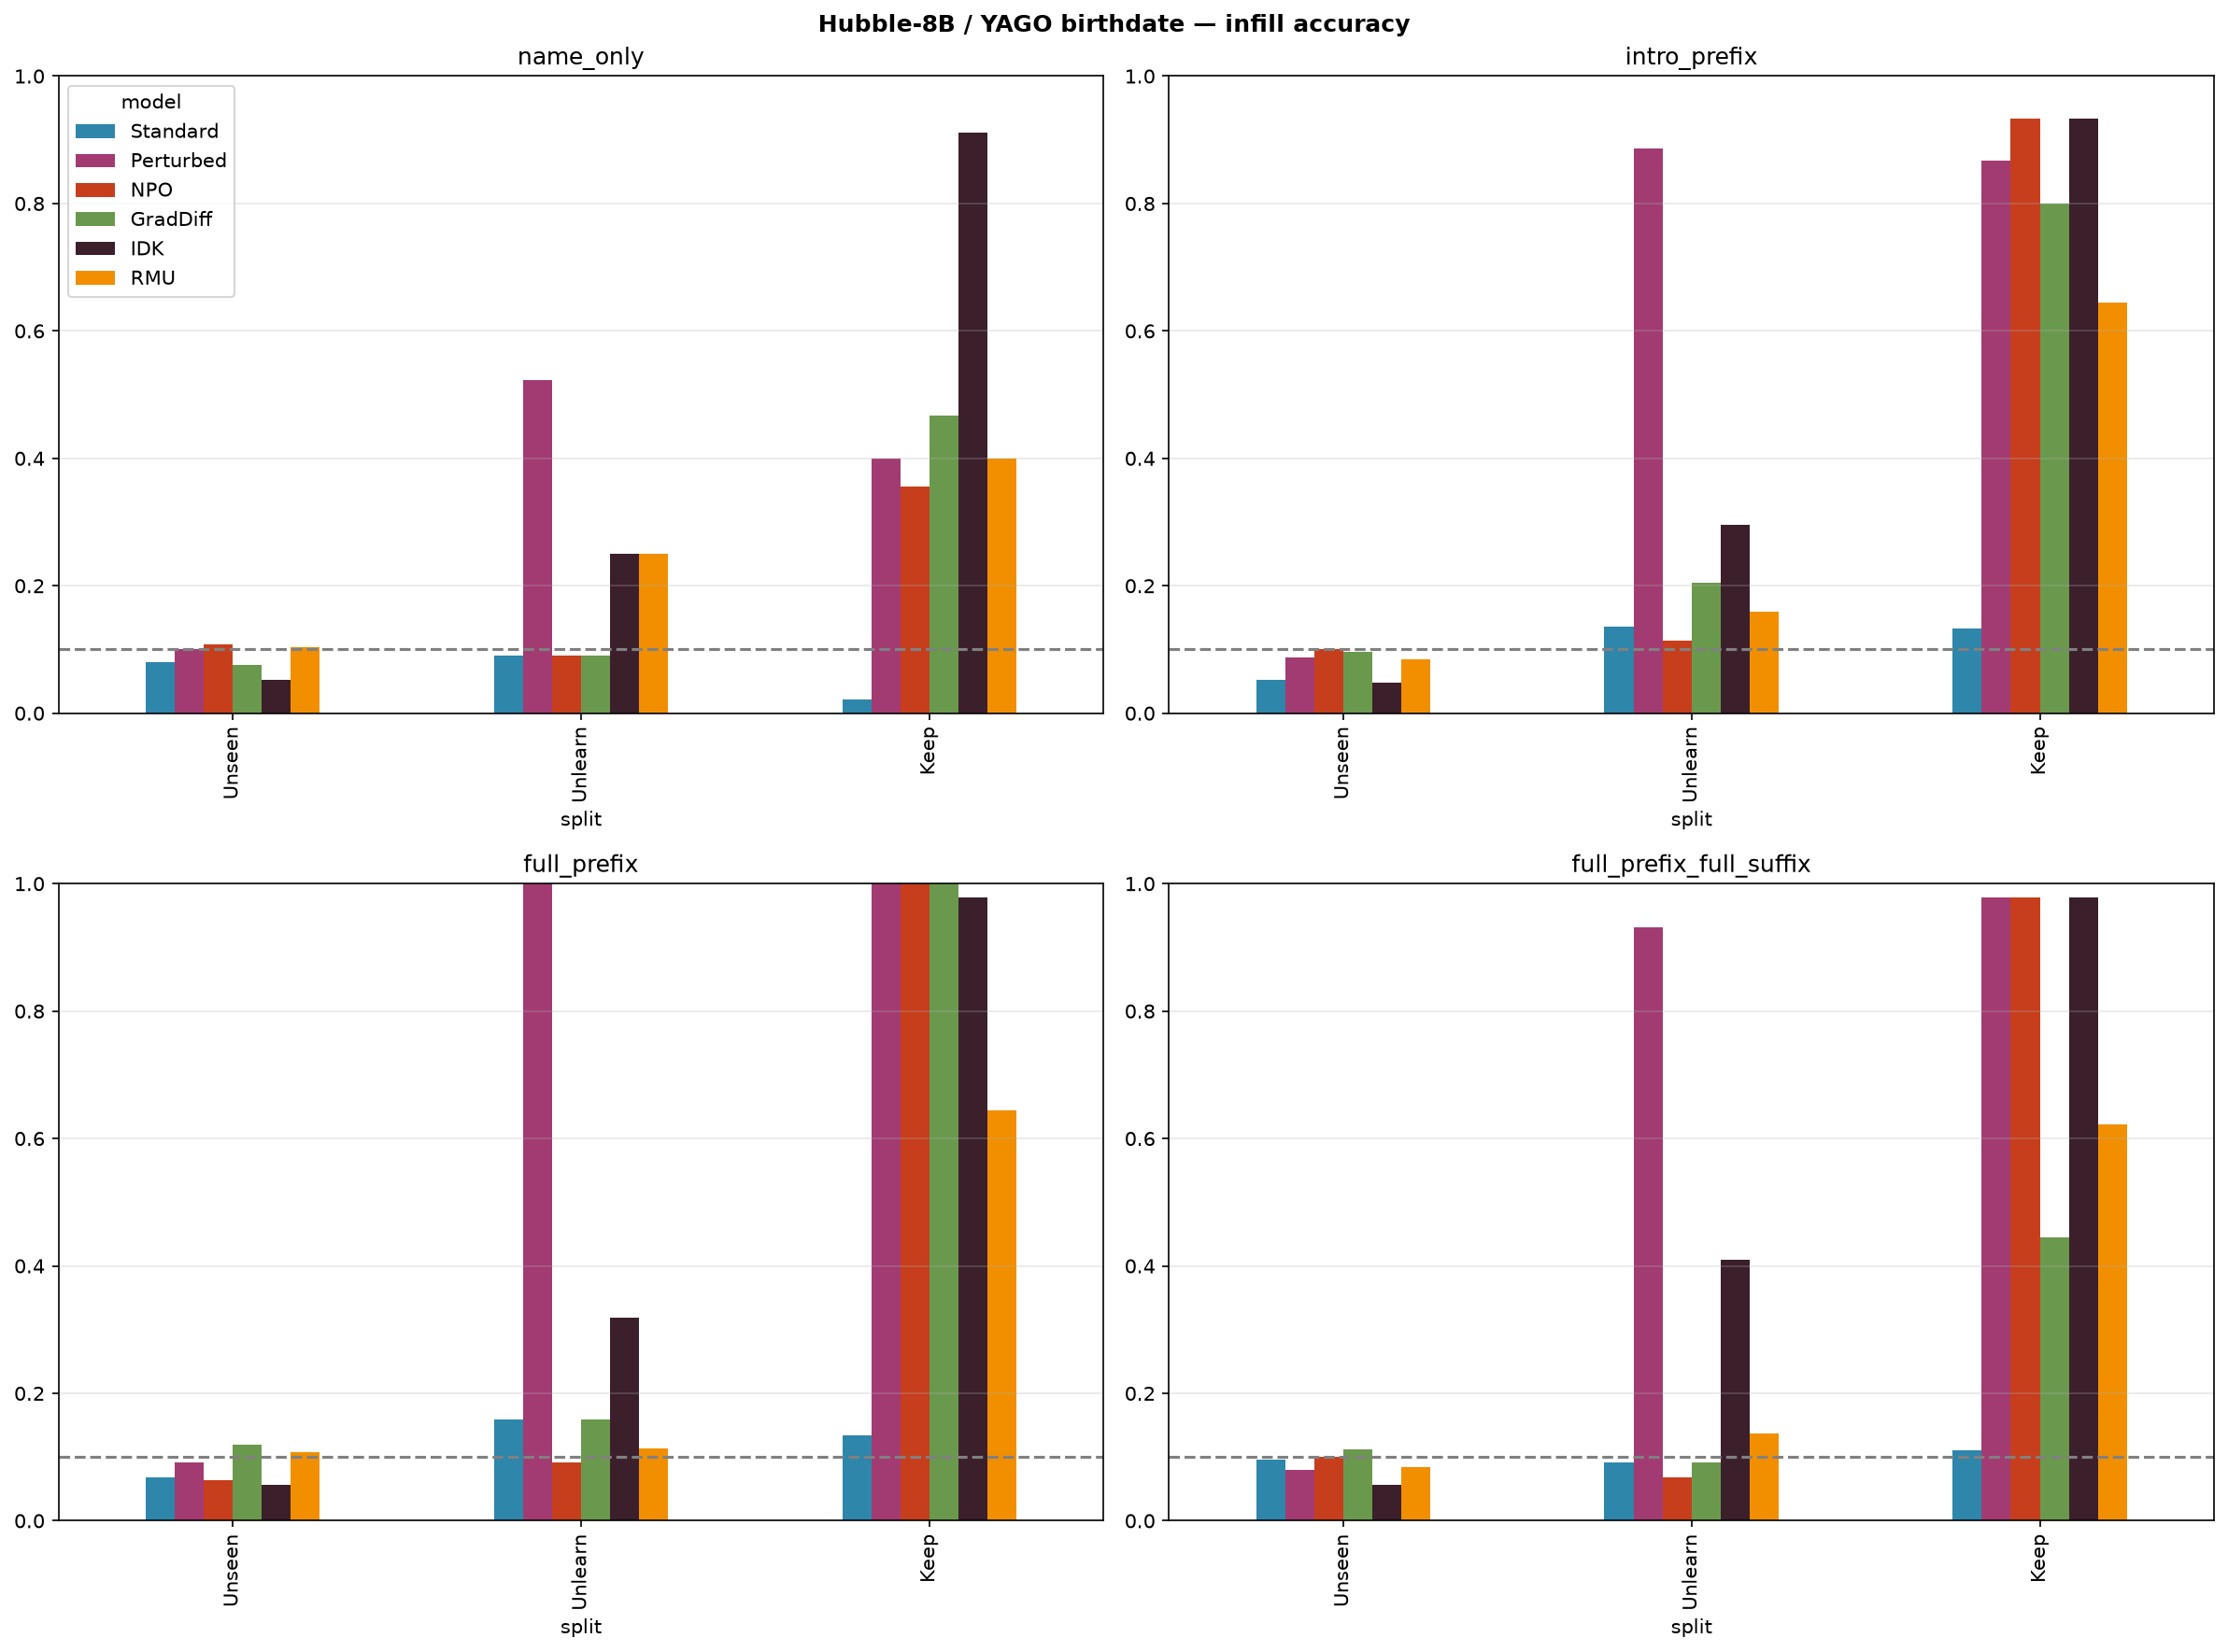
Main result 1 — behaviour: forget drops, retain preserved
- With retain = Keep, NPO & GradDiff drive Unlearn accuracy to chance while Keep stays near 1.0 — the behavioural before/after.

Slide 6
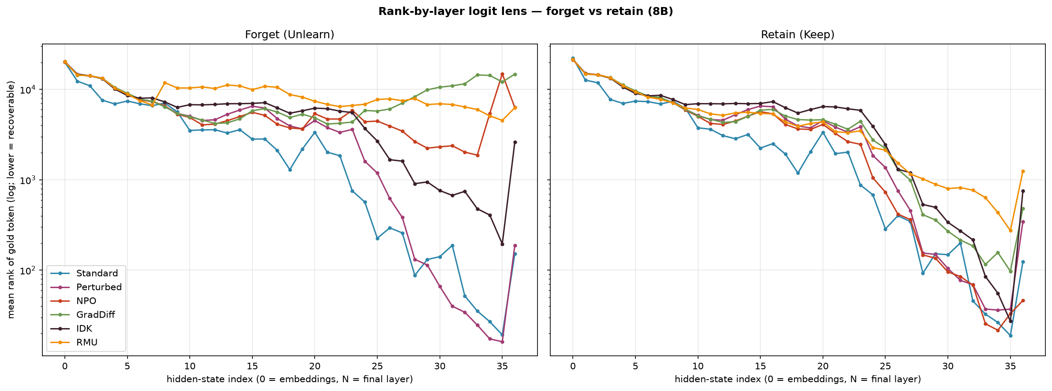
Main result 2 — mechanism: is the fact still recoverable?
- Final-layer gold-token rank
  • (higher = more buried)
- forget / retain
- Perturbed: 187 / 345 (knows)
- NPO: 6,325 / 46 → 137×
- GradDiff: 14,786 / 485 → 30×
- RMU: 6,282 / 1,248 → 5×
- IDK: 2,617 / 754 → 3.5×
- NPO/GradDiff bury the forget fact deep while retain stays recoverable → ACTUAL removal, not surface suppression.

Slide 7
Method verdict — and RMU vs the Hubble paper
- NPO & GradDiff — ACTUAL selective unlearning: forget buried, retain kept, semantic concept erased (LSR below never-knew floor).
- IDK — SURFACE-LEVEL: it only learns to refuse. Forget rank barely moves (2,617) and LSR = 0.43 sits ABOVE the never-knew floor (0.35) → the fact is still inside, just not spoken.
- RMU — FAILURE / indiscriminate: it does bury the forget fact, but retain collapses too (retain rank 1,248; Keep accuracy 0.64).
  • Connects to the Hubble paper: it reports RMU/RR catastrophic JOINT collapse at 8B. RMU steers early layers (5–7) where representations are shared, so even an explicit retain signal can't fully spare the neighbours.

Slide 8
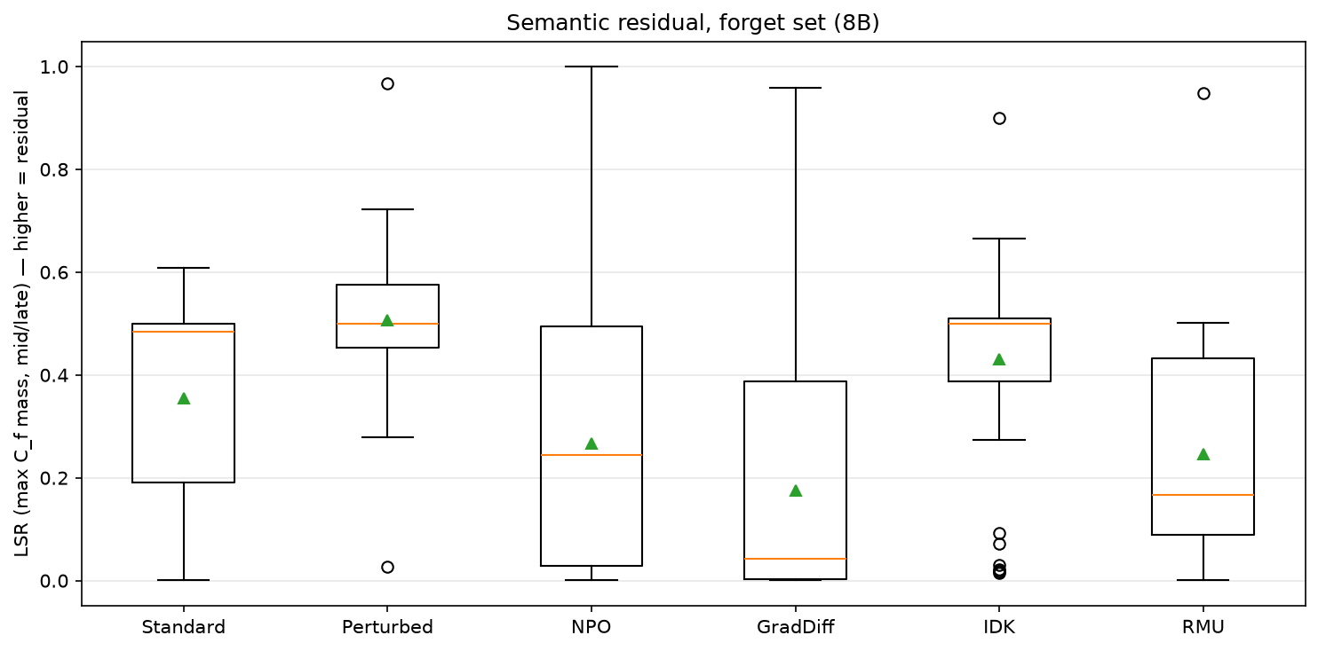
LSR — semantic residual (work in progress)
- Idea: did the CONCEPT get erased, or only the exact word? Score the mass on the gold token + its 20 nearest embedding neighbours (max over mid/late layers).
- Perturbed 0.51 (knows) vs Standard 0.35 (never-knew) — discriminates knowing (p = 5e-7).
- NPO 0.27, GradDiff 0.17, RMU 0.25 → below never-knew = concept erased.
- IDK 0.43 → ABOVE never-knew = concept retained → corroborates surface-level.
- WIP: calibrating LSR jointly on forget + retain (per-set, baseline-normalised selectivity); per-entity is noisy, so this is being finalised at the aggregate level.

Slide 9
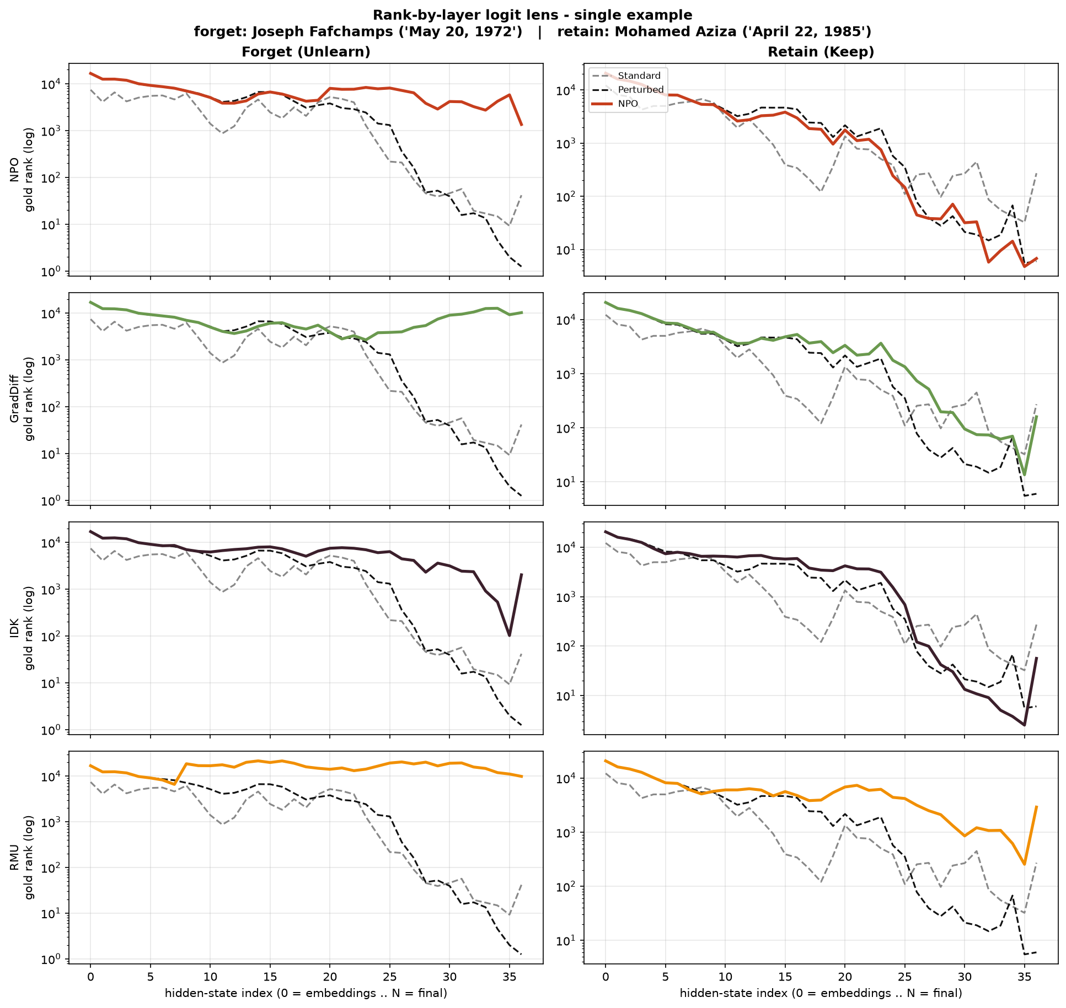
Single-example intuition (baseline chosen w.r.t. Perturbed)
- For a clean before/after we feature an entity Perturbed clearly KNOWS (rank ≈ 1) — so the unlearning picture is unambiguous.
- Forget: Joseph Fafchamps — NPO lifts the gold rank 1 → 1,354 (buried).
- Retain: Mohamed Aziza — NPO keeps rank ≈ 7 (= Perturbed) → preserved.
- Selection is baseline-only (never uses the methods' outcomes) — honest, illustrative; the aggregate above is the claim.

Slide 10
Takeaways
- Restructuring retain = Keep gave a clean control → a legible mechanistic signal, unlike the 1B setup where forget and retain were inseparable.
- NPO & GradDiff achieve ACTUAL selective unlearning — the fact is removed from the representation, not just hidden.
- IDK is SURFACE-LEVEL — refusal on top of intact knowledge.
- RMU FAILS indiscriminately — consistent with the Hubble paper's 8B joint-collapse finding.
- The 8B logit-lens plots are markedly cleaner and more separable than the 1B runs.
- Next: finalise the calibrated forget+retain LSR selectivity at the aggregate level.

