Slide 1
LeakLens
Does unlearning survive deployment compression?
Auditing whether quantization undoes machine unlearning, and localizing where it leaks, with the logit lens
A portfolio project extending the TUM master's thesis on mechanistic interpretability of unlearning

Slide 2
OUTLINE
The complete story, in four parts
Part I. The unlearning problem (from the thesis)
– Output metrics cannot tell unlearning methods apart; the logit lens shows most unlearning suppresses rather than erases.
Part II. The quantization twist (LeakLens)
– Training and quantization are both lossy compression. Does deployment-time 4-bit quantization undo the deletion? The tool, its pipeline, and the recovery-depth metric.
Part III. Results
– The backend decides whether unlearning survives; the calibration-set attack (an honest null); the real-GPTQ cross-check.
Part IV. Takeaways
– What is firm, what is open, and what ships.

Slide 3
PART I
The unlearning problem
what the thesis established: suppression is not erasure

Slide 4
1 · MACHINE UNLEARNING AND THE VERIFICATION GAP
did the model forget, or just hide it?
What unlearning promises
– Remove specific knowledge from a trained model, post hoc, without retraining: for privacy (right to be forgotten), copyright, and safety.
The hard question
– Unlearning is validated at the OUTPUT: ask the model and check the answer is gone. But a model can look forgotten on the outside while holding the knowledge inside.
Suppression vs erasure
– The thesis showed, on the Hubble benchmark, that most unlearning SUPPRESSES the fact at the output while its internal representation stays intact, and that a paraphrase, a few fine-tune steps, or a change of precision can bring it back.

Slide 5
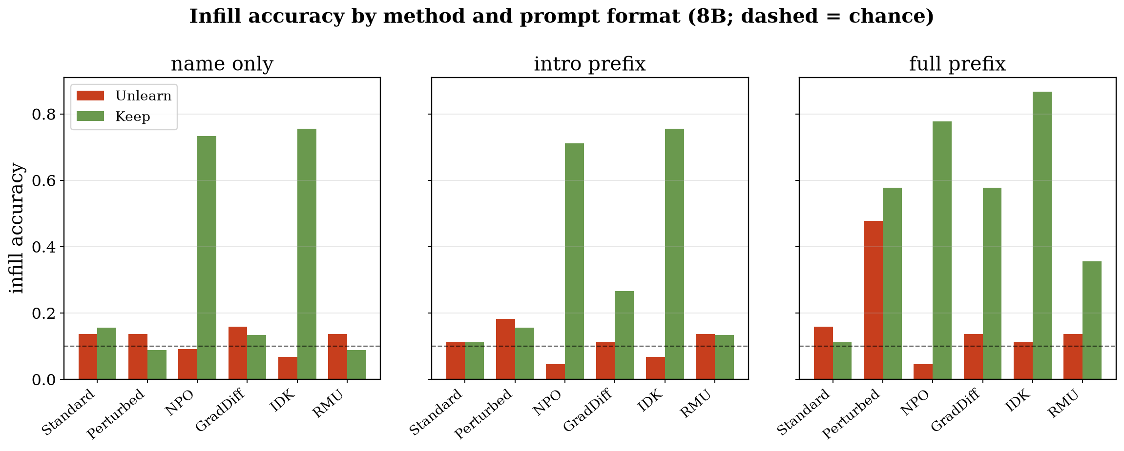
1 · THE OUTPUT IS BLIND
at the output, the four unlearning methods look identical (8B)
Every unlearned method drops to the never-knew floor. One output verdict; no way to tell the methods, or true erasure, apart.

Slide 6
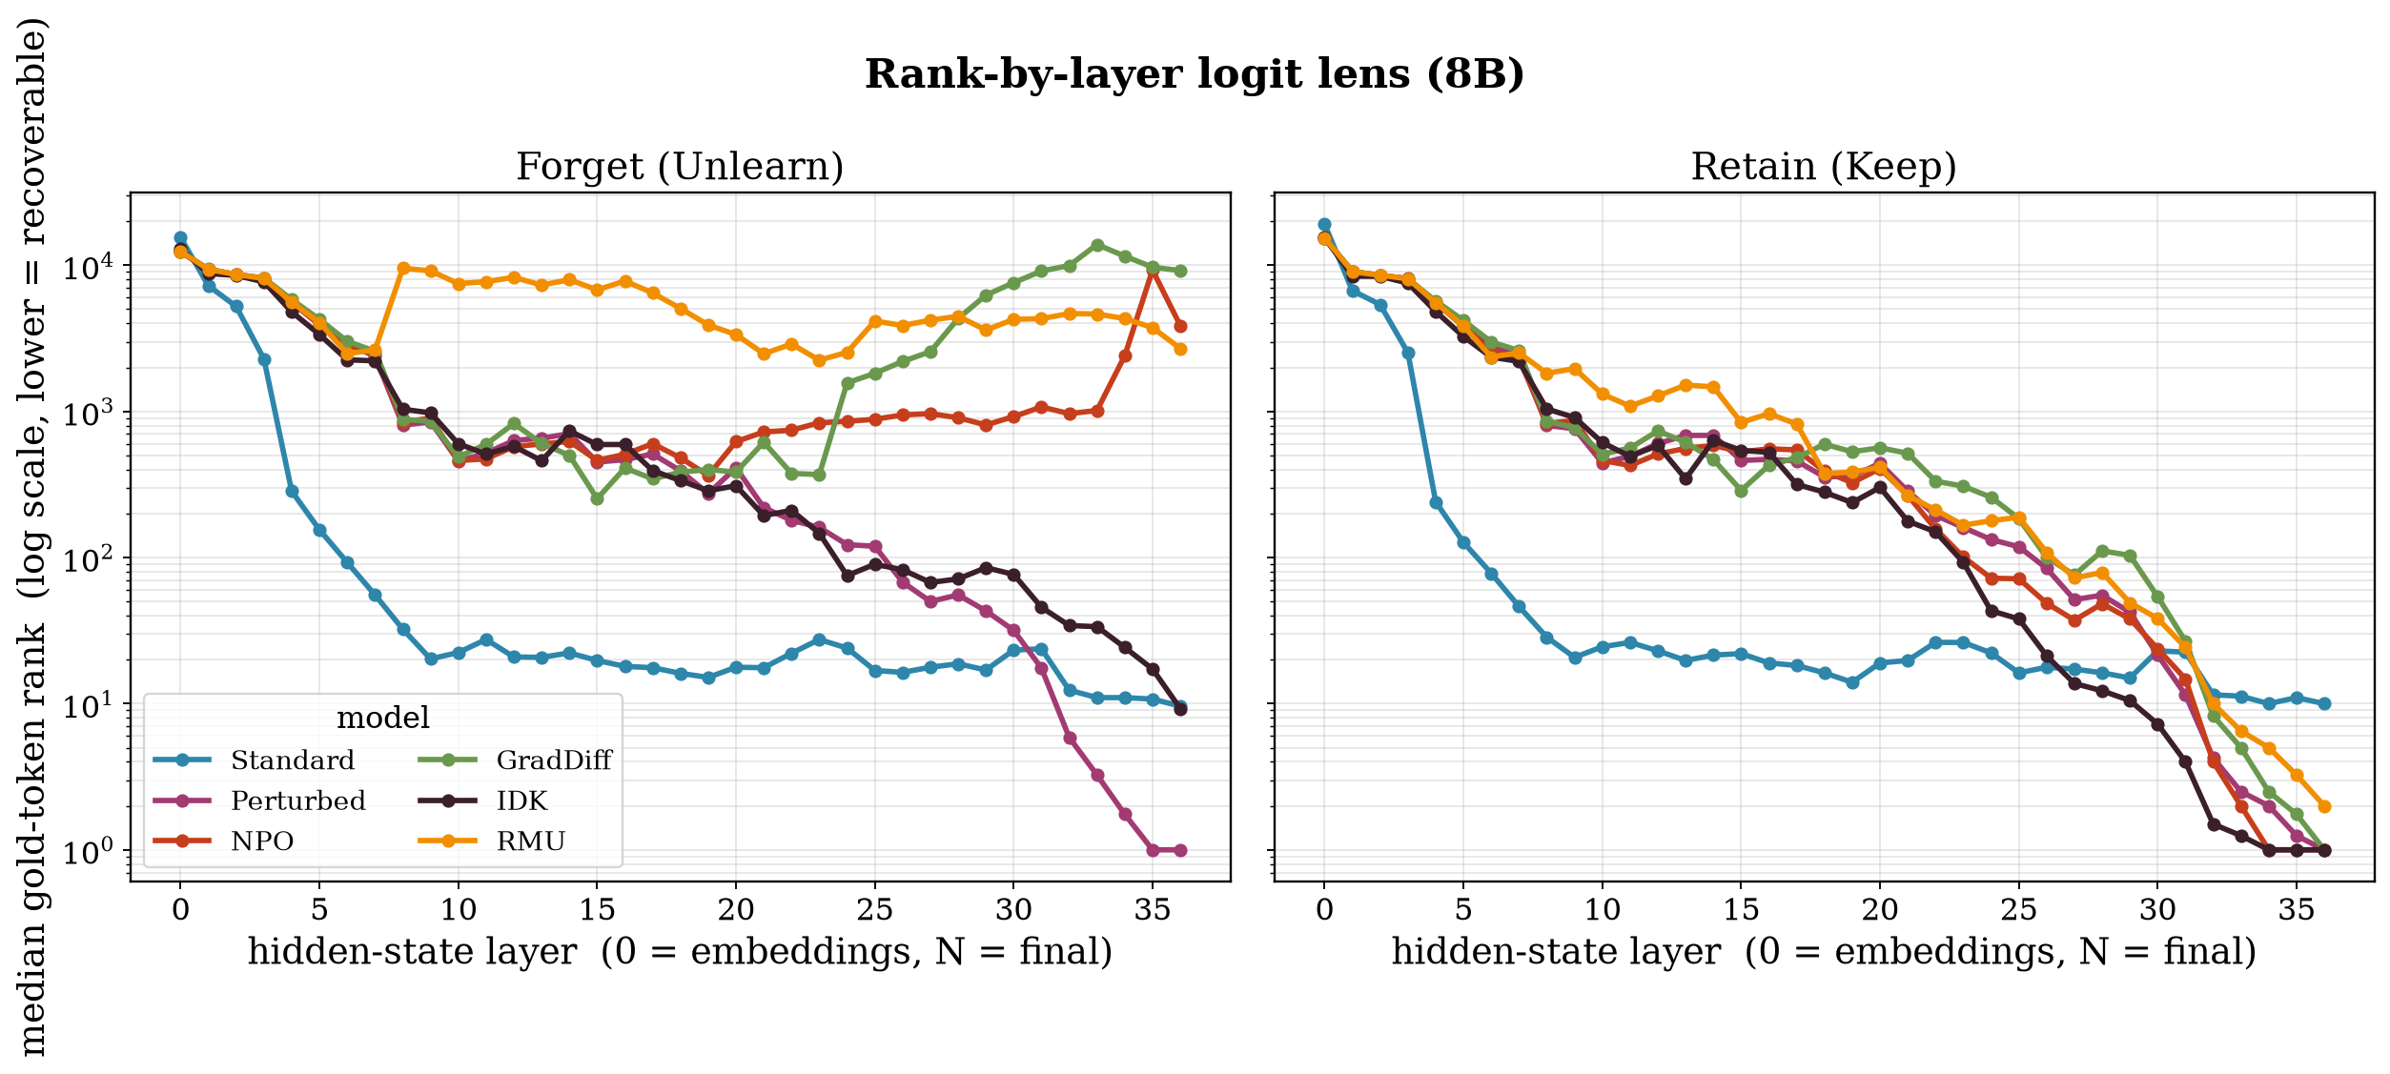
1 · READING INSIDE: THE LOGIT LENS
the internal readout separates them: suppression is not erasure (8B)
Rank-by-layer of the gold token. NPO / GradDiff / RMU bury it; IDK keeps it at the surface; none achieves internal erasure. Invisible at the output.

Slide 7
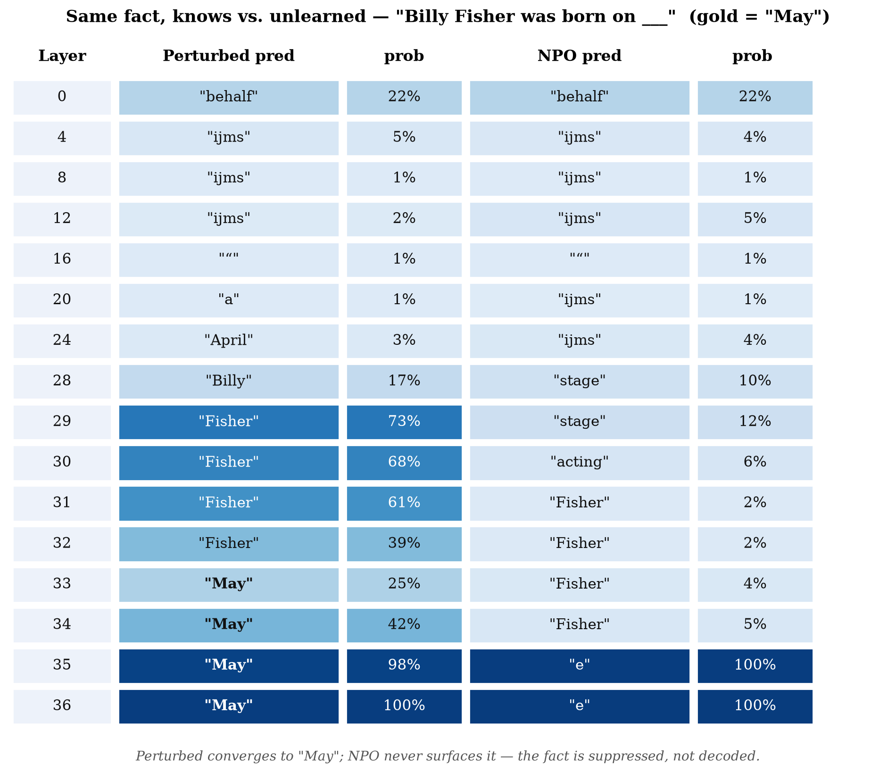
1 · ONE FACT, LAYER BY LAYER
the model that knows converges; the unlearned one never surfaces the answer
Top-1 logit-lens prediction per layer. Suppression, not erasure, in a single table.

Slide 8
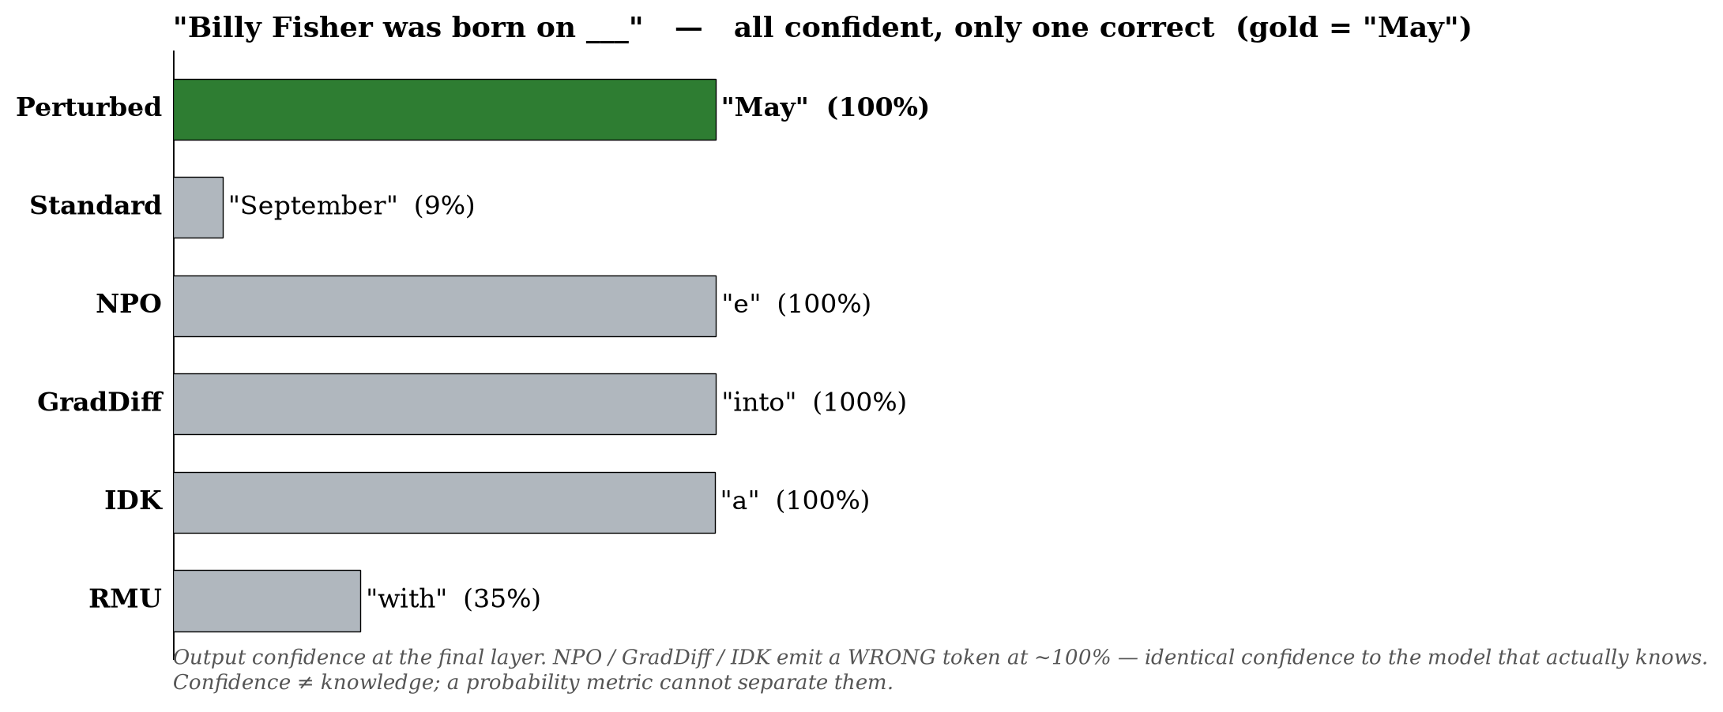
1 · CONFIDENCE IS NOT KNOWLEDGE
unlearned models are as confident in a wrong token as the knowing model is in the right one
A probability metric cannot separate confidently knows from confidently deflects. The output-metric failure, made visual.

Slide 9
PART II
The quantization twist
deployment compression can undo the deletion

Slide 10
2 · TWO COMPRESSIONS
training compresses, unlearning deletes, quantization compresses again
– Conklin et al. (2026) frame LLM training as LOSSY COMPRESSION: a model retains only what serves its objective, and different families compress differently.
The chain LeakLens studies
– 1. Training compresses the data into weights. 2. Unlearning claims to surgically DELETE one retained piece. 3. Quantization applies a second, much cruder compression (4-bit) before deployment.
The question
– Unlearning is validated at FP16. Models ship at 4-bit. Does the second compression UNDO the first deletion, and if so, where in the network does the fact come back?

Slide 11
2 · PRIOR WORK AND THE GAP
the phenomenon is known; a representational, multi-backend audit is not
prior work | what it left open
Zhang et al., ICLR 2025 | Quantization restores forgotten knowledge (21% at fp16 -> 83% at 4-bit). Behavioral + weight-space; benchmarks fail to detect it.
Two-failure-modes (2026) | Logit-lens view of quantization failure generally; calls mechanistic analysis of quantized models preliminary and fragmented.
Mechanistic unlearning (2024) | Interpretability used to DO unlearning more robustly; does not test quantization.
The gap: no reproducible, multi-backend tool that reports REPRESENTATIONAL recovery and localizes the layer at which forgotten knowledge re-opens. LeakLens builds one with the logit lens.

Slide 12
2 · LEAKLENS: WHAT IT DOES
a config-driven audit of unlearning under quantization
Inputs (one YAML)
– A base model that KNOWS the facts, the UNLEARNED models (one per method), a forget set, and a list of deployment quantization configs.
Five quantization backends
– none (fp16 reference), bitsandbytes (INT8 / NF4 / FP4), round-to-nearest (INT8 / INT4), calibration-aware AWQ, and real GPTQ.
Outputs
– Behavioral recovery, the representational RECOVERY-DEPTH metric, and a single heatmap (method x quant, colour = recovery, label = depth) plus a report card.

Slide 13
2 · HOW IT WORKS: THE PIPELINE
how execution travels through the tool (flow.md)
leaklens audit --config
one YAML
load base once
knows reference
for method x quant
load + quantize
logit-lens probe
rank per layer
recovery metrics
fraction + depth
report
heatmap
→
→
→
→
→
– The backend is a pluggable dimension: the same audit loop drives fp16, bitsandbytes, RTN, AWQ, and GPTQ. Calibration-based backends take a calibration corpus, and sweeping that corpus IS the calibration-set attack.
– Two compute-heavy leaves (the lens and the metrics) have no internal dependencies, so they are unit-tested in isolation; every number traces to one config file.

Slide 14
2 · THE RECOVERY-DEPTH METRIC
not just whether forgotten knowledge returns, but where
– The logit lens gives, at every layer, the rank of the gold answer token. Run it on the base, the unlearned, and the unlearned-then-quantized model.
Recovery depth (the novel scalar)
– The shallowest mid-stack layer at which the QUANTIZED model's gold-token rank returns toward the base while the fp16-unlearned model's had not, i.e. the layer at which quantization re-opens the fact.
Recovery fraction (the behavioral screen)
– The share of the deleted knowledge that returns at a given precision, normalized against the fp16-unlearned baseline. Isolates the quantization effect; drives the heatmap colour.

Slide 15
PART III
Results
on the Hubble-8B suite (base recalls the facts at gold-probability 0.909)

Slide 16
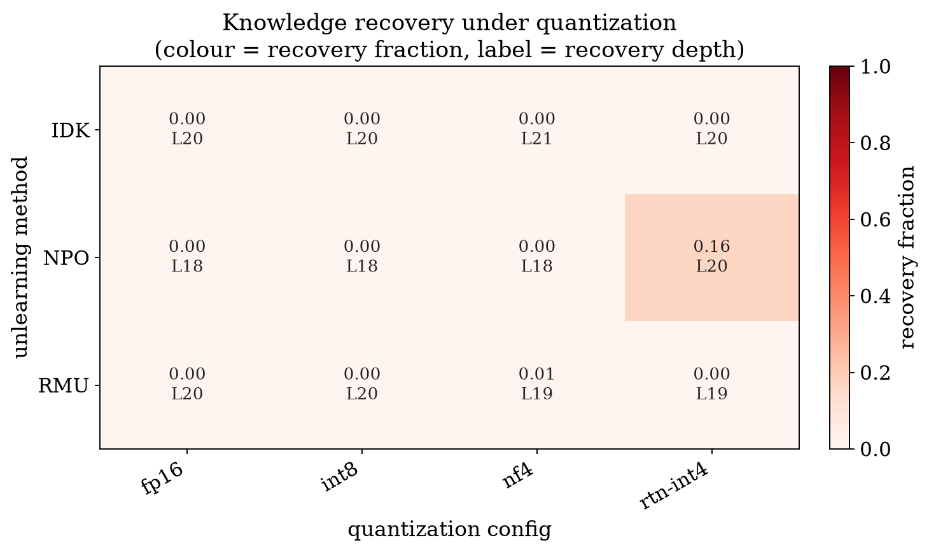
3 · RESULT 1: THE BACKEND DECIDES SURVIVAL
one hot cell: NPO's unlearning is undone by 4-bit round-to-nearest
NPO's forgotten fact goes from rank 4,263 (fp16) to rank 3 under rtn-int4 (recovery 0.16), while calibration-aware bitsandbytes NF4 / INT8 keep it buried. The backend, not just the bit-width, decides.

Slide 17
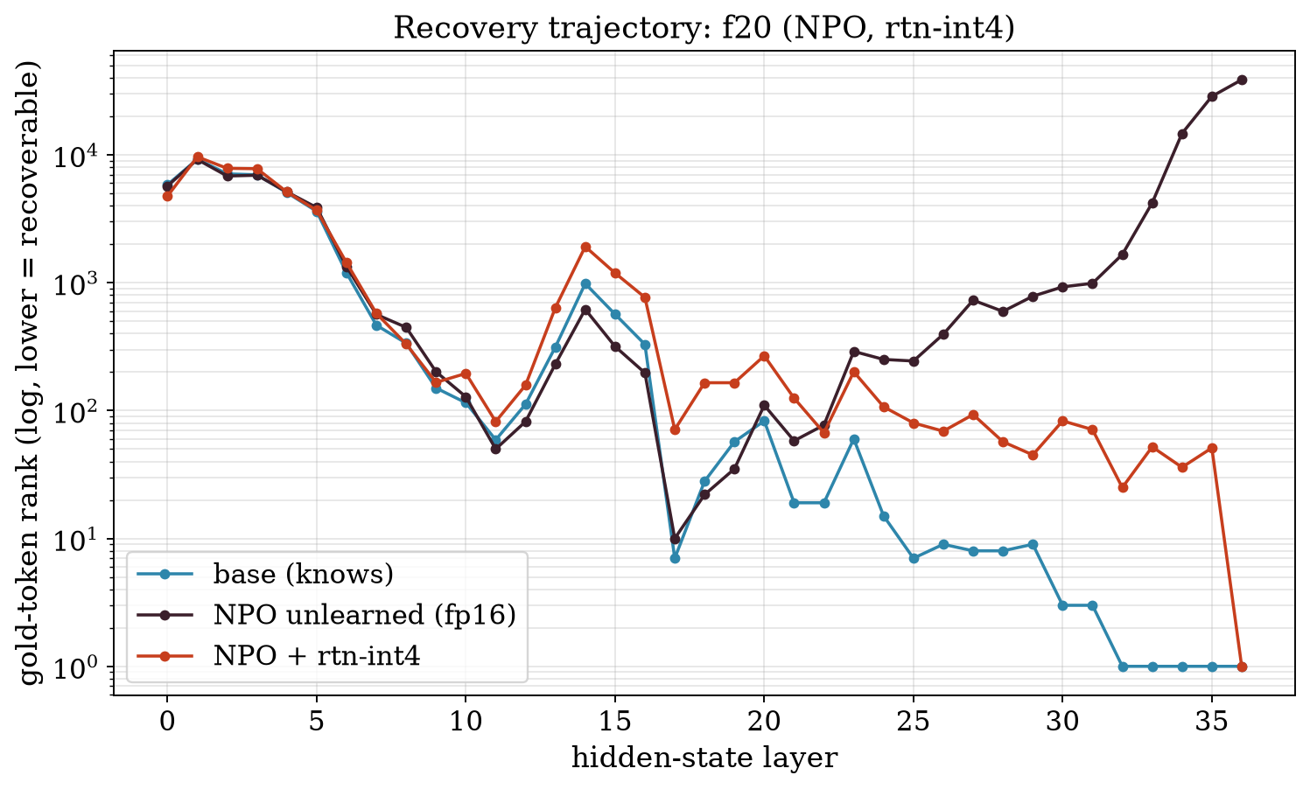
3 · RESULT 1: THE RECOVERY TRAJECTORY
where the fact re-opens, layer by layer
Base (knows) vs NPO-unlearned (fp16, buried) vs NPO + rtn-int4 (recovered). Quantization pulls the trajectory back toward the knowing model.

Slide 18
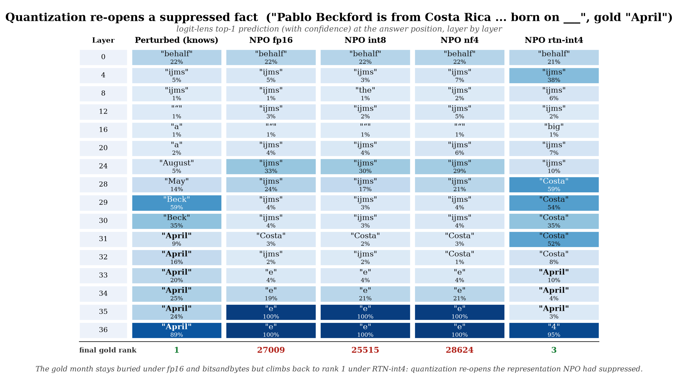
3 · RESULT 1: RE-OPENING, TECHNIQUE BY TECHNIQUE
one fact, the logit-lens top token at every layer across quantization backends
Gold token stays buried under fp16, INT8 and NF4 (decodes garbage at high confidence) but climbs back to rank 3 - surfacing the answer at the deep layers - under crude 4-bit RTN. The same lens-table view from the thesis, now read across compression schemes.

Slide 19
3 · RESULT 2: FOUR MECHANISMS, FOUR RESPONSES
the internal readout explains who survives quantization
IDK
– Redirects the OUTPUT ("I don't know") without disturbing the representation, so the token stays internally accessible throughout; quantization neither helps nor hurts.
NPO
– Buries the fact deeply at fp16 but the representation is fragile: crude 4-bit RTN re-opens it (Result 1).
RMU
– Scrambles the representation early and deep (the strongest suppression of the three); only mildly moved by quantization.
– The deployment-compression view reproduces the thesis mechanistic taxonomy (IDK surface, NPO late suppression, RMU deep scramble).

Slide 20
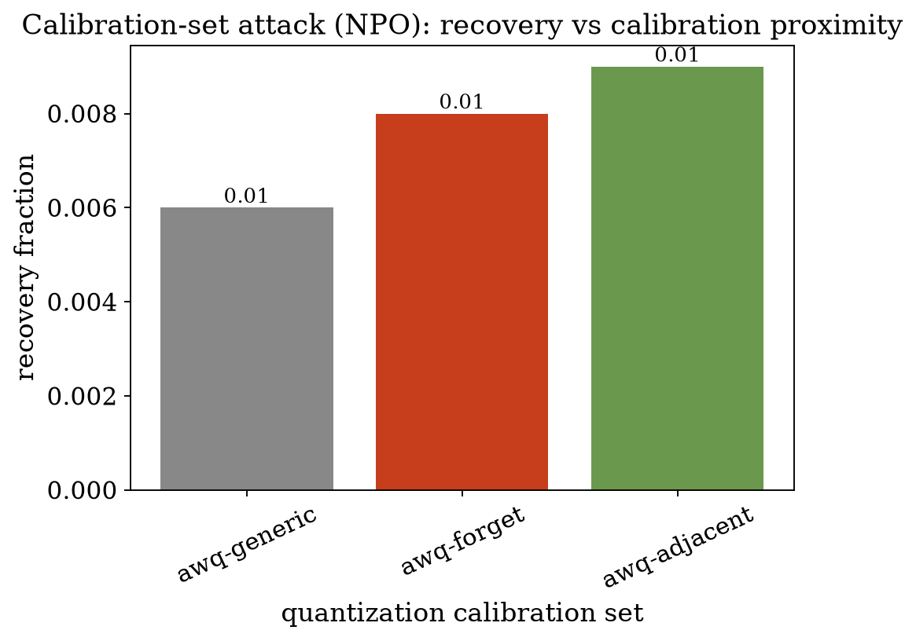
3 · RESULT 3: THE CALIBRATION-SET ATTACK
an honest null: calibration proximity barely moves recovery
Sweeping the AWQ calibration corpus generic -> adjacent -> forget moves recovery only 0.006 to 0.009, within noise at n=25. Not shown to be an attack surface. Reported as a null, not spun.

Slide 21
3 · RESULT 4: THE REAL-GPTQ CROSS-CHECK
the decisive test could not be run in this environment
– We wired a real GPTQ backend (gptqmodel, desc_act, calibration = the swept corpus) as the decisive, more calibration-sensitive test.
What happened
– GPTQ QUANTIZES successfully, but the packed model's forward pass crashes in gptqmodel's fallback kernel, an incompatibility with this environment's bleeding-edge Transformers 5.14 / Torch 2.11 (no optimized CUDA kernels available). Three successive fixes each advanced further; the last failure is internal to the library.
Consequence, stated plainly
– The GPTQ cross-check is unresolved here, so the calibration-attack question stays open. The firm result LeakLens ships is the backend-dependent recovery of Result 1.

Slide 22
PART IV
Takeaways
the complete story, and what is firm vs open

Slide 23
4 · LIMITATIONS
stated honestly
– Single model family (Hubble), single attribute (birthdate), one unlearned checkpoint per method; the recovery findings are on 25 to 44 facts.
– The AWQ backend is a transparent activation-scaling re-implementation isolating the calibration mechanism, not the reference kernel.
– The real-GPTQ cross-check was blocked by an environment/kernel incompatibility, so the calibration-set attack remains an open question rather than a settled result.
– Recovery depth and recovery fraction are complementary; the behavioral fraction is the primary, quantization-isolating signal.

Slide 24
CONCLUSION
one continuous story, from unlearning to deployment
The thesis showed that most unlearning SUPPRESSES a fact at the output while its
representation stays intact. LeakLens shows that deployment-time quantization can
RE-OPEN that suppressed representation, and that the quantization backend decides whether it does.
If your compliance story depends on unlearning, quantization can silently void it, and now there is a tool that measures it.
Future work: a pinned GPTQ / AWQ environment to settle the calibration attack, more model families and attributes, and the PII per-attribute breakdown.

