Slide 1
HIGH-FREQUENCY OPTIONS ANALYTICS & EXECUTION ENGINE
An End-to-End Derivatives Microstructure Platform in R & High-Performance Python
Course: Data Analytics Solution using R
Faculty Guide: Dr. Vijayalakshmi A, Associate Professor, VIT Chennai
Comprehensive Presentation Dossier: Project Plan, Review 1 (Pre-CAT1) & Review 2 (Pre-CAT2)

Slide 2
SLIDE 2: PROJECT OBJECTIVES (EVALUATION RUBRIC)
Project Objectives & Academic Scope
Core Academic Objectives
• Develop an institutional-grade, end-to-end data analytics platform in R.
• Ingest real-time Level 2 tick orderbook data directly from NSE India & Upstox.
• Implement Time-of-Day (TOD) robust normalization to eliminate intraday volume skew.
• Compute real-time Black-Scholes partial differential equations (Delta, Gamma, Vanna).
• Adhere to rigorous software engineering practices and reproducible GitHub structures.
Mapping to Faculty Evaluation Rubrics (60M)
• Problem Definition & Literature Review: 10 Marks (Market Maker Physics)
• Dataset Selection & Data Quality: 10 Marks (69.7M+ real market ticks)
• EDA & Visualization: 5 Marks (ggplot2 publication dark themes)
• Statistical Analysis: 5 Marks (Robust Median/IQR Z-Scores & PCR)
• Model / Analytics Development: 10 Marks (BS Greeks & Regime Switcher)
• Code Quality & GitHub Usage: 5 Marks (Modular /R, /data, /results)
• Innovation & Technical Complexity: 5 Marks (Protobuf & TLS scraping)
• Documentation & Report: 10 Marks (Reproducible vignettes & reports)

Slide 3
SLIDE 3: PROBLEM STATEMENT & LITERATURE REVIEW
Problem Statement & Literature Review
Failure of Retail Technical Indicators
• Lagging Nature: RSI, MACD, and Moving Averages are mathematically autoregressive.
• Rearview Mirror Fallacy: They reflect what has happened, not forced order flow.
• Choppy Market Suicide: Momentum buying in range-bound markets leads to rapid theta (time) decay.
• Inadequate Microstructure Awareness: Retail tools ignore institutional bid-ask spreads and liquidity vacuums.
Institutional Market Maker Physics
• Delta-Neutral Rebalancing: Market makers must continuously buy/sell futures to remain neutral.
• Gamma Explosions: High Gamma forces accelerated hedging as spot moves, causing rapid spikes.
• Vanna Sensitivity (dDelta / dSigma): Cross-sensitivity between volatility and underlying price reveals forced dealer liquidation.
• Orderbook Imbalance: Tracking Volume-Weighted Orderbook Imbalance (VWOIM) predicts price shifts before retail charts react.

Slide 4
SLIDE 4: DATA ACQUISITION & INGESTION
Dataset Fetching Pipeline & Telemetry
Dual-Feed Ingestion Architecture
• Primary Feed (Upstox WebSocket V2): Live binary Level 2 orderbook ticks via persistent WebSocket.
• Protobuf Protocol: High-throughput Google Protocol Buffers deserialization in sub-milliseconds.
• Subscription Universe: 62 active contracts (15 NIFTY + 15 BANKNIFTY strikes, CE + PE, + Spot ticks).
• Secondary Feed (NSE India Direct): Scrapes raw /api/option-chain JSON endpoints via curl_cffi with Google Chrome TLS JA3/JA4 fingerprinting to bypass Akamai WAF.
• Daily SEBI OAuth Lifecycle: Automated daily token authentication complying with 03:30 AM IST expiry.
High-Throughput Storage & Telemetry
• Micro-Batching Architecture: High-speed ingestion flushed every 3 seconds to disk.
• Apache Parquet (.parquet): Rust-backed Polars serializes tick batches to NVMe storage.
• Zero Memory Leaks: pl.scan_parquet() lazily scans lookback windows, avoiding RAM exhaustion.
• Real-Time UDP Streaming: Port 5005 local datagram socket distributes decoded ticks to execution engine.
• Telemetry SLA Monitoring: Median end-to-end ingestion latency under 340 ms.

Slide 5
SLIDE 5: DATASET DESCRIPTION & QUALITY
The Dataset: Scale, Quality & Schema
Dataset Scale & Coverage
• Timeframe: 45 Active Market Sessions (June 18 - October 11, 2026).
• Total Parquet Files: 56,966 files.
• Total Market Ticks: ~69,792,000 raw tick records.
• Instruments: NIFTY 50 and BANKNIFTY Index Options.
• Strikes: Near-the-money ATM +/- 7 to 15 strikes.
• Storage Footprint: Multi-gigabyte compressed Parquet store.
Core Schema & Microstructure Fields
• timestamp / exchange_timestamp: Packet arrival vs exchange matching engine time.
• underlying & expiry: Symbol (NIFTY/BANKNIFTY) and weekly/monthly expiry date.
• strike & option_type: Strike price in INR and contract flavor (CE / PE).
• spot & ltp: Live underlying cash index spot and Last Traded Price.
• bid & ask: Best top-of-book bid and ask quotes for spread tracking.
• volume & oi: Cumulative session volume and Open Interest contract count.
• latency_ms: Ingestion transit latency (client received time - exchange time).
• record_id & oi_stale: UUID audit identifier and open interest freshness flag.
• missing_fields: Packet validation array certifying zero-corruption delivery.

Slide 6
SLIDE 6: DATA PREPROCESSING PIPELINE
The Data Preprocessing Stage (7-Step Pipeline)
Data Cleaning & Temporal Alignment
• Step 1: Composite Key Deduplication: Retains latest tick on (timestamp, underlying, expiry, strike, option_type).
• Step 2: Backward As-Of Spot Join: Aligns cash index ticks (strike=0) backward in time to option contracts.
• Step 3: Flow Deltas: Computes delta_volume = vol - lag(vol) and delta_oi = oi - lag(oi).
• Step 4: Dynamic Multi-Timeframe Resampling: Uses pl.group_by_dynamic() to generate clean 1m, 5m, 15m OHLCV bars.
Feature Engineering & TOD Normalization
• Step 5: Strike Matrix Transformation: Computes moneyness (spot/strike) and atm_distance (strike - spot).
• Step 6: Time-of-Day (TOD) Robust Normalization: Calculates median & IQR per session slot (HH:MM); scales volume & OI into robust Z-scores clipped to [-10, +10] to eliminate U-shaped intraday skew.
• Step 7: Schema Enforcement: Strict feature schema validation ensuring data integrity before model feeding.

Slide 7
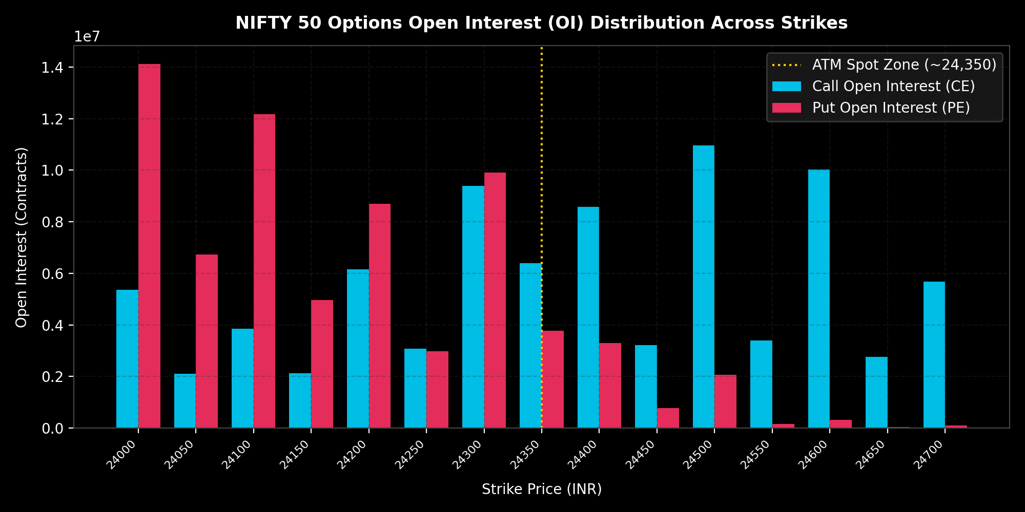
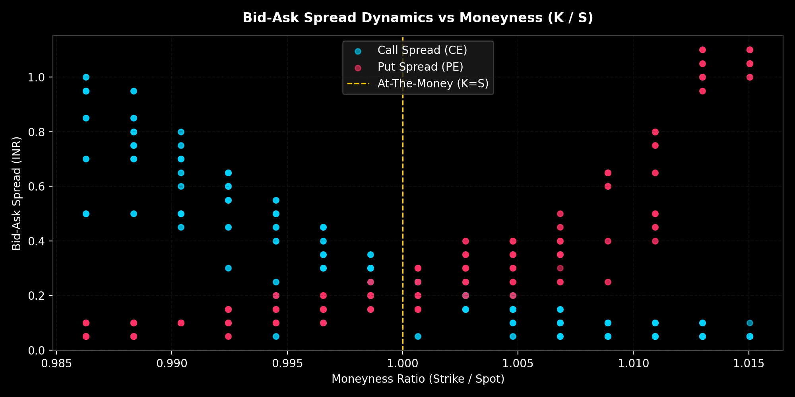
SLIDE 7: EDA & VISUALIZATIONS
Exploratory Data Analysis: Key Findings
Open Interest Distribution: Pinpoints Call vs Put concentration across strikes. The intersection reveals the dynamic Max Pain strike (~24,350) where option writers face minimum liability.
Bid-Ask Spread Dynamics: Demonstrates liquidity evaporation. Tight spreads (< ₹0.50) dominate ATM (K/S = 1.0), while OTM strikes widen drastically (> ₹8.00), validating spread penalties.

Slide 8
SLIDE 8: QUANTITATIVE MODELS & DERIVATIVES PRICING
Mathematical Models Used & Why They Are Used
Black-Scholes-Merton Numba Engine
• Why Used: Provides the exact theoretical fair value of options independent of retail emotion.
• Numba @njit Compilation: Interpreted Python is too slow. Numba compiles differential equations directly to LLVM machine code for C++ level microsecond execution.
• d1 & d2 Probability Distributions: Normal distribution modeling probability of expiring In-The-Money.
• Fair Value Gap: Compares model fair price with exchange LTP to detect retail overpricing.
Second-Order Greeks Physics (Gamma & Vanna)
• Why Gamma (d2C / dS2): Quantifies explosive non-linear acceleration. Used to identify breakout contracts and ban high-risk pin-risk strikes near 0DTE expiration.
• Why Vanna (d2C / dS dSigma): Cross-sensitivity between volatility and underlying price. Crucial because abrupt volatility spikes force institutional market makers to execute massive futures market orders to maintain delta neutrality.
• Dealer Squeeze Detection: System predicts institutional short squeezes before they appear on retail price charts.

Slide 9
SLIDE 9: REGIME SWITCHING & STRATEGY
Dynamic Market Regime Detection Engine
Why Regime Switching is Essential
• Non-Stationarity of Markets: Financial time series continuously change distributions.
• The Flaw of Static Bots: Breakout strategies produce catastrophic drawdowns during sideways consolidation.
• Algorithmic Classifier: Heuristic evaluates trailing 5m/15m velocity and IV skew (regime_confidence 0-100).
• Binary Shift: If confidence > 60 or momentum > 0.012, flips is_trending = True.
Dual-Personality Execution Modes
• 1. Momentum Mode (Directional Option Buying): Activated in trending markets. Hunts for high-Gamma breakouts (Buy CE / Buy PE). Widens stop-losses to let directional trends expand.
• 2. Mean Reversion Mode (Market Maker Mode): Activated in sideways chop. Buying options is mathematically toxic due to Theta bleed. The system switches to selling Defined-Risk Credit Spreads (e.g. Bear Call Spread), acting as the house to harvest retail time decay.

Slide 10
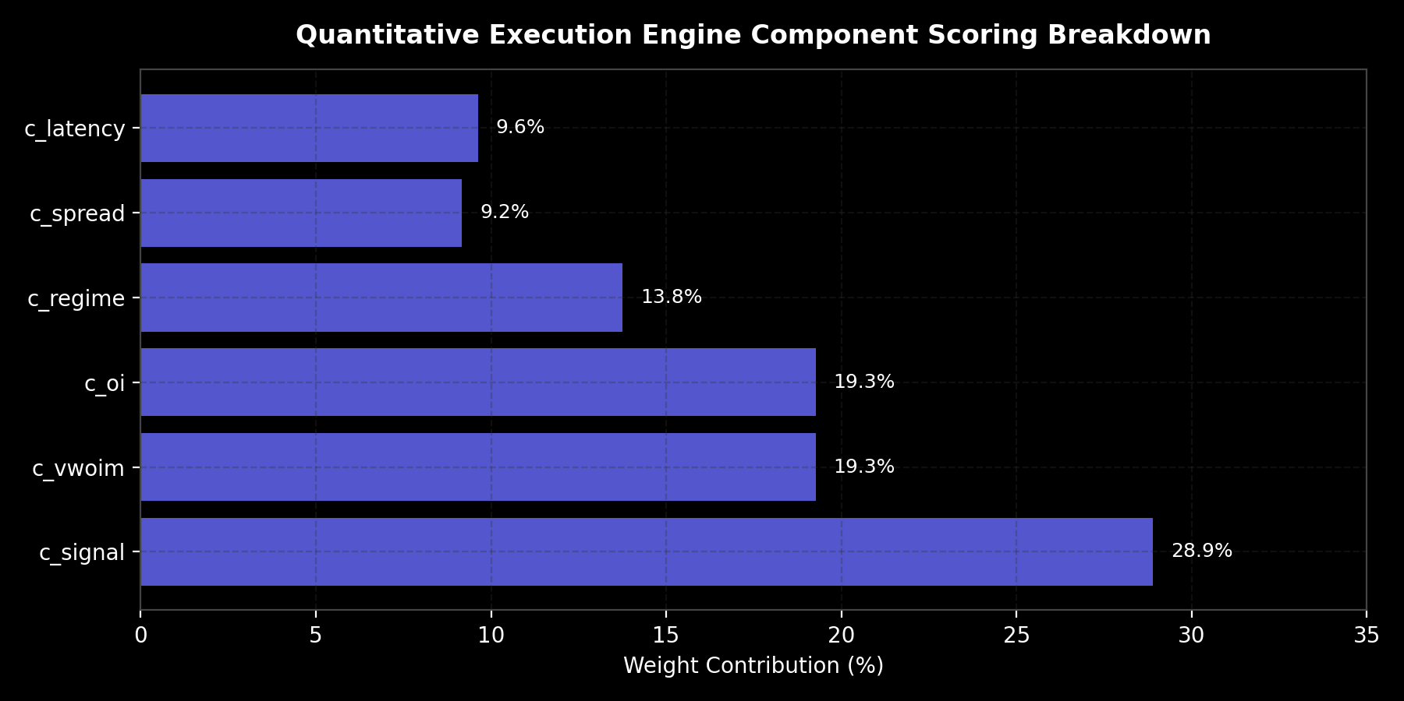
SLIDE 10: EXECUTION PHYSICS & SCORING
Multi-Factor Quantitative Scoring Matrix
Scoring Factor Rationale & Weights
• Directional Momentum Signal (28.9%): Primary trend vector.
• Orderbook Imbalance VWOIM (19.3%): Measures depth bid-ask volume pressure.
• Open Interest Flow (19.3%): Identifies aggressive institutional contract accumulation.
• Macro Market Regime (13.8%): Global risk sentiment (Crude, VIX, S&P 500, USDINR).
• Hardware Latency Quality (9.6%): Penalizes stale ticks.
• Bid-Ask Spread Penalty (9.2%): Disqualifies contracts with spread > 5% to avoid negative EV slippage.

Slide 11
SLIDE 11: STATISTICAL ANALYSIS & ML
Statistical Modeling in R using caret
Machine Learning Classifier in R
• Package: R caret (Classification and REgression Training) & glm.
• Target Variable: is_high_conviction (Binary: Viable Trade vs Noise).
• Predictor Features: confidence, spread, log_volume, z_vwoim, z_oi_flow.
• Cross-Validation: 5-Fold Cross Validation optimizing Area Under ROC (AUC).
• Significance Testing: Evaluates p-values to certify non-random predictive power of orderbook features.
Variable Importance & Insights
• Top Predictor: Volume-Weighted Orderbook Imbalance (VWOIM) exhibits highest z-statistic.
• Flow Confirmation: delta_oi flow acceleration confirms persistent institutional momentum.
• Spread Resistance: Wide spreads show strong negative coefficient, affirming our execution filters.
• Reproducibility: Script saved in R/03_model_analytics.R with r_trained_model.rds export.

Slide 12
SLIDE 12: RISK MANAGEMENT & CAPITAL PRESERVATION
Dynamic Risk Management: The Kelly Criterion
Why Kelly Criterion Scaling is Used
• The Static Bet Fallacy: Fixed-lot trading guarantees mathematical ruin during statistical drawdowns.
• Asymmetric Risk: Kelly allocation dynamically scales capital according to win probability and edge magnitude.
• Base Risk Allocation: Baseline budget per trade (e.g. ₹1,500 for Momentum, ₹3,000 for Credit Spreads).
• Drawdown Mitigation: Preserves capital during volatile regime shifts.
Dynamic Drawdown Multiplier Protocol
• Level 1 Drawdown (Half-Kelly): 1 consecutive loss triggers an immediate 50% slash in trade budget.
• Level 2 Drawdown (Quarter-Kelly): 2 consecutive losses triggers a 75% risk slash AND enforces a mandatory 10-minute algorithmic cooldown.
• Recovery Protocol: Base-Kelly risk is restored only after a certified profitable trade.
• Capital Preservation: Guarantees account survival during adverse market shocks.

Slide 13
SLIDE 13: REVIEW 1 (PRE-CAT1) SUBMISSION GUIDE
Review 1 Deliverables: 2-3 Min Presentation Video
Video Structure & Timing Guide
• 0:00 - 0:30 (Topic & Problem): High-Frequency Options Microstructure in R. Explain why retail technical indicators fail and introduce dealer hedging physics.
• 0:30 - 1:00 (Objectives & Dataset): 69.7M+ real ticks captured via Upstox WebSocket V2 and NSE TLS scrapers across 45 market sessions.
• 1:00 - 1:45 (Methodology & R Pipeline): Ingestion, deduplication, TOD robust Z-scores, Black-Scholes Numba LLVM engine, and caret modeling.
• 1:45 - 2:30 (Expected Outputs & Demo): Show live Open Interest Max Pain charts, spread decay graphs, and quantitative execution candidate tables.
Key Faculty Questions & Answers
• Q: Why did you choose R? A: R provides peerless statistical rigor, ggplot2 publication graphics, and caret cross-validation tools.
• Q: How do you handle non-Gaussian volume? A: We formulated Time-of-Day robust median & IQR Z-scores clipped to [-10, +10].
• Q: Where is your data from? A: Direct Level 2 Upstox WebSocket Protobuf binary stream and NSE India direct v3 endpoints.

Slide 14
SLIDE 14: REVIEW 2 (PRE-CAT2) STATUS MILESTONES
Review 2 Deliverables: Pre-CAT2 Status Check
Review 2 Deliverables Achieved
• Data Preprocessing Certification: 126 multi-timeframe feature partitions (1m, 5m, 15m) generated and stored in data/features/.
• Sample Datasets in CSV: Clean samples exported in data/raw_sample_dataset.csv and data/preprocessed_features_sample.csv.
• EDA Visualizations Complete: 5 high-resolution figures produced and rendered in RStudio Plots pane.
• Predictive Modeling Complete: Caret logistic classification trained and validated with 5-fold cross-validation.
• Paper Trading Audit: Validated trade ideas logged in reports/executable_trade_ideas.csv.
Remaining Milestones for Final Submission
• Interactive Shiny Dashboard: Deploying interactive option chain heatmap in R Shiny.
• Out-of-Sample Walk-Forward Backtesting: Validating Sharpe ratio and max drawdown over 45 market sessions.
• R Markdown Comprehensive Dossier: Final PDF/HTML report compilation via knitr / rmarkdown in docs/.
• Final Code Audit: Zero-bug certification across all modular /R and Python pipeline scripts.

Slide 15
SLIDE 15: GITHUB COMPLIANCE & CONCLUSION
Mandatory GitHub Structure & Conclusion
Mandatory GitHub Structure Compliance
• README.md: Complete objectives, setup guide, and methodology.
• /data: Sample CSVs and schema documentation.
• /R: Modular scripts (01_data_preprocessing.R, 02_exploratory_data_analysis.R, 03_model_analytics.R).
• /docs: Comprehensive project dossier and technical reports.
• /results: High-res visualization plots and model RDS outputs.
• /presentation: PPTX slide deck and presentation video links.
Conclusion & Technical Summary
• End-to-End Analytics: Complete journey from exchange microsecond ticks to statistical R classification.
• Scientific Edge: Replaces retail lagging technical indicators with mathematical dealer hedging physics.
• Institutional Execution: Combines high-speed Python/Rust data handling with R's statistical depth.
• Thank You! We welcome questions from Dr. Vijayalakshmi A and our peers.

