Slide 1
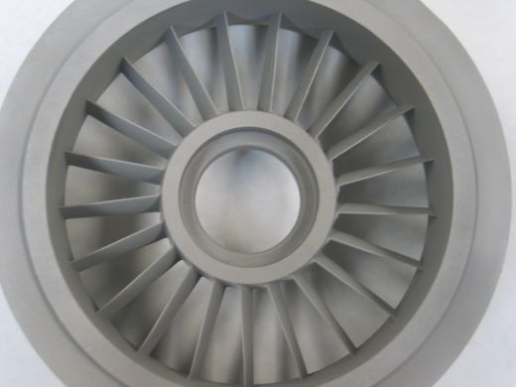
Special Casting
By SUMER SINGH RAO

Slide 2
Investment Casting
Investment casting process or lost wax process
Basic steps:
1. Produce expendable wax, plastic, or polystyrene patterns.
2. Assemble these patterns onto a gating system
3. Investing or covering the pattern assembly with refractory slurry
4. Melting the pattern assembly to remove the pattern material
5. Firing the mould to remove the last traces of the pattern material
6. Pouring molten metal
7. Knockout, cutoff and finishing.
Notes:
The root of the investment casting process, the cire Perdue or "lost wax" method dates back to at least the fourth millennium B.C. The artists and sculptors of ancient Egypt and Mesopotamia used the rudiments of the investment casting process to create intricately detailed jewelry, pectorals and idols. The investment casting process also called lost wax process begins with the production of wax replicas or patterns of the desired shape of the castings. A pattern is needed for every casting to be produced. The patterns are prepared by injecting wax or polystyrene in a metal dies. A number of patterns are attached to a central wax sprue to form a assembly. The mold is prepared by surrounding the pattern with refractory slurry that can set at room temperature. The mold is then heated so that pattern melts and flows out, leaving a clean cavity behind. The mould is further hardened by heating and the molten metal is poured while it is still hot. When the casting is solidified, the mold is broken and the casting taken out.

Slide 3
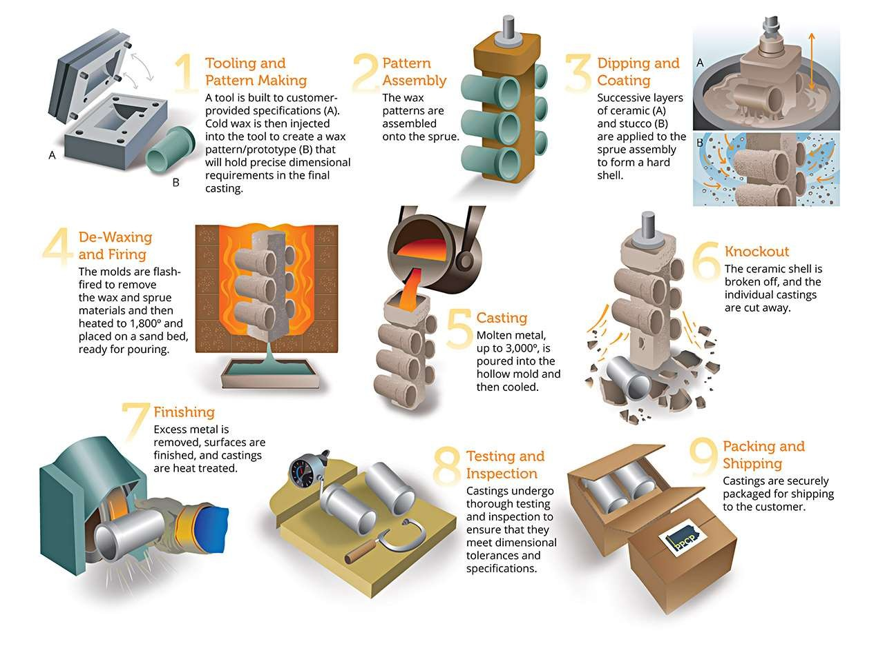

Slide 4
Fig. Investment flask-casting procedure

Slide 5
Advantages
Requires less time, no rapping and draft allowances are required on the pattern since it is not to be taken out of the mould.
No need of cores, core boxes, parting lines or riser systems.
Polystyrene is inexpensive and it can be easily fabricated into patterns having very complex shapes and fine surface details.
Inexpensive moulding flasks are sufficient for the process.
The product needs minimum cleaning and finishing operations.

Slide 6
Limitations
The pattern being delicate, the process is not suitable for machine moulding.
As the pattern gets destroyed in the process, the process is mainly used for product research in foundry industry.

Slide 7
Applications
Cylinder heads,
Crankshafts
Brake components
Machine bases and manifolds for automobiles.
PMMA and polyalkaline carbonate have been used as the pattern materials for ferrous castings.

Slide 8
Permanent Mould Casting
The process in which we use a die to make the castings is called permanent mold casting or gravity die casting, since the metal enters the mold under gravity.
Some time in die-casting we inject the molten metal with a high pressure. When we apply pressure in injecting the metal it is called pressure die casting process.
Grey cast iron is used for mould material.
Notes:
In all the above processes, a mold need to be prepared for each of the casting produced. For large-scale production, making a mold, for every casting to be produced, may be difficult and expensive. Therefore, a permanent mold, called the die may be made from which a large number of castings can be produced. , the molds are usually made of cast iron or steel, although graphite, copper and aluminum have been used as mold materials. The process in which we use a die to make the castings is called permanent mold casting or gravity die casting, since the metal enters the mold under gravity. Some time in die-casting we inject the molten metal with a high pressure. When we apply pressure in injecting the metal it is called pressure die casting process.

Slide 9
Advantages
Good surface finish and dimensional accuracy
Metal mold gives rapid cooling and fine-grain structure
Multiple-use molds.
Notes:
Permanent Molding produces a sound dense casting with superior mechanical properties.
The castings produced are quite uniform in shape have a higher degree of dimensional accuracy than Castings produced in sand
The permanent mold process is also capable of producing a consistent quality of finish on castings.

