Slide 1
ABOUT SUMER- ONLINE MENTOR, LIFE TIME LEARNER,TIRELESS SOUL
SHARING AND CARING (SPIRITUALITY)
STOP HATING ,START LOVING
ENTHUSIASM TO WORK ,AND ENTHUSIASM TO BE COMPASSIONATE
DO WHAT YOU LOVE TO DO?
NEVER UNDERESTIMATE YOURSELF
YOU ARE STRONGER THAN YOU THINK

Slide 2
METAL FORMING
PRESENTED BY-SUMER SINGH RAO

Slide 3
Large group of manufacturing processes in which plastic deformation is used to change the shape of metal workpieces
The tool, usually called a die, applies stress that exceed the yield strength of the metal
The metal takes a shape determined by the
geometry of the die
Bulk Deformation Processes
These processes involve large amount of plastic
deformation. The cross‐section of workpiece changes without volume change. For most operations, hot working conditions are preferred although some operations are carried out at room temperature(cold working)

Slide 4
Four Important forming techniques are:
Rolling: The process of plastically deforming metal by
passing it between rolls.
Forging: The workpiece is compressed between two
opposing dies so that the die shapes are imparted to the
work.
Extrusion : The work material is forced to flow
through a die opening taking its shape
Drawing: The diameter of a wire or bar is reduced by
pulling it through a die opening (bar drawing) or a series
of die openings (wire drawing)

Slide 5



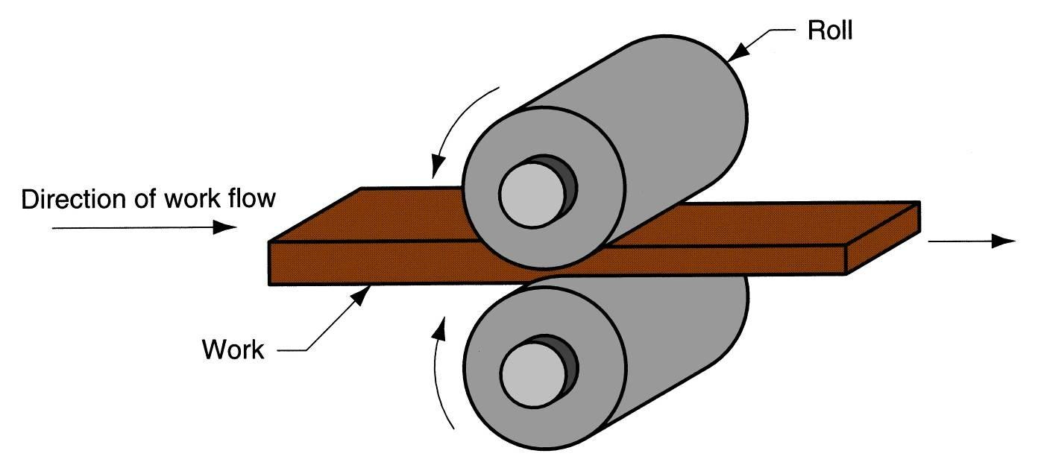
Rolling
Deformation process in which work thickness is reduced by compressive forces exerted by two opposing rolls
The rolling process (specifically, flat rolling).

Slide 6

The Rolls
Rotating rolls perform two main functions:
Pull the work into the gap between them by
friction between workpart and rolls
Simultaneously squeeze the work to reduce its cross section

Slide 7

Types of Rolling
Based on workpiece geometry :
Flat rolling - used to reduce thickness of a
rectangular cross section
Shape rolling - square cross section is formed into a shape such as an I-beam
Based on work temperature :
Hot Rolling – most common due to the large amount of deformation required
Cold rolling – produces finished sheet and
plate stock

Slide 8
Rolling Mills
Equipment is massive and expensive
Rolling mill configurations:
Two-high – two opposing rolls
Three-high – work passes through rolls in both directions
Four-high – backing rolls support smaller
work rolls
Cluster mill – multiple backing rolls on smaller rolls

Slide 9

Types of Forging
Open-die forging - work is compressed between two flat dies, allowing metal to flow laterally with minimum constraint
Impression-die forging - die contains cavity or impression that is imparted to workpart
Metal flow is constrained so that flash is created
Flashless forging - workpart is completely constrained in die
No excess flash is created

Slide 10
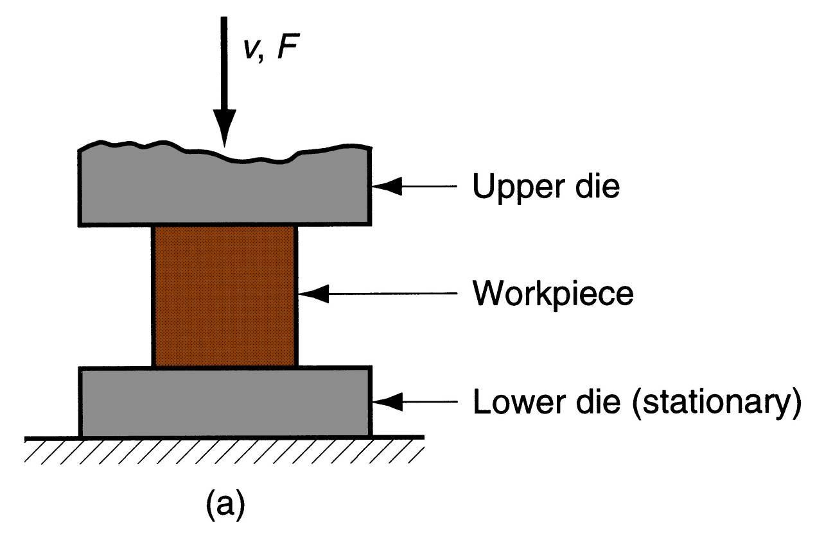
Open-Die Forging
Three types of forging: (a) open-die forging.

Slide 11
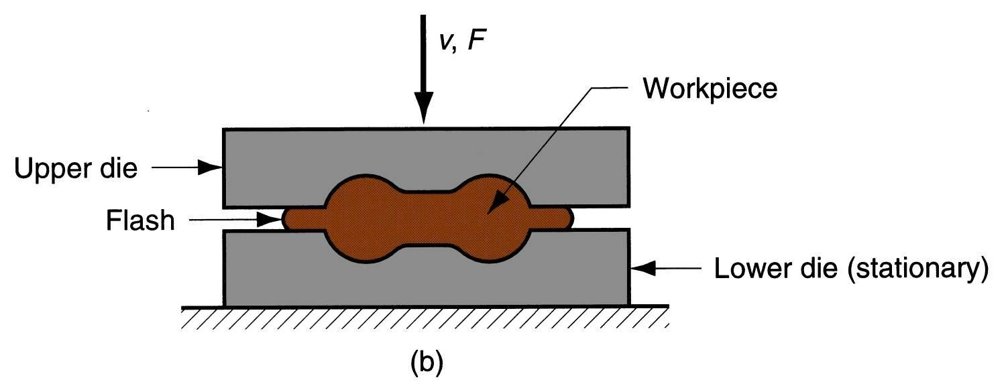
Impression-Die Forging
Three types of forging: (b) impression-die forging.

Slide 12
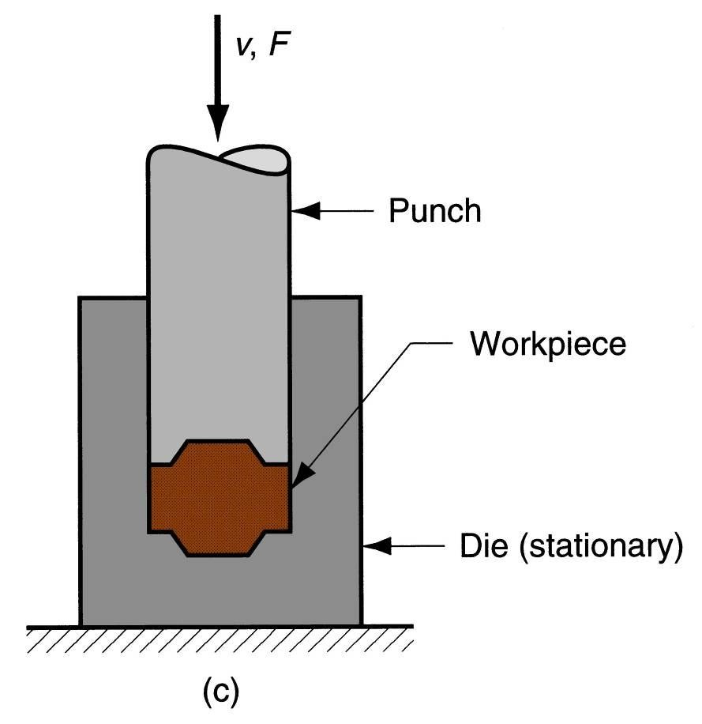
Flashless Forging
Three types of forging (c) flashless forging.

Slide 13
Advantages of Forging
1.Discrete shape of product can be produced.
2.Mechanical properties and reliability of the materials
increases due to improve in crystal structure.
3.In forging favorable grain orientation of metal is
obtained that strengthen the component but forging
distorts the previously created uni‐directional fibre.
4.Forging reduces the grain size of the metal, which
increases strength and toughness.
5.Fatigue and creep strength increases.

Slide 14
Disadvantages of Forging
1.Costly
2.Poor dimensional accuracy and surface finish.
3.Forging operations are limited to simple shapes and has limitations for parts having undercuts, re‐entrant surfaces, etc

Slide 15
Extrusion
Compression forming process in which work metal is forced to flow through a die opening to produce a desired cross-sectional shape
Process is similar to squeezing toothpaste out of a toothpaste tube
In general, extrusion is used to produce long
parts of uniform cross sections
Two basic types:
Direct extrusion
Indirect extrusion

Slide 16
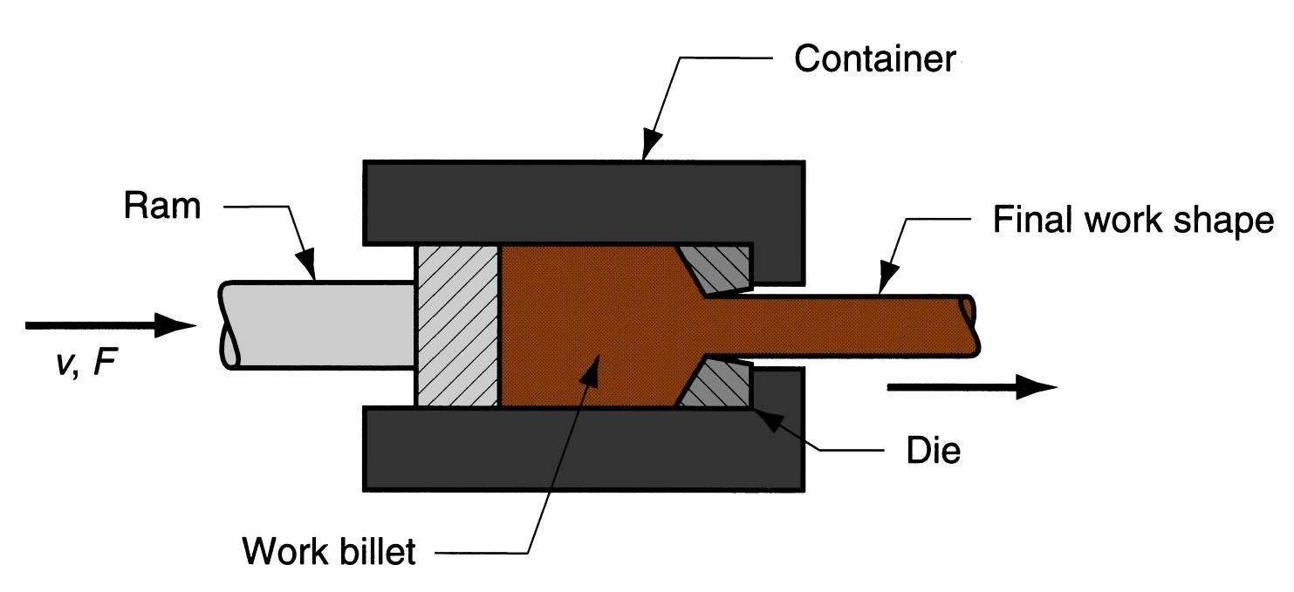
Direct Extrusion
Direct extrusion.

Slide 17
Direct Extrusion
Also called forward extrusion
As ram approaches die opening, a small portion of billet remains that cannot be forced through die opening
This extra portion, called the butt, must be separated from extrudate by cutting it just beyond the die exit
Starting billet cross section usually round
Final shape of extrudate is determined by die
opening

Slide 18
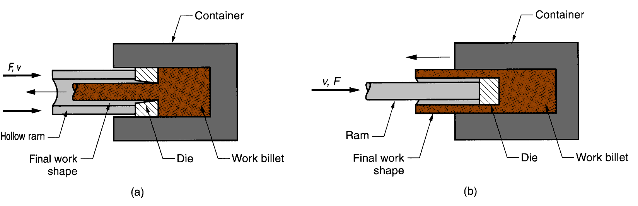
Indirect Extrusion
Indirect extrusion to produce (a) a solid cross section and (b) a hollow cross section.

Slide 19
Indirect Extrusion
Also called backward extrusion and reverse extrusion
Limitations of indirect extrusion are imposed by
Lower rigidity of hollow ram
Difficulty in supporting extruded product as it exits die

Slide 20

Wire and Bar Drawing
Cross-section of a bar, rod, or wire is reduced by pulling it through a die opening
Similar to extrusion except work is pulled through die in drawing (it is pushed through in extrusion)
Although drawing applies tensile stress, compression also plays a significant role since metal is squeezed as it passes through die opening

Slide 21
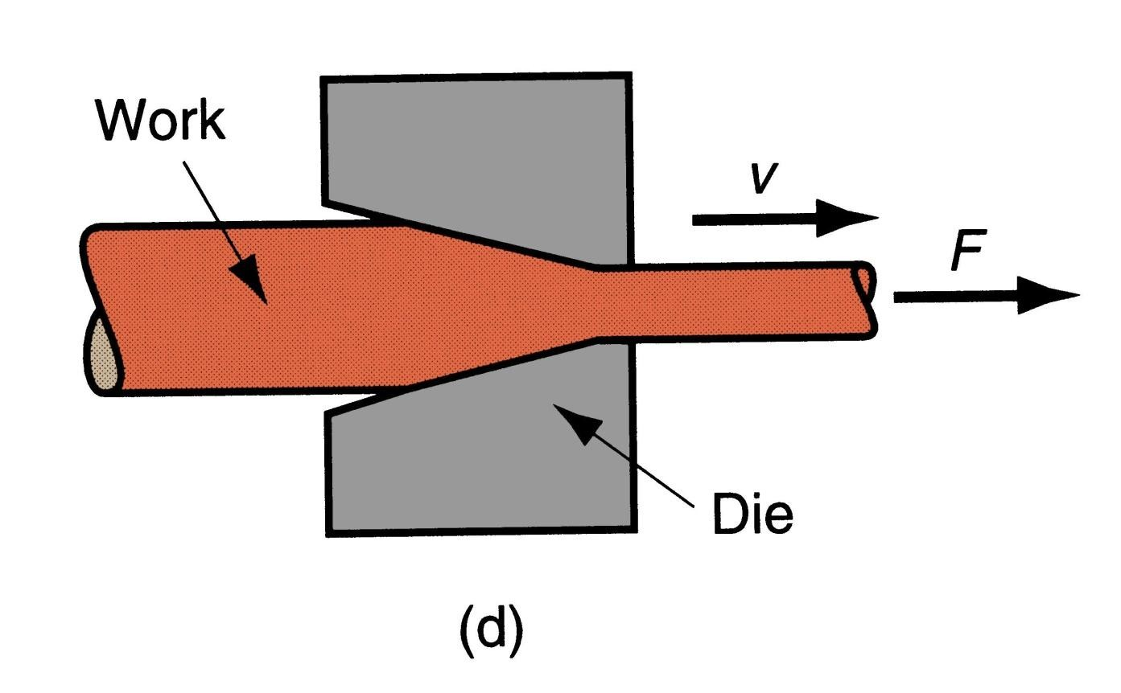
Wire and Bar Drawing
Basic bulk deformation processes: (d) drawing

Slide 22

Basic Types of Sheet Metal Processes
Cutting
Shearing to separate large sheets
Blanking to cut part perimeters out of sheet metal
Punching to make holes in sheet metal
Bending
Straining sheet around a straight axis
Drawing
Forming of sheet into convex or concave shapes

Slide 23
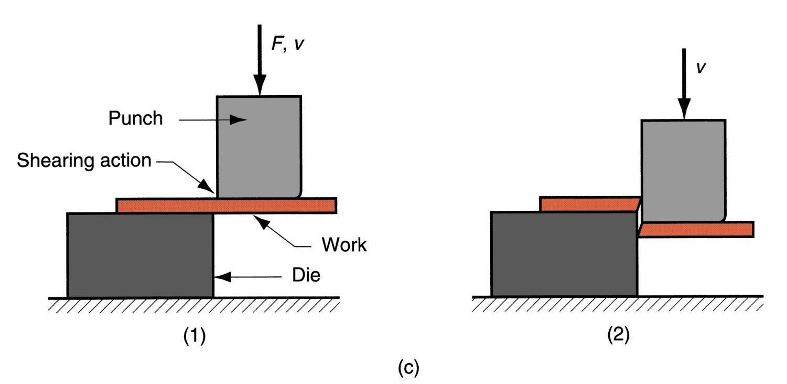
Shearing
Sheet metal cutting operation along a straight line between two cutting edges
Typically used to cut large sheets
Basic sheet metalworking operations: (c) shearing

Slide 24
Drawing (Deep drawing)
Sheet metal forming to make cup-shaped, box-shaped, or other complex-curved, hollow-shaped parts
Sheet metal blank is positioned over die cavity and then punch pushes metal into opening
Products: beverage cans, ammunition shells,
automobile body panels
Also known as deep drawing (to distinguish it from wire and bar drawing)

Slide 25
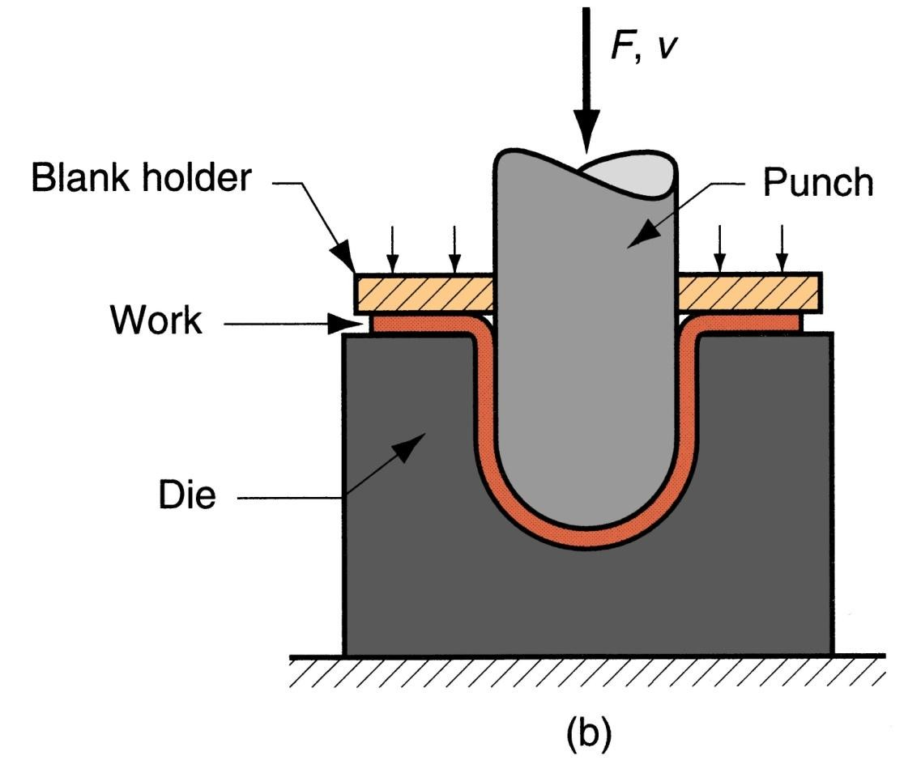
Deep Drawing
Basic sheet metalworking operations: (b) drawing

Slide 26
Advantages of Cold Working
1. Better accuracy, closer tolerances
2. Better surface finish
3. Strain hardening increases strength and hardness
4. Grain flow during deformation can cause desirable directional properties in product
5. No heating of work required (less total energy)

Slide 27
Disadvantages of Cold Working
1. Equipment of higher forces and power required
2. Surfaces of starting work piece must be free of scale and dirt
3. Ductility and strain hardening limit the amount of forming that can be done
4. In some operations, metal must be annealed to allow further deformation
5. Some metals are simply not ductile enough to be cold worked.

Slide 28
Advantages of Hot Working
1. The porosity of the metal is largely eliminated.
2. The grain structure of the metal is refined.
3. The impurities like slag are squeezed into fibers and distributed throughout the metal.
4. The mechanical properties such as toughness,
percentage elongation, percentage reduction in area, and resistance to shock and vibration are improved due to the refinement of grains.

Slide 29
Dis‐advantages of Hot Working
1. It requires expensive tools.
2. It produces poor surface finish, due to the rapid oxidation and scale formation on the metal surface.
3. Due to the poor surface finish, close tolerance cannot be maintained.

Slide 30
Recrystallisation Temperature (Rx temp.)
Rx temp. decreases strength and increases ductility.
If working above Rx temp.- hot‐working process
whereas working below are cold‐working process.
Rx temp. varies between 1/3 to ½ melting point.
For Pure metal Rx temp. = 0.3 x Melting temp.(K)
For Alloy Rx temp. = 0.5 xMelting temp.(K)

Slide 31
IMPORTANT QUESTIONS(UNIT 2 & 3)
Q1.EXPLAIN THE CONSTRUCTIONAL DETAILS OF CENTRE LATHE MACHINE.
Q2.EXPLAIN DIFFERENT LATHE MACHINE OPERATIONS.
Q3.EXPLAIN DIFFERENT CUTTING TOOLS USED ON LATHE MACHINE.
Q4.WRITE DIFFERENCE BETWEEN CAPSTAN AND TURRET LATHE.
Q5.EXPLAIN TAPER TURNING METHOD ON LATHE MACHINE.
Q6.EXPLAIN CONSTRUCTIONAL DETAILS OF SHAPER MACHINE.
Q7.EXPLAIN DIFFERENT TYPES OF SHAPER MACHINE.
Q8.EXPLAIN CRANK AND SLOTTED LEVER MECHANISM.
Q9.EXPLAIN DIFFERENT OPERATIONS PERFORMED ON SHAPER MACHINE.
Q10. EXPLAIN RADIAL AND PILLAR TYPE DRILLING MACHINE.
Q11.EXPLAIN DIFFERENT DRILLING OPERATIONS.
Q12.EXPLAIN GEOMETRY OF TWIST DRILL.
Q13.EXPLAIN DIFFERENCE B/W HOT AND COLD WORKING PROCESS
Q14.EXPLAIN FOLLOWING PROCESS- 1.ROLLING 2.FORGING 3.EXTRUSION 4. WIRE DRAWING 5.SHEET METAL PROCESS

Slide 32
IMPORTANT QUESTIONS(UNIT 1&4)
Q1.EXPLAIN FOLLOWING:- 1.TYPES OF PATTERN 2.TOOLS AND EQUIPMENT UESD IN MOULDING 3.CORE &TYPES OF CORE
4.CASTING DEFECTS 5.SAND CASTING PROCESS WITH DIAGRAM
Q2.EXPLAIN TYPES OF MOULDING SAND AND ITS PROPERTIES
Q3.WHAT IS CASTING? EXPLAIN INVESTMENT CASTING
Q4.WHAT IS WELDING ? EXPLAIN ELECTRIC ARC WELDING
Q5.EXPLAIN FOLLOWING:-1.WELDIND &TYPES OF WELDING 2. WELDING TOOLS AND SAFETY DEVICES
3.TYPES OF WELD AND WELDING JOINT 4.SOLDERING AND BRAZING
5.WELDING DEFECTS 6.TYPES OF ELECTRODES
Q6.WHAT IS PRINCIPLE OF RESISTANCE WELDING?EXPLAIN BUTT WELDING WITH NEAT SKETCH.
Q7.WHAT IS PRINCIPLE OF OXYACETYLENE GAS WELDING ?EXPLAIN TYPES OF FLAMES
Q8.EXPLAIN TIG AND MIG WELDING.

