Slide 1
ABOUT SUMER- ONLINE MENTOR, LIFE TIME LEARNER,TIRELESS SOUL
SHARING AND CARING (SPIRITUALITY)
STOP HATING ,START LOVING
ENTHUSIASM TO WORK ,AND ENTHUSIASM TO BE COMPASSIONATE
DO WHAT YOU LOVE TO DO?
NEVER UNDERESTIMATE YOURSELF
YOU ARE STRONGER THAN YOU THINK

Slide 2
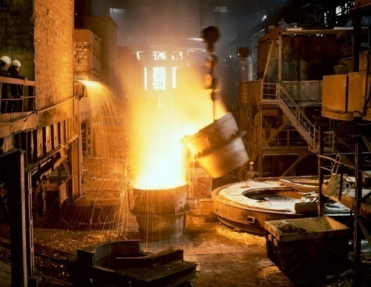
Metal Casting
By SUMER SINGH RAO

Slide 3
Casting means pouring molten metal into a mold with a cavity of the shape to be made, and allowing it to solidify. When solidified, the desired metal object is taken out from the mold either by breaking the mold or taking the mold apart. The solidified object is called the casting. By this process, intricate parts can be given strength and rigidity frequently not obtainable by any other manufacturing process. The mold, into which the metal is poured, is made of some heat resisting material. Sand is most often used as it resists the high temperature of the molten metal. Permanent molds of metal can also be used to cast products.

Slide 6
Casting Terms
Flask: A moulding flask is one which holds the sand mould intact. It is made up of wood for temporary applications or metal for long-term use.
Drag: Lower moulding flask.
Cope: Upper moulding flask.
Contd…

Slide 7
Pattern: Pattern is a replica of the final object to be made with some modifications.
Parting line: This is the dividing line between the two moulding flasks that makes up the sand mould.
Bottom board: This is a board normally made of wood, which is used at the start of the mould making.
Contd…
Notes:
Pattern: Pattern is a replica of the final object to be made with some modifications. The mould cavity is made with the help of the pattern.
Parting line: This is the dividing line between the two moulding flasks that makes up the sand mould. In split pattern it is also the dividing line between the two halves of the pattern.
Bottom board: This is a board normally made of wood, which is used at the start of the mould making. The pattern is first kept on the bottom board, sand is sprinkled on it and then the ramming is done in the drag.

Slide 8
Moulding sand: The freshly prepared refractory material used for making the mould cavity. It is a mixture of silica, clay and moisture in appropriate proportions.
Backing sand: This is made up of used and burnt sand.
Core: Used for making hollow cavities in castings.
Notes:
Moulding sand: It is the freshly prepared refractory material used for making the mould cavity. It is a mixture of silica, clay and moisture in appropriate proportions to get the desired results and it surrounds the pattern while making the mould.
Backing sand: It is what constitutes most of the refractory material found in the mould. This is made up of used and burnt sand.
Core: It is used for making hollow cavities in castings.

Slide 9
Pouring basin: A small funnel-shaped cavity at the top of the mould into which the molten metal is poured.
Sprue: The passage through which the molten metal from the pouring basin reaches the mould cavity.
Runner: The passage ways in the parting plane through which molten metal flow is regulated before they reach the mould cavity.
Gate: The actual entry point through which molten metal enters the mould cavity in a controlled rate.
Contd…
Notes:
Pouring basin: A small funnel-shaped cavity at the top of the mould into which the molten metal is poured.
Sprue: The passage through which the molten metal from the pouring basin reaches the mould cavity. In many cases it controls the flow of metal into the mould.
Runner: The passage ways in the parting plane through which molten metal flow is regulated before they reach the mould cavity.
Gate: The actual entry point through which molten metal enters the mould cavity in a controlled rate.

Slide 10
Chaplet: Chaplets are used to support cores inside the mould cavity.
Chill: Chills are metallic objects, which are placed in the mould to increase the cooling rate of castings.
Riser: It is a reservoir of molten metal provided in the casting so that hot metal can flow back into the mould cavity when there is a reduction in volume of metal due to solidification
Contd…
Notes:
Chaplet: Chaplets are used to support cores inside the mould cavity to take care of its own weight and overcome the metallostatic forces.
Chill: Chills are metallic objects, which are placed in the mould to increase the cooling rate of castings to provide uniform or desired cooling rate.
Riser: It is a reservoir of molten metal provided in the casting so that hot metal can flow back into the mould cavity when there is a reduction in volume of metal due to solidification.

Slide 11
Sand casting
Sand casting uses ordinary sand as the primary mould material.
The sand grains are mixed with small amounts of other materials, such as clay and water, to improve mouldability and cohesive strength, and are then packed around a pattern that has the shape of the desired casting.
The pattern must be removed before pouring, the mold is usually made in two or more pieces.
An opening called a sprue hole is cut from the top of the mold through the sand and connected to a system of channels called runners.
Contd….
Notes:
Sand casting uses ordinary sand as the primary mold material. The sand grains are mixed with small mounts of other materials, such as clay and water, to improve moldability and cohesive strength, and are then packed around a pattern that has the shape of the desired casting. Because the grains will pack into thin sections and can be used economically in large quantities, products spanning a wide range of sizes and detail can be made by this method. If the pattern must be removed before pouring, the mold is usually made in two or more pieces. An opening called a sprue hole is cut from the top of the mold through the sand and connected to a system of channels called runners. The molten metal is poured into the sprue hole, flows through the runners, and enters the mold cavity through an opening called a gate. Gravity flow is the most common means of introducing the metal into the mold. After solidification, the mold is broken and the finished casting is removed. Because the mold is destroyed, a new mold must be made for each casting.
When the casting has solidified it is removed by destroying the sand mould. The casting is then “fettled” by cutting off the ingate and the feeder head.

Slide 12
The molten metal is poured into the sprue hole, flows through the runners, and enters the mold cavity through an opening called a gate.
Gravity flow is the most common means of introducing the metal into the mold.
After solidification, the mold is broken and the finished casting is removed.
The casting is then “fettled” by cutting off the ingate and the feeder head.
Because the mold is destroyed, a new mold must be made for each casting.
Contd…

Slide 13
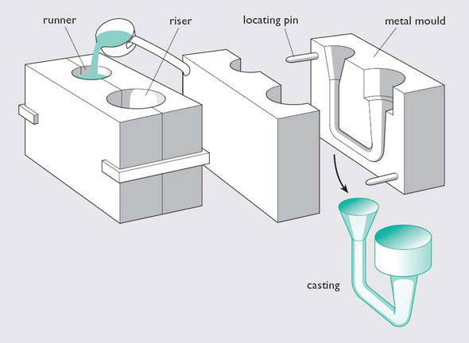

Slide 14
Sequential steps in making a sand casting
A pattern board is placed between the bottom (drag) and top (cope) halves of a flask, with the bottom side up.
Sand is then packed into the drag half of the mold.
A bottom board is positioned on top of the packed sand, and the mold is turned over, showing the top (cope) half of pattern with sprue and riser pins in place.
The cope half of the mold is then packed with sand.
Contd…

Slide 15
The mold is opened, the pattern board is drawn (removed), and the runner and gate are cut into the surface of the sand.
The mold is reassembled with the pattern board removed, and molten metal is poured through the sprue.
The contents are shaken from the flask and the metal segment is separated from the sand, ready for further processing.

Slide 16
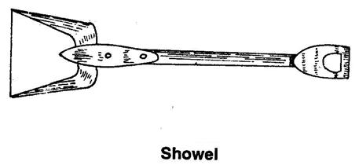
FOUNDRY SHOP HAND TOOLS :
1.Showel: It consists of iron pan with a wooden handle. It can be used for mixing and conditioning the sand.

Slide 17
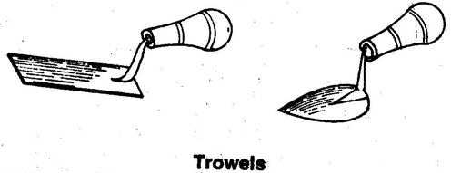
2. Trowels: These are used for finishing flat surfaces and corners inside a mould. Common shapes of trowels are shown as under. They are made of iron with a wooden handle.

Slide 18

3. Lifter: A lifter is a finishing tool used for repairing the mould and finishing the mould sand. Lifter is also used for removing loose sand from mould.

Slide 19
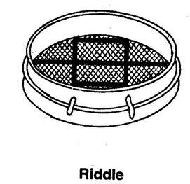
4. Hand riddle: It is used for ridding of sand to remove foreign material from it. It consists of a wooden frame fitted with a screen of standard wire mesh at the bottom.

Slide 20
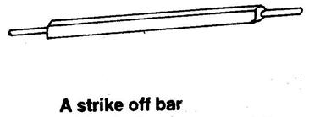
5.Strike off bar: It is a flat bar, made of wood or iron to strike off the excess sand from the top of a box after ramming.
Its one edge made beveled and the surface perfectly smooth and plane.

Slide 21
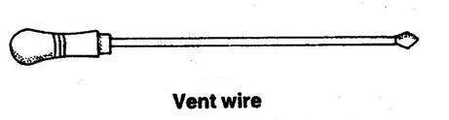
6. Vent wire: It is a thin steel rod or wire carrying a pointed edge at one end and a wooden handle or a bent loop at the other. After ramming and striking off the excess sand it is used to make small holes, called vents, in the sand mould to allow the exit of gases and steam during casting.

Slide 22
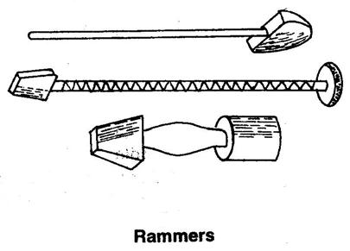
7. Rammers: Rammers are used for striking the sand mass in the moulding box to pack it closely around one pattern. Common types of rammers are shown as under.

Slide 23
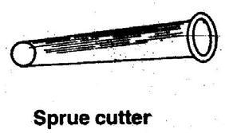
8. Sprue pin: It is a tapered rod of wood or iron, which is embedded in the sand and later withdrawn to produce a hole, called runner, through which the molten metal is poured into the mould.
9. Sprue cutter: It is also used for the same purpose as a sprue pin, but there is a marked difference between their use in that the cutter is used to produce the hole after ramming the mould. It is in the form of a tapered hollow tube, which is inserted in the sand to produce the hole.

Slide 24
Pattern
A pattern is a replica of the object to be made by the casting process, with some modifications.
The main modifications are
The addition of pattern allowances,
The provision of core prints, and

Slide 25
The pattern material should be
Easily worked, shaped and joined
Light in weight
Strong, hard and durable
Resistant to wear and abrasion
Resistant to corrosion, and to chemical reactions
Dimensionally stable and unaffected by variations in temperature and humidity.
Available at low cost.

Slide 26
Types of Pattern
Single Piece Pattern
These are inexpensive and the simplest type of patterns. As the name indicates, they are made of a single piece.
Gated Pattern
Gating and runner system are integral with the pattern. This would eliminate the hand cutting of the runners and gates and help in improving the productivity of a moulding.

Slide 27
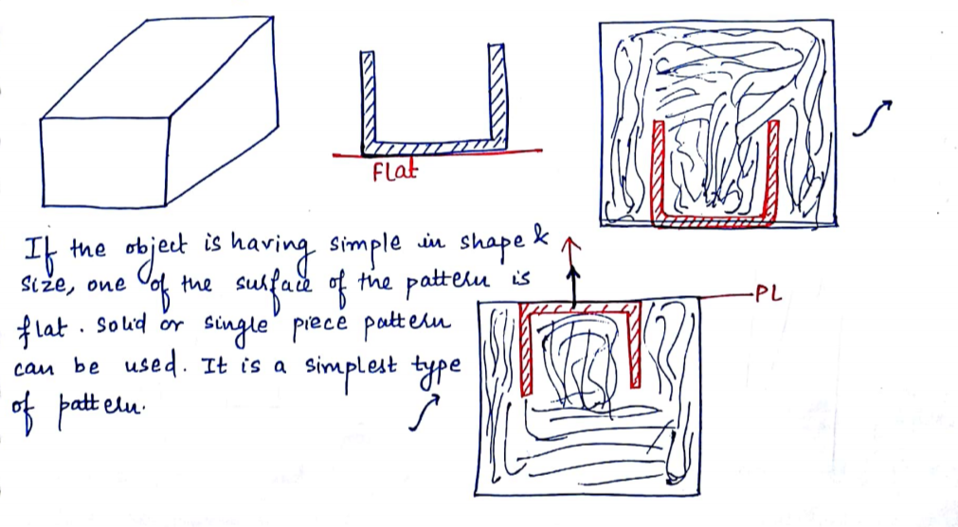

Slide 28
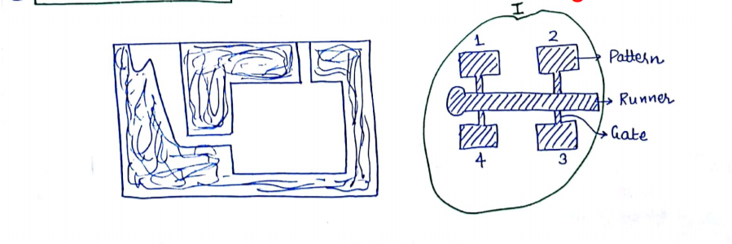

Slide 29
Types of Pattern
Split Pattern or Two Piece Pattern
This is the most widely used type of pattern for intricate castings. When the contour of the casting makes its withdrawal from the mould difficult, or when the depth of the casting is too high, then the pattern is split into two parts so that one part is in the drag and the other in the cope.

Slide 30
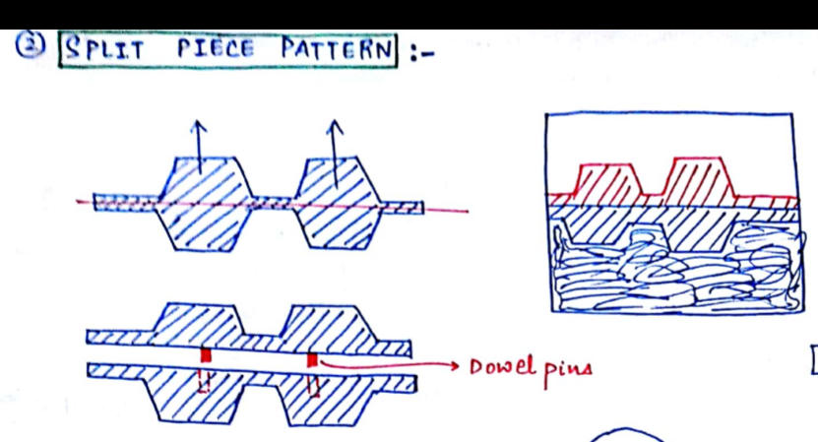

Slide 31
Types of Pattern
Cope and Drag Pattern
These are similar to split patterns. In addition to splitting the pattern, the cope and drag halves of the pattern along with the gating and riser systems are attached separately to the metal or wooden plates along with the alignment pins. They are called the cope and drag patterns.

Slide 32
Types of Pattern
Match Plate Pattern
The cope and drag patterns along with the gating and the risering are mounted on a single matching metal or wooden plate on either side.

Slide 33
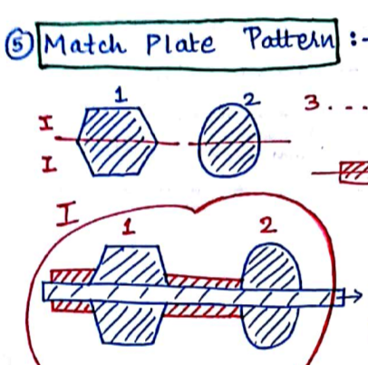

Slide 34
Types of Pattern
Loose Piece Pattern
This type of pattern is also used when the contour of the part is such that withdrawing the pattern from the mould is not possible.

Slide 35
Types of Pattern
Follow Board Pattern
This type of pattern is adopted for those castings where there are some portions, which are structurally weak and if not supported properly are likely to break under the force of ramming.
Notes:
This type of pattern is adopted for those castings where there are some portions, which are structurally weak and if not supported properly are likely to break under the force of ramming.
Hence, the bottom board is modified as a follow board to closely fit the contour of the weak pattern and thus support it during the ramming of the drag. During the preparation of the cope, no follow board is necessary because the sand that is already compacted in the drag will support the fragile pattern. An example is shown in figure below.

Slide 36
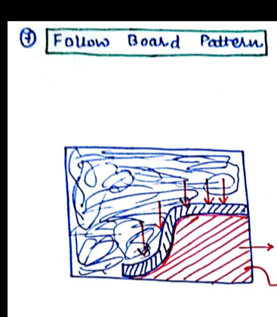

Slide 37
Types of Pattern
Sweep Pattern
It is used to sweep the complete casting by means of a plane sweep. These are used for generating large shapes, which are axi-symmetrical or prismatic in nature such as bell-shaped or cylindrical.

Slide 38
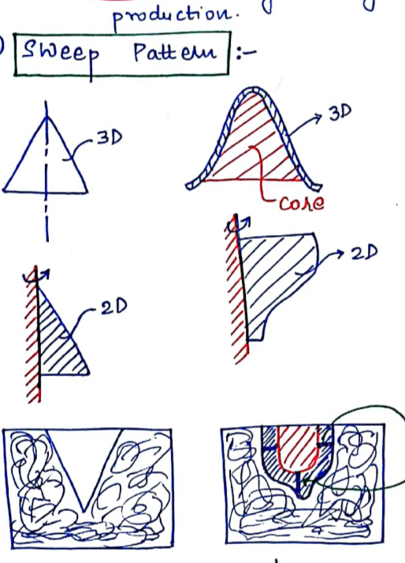

Slide 39
Fluidity
The ability of a metal to flow and fill a mold is known as fluidity.
Pouring Temperature
The most important controlling factor of fluidity is the pouring temperature or the amount of superheat.
Higher the pouring temperature, the higher the fluidity.
Notes:
Pouring Temperature
Fluidity is dependent on the composition, freezing temperature, and freezing range of the metal or alloy, but the most important controlling factor is usually the pouring temperature or the amount of superheat. The higher the pouring temperature, the higher the fluidity. Excessive temperatures should be avoided, however. At high pouring temperatures, metal-mold reactions are accelerated and the fluidity may be so great as to permit penetration. Penetration is a defect where the metal not only fills the mold cavity but also fills the small voids between the sand particles in a sand mold. The product surface then contains small particles of embedded sand.

Slide 40
Moulding Sand Composition
Sand: Ordinary silica Sand (SiO₂), zircon, or olivine sands.
Clay: Acts as binding agents mixed to the moulding sands
fire clay (Al₂O₃ 2SiO₂ 2H₂O), and
Bentonite (Al₂O₃ 4SiO₂ H₂O nH₂O).
Water: Clay is activated by water.
Notes:
Sand: Ordinary silica (SiO₂), zircon, or olivine (forsterite and fayalite) sands are compounded with additives to meet our requirement.
Clay: Clays are the most generally used binding agents mixed to the moulding sands to provide strength, because of their low cost and wider utility
Kaolinite or fire clay (Al₂O₃ 2SiO₂ 2H₂O), and
Bentonite (Al₂O₃ 4SiO₂ H₂O nH₂O).
Water: Clay is activated by water so that it develops the necessary plasticity and strength.

Slide 41
Moulding Sand Properties
Porosity or Permeability: Permeability or porosity of the moulding sand is the measure of its ability to permit air to flow through it.
Strength: It is defined as the property of holding together of sand grains. A moulding sand should have ample strength so that the mould does not collapse or get partially destroyed during conveying, turning over or closing.
Refractoriness: It is the ability of the moulding sand mixture to withstand the heat of melt without showing any signs of softening or fusion.
Contd…

Slide 42
Plasticity: It is the measure of the moulding sand to flow around and over a pattern during ramming and to uniformly fill the flask.
Collapsibility: This is the ability of the moulding sand to decrease in volume to some extent under the compressive forces developed by the shrinkage of metal during freezing and subsequent cooling.
Adhesiveness: This is the property of sand mixture to adhere to another body (here, the moulding flasks). The moulding sand should cling to the sides of the moulding boxes so that it does not fall out when the flasks are lifted and turned over. This property depends on the type and amount of binder used in the sand mix.

Slide 43
Other Sands
Facing sand: The small amount of carbonaceous material sprinkled on the inner surface of the mold cavity to give a better surface finish to the castings.
Backing sand: It is what constitutes most of the refractory material found in the mould. This is made up of used and burnt sand.
Green Sand: The molding sand that contains moisture is termed as green sand. The green sand should have enough strength so that the constructed mould retains its shape.
Dry sand: When the moisture in the moulding sand is completely expelled, it is called dry sand.

Slide 44
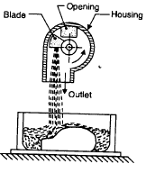
Sand Slinger

Slide 45
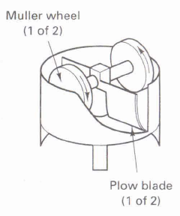

Slide 46
Gating System
Contd…

Slide 47
Gating System
Pouring basin: A small funnel shaped cavity at the top of the mould into which the molten metal is poured.
Sprue: The passage through which the molten metal, from the pouring basin, reaches the mould cavity. In many cases it controls the flow of metal into the mould.
Contd…

Slide 48
Runner: A runner is commonly a horizontal channel which connects the sprue with gates, thus allowing the molten metal to enter the mould cavity. The runners are of larger cross-section and often streamlined to slow down and smooth out the flow, and are designed to provide approximately uniform flow rates to the various parts of the mould cavity. Runners are commonly made trapezoidal in cross-section.
Contd…

Slide 49
Ingate: A channel through which the molten metal enters the mould cavity.
Vent: Small opening in the mould to facilitate escape of air and gases.

Slide 50
Ladles
Two types of ladles used in the pouring of castings.

Slide 51
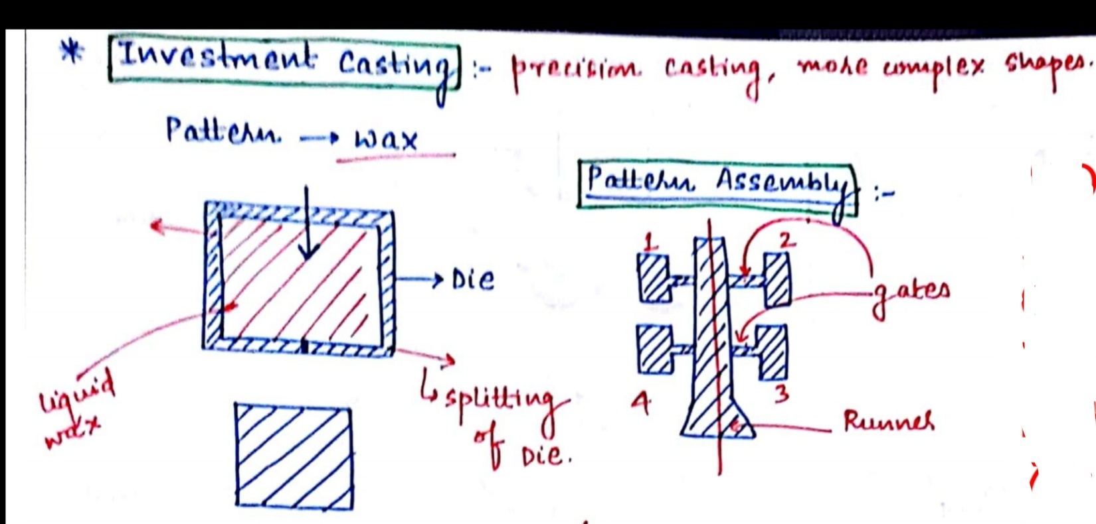

Slide 52
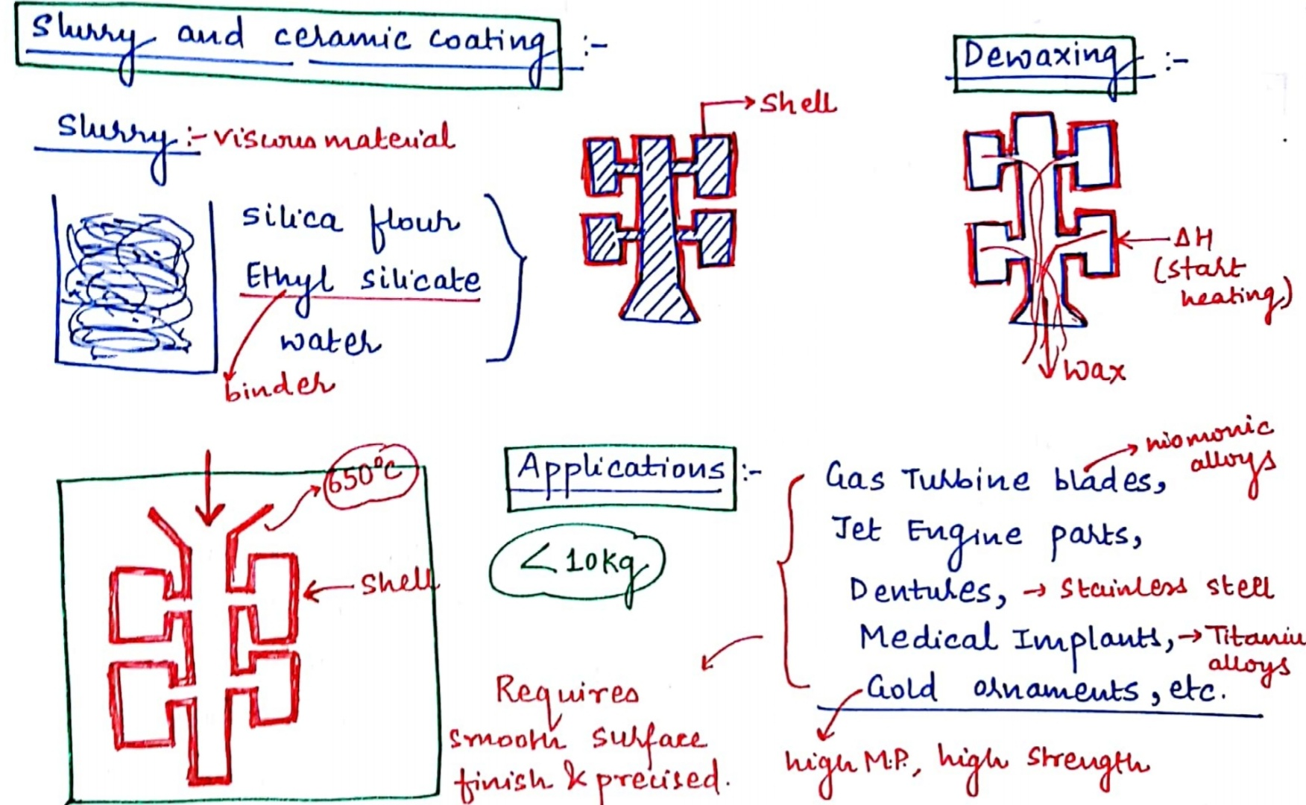

Slide 53
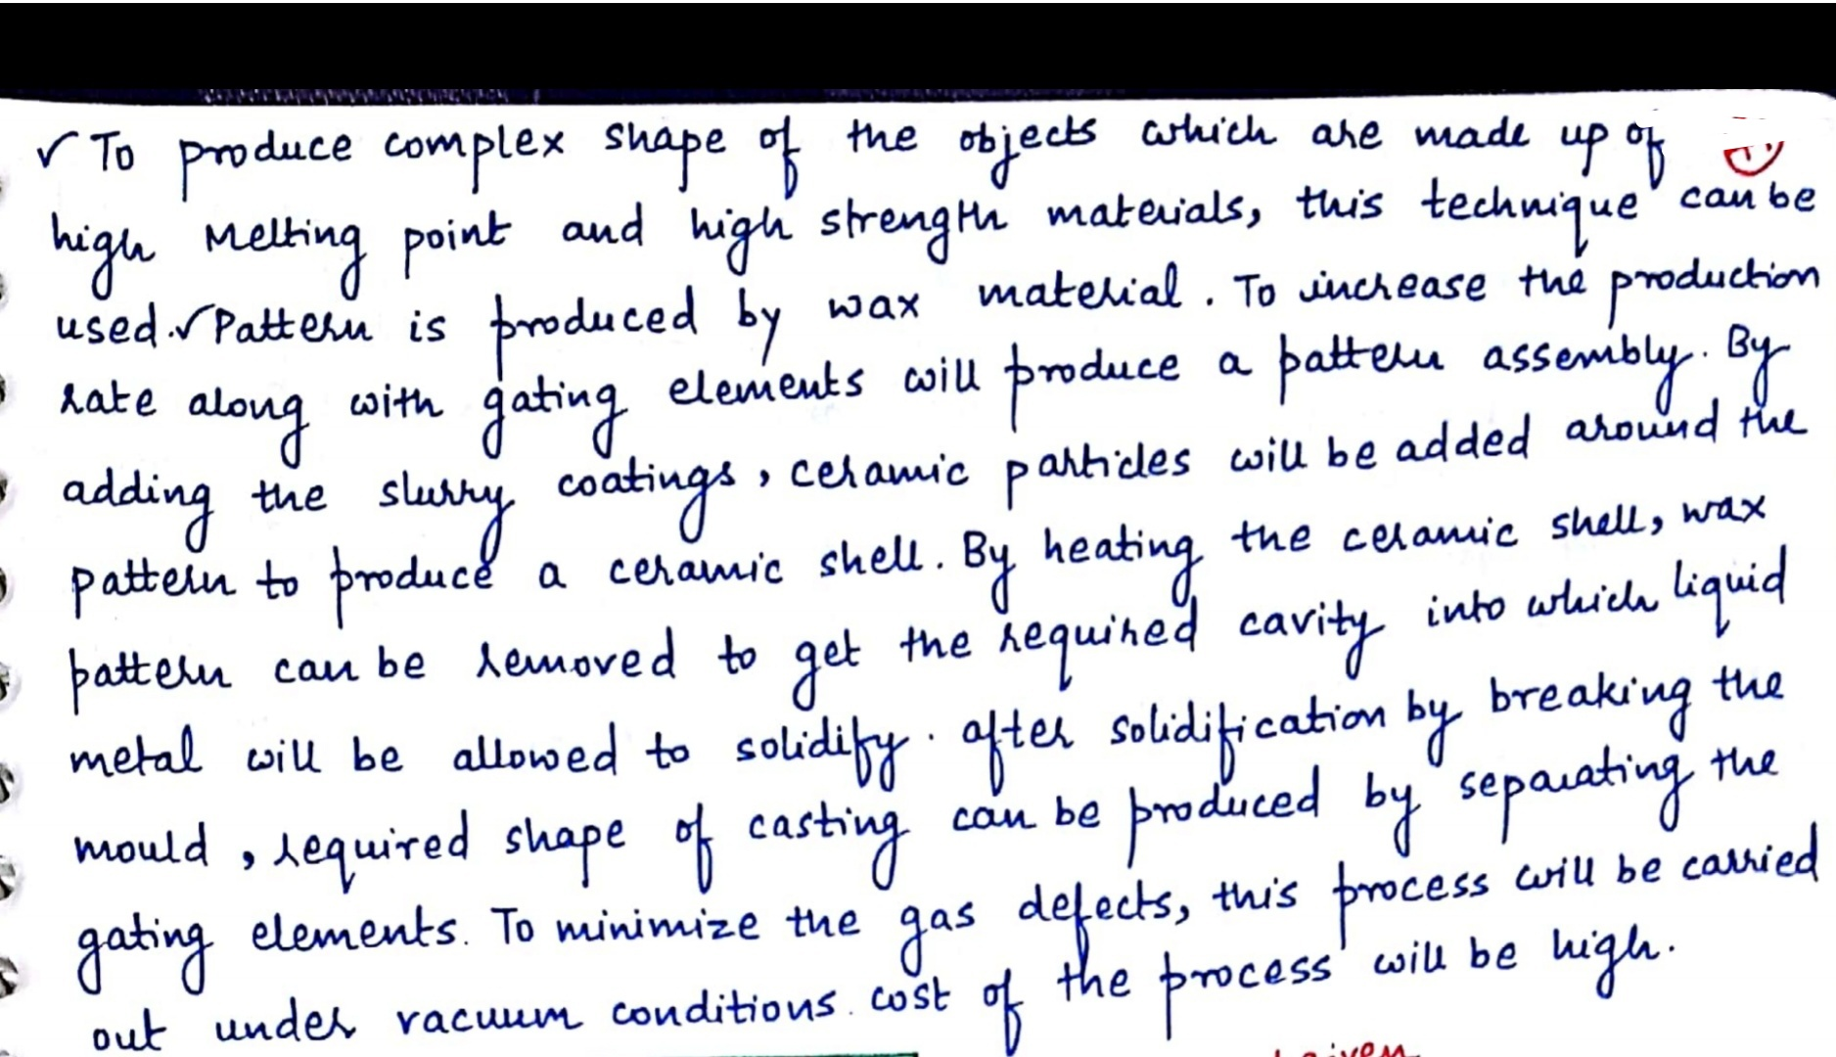

Slide 54
Casting Defects
The following are the major defects, which are likely to occur in sand castings:
Gas defects
Shrinkage cavities
Molding material defects
Pouring metal defects
Mold shift.

Slide 55
Gas Defects
A condition existing in a casting caused by the trapping of gas in the molten metal or by mold gases evolved during the pouring of the casting.
The defects in this category can be classified into blowholes and pinhole porosity.
Blowholes are spherical or elongated cavities present in the casting on the surface or inside the casting.
Pinhole porosity occurs due to the dissolution of hydrogen gas, which gets entrapped during heating of molten metal.

Slide 56
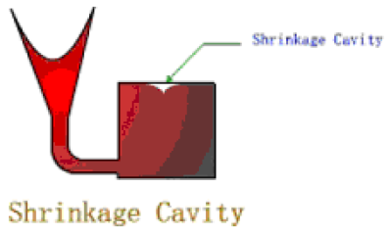
Shrinkage Cavities
These are caused by liquid shrinkage occurring during the solidification of the casting.
To compensate for this, proper feeding of liquid metal is required. For this reason risers are placed at the appropriate places in the mold.
Sprues may be too thin, too long or not attached in the proper location, causing shrinkage cavities.
It is recommended to use thick sprues to avoid shrinkage cavities.

Slide 57
Molding Material Defects
Cuts and washes,
Scab
Metal penetration,
Fusion, and
Swell

Slide 58
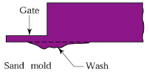
Cut and washes
These appear as rough spots and areas of excess metal, and are caused by erosion of molding sand by the flowing metal.
This is caused by the molding sand not having enough strength and the molten metal flowing at high velocity.
The former can be taken care of by the proper choice of molding sand and the latter can be overcome by the proper design of the gating system.

Slide 59
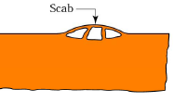
Scab
This defect occurs when a portion of the face of a mould lifts or breaks down and the recess thus made is filled by metal.
When the metal is poured into the cavity, gas may be disengaged with such violence as to break up the sand, which is then washed away and the resulting cavity filled with metal.
The reasons can be: - too fine sand, low permeability of sand, high moisture content of sand and uneven mould ramming.

Slide 60
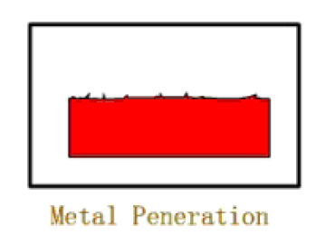
Metal penetration
When molten metal enters into the gaps between sand grains, the result is a rough casting surface.
This occurs because the sand is coarse or no mold wash was applied on the surface of the mold. The coarser the sand grains more the metal penetration.

Slide 61
Pouring Metal Defects
The likely defects in this category are
Mis-runs and
Cold shuts
A mis-run is caused when the metal is unable to fill the mold cavity completely and thus leaves unfilled cavities.
A cold shut is caused when two streams while meeting in the mold cavity, do not fuse together properly thus forming a discontinuity in the casting.
Contd…
Notes:
A mis-run is caused when the metal is unable to fill the mold cavity completely and thus leaves unfilled cavities. A mis-run results when the metal is too cold to flow to the extremities of the mold cavity before freezing. Long, thin sections are subject to this defect and should be avoided in casting design. The mis-run defect is caused either by a lower fluidity of the mold or when the section thickness of the casting is very small. Fluidity can be improved by changing the composition of the metal and by increasing the pouring temperature of the metal.

Slide 62
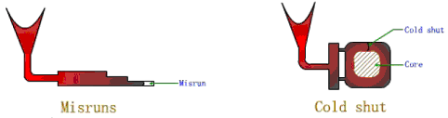
The mis-run and cold shut defects are caused either by a lower fluidity of the mold or when the section thickness of the casting is very small. Fluidity can be improved by changing the composition of the metal and by increasing the pouring temperature of the metal.
Notes:
A cold shut is caused when two streams while meeting in the mold cavity, do not fuse together properly thus forming a discontinuity in the casting. When the molten metal is poured into the mold cavity through more than-one gate, multiple liquid fronts will have to flow together and become one solid. If the flowing metal fronts are too cool, they may not flow together, but will leave a seam in the part. Such a seam is called a cold shut, and can be prevented by assuring sufficient superheat in the poured metal and thick enough walls in the casting design.
The mis-run and cold shut defects are caused either by a lower fluidity of the mold or when the section thickness of the casting is very small. Fluidity can be improved by changing the composition of the metal and by increasing the pouring temperature of the metal.

Slide 63
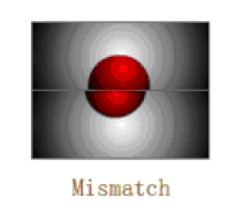
Mold Shift
The mold shift defect occurs when cope and drag or molding boxes have not been properly aligned.

Slide 64
Metallurgical defects
Hot tears or hot cracking, cause of this defect is that stresses and strains built up during solidification are too high compared to the actual strength of the semisolid material. This type of defects occurs in the lower part of the solidification range, close to the solidus, when the alloy has a wide solidification temperature range and a small amount of liquid, when the solid fraction is more than 0.9, the hot tearing is easy to occur. Proper mould design prevents this type of defect.
Hot spots are areas on the surface of casting that become very hard because they cooled more quickly than the surrounding material.

Slide 65


Slide 66
IMPORTANT QUESTIONS(UNIT 2 & 3)
Q1.EXPLAIN THE CONSTRUCTIONAL DETAILS OF CENTRE LATHE MACHINE.
Q2.EXPLAIN DIFFERENT LATHE MACHINE OPERATIONS.
Q3.EXPLAIN DIFFERENT CUTTING TOOLS USED ON LATHE MACHINE.
Q4.WRITE DIFFERENCE BETWEEN CAPSTAN AND TURRET LATHE.
Q5.EXPLAIN TAPER TURNING METHOD ON LATHE MACHINE.
Q6.EXPLAIN CONSTRUCTIONAL DETAILS OF SHAPER MACHINE.
Q7.EXPLAIN DIFFERENT TYPES OF SHAPER MACHINE.
Q8.EXPLAIN CRANK AND SLOTTED LEVER MECHANISM.
Q9.EXPLAIN DIFFERENT OPERATIONS PERFORMED ON SHAPER MACHINE.
Q10. EXPLAIN RADIAL AND PILLAR TYPE DRILLING MACHINE.
Q11.EXPLAIN DIFFERENT DRILLING OPERATIONS.
Q12.EXPLAIN GEOMETRY OF TWIST DRILL.
Q13.EXPLAIN DIFFERENCE B/W HOT AND COLD WORKING PROCESS
Q14.EXPLAIN FOLLOWING PROCESS- 1.ROLLING 2.FORGING 3.EXTRUSION 4. WIRE DRAWING 5.SHEET METAL PROCESS

Slide 67
IMPORTANT QUESTIONS(UNIT 1&4)
Q1.EXPLAIN FOLLOWING:- 1.TYPES OF PATTERN 2.TOOLS AND EQUIPMENT UESD IN MOULDING 3.CORE &TYPES OF CORE
4.CASTING DEFECTS 5.SAND CASTING PROCESS WITH DIAGRAM
Q2.EXPLAIN TYPES OF MOULDING SAND AND ITS PROPERTIES
Q3.WHAT IS CASTING? EXPLAIN INVESTMENT CASTING
Q4.WHAT IS WELDING ? EXPLAIN ELECTRIC ARC WELDING
Q5.EXPLAIN FOLLOWING:-1.WELDIND &TYPES OF WELDING 2. WELDING TOOLS AND SAFETY DEVICES
3.TYPES OF WELD AND WELDING JOINT 4.SOLDERING AND BRAZING
5.WELDING DEFECTS 6.TYPES OF ELECTRODES
Q6.WHAT IS PRINCIPLE OF RESISTANCE WELDING?EXPLAIN BUTT WELDING WITH NEAT SKETCH.
Q7.WHAT IS PRINCIPLE OF OXYACETYLENE GAS WELDING ?EXPLAIN TYPES OF FLAMES
Q8.EXPLAIN TIG AND MIG WELDING.

