Slide 1
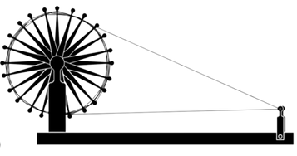
HERITAGE LOOMS
Preserving Tradition,Celebrating Heritage
Team members
1.Harsh Kumar
2.B.Phani Sriram
3.G.Sudeep
4.V.Anusri

Slide 2
Table of Contents
Problem Statement
2. Objectives
3. Uml Use Case Diagram
4. Uml Class Diagram
5. E-R Diagram

Slide 3
Problem Statement
Competition from power loom and mass-produced textiles
Decreasing interest among younger generations
Lack of modernization and technology adoption
Fluctuating market demand and inconsistent income
Limited access to markets and marketing challenges

Slide 4

Objectives
Promote and Preserve India's Handloom Heritage through Authentic Products
Empower Handloom Weavers and Communities with a Fair Platform to Showcase and Sell Authentic Products.
To cater customers who appreciate the value of handcrafted, rare, and distinctive products.
Our website differentiate itself from others by offering unique features, exclusive designs and authenticity.

Slide 5
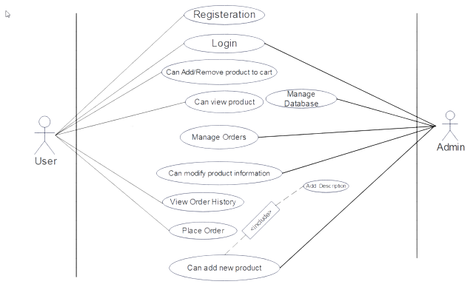
UML Use Case Diagram

Slide 6
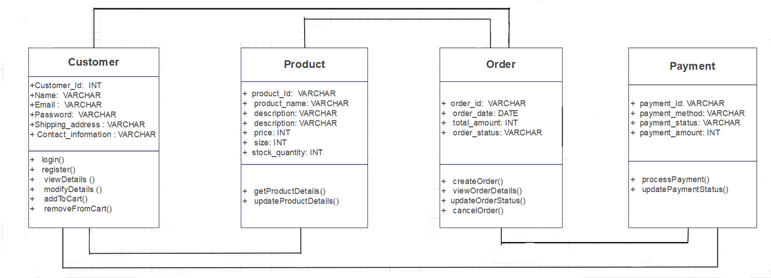
Class Diagram

Slide 7
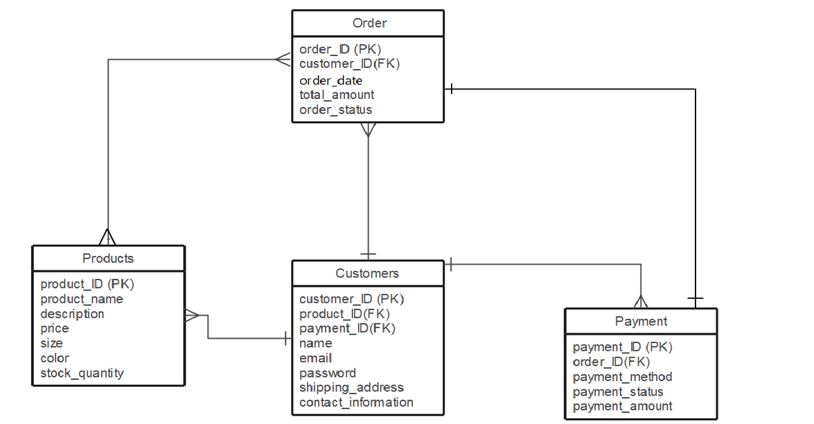
ER Diagram

Slide 8
THANK YOU

