Slide 1
Spoural Management System
Welcome to Spoural, a system designed to manage spoural events in our college. Spoural streamlines event registration, simplifying the process for students and ULSC members. A spectacular fusion of culture, sports, and talent like never before! Feel the Energy: Immerse yourself in jaw-dropping performances that will leave you in awe. Compete to Win: Cheer on your favorites in adrenaline- pumping sports showdowns.

Slide 2
For the Admins: Taking Control of ULSC Events
Event Creation & Management: Easily create events, set dates, timings, venues, participation limits, and other details.
ULSC Member Management: Add, edit, and manage ULSC member profiles within the system.
Data Export: Download event participant lists as PDFs for easy sharing and record-keeping.
Quick Example: Creating an Inter-Department Cricket Tournament – simple and fast!
1
Event Creation
2
Member Management
3
Data Export

Slide 3
ULSC Member Dashboard: Stay Updated & Engaged
Personalized view of upcoming events, registration status, and participation history.
Quick access to register for new events and manage personal information.
Important alerts and notifications displayed prominently.
Promotes active engagement in ULSC activities.
Participants Registration
1
2
Event Tracking
Participation Alerts
3

Slide 4



Key Feature: Participation Limits & Control
System automatically enforces participation limits for each event.
Prevents overbooking and ensures fair access to all ULSC members.
Reduces admin workload by eliminating manual tracking of participant numbers.
Ensures smooth execution of events with controlled participation.
Set Participation Limit
Automatic Enforcement
Controlled Participation

Slide 5



Benefits of Spoural: Why It Matters
Automated Tracking: No more spreadsheets! Track everything automatically.
Error-Free Registration: Minimizes human error and ensures accurate data.
Simplified Record Handling: Easy access to event data and participant information.
Saves time, reduces stress, and improves overall event organization!
2
Accuracy
1
Efficiency
3
Convenience

Slide 6
Benefits for Students & ULSC
Simplified Registration
Register for events in just a few clicks.
Timely Notifications
Stay updated on event details and deadlines.
Easy Access to Information
Find all event-related information in one place.
ULSC Efficiency
Reduced workload, improved organization, and better data management.

Slide 7
Screenshots

Slide 8
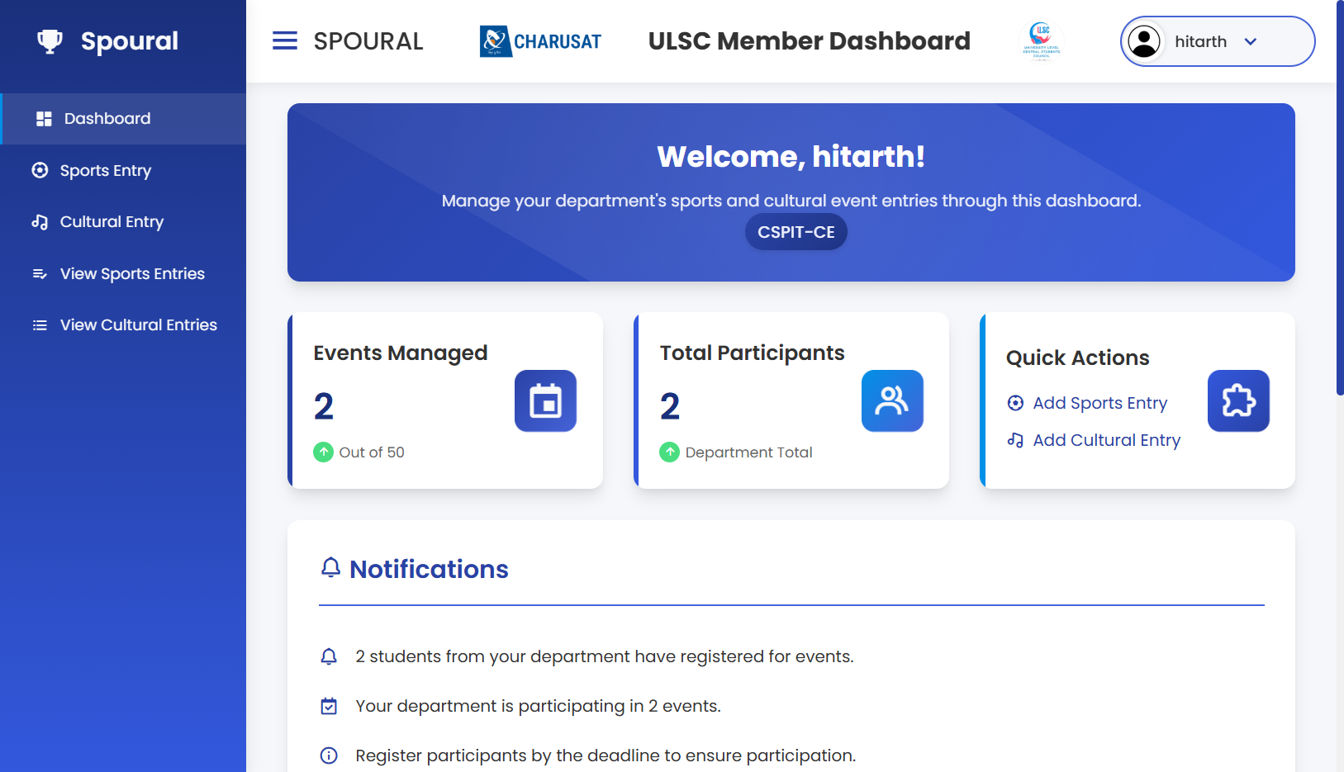

Slide 9
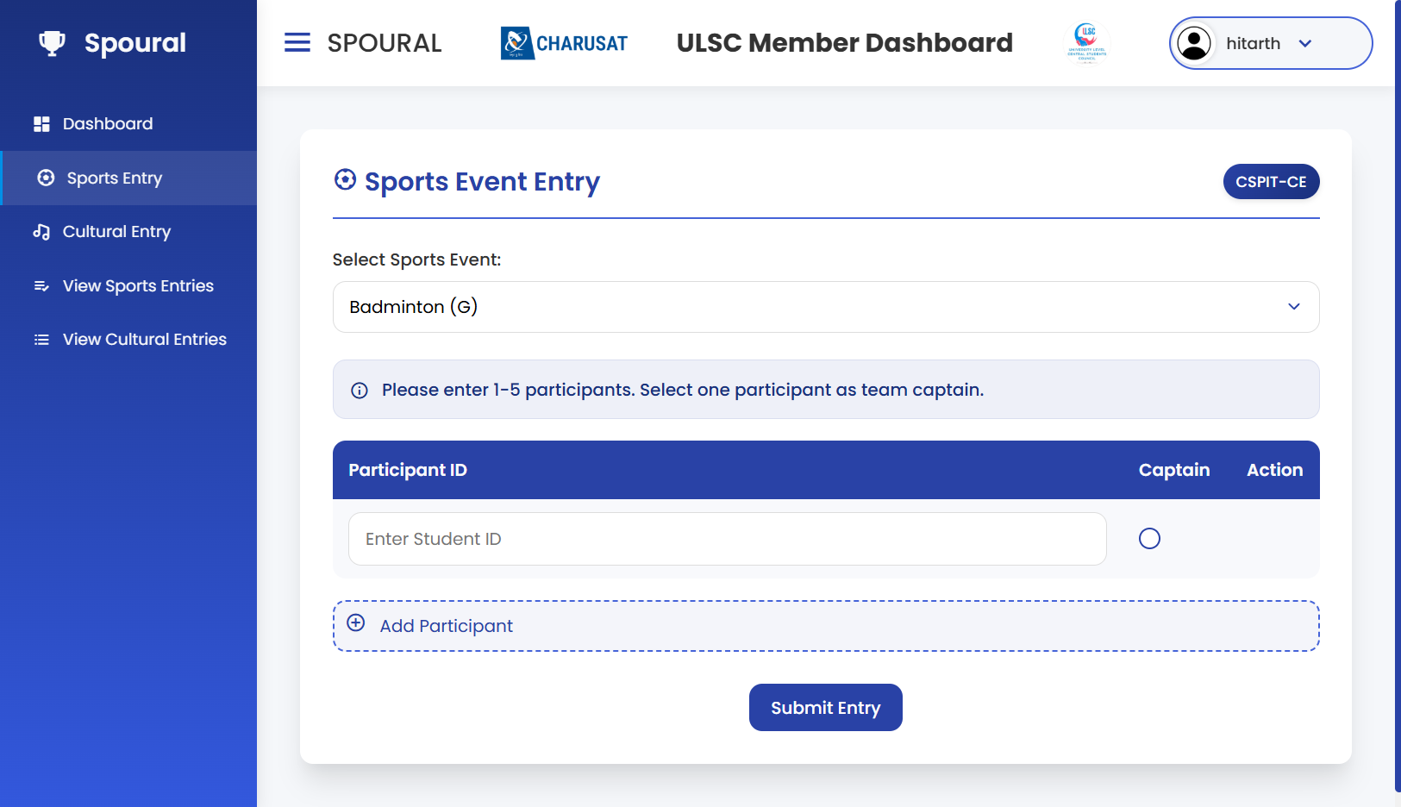


Slide 10
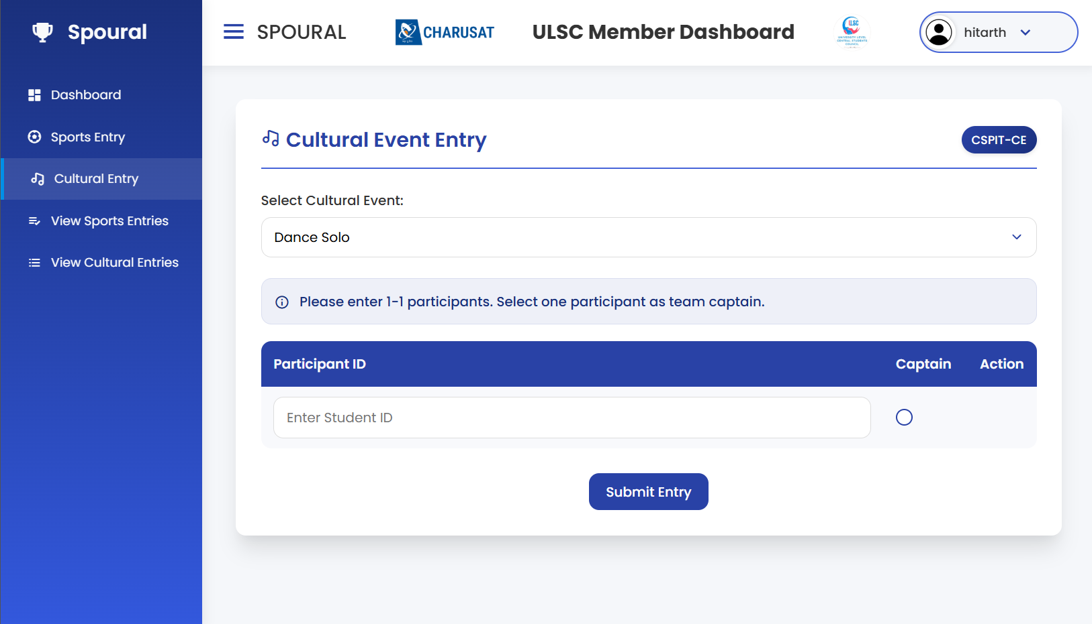

Slide 11
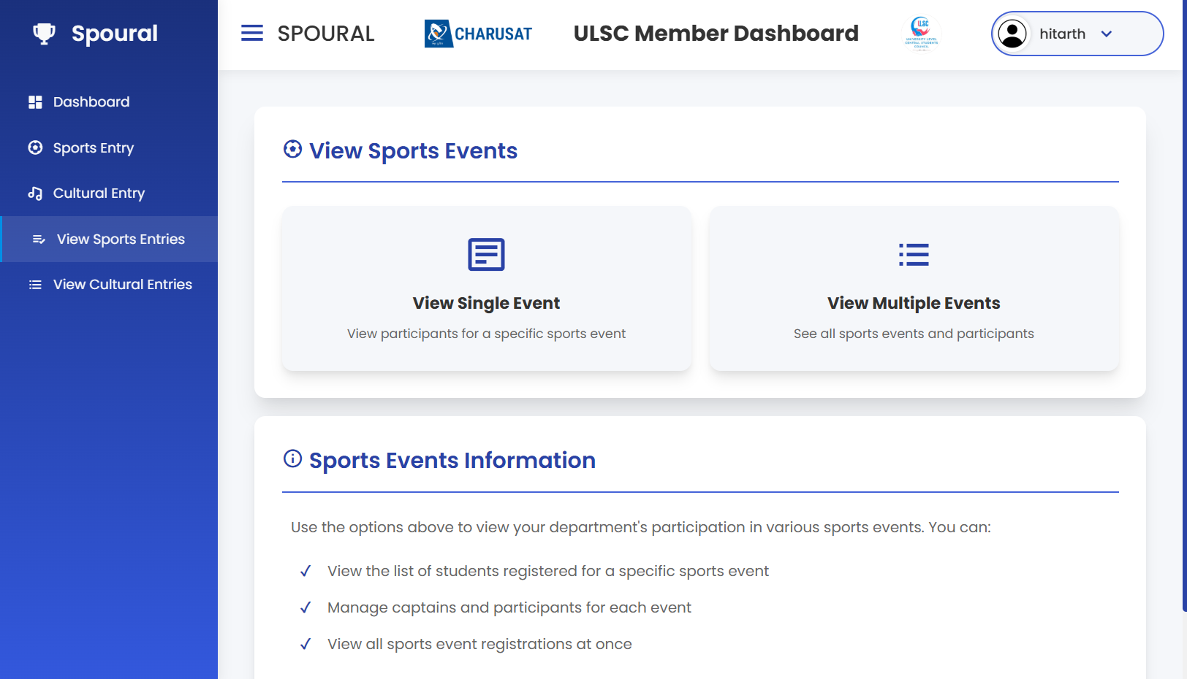

Slide 12
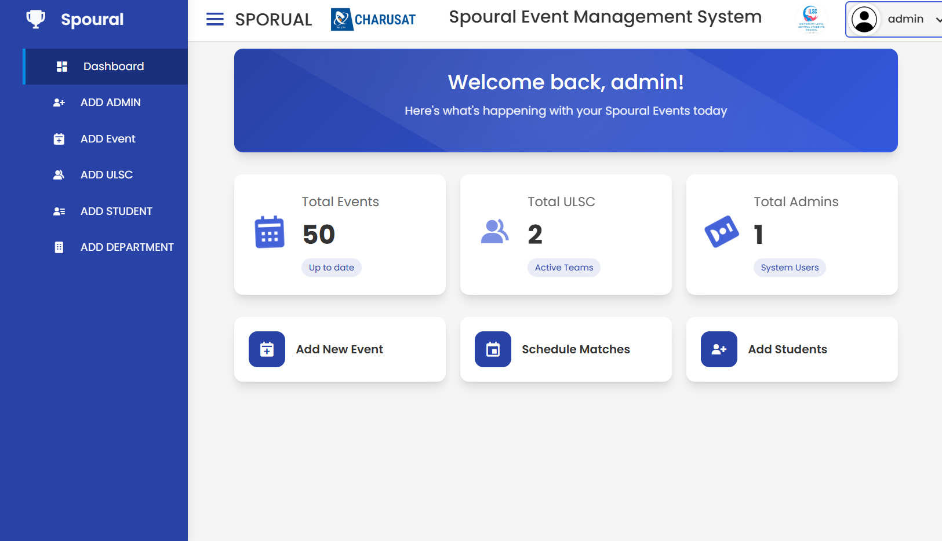

Slide 13
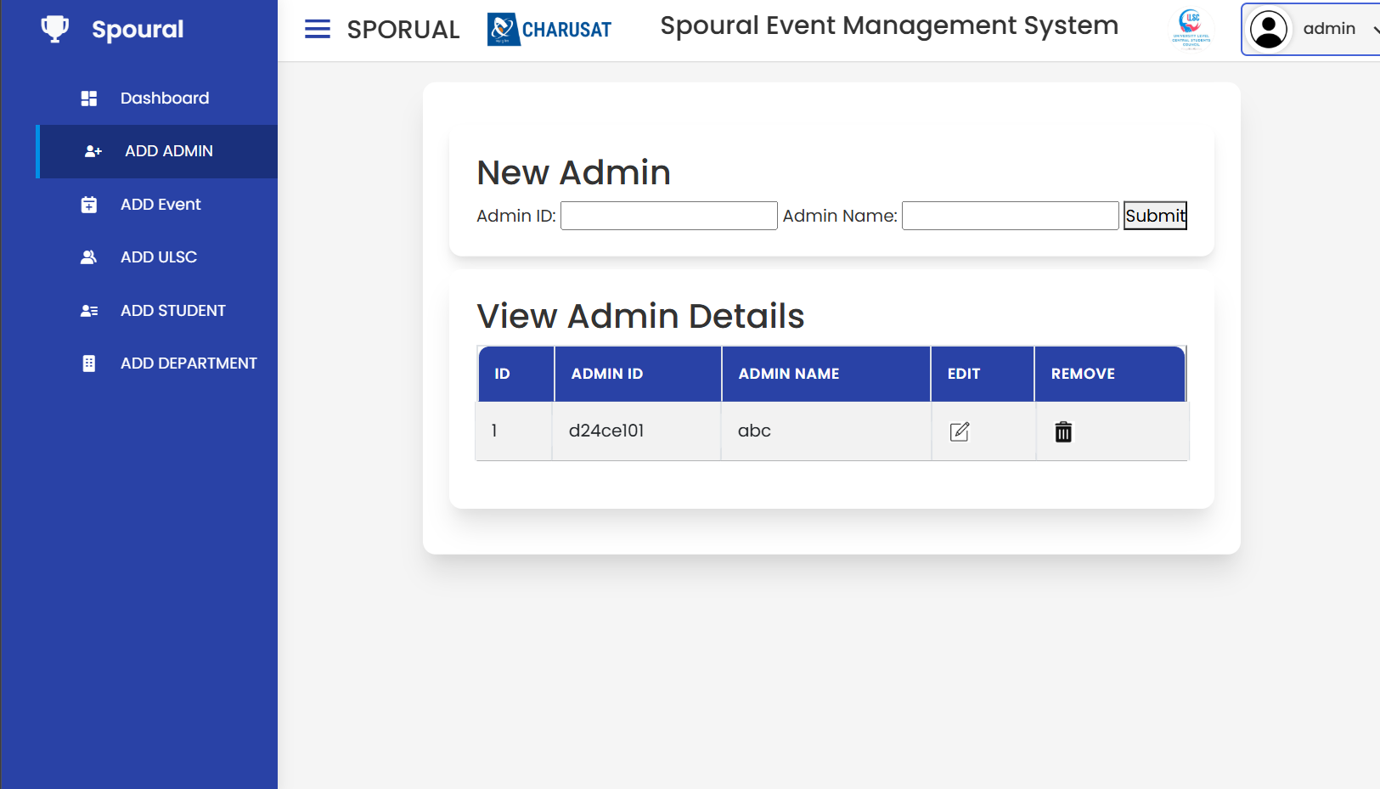

Slide 14
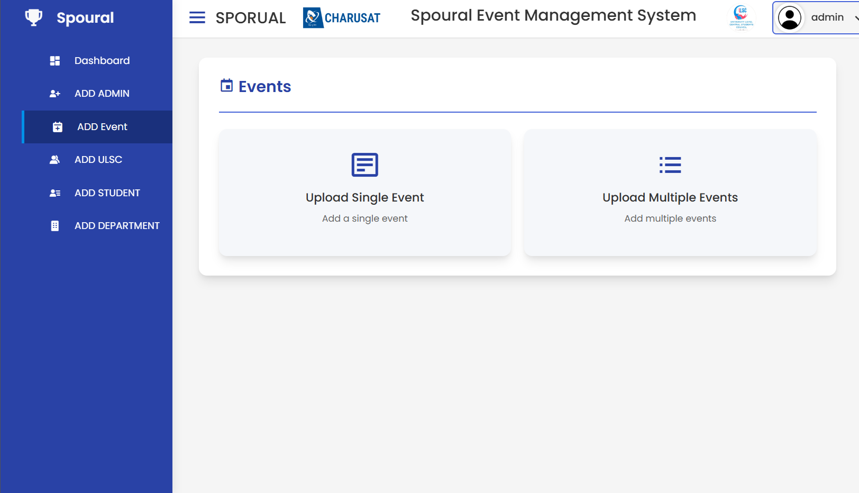

Slide 15
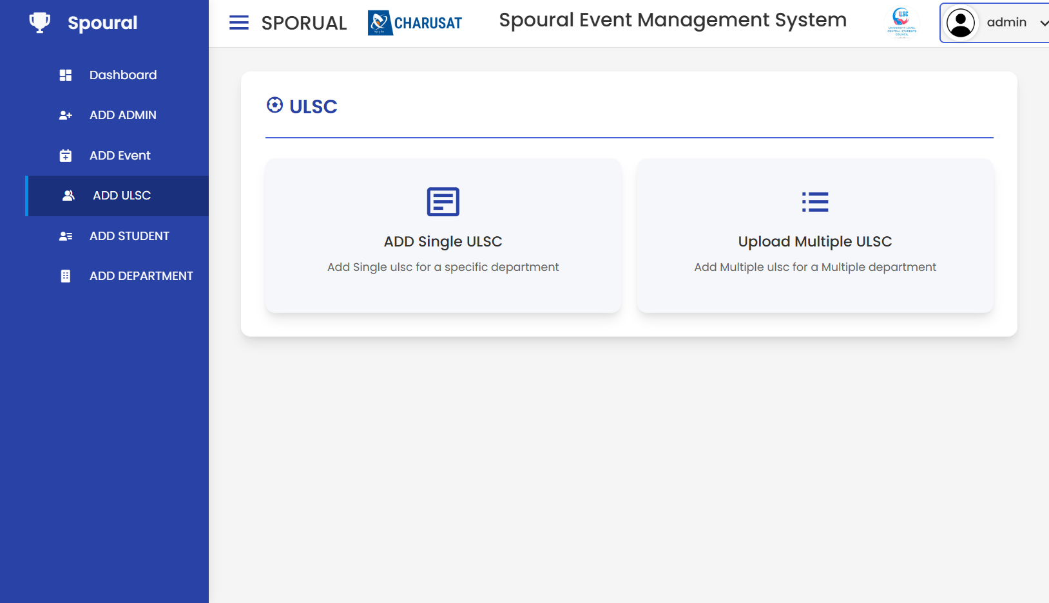

Slide 16
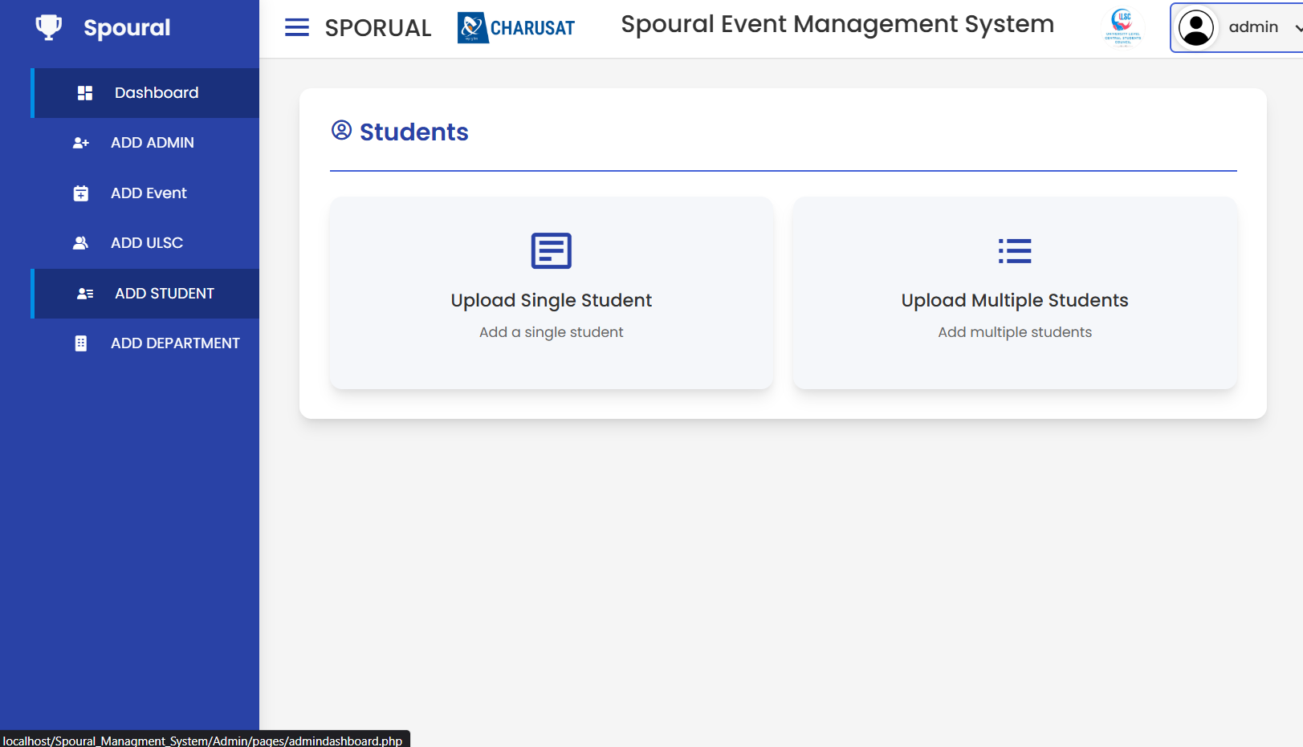

Slide 17
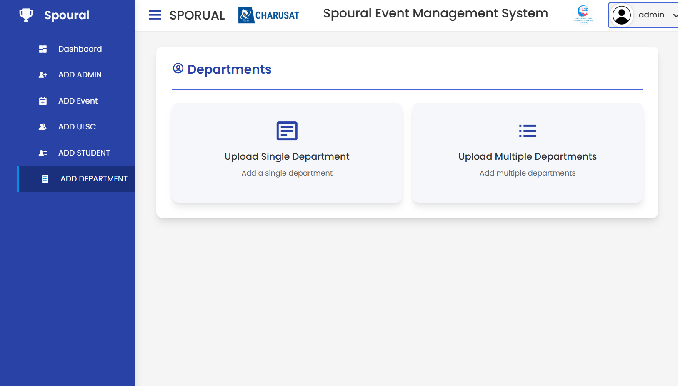

Slide 18

Thank you
We are confident that Spoural will be a valuable asset for our college community. We look forward to its successful implementation and the positive impact it will have on our events.

