Slide 1
ZS Young Data Scientist Challenge
Harshit Saxena

Slide 2
Overview of Data & Quality-checks
Problem can be defined as Sequence prediction
Training Data: 3000 Patients, 6472 unique Event IDs
Testing Data is very small where we have to predict next 10 entries.
Plotting data of various patients gave meaningful insights as there are quite a few patients with just active in last 6-8 months whereas few are active in checkups only till July 2013.[attached screenshots in next slide]
It makes more sense to give more weightage to recent data

Slide 3
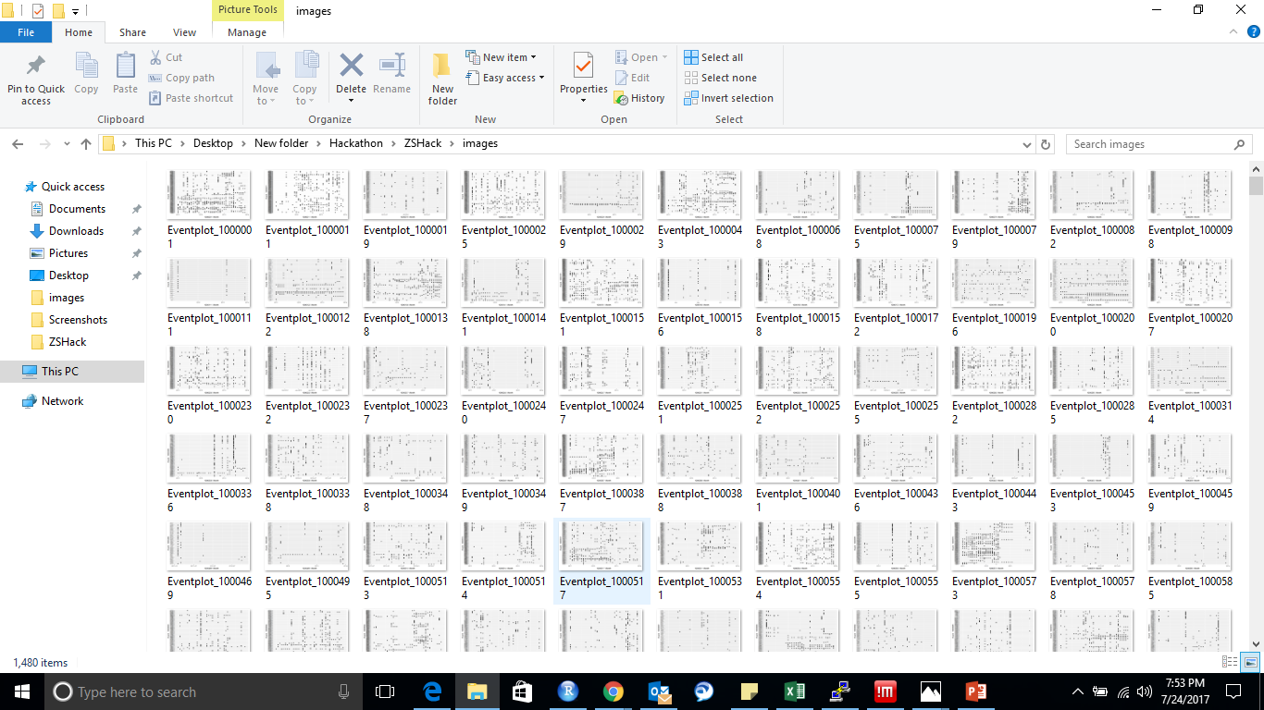
Visualization of each Patient
This tells variation in Patient data

Slide 4
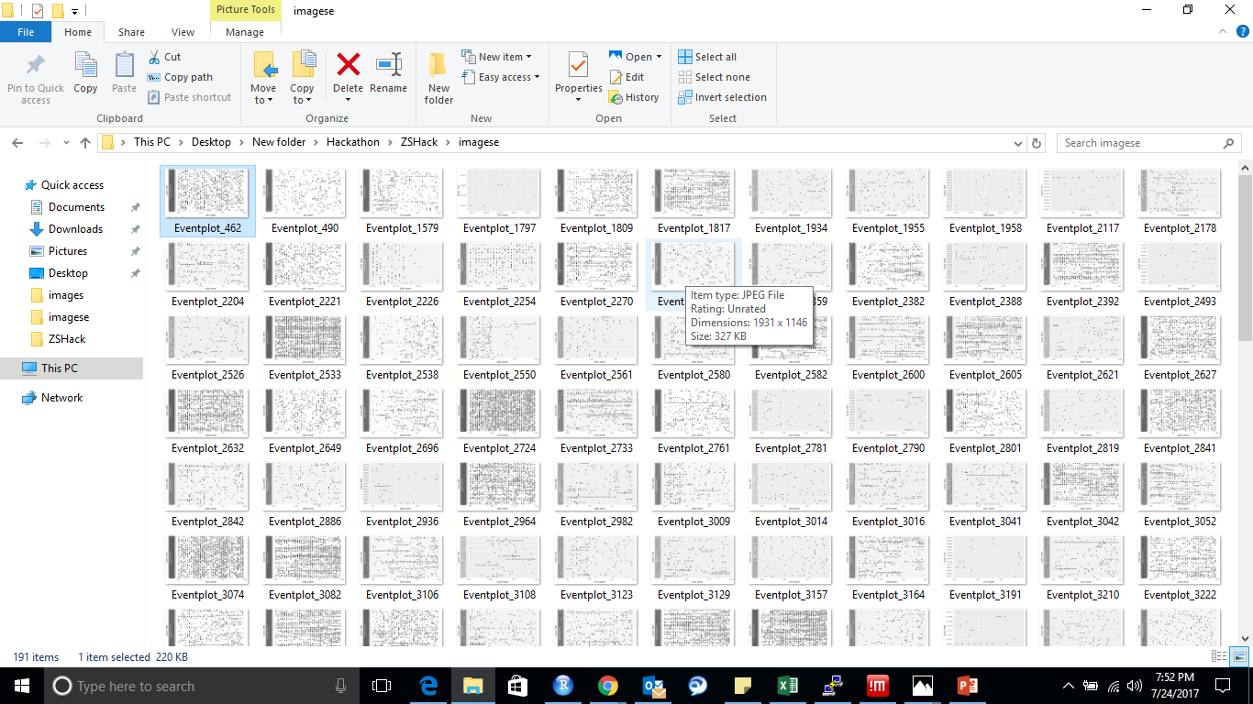
Visualization of each event
This tells variation in frequency of events

Slide 5
There are many events with frequency of 30+ in each patient data which tells that event checkup is done regularly. Hence gives insight of repeating data when we switch month
Average frequency of events in month is not very high, typically around 10 for each patient. So it makes more sense to repeat event IDs

Slide 6
Model Selection
First model approach : Hidden Markov Models were performing very bad on the leaderboard data
Second Model approach: ALS(alternating least square method) for correlating patients. It was not able to find good features from data as a result accuracy was very low
Third Model approach: Top k elements in each patient data. This method was used in my final submission.

Slide 7
Feature Engineering
I created two different datasets - subset data of PatientIDs with high frequency in just last 6 months – full data of PatientIDs with no presence in last 6 month
Created features for calculating frequencies of top 10 elements for each patientID in last 6 months. This helps to capture 0s in top k ( Suppose an event had high occurrence in patients history but he never went for that event in last 6 months. This remove wrong values.
Based on this replaced 0s with most occurring event(highest probability for occurrence)
Next important challenge is to predict correct sequence of events
Created copy of first 3 most frequent events and replaced with last columns. This gave boost to my score on leaderboard.
This method may lead to overfit.

Slide 8
Accuracy Check
Created accuracy checker where it gives error based on occurrence of event in actual top k.
Created validation data of 10 events.
Error = +1(if predicted_event is not in actual_event) else 0
My error reduced when I replaced most frequent columns by last columns
My model was consistent with the error when I tuned the parameters which give insight of avoiding overfit atleast for this test data.

Slide 9
Thank You

