Slide 1

Kowshik Chilamkurthy
Harshit Saxena
IIT MADRAS

Slide 2
Problem Overview
Develop a model to predict the churners/its probability
Based on the modelling data set(9966 instances), We should be able to predict the churners in the validating data set(4896 instances)
Process Followed
Cross validation
Data Storing
Pre-processing
NLP, Sampling
Feature Engineering
Parametric Tuning
Training and predicting

Slide 3
Key Challenges To Address
Imbalanced classes, Missing values, Feature extraction, Accuracy paradox, Handling outliers, Natural language processing, over fitting
Imbalanced Classes
Over sampling
Under Sampling??
Right Metrics
Decision tree models
Missing values
Removing is not a better option
Filled by random forest tree model

Slide 4
Feature Extraction
New features have been introduced
Query frequency, Realization months, Default number, Default sum, Card type, Scheme cost, DataGB, Query days, Usage Number, Commence days, Warranty days
20 more NLP features
Handling outliers
Unsupervised model to handle outlier
Inlier data is used for sampling.
Assumed Gaussian mixture models

Slide 5
Natural language processing
20 most common tokens are used for processing
Ignoring stop words, lemmatizing etc.
Each user is being assigned a vector similar to one hot encoding
NLP Features
Over Fitting
Too many features leads to over fitting
Correlation matrix, Feature importance is used to drop features
AUC, ROC is maximized in each iteration

Slide 6
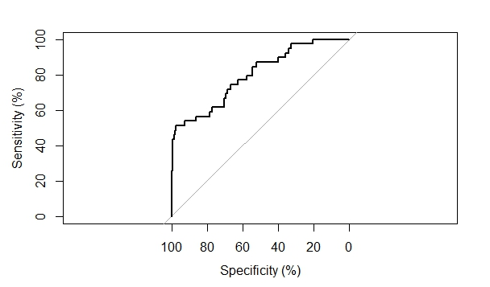
Accuracy paradox
Precision makes no sense in this highly imbalance dataset.
AUC, ROC, Sensitivity metrics are used for modelling
Threshold is calculated using this curve
Maximises the true positives, while minimising the false positives.
Confusion matrix

Slide 7
Model Training and performance
Training
10 fold cross validation (AUC) is adopted for assessing the goodness of classification model
Random forest tress algorithm is used for this problem.
Boosting is not working
Over 9 features out of 54 features are dropped, 5 out of 9 are NLP features
Over sampling is done using the inlier data
Threshold = 0.17 , which is selected using the ROC curve
Performance
Column1 | correct_zeros | Incorrect Zeros | Correct Ones | Incorrect Ones | AUC
1 | 899 | 33 | 22 | 34 | 73.62047823
2 | 953 | 44 | 17 | 39 | 77.7475283
3 | 910 | 30 | 19 | 29 | 72.50664894
4 | 881 | 29 | 27 | 36 | 76.42944357
5 | 987 | 38 | 23 | 28 | 75.29220469
6 | 882 | 41 | 16 | 28 | 72.66078991
7 | 880 | 40 | 20 | 19 | 79.70457079
8 | 890 | 39 | 16 | 33 | 76.63056611
9 | 962 | 36 | 19 | 29 | 75.90806613
10 | 861 | 25 | 17 | 35 | 74.68093419
Average AUC = 75.5

