Slide 1

INTELLIGENT ATTRITION MANAGEMENT METADATA.AI

Slide 2
FLOW
Outlier
Threshold
Imbalance data
K-Fold,best
Paramenters
Missing Values
Understanding
Business Problem
Sampling
Feature Engineering
Results and Interpetations
Model
Understanding
and Cleaning Data
Feature
Generation/Extraction
Crude Way to solve
Metrics
NLP
Elegent way
Accuracy interpretations
Correlation
Optimal Features

Slide 3
Understanding Business Problem
Company is experiencing high attrition rate of customers
Based on the data, find an elegant way to group these churners
Goal is to predict the group of customers with highest churning rate, so incentives provided can be optimized

Slide 4
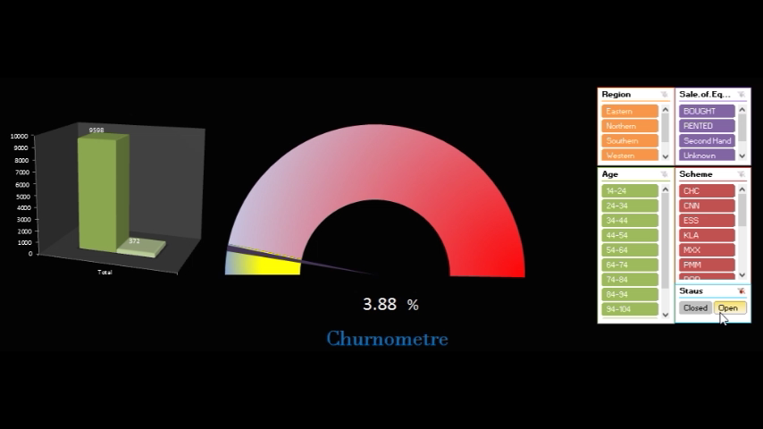
Crude Way
There is always a crude way to solve this problem
Restricted to 5 basic variables on which we can tweak and visualize

Slide 5
Elegant Way
Find an elegant way to classify these Customers
The Variables may not be enough for grouping the existing churners
Generate more informative Features from the available variables
Create a model which learns on past 3-month data
Understand importance of Variables based on the learning and existing bias in our model
Speak to the Data

Slide 6
Understanding Data
Missing Values
Distributions
Imbalance Data
Outliers

Slide 7
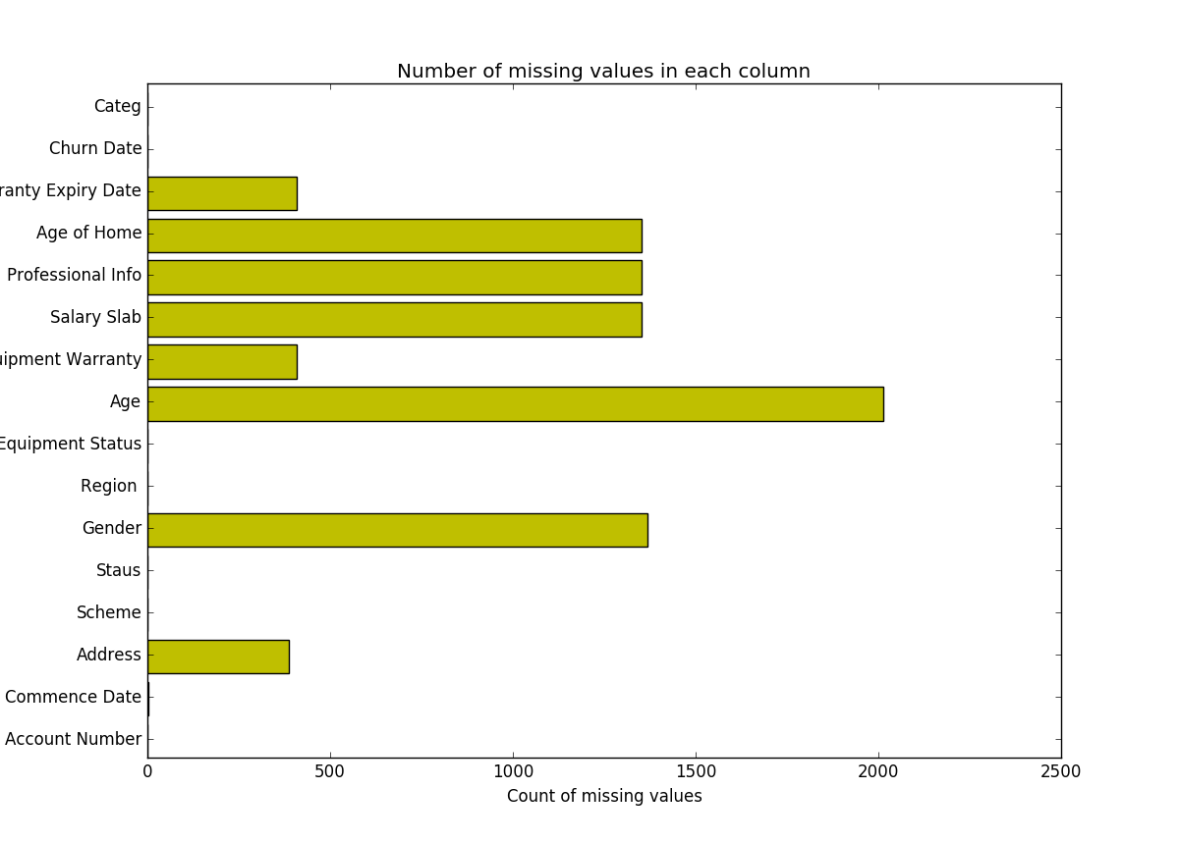
Missing Values
3 Sets of missing values
May lose information
Random forest trained on the observed values of a data matrix to predict the missing values.
NRMSE imputation error = 0.0023
Lets Understand the distributions

Slide 8
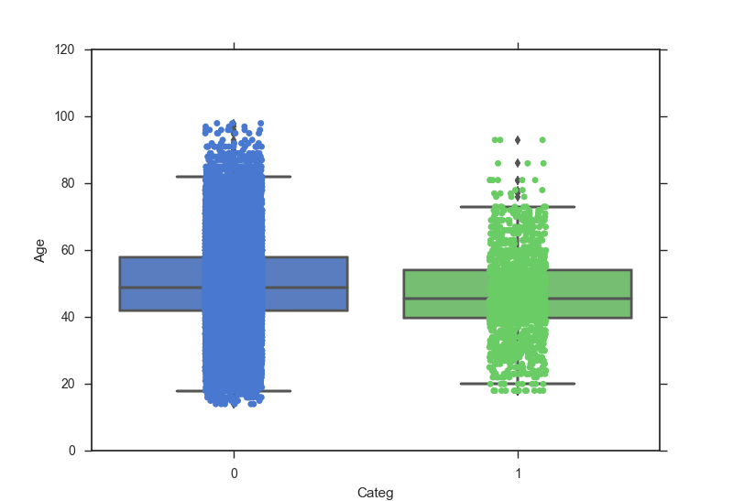
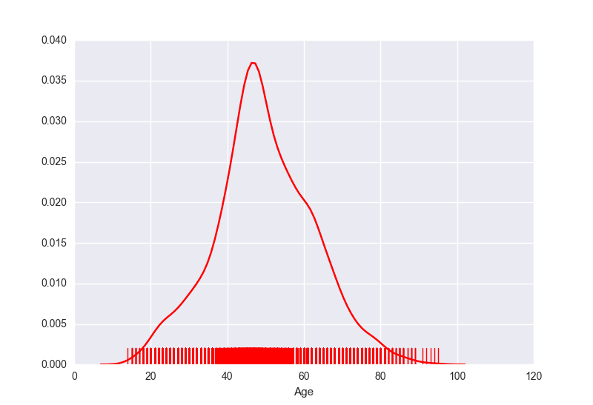
Close to Normal distribution with less variance
Not much skewed, but Outliers do exist

Slide 9
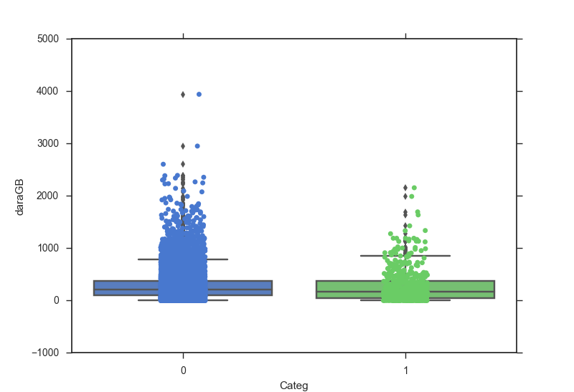
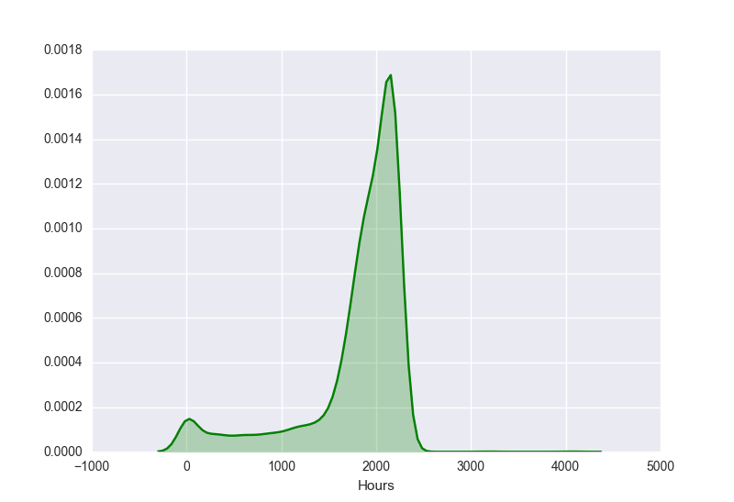
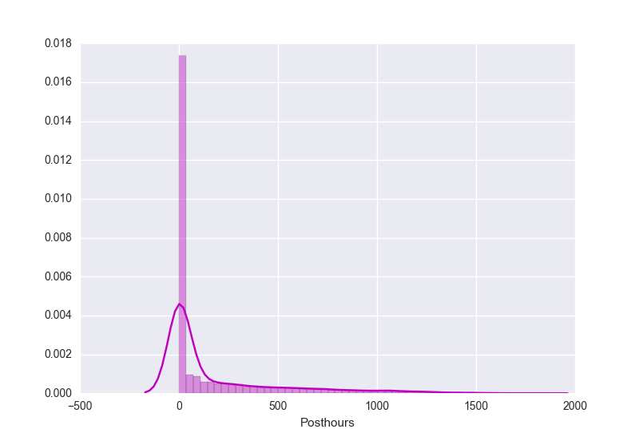
Outliers!!

Slide 10
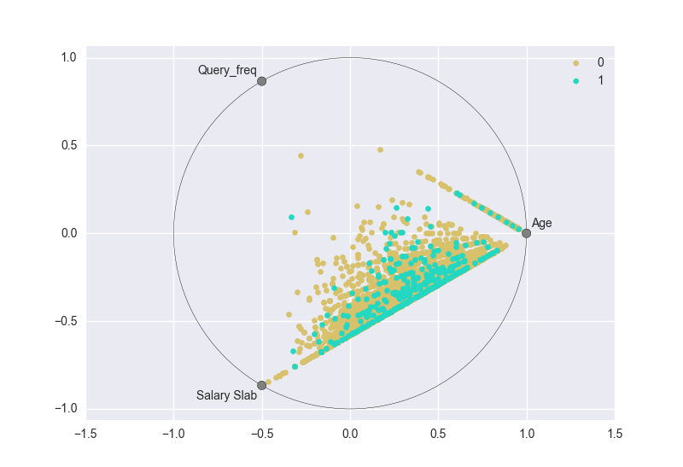
Frequency of Queries asked is not a informative variable.

Slide 11
Imbalance Data
Accuracy Paradox
Oversampling, Not Under-sampling !!
Too less data to go for under-sampling of modelling data

Slide 12
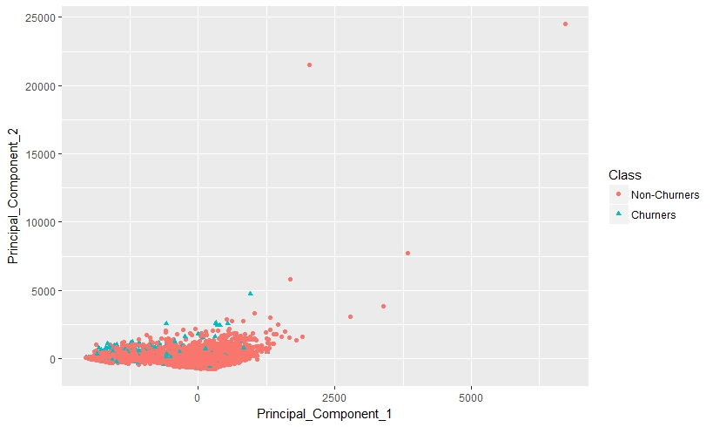
Outliers
We applied Principle component analysis to visualize our data
Found Few Outlier like M135,M4091,M6011

Slide 13
Feature Engineering
Feature Extraction
NLP
Correlation
Feature Selection

Slide 14
Feature Extraction
Total 53 features are extracted from the different data sheets , NLP and among the features
Adding new features is making sense
Warrantee Days, Maturity of scheme, Realization months, Default number are the features which are performing good relatively.

Slide 15
NLP Features
Turn the text content into numerical feature vectors
The data is given in token forms
Understand the frequencies of these keywords/Tokens
More frequently in churning text data more informative
Top 20 most frequent key-words
Count the number of occurrences of each word in a particular user calling text (bag – of –words )

Slide 16
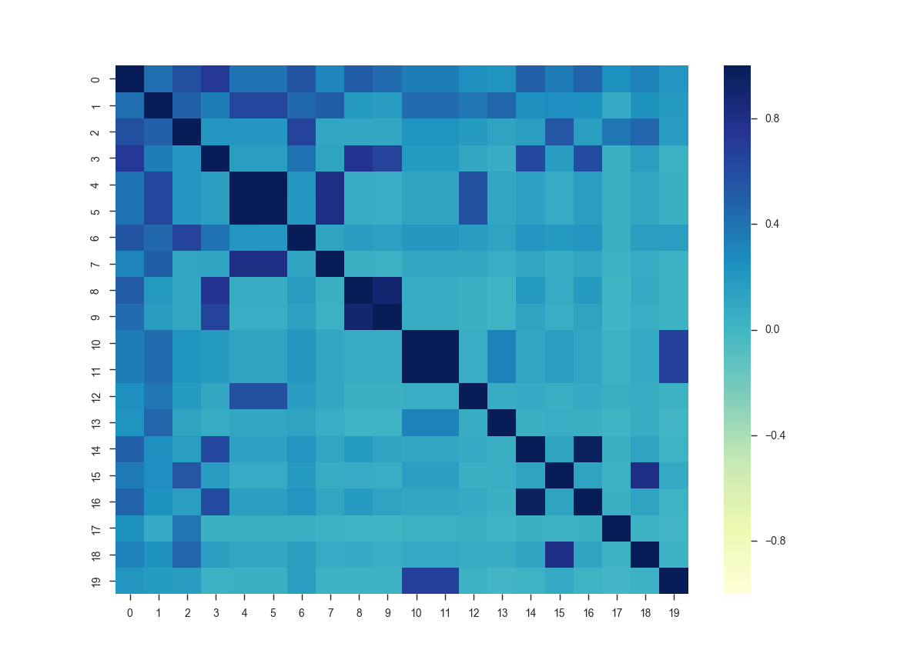
NLP Features
The NLP tokens as features are performing relatively bad in this classification model
Still introducing some of these features gave a considerable hike in Average AUC
These NLP Features are highly correlated among themselves,
Dropping of 9 NLP Features to rule out the chances of over fitting.

Slide 17
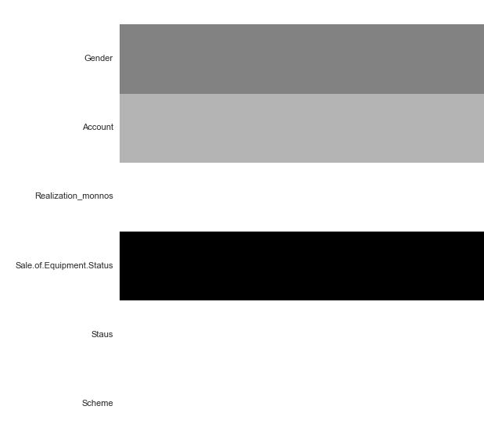
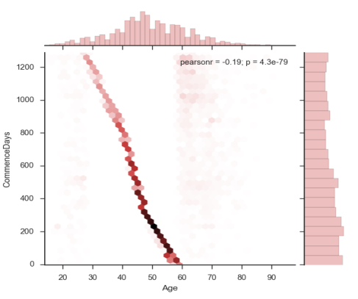
Correlation
The correlations between categorical data features are captured by chi-squared test.
The correlations between continuous numerical data features are captured by one-Class anova and T-test.
chi-squared test
Pearson value

Slide 18
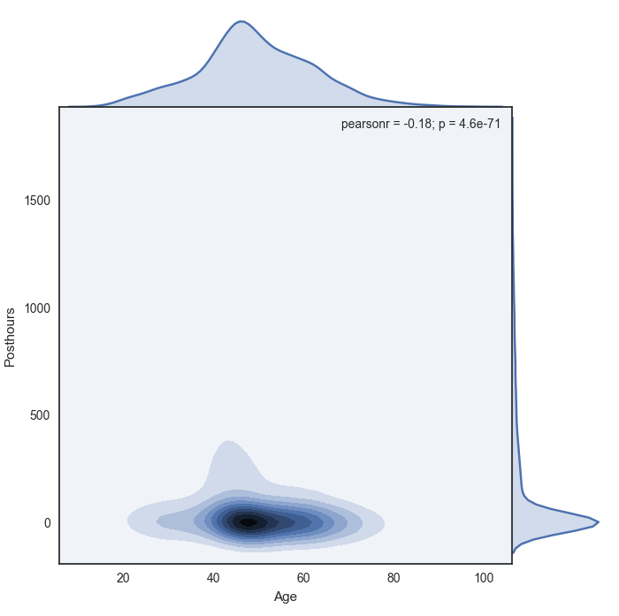
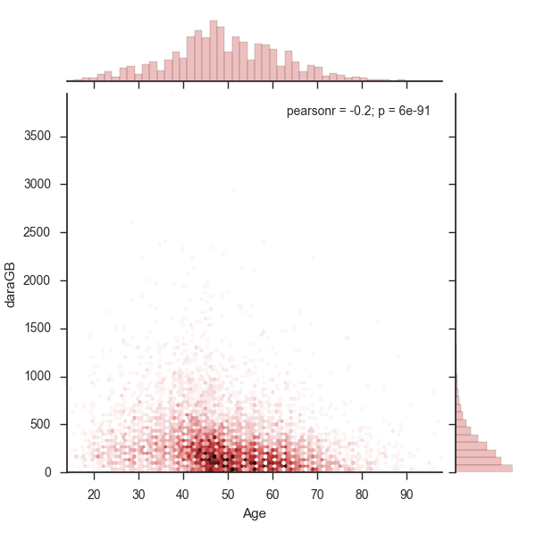
Correlation
Correlation among
Proven informative variables

Slide 19
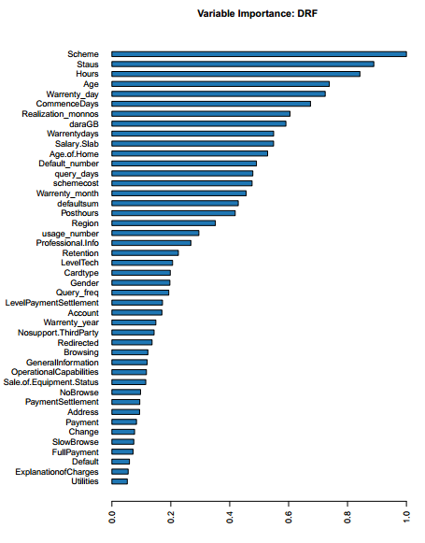
Feature Selection
Including all these 53 features will either over-fit or introduce variance to our model
More features also increase the flexibility of the model, which might end up with bad results on validating data set.
13 features are dropped based on the feature importance’s and correlation (both categorical and continuous)
Reduce training time
Improved Accuracies

Slide 20
Feature Selection

Slide 21
Model
Sampling
K-Fold
Evaluation
Threshold

Slide 22
Sampling
Modelling dataset contains highly imbalance classes
ML algorithms struggle with accuracy because of the unequal distribution in dependent variable.
This causes the performance of existing classifiers to get biased towards majority class.
Over Sampling
Avoid discarding useful information

Slide 23
K-Fold Evaluation
Decision trees often perform well on imbalanced datasets
The splitting rules that look at the class variable used in the creation of the trees, can force both classes to be addressed.
Boosting is discarded
Random Forest is chosen
10-Kfold model is ran to optimize the learning process.
Average AUC Is optimized in iteration
Best Parameters are chosen based on the K-Fold CV

Slide 24
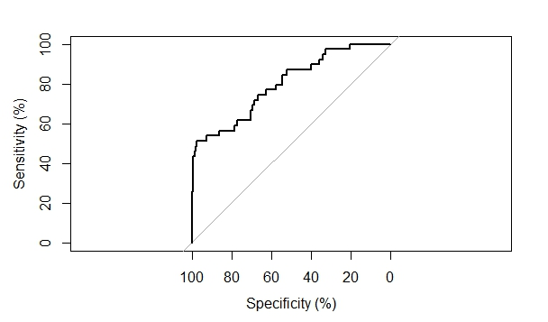
Threshold
Precision vs Recall
Threshold from ROC Curve is taken as reference
10-Fold CV is ran to optimize threshold

Slide 25
Threshold

Slide 26
Results and Interpretation
Metrics Choosen
Interpretations

Slide 27
Metrics Chosen
ROC curve: It can be used to select a threshold for a classifier which maximises the true positives, while minimising the false positives.
AUC: It can be used to compare the performance of two or more classifiers.
Confusion matrix: It can be used to understand the TP,TN,FP,FN and it can be used to understand the model performance.
Recall : TP / (TP+FP)
Precision : TP / (TP+FN)
F-Score : (2*Recall*Precision) / (Recall +Precision)

Slide 28
Accuracies & Interpretation
The Accuracies are presented for 10-Fold cross validation
AUC = 79.7
Recall = 0.512
Precision = 0.33
Accuracy = 0.938
F-Score = 0.54
Confusion matrix is presented for Training : 80%,Testing: 20%
0 1
0 1801 93
1 51 49
Threshold : 0.17

Slide 29
Accuracies & Interpretation
The results shown here are for Training : 80%,Testing: 20%
Threshold : 0.1
0 1
0 1688 206
1 49 51
Trade off between Precision and Recall
Accuracy Decided by business problem by allotting individual cost for classification (TP,FP,TN,FN costs)
Threshold : 0.17
0 1
0 1801 93
1 51 49
Threshold : 0.3
0 1
0 1874 20
1 71 29

Slide 30
Accuracies & Interpretation
Threshold : 0.1
0 1
0 1688 206
1 49 51
If company wants to provide discounts to the group of predicted
Churners, then in these 3 cases company have to allot discounts
For 257 customers to capture 51 true churners with threshold 0.1
For 142 customers to capture 49 true churners with threshold 0.17
For 49 customers to capture 29 true churners with threshold 0.3
Threshold : 0.17
0 1
0 1801 93
1 51 49
Threshold : 0.3
0 1
0 1874 20
1 71 29

Slide 31
QUESTIONS ?

