Slide 1

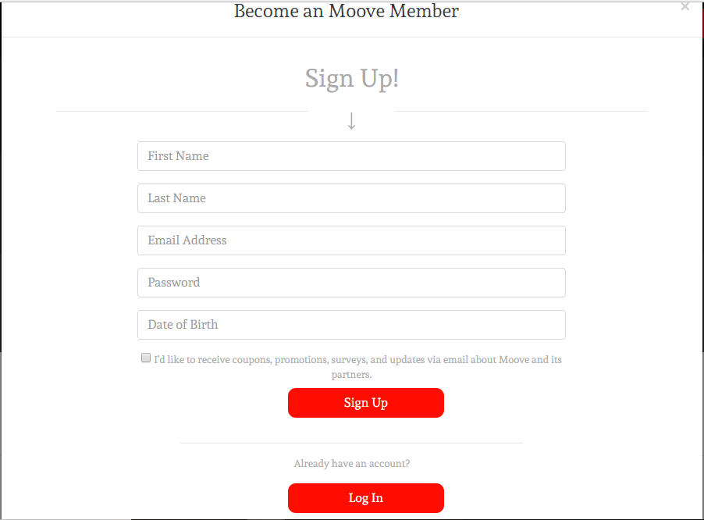
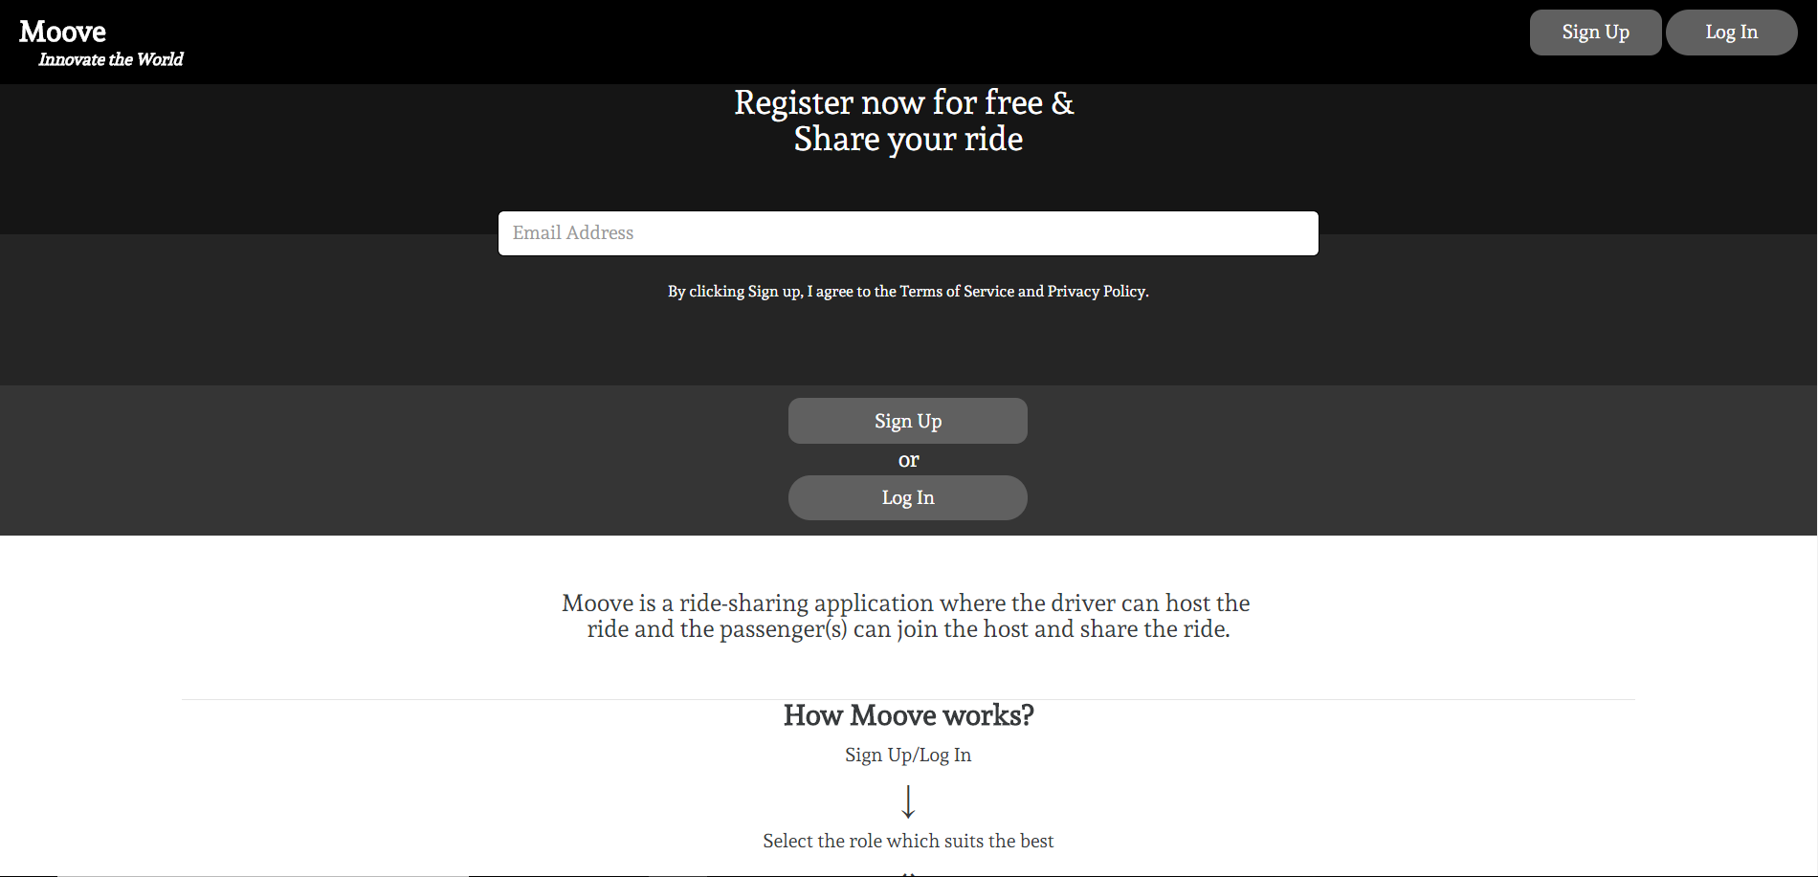
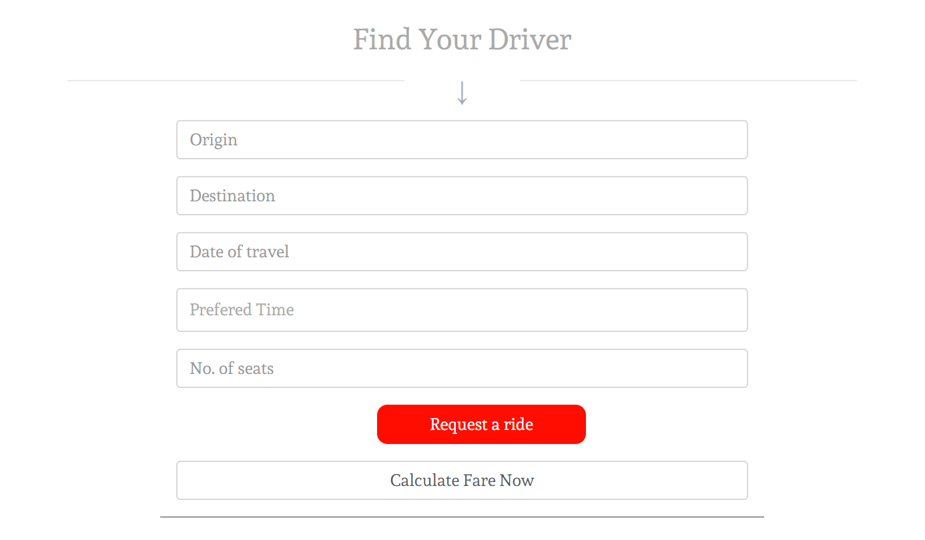
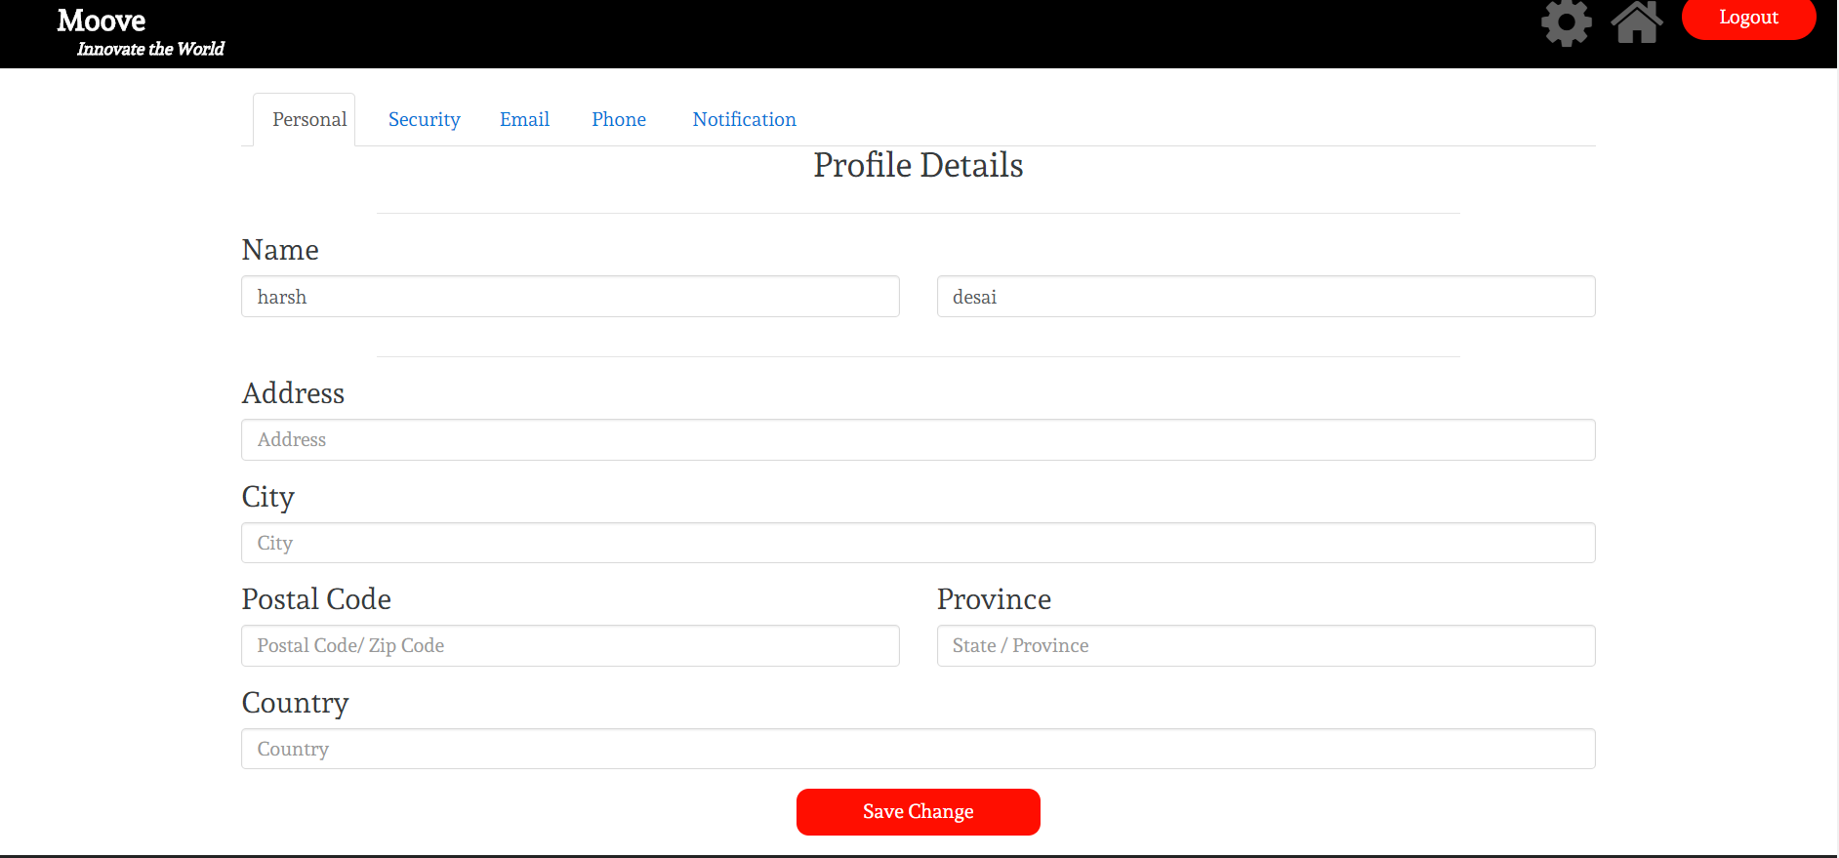
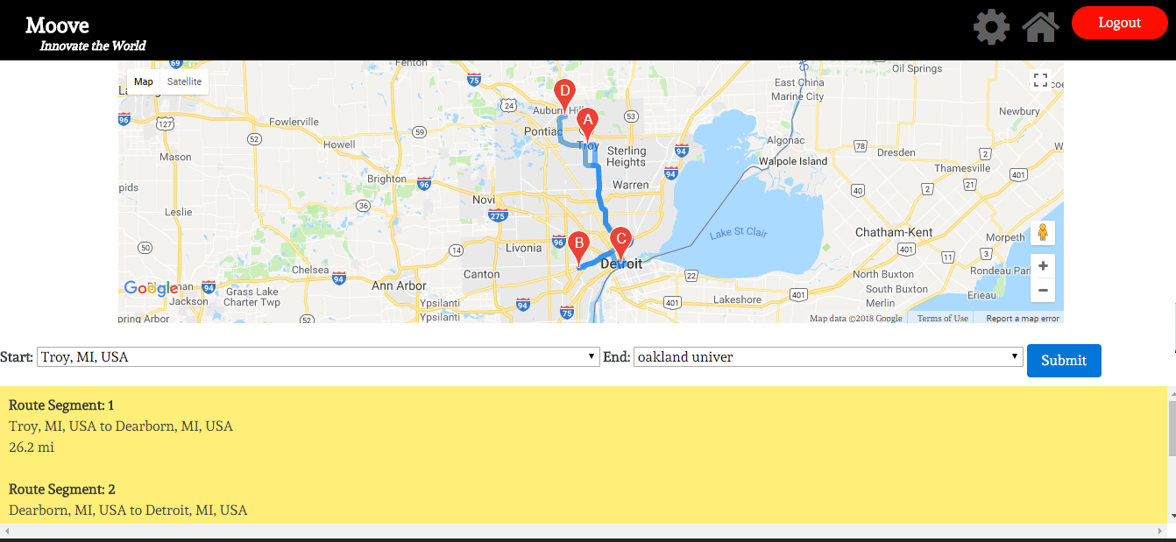
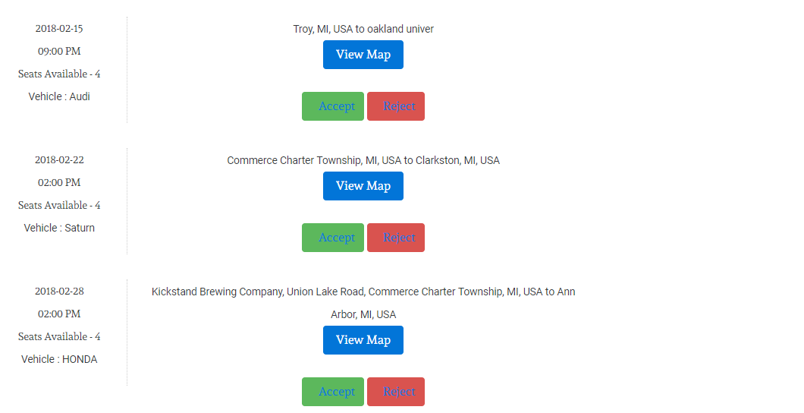
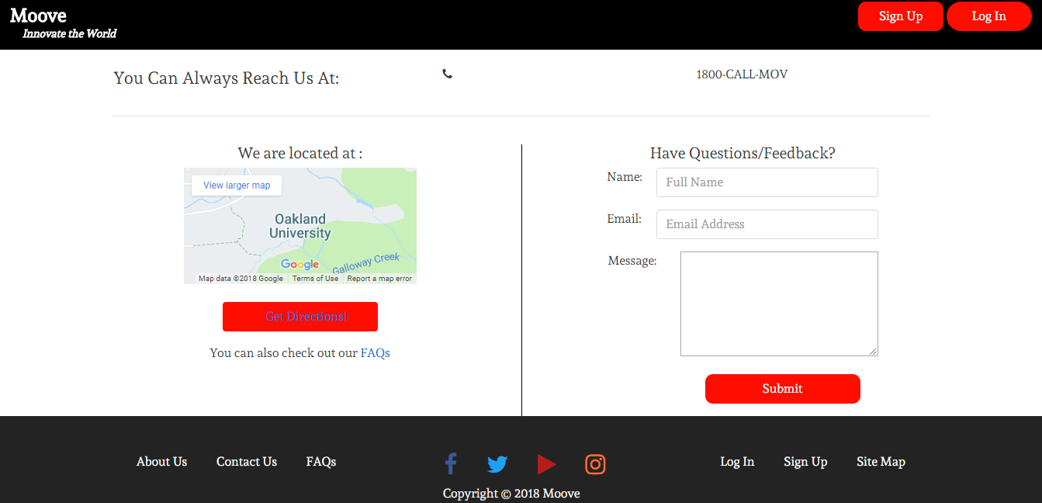
Let's Innovate the World
UI-UX Designs
Project Plan
The big picture scope of the project is meant to include a web application that allows for users to ask for rides and to drive other riders. This application includes methods for users to pay their drivers, provide feedback on the service, see his or her’s ride history, update profile information, and calculate fares before requesting a ride.
Tools:
XAMPP
Android Studio
PHPStorm
BootStrap
Apache Server
Ubuntu 16.10 OS
Digital Ocean Server
Stripe Payment
Google Distance Matrix API
Security Concerns
Securing payment and user data is our top priority
Securing users from outside sources (other users, accidents, theft, etc.) is a huge potential problem
Ethical Concerns
How do we evaluate background checks?
How do we decide on the safest age to host a ride?
How do we validate drivers licenses?
How do we ensure our users safety?
How do we compensate for damage/accidents/theft?
What is our procedure for reviewing cases?
Who is held liable on a case by case basis?
Technology
CSS
HTML
PHP JavaScript
MySQL
Workflow
In person meetings
Discord Online Chat
TeamViewer
Google Cloud
PHPMyAdmin
Team Collaboration
Adam Vida - Web developer, QA Engineer
Harsh Desai - Founder and Developer
Sagun Sedai - Full Stack Developer
Wesley Shall - Web Developer
Nathaniel Auxier - Back End Developer
Apurva Tolia - QA Engineer and Developer
Future Plan
Implement a fully functional Android Application
Provide more feedback options for customers
Enhance the mobile friendly web based application
A more fluid and approachable layout for the Ride History page

