Slide 1

ARRAY
Presented by
Harsh Kumar(191020426)
Santosh Tigga(191020448)
Data Structure

Slide 2
Title and Content Layout with List
Arrays
Multidimensional Arrays
Arrays & Function
Arrays and Pointers

Slide 3
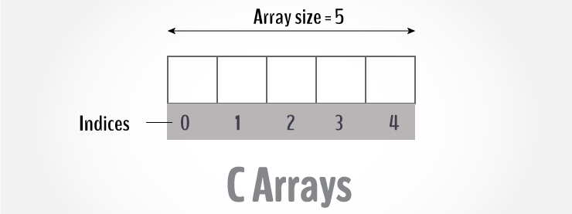
C Arrays
An array is a variable that can store multiple values. For example, if you want to store 100 integers, you can create an array for it.
int data[100];

Slide 4
How to declare an array?
datatype array Name[array Size];
For example,
float mark[5];
Here, we declared an array, mark, of floating-point type. And its size is 5. Meaning, it can hold 5 floating-point values.
It's important to note that the size and type of an array cannot be changed once it is declared.

Slide 5
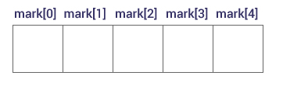
Access Array Elements
You can access elements of an array by indices.
Suppose you declared an array mark as above. The first element is mark[0], the second element is mark[1] and so on.

Slide 6
Few keynotes:
Arrays have 0 as the first index, not 1. In this example, mark[0] is the first element.
If the size of an array is n, to access the last element, the n-1 index is used. In this example, mark[4]
Suppose the starting address of mark[0] is 2120d. Then, the address of the mark[1] will be 2124d. Similarly, the address of mark[2] will be 2128d and so on. This is because the size of a float is 4 bytes.

Slide 7
How to initialize an array?
It is possible to initialize an array during declaration. For example,
int mark[5] = {19, 10, 8, 17, 9};
You can also initialize an array like this.
int mark[] = {19, 10, 8, 17, 9};
Here, we haven't specified the size. However, the compiler knows its size is 5 as we are initializing it with 5 elements.

Slide 8
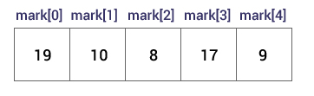
Here,
mark[0] is equal to 19 mark[1] is equal to 10 mark[2] is equal to 8 mark[3] is equal to 17 mark[4] is equal to 9

Slide 9
Change Value of Array elements
int mark[5] = {19, 10, 8, 17, 9} // make the value of the third element to -1 mark[2] = -1; // make the value of the fifth element to 0 mark[4] = 0;

Slide 10
Input and Output Array Elements
Here's how you can take input from the user and store it in an array element.
// take input and store it in the 3rd element ​scan("%d", &mark[2]); // take input and store it in the ith element scan("%d", &mark[i-1]);

Slide 11
Here's how you can print an individual element of an array.
// print the first element of the array printf("%d", mark[0]); // print the third element of the array printf("%d", mark[2]); // print ith element of the array printf("%d", mark[i-1]);

Slide 12
Access elements out of its bound!
Suppose you declared an array of 10 elements. Let's say,
int testArray[10];
You can access the array elements from test Array[0] to test Array[9].
Now let's say if you try to access testArray[12]. The element is not available. This may cause unexpected output (undefined behavior). Sometimes you might get an error and some other time your program may run correctly.
Hence, you should never access elements of an array outside of its bound.

Slide 13
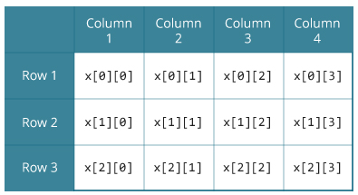
C Multidimensional Arrays
In C programming, you can create an array of arrays. These arrays are known as multidimensional arrays. For example,
float x[3][4];
Here, x is a two-dimensional (2d) array. The array can hold 12 elements. You can think the array as a table with 3 rows and each row has 4 columns.
Similarly, you can declare a three-dimensional (3d) array. For example,
float y[2][4][3];
Here, the array y can hold 24 elements.

Slide 14
Initializing a multidimensional array
Initialization of a 3d array
Initialization of a 2d array
// Different ways to initialize two-dimensional array int c[2][3] = {{1, 3, 0}, {-1, 5, 9}}; int c[][3] = {{1, 3, 0}, {-1, 5, 9}}; int c[2][3] = {1, 3, 0, -1, 5, 9};
int test[2][3][4] = { {{3, 4, 2, 3}, {0, -3, 9, 11}, {23, 12, 23, 2}}, {{13, 4, 56, 3}, {5, 9, 3, 5}, {3, 1, 4, 9}}};

Slide 15
Pass arrays to a function in C
Passing array elements to a function is similar to passing variables to a function.
To pass multidimensional arrays to a function, only the name of the array is passed to the function(similar to one-dimensional arrays).

Slide 16
Relationship Between Arrays and Pointers
Array in C is used to store elements of same types whereas Pointers are address variables which stores the address of a variable. Now array variable is also having a address which can be pointed by a pointer and array can be navigated using pointer.

Slide 17

This Photo by Unknown author is licensed under CC BY-SA-NC.

