Slide 1
Kerberos
Kerberos is an authentication service developed as part of Project Athena at MIT.
It is designed to provide authentication for client/server applications.
Windows 2000 use Kerberos.
It address the following issue:
Assume an open distributed environment in which users at workstations wish to access services on servers distributed throughout the network.
Version 4 (1988) and Version 5 (1994)->RFC 4120.
http://web.mit.edu/kerberos/krb5-1.3/krb5-1.3.5/doc/krb5-install.html#Building%20Kerberos%20V5
http://www.kerberos.org/software/adminkerberos.pdf

Slide 2
Kerberos
Kerberos relies exclusively on symmetric encryption, making no use of public key encryption.
Kerberos provides a centralized authentication server (AS) whose function is to authenticate users (C) to real servers (V) and real servers (V) to users (C).

Slide 3
Kerberos: Requirements
Secure: A network eavesdropper should not be able to obtain the necessary information to impersonate a user.
Reliable: For all services that rely on Kerberos for access control, lack of availability of the Kerberos service means lack of availability of the supported services. Hence, Kerberos should be highly reliable and should employ a distributed server architecture with one system able to back up another.

Slide 4
Kerberos: Requirements
Transparent: Ideally, the user should not be aware that authentication is taking place beyond the requirement to enter a password.
Scalable: The system should be capable of supporting large numbers of clients and servers.
This suggests a modular, distributed architecture. To support these requirements, the overall scheme of Kerberos is that of a trusted third-party authentication service that uses a protocol based on that proposed by Needham and Schroeder.

Slide 5
Kerberos: Version 4
Authentication Server (AS): AS is the KDC in the Kerberos protocol.
authenticates users (C) to real servers (V) and
authenticates real servers (V) to users (C).
Ticket-granting Server (TGS): The TGS issues a ticket for the real server/data server (V).
Issue ticket for C based on which C access V.
Real Server: The real server V provides services for the user (C).

Slide 6
Kerberos: Version 4
User (C)
KDC
Real server (V)
AS
TGS

Slide 7
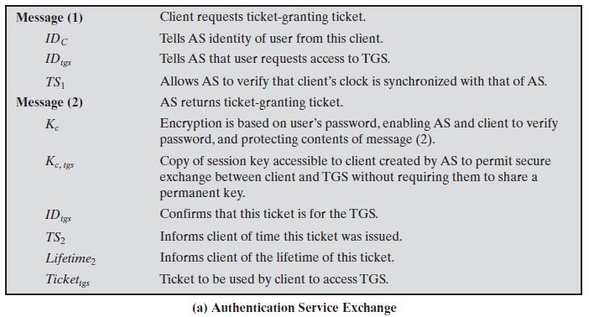
Kerberos: Version 4

Slide 8
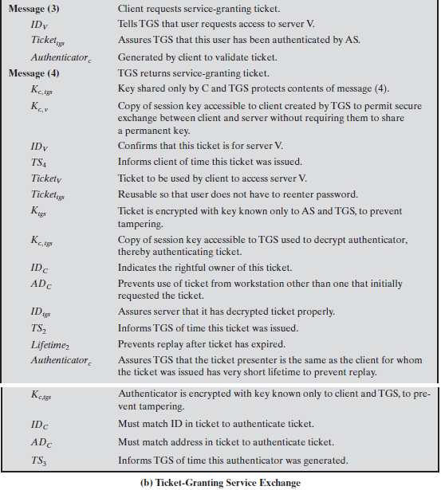
Kerberos: Version 4

Slide 9
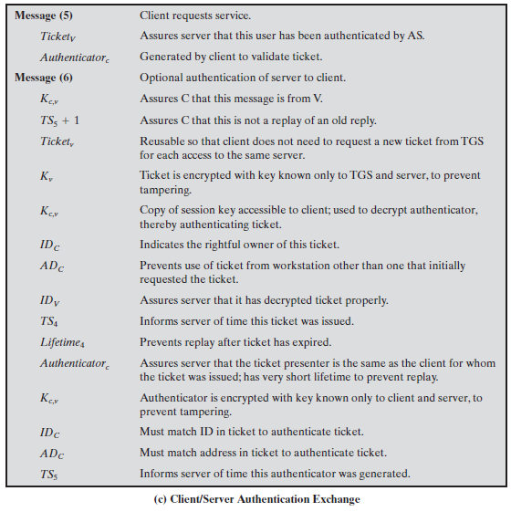
Kerberos: Version 4

Slide 10
Kerberos: Version 4
User (C)
KDC
Real server (V)
AS
TGS
1
2
1: ID_{c},ID_{tgs},TS₁
2: E(K_{c}, [K_{c,tgs}||ID_{tgs}||TS₂||Lifetime₂ ||Ticket_{tgs}])
Ticket_{tgs} = E(K_{tgs}, [K_{c, tgs} || ID_{C} | AD_{C}||ID_{tgs}||TS₂||Lifetime₂])

Slide 11
Kerberos: Version 4
User (C)
KDC
Real server (V)
AS
TGS
1
2
3
3: ID_{v},Ticket_{tgs},Authenticator_{C}
Authenticator_{C} = E(K_{c, tgs}, [ID_{C}||AD_{C}||TS₃])
Ticket_{tgs} = E(K_{tgs}, [K_{c, tgs} || ID_{C} | AD_{C}||ID_{tgs}||TS₂||Lifetime₂])

Slide 12
Kerberos: Version 4
User (C)
KDC
Real server (V)
AS
TGS
1
2
3
4
4: E(K_{c, tgs}, [K_{c, v} ||ID_{v} ||TS₄||Ticket_{v}])
Ticket_{v} = E(K_{v}, [K_{c, v}||ID_{C}||AD_{C}||ID_{v}||TS₄||Lifetime₄])

Slide 13
Kerberos: Version 4
User (C)
KDC
Real server (V)
AS
TGS
1
2
3
4
5
5: Ticket_{v}||Authenticator_{c}
Ticket_{v} = E(K_{v}, [K_{c, v}||ID_{C}||AD_{C}||ID_{v}||TS₄||Lifetime₄])
Authenticator_{c} = E(K_{c, v}, [ID_{C}||AD_{C} ||TS₅])

Slide 14
Kerberos: Version 4
User (C)
KDC
Real server (V)
AS
TGS
1
2
3
4
5
6
6: E(K_{c,v},[TS₅+1])(for mutual authentication)
If C needs to receive services from different real servers, she need repeat only the last four steps.

Slide 15
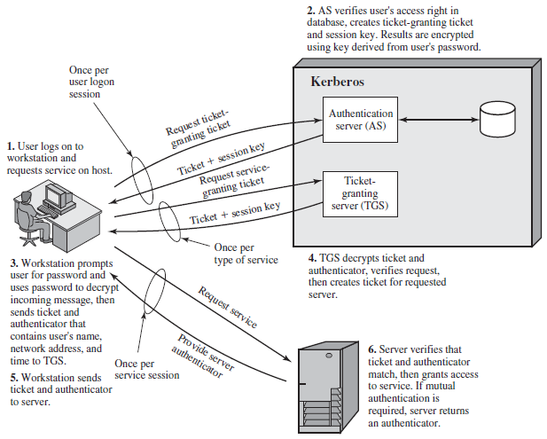
Kerberos: Version 4

Slide 16
Kerberos: Version 4
Kerberos Realms
Kerberos allows the global distribution of ASs and TGSs, with each system called a realm. A user may get a ticket for a local TGS or a remote TGS.
A full-service Kerberos environment consisting of a Kerberos server, a number of clients, and a number of application servers requires the following:
The Kerberos server must have the user ID and hashed passwords of all participating users in its database. All users are registered with the Kerberos server.
The Kerberos server must share a secret key with each server. All servers are registered with the Kerberos server.
The Kerberos server in each interoperating realm shares a secret key with the server in the other realm. The two Kerberos servers are registered with each other.

Slide 17
Kerberos: Version 4
Kerberos Realm Environment
A Kerberos realm is a set of managed nodes that share the same Kerberos database.
The Kerberos database resides on the Kerberos master computer system, which should be kept in a physically secure room.
A read-only copy of the Kerberos database might also reside on other Kerberos computer systems. However, all changes to the database must be made on the master computer system. Changing or accessing the contents of a Kerberos database requires the Kerberos master password.
The scheme requires that the Kerberos server in one realm trust the Kerberos server in the other realm to authenticate its users. Furthermore, the participating servers in the second realm must also be willing to trust the Kerberos server in the first realm.

Slide 18
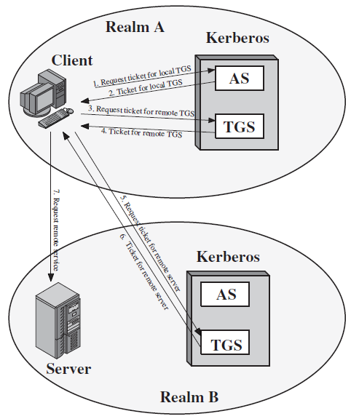
Kerberos: Version 4

Slide 19
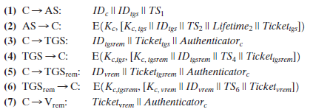
Kerberos: Version 4
Authenticator_{C} = E(K_{c, tgs}, [ID_{C}||AD_{C}||TS₃])
Ticket_{tgs} = E(K_{tgs}, [K_{c, tgs}||ID_{C}|AD_{C}||ID_{tgs}||TS₂||Lifetime₂])
Ticket_{tgsrem} = E(K_{tgsrem}, [K_{c, tgsrem}||ID_{C}||AD_{C}||ID_{tgsrem}||TS₄||Lifetime₄])
Authenticator_{c} = E(K_{c, tgsrem}, [ID_{C}||AD_{C} ||TS₅])
Ticket_{verm} = E(K_{vrem}, [K_{c, vrem}||ID_{C}|IAD_{C}||ID_{vrem}||TS₆||Lifetime₆])
Authenticator_{c} = E(K_{c, tgsrem}, [ID_{C}||AD_{C} ||TS₇])

Slide 20
Kerberos: Version 4
One problem presented by the foregoing approach is that it does not scale well to many realms.
If there are N realms, then there must be N(N-1)/2 secure key exchanges so that each Kerberos realm can interoperate with all other Kerberos realms.

Slide 21
Kerberos: Version 5
V5 is intended to address the limitations of V4 in two areas:
Environmental shortcomings.
Encryption system dependence
Internet protocol dependence
Ticket lifetime
Authentication forwarding
Interrealm authentication
Technical deficiencies
Double encryption
PCBC encryption
Session keys
Password attacks

Slide 22
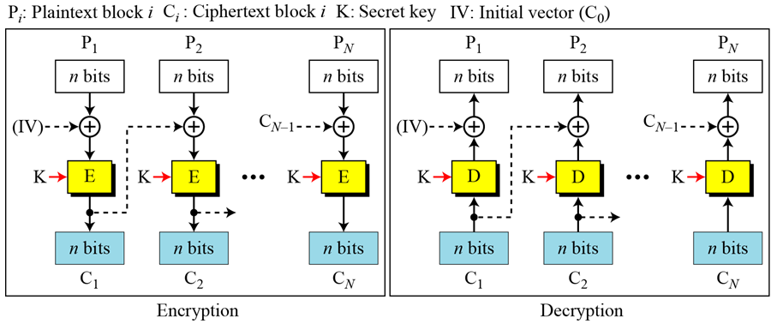
CBC & PCBC
Propagating Cipher Block Chaining (PCBC)
C_{i} = E_{K}(P_{i}P_{i-1}C_{i-1}) P_{i} = D_{K}(C_{i})C_{i-1}P_{i-1} IV is P₀C₀
PCBC is designed to extend or propagate a single bit error in the ciphertext. This allows errors in transmission to be captured and the resultant plaintext to be rejected.

Slide 23
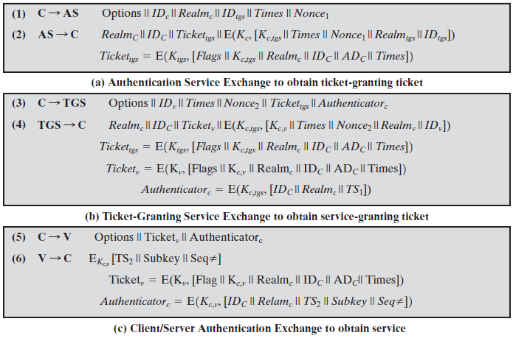
Kerberos: Version 5
Summary of Kerberos Version 5 Message Exchanges

Slide 24
Kerberos: Version 5
Summary of Kerberos Version 5 Message Exchanges
Message 1:
ID of the Client and the TGS
Realm: Indicates realm of user
Options: Used to request that certain flags be set in the returned ticket
Times: Used by the client to request the following time settings in the ticket:
From: the desired start time for the requested ticket
Till: the requested expiration time for the requested ticket
rtime: requested renew-till time
Nonce: A random value to be repeated in Message 2 to assure that the response is fresh and has not been replayed by an opponent

Slide 25
Kerberos: Version 5
Summary of Kerberos Version 5 Message Exchanges
Message 2:
A ticket-granting ticket
ID of the client
a block encrypted using the encryption key based on the user’s password. This block includes
the session key to be used between the client and the TGS
times specified in Message 1
the nonce from Message 1
ID of TGS

Slide 26
Kerberos: Version 5
Summary of Kerberos Version 5 Message Exchanges
Message 2:
The ticket itself includes
the session key
ID of the client
the requested time values
the requested options
flags that reflect the status of this ticket
Message 2 in V5
Realm_{C}||ID_{C}||Ticket_{tgs}||E(K_{c}, [K_{c,tgs}||Times||Nonce₁||Realm_{tgs}||ID_{tgs}])
Ticket_{tgs} = E(K_{tgs}, [Flags||K_{c,tgs}||Realm_{c}||ID_{C}||AD_{C}||Times])

Slide 27
Kerberos: Version 5
Summary of Kerberos Version 5 Message Exchanges
Message 3:
an authenticator
a ticket
the name of the requested service
Requested times
options for the ticket
a nonce

Slide 28
Kerberos: Version 5
Summary of Kerberos Version 5 Message Exchanges
Message 4:
a ticket
Information needed by the client

Slide 29
Kerberos: Version 5
Summary of Kerberos Version 5 Message Exchanges
Message 5:
a ticket
the client may request as an option that mutual authentication is required.
An authenticator, which includes
Subkey: The client’s choice for an encryption key to be used to protect this specific application session. If this field is omitted, the session key from the ticket (K_{c,v}) is used.
Sequence number: An optional field that specifies the starting sequence number to be used by the server for messages sent to the client during this session. Messages may be sequence numbered to detect replays.

Slide 30
Kerberos: Version 5
Summary of Kerberos Version 5 Message Exchanges
Message 6:
This is for mutual authentication. It includes
the timestamp from the authenticator
The subkey field, if present, overrides the subkey field, if present, in message (5).
https://tools.ietf.org/html/rfc1510

Slide 31
Kerberos: Version 5
Ticket Flags
INITIAL: This ticket was issued by AS protocol (not by TGS) and not issued based on a ticket granting ticket.
PRE-AUTHENT: During initial authentication, the client was authenticated by the AS before a ticket was issued.
HW-AUTHENT: The protocol employed for initial authentication required the use of hardware expected to be possessed solely by the named client. (Indicates that the initial authentication required the use of hardware.)
https://www.ietf.org/rfc/rfc4120.txt

Slide 32
Kerberos: Version 5
Ticket Flags
RENEWABLE: Tells TGS that this ticket can be used to obtain a replacement ticket that expires at a later date.
MAY-POSTDATE: Tells TGS that a postdated ticket may be issued based on this ticket-granting ticket.
POSTDATED: Indicates that this ticket has been postdated; the end server can check the authtime field to see when the original authentication occurred.
INVALID: This ticket is invalid and must be validated by the KDC before use.

Slide 33
Kerberos: Version 5
Ticket Flags
PROXIABLE: Tells TGS that a new service-granting ticket with a different network address may be issued based on the presented ticket.
PROXY: Indicates that this ticket is a proxy.
Neuman, B. “Proxy-Based Authorization and Accounting for Distributed Systems.” Proceedings of the 13th International Conference on Distributed Computing Systems, May 1993.

Slide 34
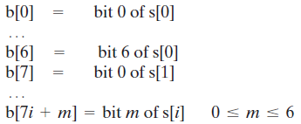
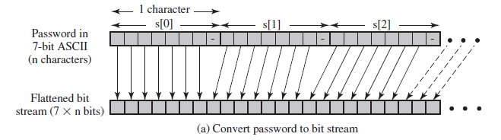
Kerberos: Version 5
Password-to-Key Transformation
Password is limited to ‘n’ characters, s(0), s(1), ..., s(n-1).
Convert password to bit stream as follows

Slide 35
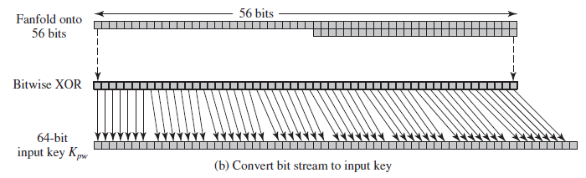
Kerberos: Version 5
Password-to-Key Transformation
The bit string is compacted to 56 bits (DES key) by aligning the bits in “fanfold” fashion and performing a bitwise XOR.
To conform to the expected 64-bit key format, the string is treated as a sequence of eight 7-bit blocks and is mapped into eight 8-bit blocks to form an input key K_{pw}.

Slide 36
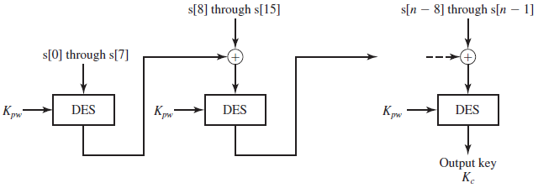
Kerberos: Version 5
Password-to-Key Transformation
Finally, the original password is encrypted using the CBC mode of DES with key K_{pw}.
The last 64-bit block returned from this process, known as the CBC checksum, is the output key (K_{c}) associated with this password.

