Slide 1
NETWORK SECURITY
Secure Socket Layer (SSL)
International Institute of Information Technology, Naya Raipur

Slide 2
Drawback of Kerberos?
Single entity trusted by all
Key management for billions of users is a problem
All users MUST be known to the KDC and the KDC must remain online all the time.
Performance bottleneck

Slide 3
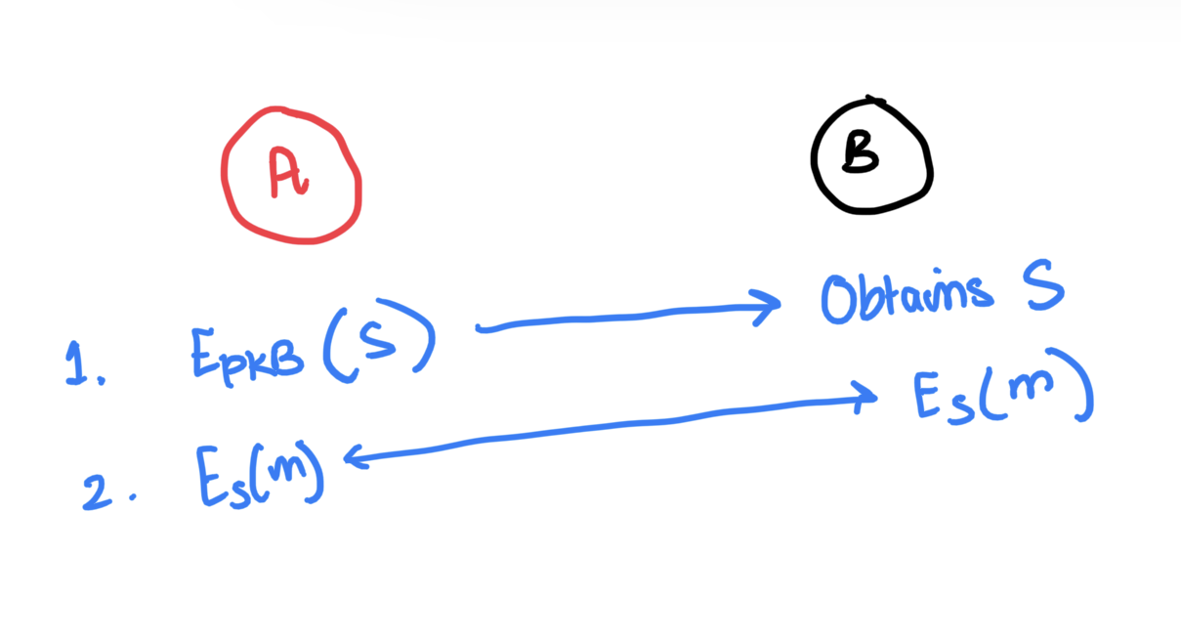
How do we change this?
Concept of public key cryptography used
Public key used to generate a session key
which is used to encrypt the messages
shared between users.
Drawbacks?
Assumes everyone knows the public key of every entity.
No authentication of entities to prove they are genuine.

Slide 4
Certificate Authority Introduced
The CA steps in here and generates certificates for the entities.
Now:
No need for an online KDC thus more scalable concept.
Certificates authenticate the entities.
If CA makes a mistake:
Certificate Revocation List
OCSP servers used to verify certificates

Slide 5
Why SSL?
There are 3 main spheres of internet communication we need to secure:
Data being transferred on the network
Data stored in browser like cookies
The UI itself (to protect users against Phishing etc.)
SSL is used to secure (1) i.e data being transferred on the network.

Slide 6
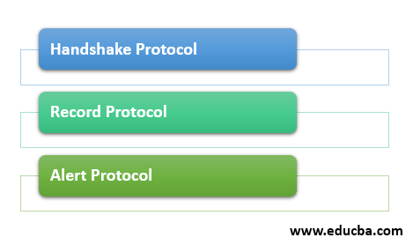
Working of SSL
SSL has three sub-protocols as shown below. These three sub-protocols constitute the overall working of SSL.
*
International Institute of Information Technology, Naya Raipur
‹#›

Slide 7
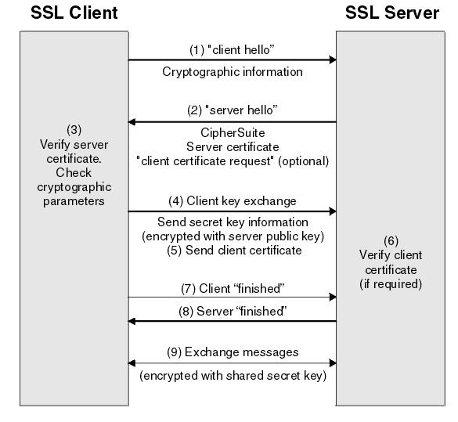
Handshake Protocol (Provides authentication)
Change Cipher Spec Protocol:
This is used to inform the
other entity that we have
changed from asymmetric to
symmetric key cryptography
Fig.1 Handshake Protocol Image courtesy: IBM

Slide 8
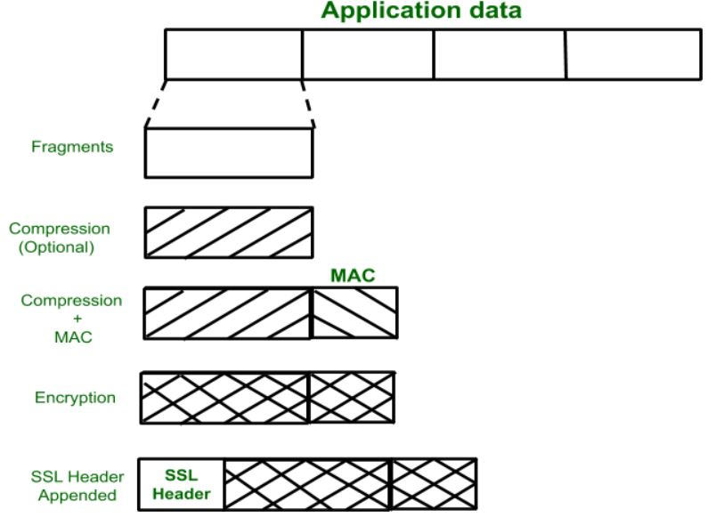
Record Protocol (Provides integrity and confidentiality)
It is used to transfer any data
within a session - both
message and other protocols
as well as for any application
layer.
Fig. 2. Record Protocol Image courtesy: GFG
*
International Institute of Information Technology, Naya Raipur
‹#›

Slide 9

3. The Alert Protocol
When either the client or the server detects an error, the detecting party sends an alert message to the other party.
Each alert message consists of two bytes.The byte 1 signifies the type
of error.
If it is a warning, this level contains 1.
If the error is fatal, this level contains 2.
The byte 2 specifies the actual errors. Fig.3 Alert protocol message format
*
International Institute of Information Technology, Naya Raipur
‹#›

Slide 10
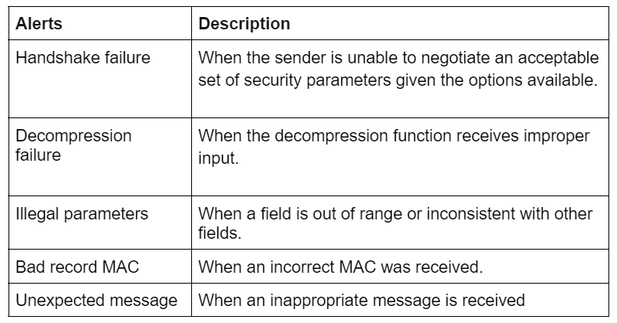
List of fatal errors.
Fig. Fatal Alerts
Table 1: Types of fatal errors

Slide 11
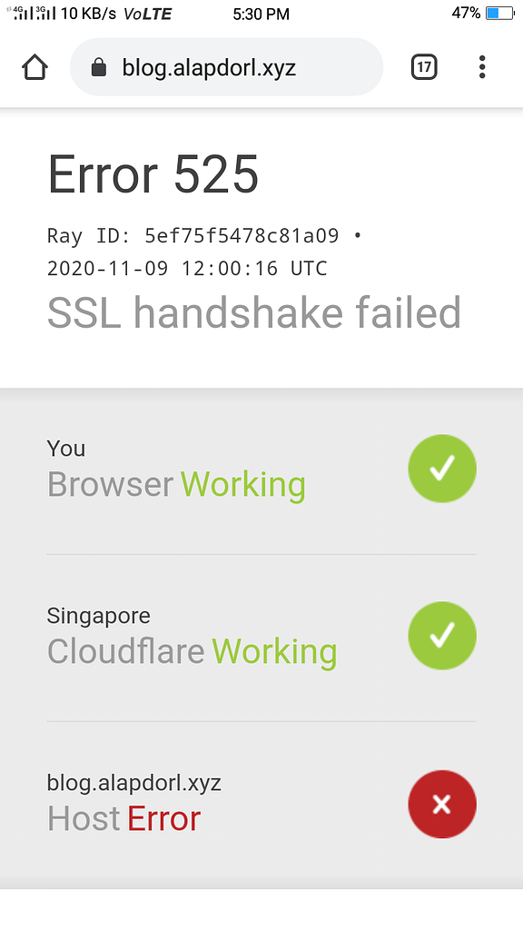
WHY?

Slide 12
TLS (Transport Layer Security)
The main question is, why use TLS instead of SSL?
TLS is an new modified version of SSL, however SSL is very commonly used.
Difference is:
SSL uses MAC (Message Authentication Code)
TLS uses HMAC (Hashed Message Authentication Code) <- more secure!
TLS uses better encryption standards.

Slide 13
Vulnerabilities of SSL
Stripping attacks: Taken advantage of how a user enters an HTTPS website from an insecure HTTP website. The attacker connects the user to their machine. Then forwards the victims request and receives the secure HTTPS page, changes it to HTTP and thus removes all security.
Wildcard Certificates: Server admins use self signed wildcard certificates using OpenSSL, which is quick but bad practise as the concept of trusted CA is removed and user can be attacked.
Fake Certificates: We saw earlier, a method to verify certificates is OCSP but it is tedious and slow. Thus, mostly certificates are not verified and even CAs like GoDaddy can be spoofed.
Expired certificates.

Slide 14
Clarify between TCP handshake and TLS handshake
TCP handshake is used to establish a stable connection between 2 entities.
TLS handshake is used to secure that connection.
TLS handshake takes place after TCP handshake.

Slide 15

THANK YOU
..
Dr. Shyama Prasad Mukherjee International Institute of Information Technology, Naya Raipur
*
International Institute of Information Technology, Naya Raipur
‹#›

