Slide 1
KATHFORD INTERNATIONAL COLLEGE OF ENGINEERING AND MANAGEMENT Balkumari,Lalitpur
PRESENTATION
ON
“Online piazza for home appliances”
Project members Rakshya Bista (025/BCT/2070)
Saroj Mishra (036/BCT/2070)

Slide 2
Introduction
The concept of Home Appliance introduced mainly on 20th century to save labor and Time.
Online Piazza for Home Appliances are a form of electronic commerce which allows consumers directly buy electrical appliances from a seller over the Internet.

Slide 3
Objectives
To buy and search different appliances in the comfort of your own home by knowing about various latest and old electrical appliances of different Category and Brand.

Slide 4
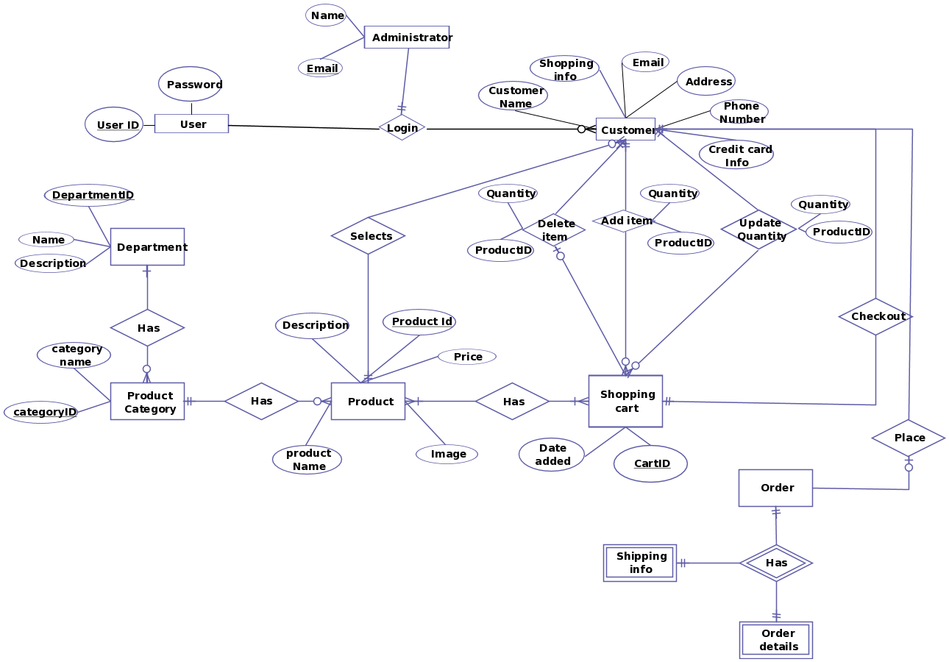
E-R diagram

Slide 5
Use Case Diagram

Slide 6
Block Diagram

Slide 7
Results and Discussion
MySQL is a database system that used on this website.
Our database is based on the relational database model.
PayPal is the online payment gateway in our site.
This site works for human comfort.

Slide 8
Conclusion
This project minimizes the troubles for a customer to walk through a brick and store.
It helps the customers to get up to date about the market price and values.
save the time as well as provide the quality product as per customer need

Slide 9
Limitations and future work
We need to expand the nationwide shipping facility.
Exchange or return of the appliances is not supported for now.
Database privileges, Query optimization, Security system improved

Slide 10
THANK YOU

