Slide 1

Topic: AutoEncoders for Recommendation Systems
Project Type: Paper Implementation
Group 27
Utkrisht Sikka (2019215)
Tanya Gupta (2019119)
Raj Kumar (2019084)
Harsh Goyal (2020562)
Shivam Jindal (2020125)
Notes:
Hi we are group 27. The title of our implementation project is Autoencoders for recommendation systems.

Slide 2
Papers
S. Sedhain, A. K. Menon, S. Sanner, and L. Xie. 2015. AutoRec: Autoencoders Meet Collaborative Filtering. In Proceedings of the 24th International Conference on World Wide Web (WWW). ACM, New York, USA, 111–112.
https://doi.org/10.1145/2740908.2742726
Datasets used- MovieLens-1M, MovieLens-10M, Netflix Prize
D. Liang, R. G. Krishnan, M. D. Hoffman, and T. Jebara. 2018. Variational Autoencoders for Collaborative Filtering. In Proceedings of The 2018 Web Conference (WWW). ACM, New York, USA, 10 pages.
https://doi.org/10.1145/3178876.3186150
Datasets used- MovieLens-20M, Netflix Prize, Million Song Dataset
3
1
O. Kuchaiev and B. Ginsburg. 2017. Training Deep AutoEncoders for Collaborative Filtering(NVIDIA). 5 pages
https://doi.org/10.48550/arXiv.1708.01715
Not presented in a conference but cited by many top tier papers (102 citations)
Dataset used- Netflix Prize, but split on time
D. Kim and B. Suh. 2019. Enhancing VAEs for Collaborative Filtering: Flexible Priors & Gating Mechanisms. In Thirteenth ACM Conference on Recommender Systems (RecSys ’19), September 16–20, 2019, Copenhagen, Denmark. ACM, New York, NY, USA, 5 pages.
https://doi.org/10.1145/3298689.3347015
Dataset used- MovieLens-20M and Netflix Prize dataset
4
2
Notes:
So we have chosen 2 sets of papers, papers 1 and 2 implement standard autoencoders and paper 2 improves upon the model provided in paper 1, similarly papers 3 and 4 implement variational autoencoders and paper 3 improves upon the model provide in paper 4

Slide 3
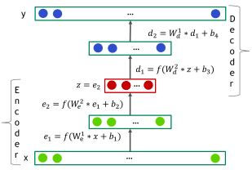

Discussion on Papers: AutoEncoders
1
AutoRec: Autoencoders Meet Collaborative Filtering
Uses an autoencoder for predicting user ratings
2 versions-
U-AutoRec (input is all the ratings of a given user)
I-AutoRec (input is all ratings of a given item)
Autoencoder equations-
Experiments with different activation functions and network depth were carried out and it was concluded that making the AutoRec deeper should improve results.
2
Training Deep AutoEncoders for Collaborative Filtering
Expands on the U-AutoRec model for netflix data
Experiments with number of layers, activation functions, adding dropout and also uses dense re-feeding
Increasing layer width and autoencoder depth and dropout increased accuracy
Notes:
Briefly discussing papers 1 and 2 first of all we have Autorec, which uses a simple autoencoder with one hidden layer to predict user ratings. The paper experiments with the input size, and thus we have 2 variations, U AutoRec which takes in as input all the ratings of a given user and tries to learn that and I AutoRec which takes in as input all the ratings for a given item and tries to learn that.
The paper experiments with various activation functions and later on also suggests that increasing the number of hidden layers in the network should improve the accuracy, which is what brings us to our second paper, Deep Autoencoders.
This paper takes the U-Autorec model of paper 1 and increases the number of hidden layers and the width of the hidden layers in the neural network. Besides this it also implements techniques like dense refeeding and dropout all of which are shown to improve accuracy.

Slide 4




Discussion on Papers: Variational AutoEncoders
3
Variational Autoencoders for Collaborative Filtering
x_{ui} = no. of clicks for item i from user u.
The model samples a K-dim. latent representation z_{u} from q.
Non linear f_{θ} applied on z_{u} to give prob. distrib. 𝜋(z_{u})
Enhancing VAEs for Collaborative Filtering: Flexible Priors & Gating Mechanisms
Flexible priors: use Laplace and Student's t-distributions inplace of the standard gaussian distribution.
Gating mechanisms: Replace the fixed sigmoid function with learnable gates, to allow the model to learn when to focus on reconstruction and when to focus on regularization
4
Parameter to train: 𝛉 and ɸ . Metrics: Recall@R, NDCG@R
Notes:
An Autoencoder has an encoding stage and a decoding stage. But VAE has additional stage in between where sampling is done. Authors in VAE papers have binarized the numerical ratings to a 1 or 0 . For eg. in Movie Lens 20M, if user gave a rating of four or higher to an item, then it is interpreted as the user has clicked that item once. For each user u, input is vector Xu. Xu is used to determine, gaussian distribution qphi . Then qphi is used to sample a vector zu. Then zu is transformed via a function fθ to produce a probability distribution over all I items.
Objective function consists of a log likelihood part and KL divergence part.
In our next paper, Enhancing VAEs, authors use Laplace and Student's t-distributions to better capture the distribution of user-item interaction. They also introduced learnable gating mechanisms to control the contribution of the reconstruction and the KL-divergence loss to the overall loss function.

Slide 5
What we did?
Implemented the papers on the BookCrossing and Anime dataset
BookCrossing: 17384 books, 2945 users
Explicit data - ratings range is 1-10
Implicit data - history of user -book interaction.
book info, user info.
Anime Dataset: 7390 animes, 5000 users
Contains explicit , implicit data and anime info.
Notes:
We ran all the models on BookCrossing and Anime dataset. Both of these datasets also contain history of user-item interactions. In VAE models, we have used only the histories.

Slide 6
Paper 1: AutoRec
Notes:
Coming to paper 1, Autorec , we have implemented both I-AutoRec and U-Autorec.

Slide 7
U-Autorec : Activation Tuning
Books dataset
First | Last | MSE | MSE(clipped) | RMSE(clipped)
Linear | Linear | 8.841 | 4.306 | 1.192
Linear | Sigmoid | 22.0562 | 21.7444 | 3.000
Linear | Relu | 29.2856 | 21.744 | 3.000
Sigmoid | Linear | 5.1944 | 3.4324 | 1.043
Sigmoid | Sigmoid | 22.3122 | 21.744 | 3.000
Sigmoid | Relu | 5.08596 | 3.3999 | 1.0371
Relu | Linear | 3.7644 | 3.007 | 0.949
Relu | Sigmoid | 22.0098 | 21.7444 | 3.000
Relu | Relu | 6.893 | 5.276 | 1.284
Anime dataset
First | Last | MSE | MSE(clipped) | RMSE(clipped)
Linear | Linear | 3.9395 | 2.869 | 1.325
Linear | Sigmoid | 41.604 | 41.541 | 5.641
Linear | Relu | 54.128 | 41.541 | 5.641
Sigmoid | Linear | 2.73198 | 1.893 | 1.086
Sigmoid | Sigmoid | 41.699 | 41.541 | 5.641
Sigmoid | Relu | 2.8502 | 1.930 | 1.095
Relu | Linear | 2.3051 | 1.973 | 1.0764
Relu | Sigmoid | 41.597 | 41.541 | 5.641
Relu | Relu | 11.1702 | 8.801 | 2.224
Notes:
We tuned the activation function hyperparameter by trying out 9 combinations of the
relu,sigmoid and linear activations and got the best results for the relu,linear function combination
for both the datasets for the UAutoRec model.

Slide 8
I-Autorec: Activation Tuning
Books Dataset
First | Last | MSE | MSE(clipped) | RMSE(clipped)
Linear | Linear | 1.831 | 1.210 | 0.756
Linear | Sigmoid | 16.043 | 16.004 | 4.000
Linear | Relu | 20.039 | 12.714 | 3.189
Sigmoid | Linear | 0.0865 | 0.003 | 0.045
Sigmoid | Sigmoid | 16.089 | 16.004 | 4.000
Sigmoid | Relu | 0.0875 | 0.002 | 0.041
Relu | Linear | 0.5574 | 0.363 | 0.450
Relu | Sigmoid | 16.055 | 16.004 | 4.000
Relu | Relu | 0.5655 | 0.393 | 0.511
Anime Dataset
First | Last | MSE | MSE(clipped) | RMSE(clipped)
Linear | Linear | 2.2416 | 1.760 | 0.817
Linear | Sigmoid | 2.26888 | 1.765 | 0.814
Linear | Relu | 3.07679 | 2.240 | 0.891
Sigmoid | Linear | 2.269 | 1.753 | 0.8153
Sigmoid | Sigmoid | 3.10365 | 2.253 | 0.900
Sigmoid | Relu | 3.034585 | 2.224 | 0.886
Relu | Linear | 3.04586 | 2.230 | 0.894
Relu | Sigmoid | 3.07772 | 2.2449 | 0.889
Relu | Relu | 3.0385 | 2.230 | 0.895
Notes:
The process was repeated for I Autorec and best results were obtained for sigmoid,relu combination for the books dataset and linear activation for anime.

Slide 9
5 fold cross validation on Books Dataset
U-Autorec
 | MSE | MSE(clipped) | RMSE(clipped)
Fold 1 | 2.169 | 1.56 | 0.533
Fold 2 | 2.031 | 1.555 | 0.532
Fold 3 | 2.135 | 1.575 | 0.538
Fold 4 | 2.051 | 1.542 | 0.534
Fold 5 | 2.104 | 1.614 | 0.554
Average | 2.098 | 1.57 | 0.538
I-Autorec
 | MSE | MSE(clipped) | RMSE(clipped)
Fold 1 | 1.601 | 0.671 | 0.324
Fold 2 | 1.587 | 0.667 | 0.326
Fold 3 | 1.511 | 0.658 | 0.322
Fold 4 | 1.662 | 0.663 | 0.322
Fold 5 | 1.421 | 0.652 | 0.32
Average | 1.556 | 0.662 | 0.322
Notes:
Finally a 5 fold cross validation was carried out for both the datasets by using the best hyperparameters.
The error metrics depict that I autorec outperforms U autorec for the books dataset.

Slide 10
5 fold cross validation on Anime dataset
U-Autorec
 | MSE | MSE(clipped) | RMSE(clipped)
Fold 1 | 1.443 | 1.115 | 0.579
Fold 2 | 1.604 | 1.218 | 0.578
Fold 3 | 1.624 | 1.227 | 0.585
Fold 4 | 1.682 | 1.34 | 0.649
Fold 5 | 1.539 | 1.183 | 0.585
Average | 1.578 | 1.216 | 0.595
I-Autorec
 | MSE | MSE(clipped) | RMSE(clipped)
Fold 1 | 2.284 | 1.437 | 0.809
Fold 2 | 2.16 | 1.363 | 0.787
Fold 3 | 2.29 | 1.445 | 0.818
Fold 4 | 2.325 | 1.393 | 0.803
Fold 5 | 2.223 | 1.415 | 0.805
Average | 2.256 | 1.41 | 0.804
Notes:
On the contrary, U-autorec outperforms I autorec for anime dataset.

Slide 11
Paper 2: Deep AutoRec
Notes:
Coming to paper 2, deep autorec, we tuned 4 hypermaanters- encoder depth, layer width, dropout and activation.

Slide 12
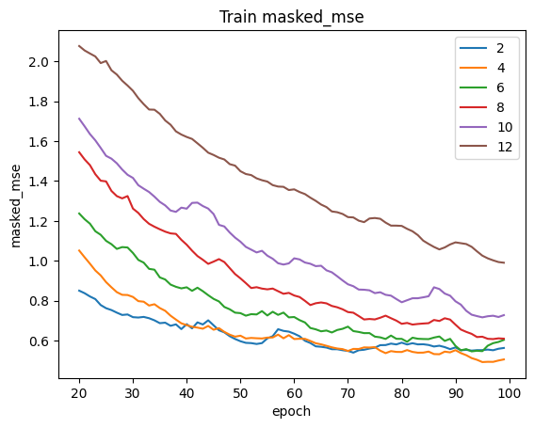
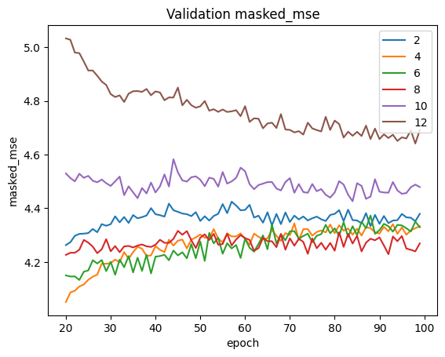
Deep Autorec: layer depth
Notes:
So These are the epochwise train and validation losses for 2,4,6,8,10 and 12 layers.

Slide 13
Deep Autorec: layer depth
Layers | MSE | MSE (clipped) | RMSE (clipped)
2 | 3464.480 | 36.551 | 1.269
4 | 2022.020 | 27.891 | 1.294
6 | 592.838 | 15.374 | 1.245
8 | 185.701 | 8.676 | 1.228
10 | 29.233 | 3.421 | 1.219
12 | 29.745 | 3.430 | 1.217
Layers | MSE | MSE (clipped) | RMSE (clipped)
2 | 54.165 | 6.251 | 1.676
4 | 31.539 | 4.810 | 1.683
6 | 10.456 | 2.657 | 1.543
8 | 5.789 | 1.914 | 1.512
10 | 3.364 | 1.351 | 1.296
12 | 2.400 | 1.088 | 1.084
Notes:
We can see that 12 hidden layers gave the best results for both datasets.

Slide 14
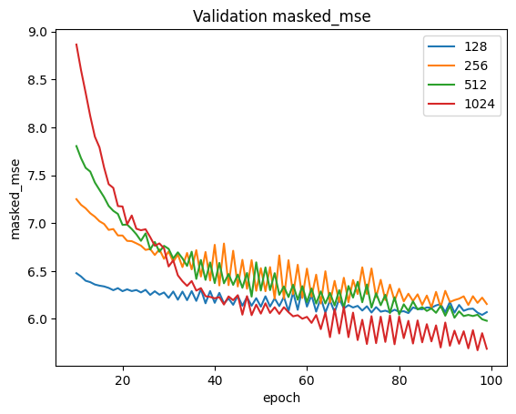
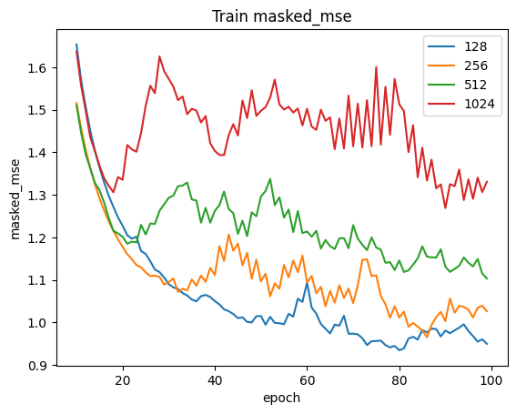
Deep Autorec: Layer Width
Notes:
Similarly we experimented with the hidden layer width of 128,256,512 and 1024 units,these are the epoch wise losses.

Slide 15
Hidden Layer Width
Books Dataset
Width | MSE | MSE(clipped) | RMSE(clipped)
128 | 215006.515 | 294.851 | 1.233
256 | 149637.406 | 245.263 | 1.233
512 | 90557.5 | 189.858 | 1.232
1024 | 38243.683 | 121.65 | 1.2449
Anime Dataset
Width | MSE | MSE(clipped) | RMSE(clipped)
128 | 63.632 | 6.397 | 2.064
256 | 46.316 | 5.413 | 1.937
512 | 51.378 | 5.82 | 1.723
1024 | 41.228 | 5.092 | 2.516
Notes:
512 units achieves best results for books dataset and 1024 for anime dataset.

Slide 16
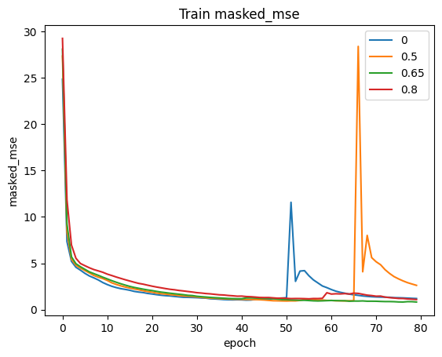
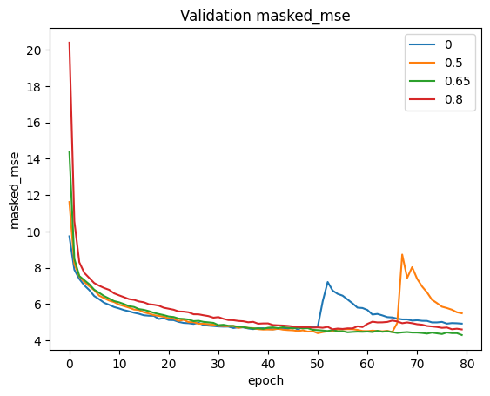
Deep Autorec: Dropout
Notes:
Moving on to dropout: we experimented with dropout values 0,0.5,0.65 and 0.8 The loss graphs are depicted here.

Slide 17
Deep AutoRec: Dropout
Books dataset
Dropout | MSE | MSE(clipped) | RMSE(clipped)
0 | 730.733 | 17.178 | 1.233
0.5 | 23.225 | 2.861 | 1.213
0.65 | 108.780 | 6.539 | 1.236
0.8 | 39.396 | 3.9545 | 1.223
Anime dataset
Dropout | MSE | MSE(clipped) | RMSE(clipped)
0 | 5.526 | 1.811 | 1.436
0.5 | 3.025 | 1.252 | 1.222
0.65 | 2.744 | 1.187 | 1.182
0.8 | 2.840 | 1.200 | 1.178
Notes:
0.5 turns out to be the best dropout for books dataset and 0.65 for anime dataset.

Slide 18
Activation function tuning (Books Dataset)
First | Last | MSE | MSE(clipped) | RMSE(clipped)
elu | linear | 18856.894 | 86.333 | 1.243
elu | sigmoid | 22.046 | 3.017 | 3.0001
relu | linear | 572024.687 | 482.482 | 1.233
relu | sigmoid | 22.051 | 3.017 | 3
selu | linear | 2205.954 | 29.133 | 1.308
selu | sigmoid | 22.039 | 3.017 | 3
tanh | linear | 8.524 | 1.335 | 1.281
tanh | sigmoid | 22.888 | 3.051 | 3
First | Last | MSE | MSE(clipped) | RMSE(clipped)
sigmoid | linear | 8.558 | 1.336 | 1.282
Sigmoid | sigmoid | 22.904 | 3.051 | 3
elu | selu | 18295.125 | 86.082 | 1.233
relu | selu | 555634.25 | 475.376 | 1.234
selu | selu | 2735.957 | 32.943 | 1.24
tanh | selu | 8.199 | 1.308 | 1.254
sigmoid | selu | 8.239 | 1.31 | 1.256
Notes:
Lastly for the activation functions, we tried out elu,relu,selu,tanh,sigmoid and linear activation combinations tanh and selu give the best results for books dataset.

Slide 19
Activation function tuning: Anime Dataset
First | Last | MSE | MSE(clipped) | RMSE(clipped)
elu | linear | 69.383 | 7.193 | 1.693
elu | sigmoid | 41.59 | 5.642 | 5.641
elu | selu | 123.141 | 9.659 | 1.695
relu | linear | 783.484 | 24.411 | 1.691
relu | sigmoid | 41.59 | 5.642 | 5.641
relu | selu | 632.26 | 21.92 | 1.69
selu | linear | 28.821 | 4.558 | 1.673
selu | sigmoid | 41.584 | 5.642 | 5.641
First | Last | MSE | MSE(clipped) | RMSE(clipped)
selu | selu | 39.45 | 5.392 | 1.685
tanh | linear | 3.478 | 1.15 | 1.1461
tanh | sigmoid | 42.005 | 5.654 | 5.641
tanh | selu | 3.37 | 1.144 | 1.14
sigmoid | linear | 3.485 | 1.145 | 1.141
sigmoid | sigmoid | 42.02 | 5.655 | 5.641
sigmoid | selu | 3.366 | 1.137 | 1.133
Notes:
For the anime dataset, we conclude that sigmoid and selu activation functions achieved the best results

Slide 20
5 fold Cross Validation Results
Books dataset
 | MSE | MSE(clipped) | RMSE(clipped) | Baseline (RMSE clipped)
Fold 1 | 4.481 | 0.447 | 0.412 | 0.533
Fold 2 | 4.182 | 0.446 | 0.41 | 0.532
Fold 3 | 4.345 | 0.462 | 0.422 | 0.538
Fold 4 | 4.2 | 0.449 | 0.414 | 0.534
Fold 5 | 4.48 | 0.463 | 0.425 | 0.554
Average | 4.337 | 0.453 | 0.416 | 0.538
Anime dataset
 | MSE | MSE(clipped) | RMSE(clipped) | Baseline (RMSE clipped)
Fold 1 | 1.833 | 0.417 | 0.415 | 0.579
Fold 2 | 2.355 | 0.424 | 0.423 | 0.578
Fold 3 | 3.079 | 0.417 | 0.415 | 0.585
Fold 4 | 3.316 | 0.416 | 0.414 | 0.649
Fold 5 | 2.948 | 0.423 | 0.421 | 0.585
Average | 2.706 | 0.4194 | 0.417 | 0.595
Notes:
Finally we ran the models with the selected best hyperparameters and carried out a five fold cross validation and the results obtained are shown here. We were able to beat the initial U-AutoRec baseline of paper 1 for both the datasets.

Slide 21
Paper 3: VAE
Notes:
Next, we are going to present results of VAE model.

Slide 22
BooksCrossing
No. of Layers
Initial Learning Rate
Layers | NDCG@100 | Recall@20 | Recall@50
3 | 0.125 | 0.100 | 0.153
5 | 0.112 | 0.078 | 0.134
7 | 0.097 | 0.072 | 0.114
9 | 0.088 | 0.057 | 0.102
Initial LR | NDCG@100 | Recall@20 | Recall@50
1e-4 | 0.116 | 0.083 | 0.14
1e-3 | 0.125 | 0.100 | 0.153
1e-2 | 0.097 | 0.072 | 0.108
1e-1 | 0.05 | 0.034 | 0.064
Notes:
First , we tune VAE model for bookcrossing.
Models with 3 or 5 layers performed better than deeper models. The authors had same observation on MovieLens dataset. We also varied initial learning rate of adam optimizer. 10^-3 value gave best NDCG.

Slide 23
BooksCrossing
Weight Decay
Total anneal steps
Weight Decay | NDCG@100 | Recall@20 | Recall@50
0 | 0.125 | 0.100 | 0.153
1e-4 | 0.125 | 0.95 | 0.144
1e-3 | 0.125 | 0.094 | 0.143
1e-2 | 0.083 | 0.062 | 0.085
1e-1 | 0.056 | 0.036 | 0.063
Steps | NDCG@100 | Recall@20 | Recall@50
400,000 | 0.125 | 0.095 | 0.143
200,000 | 0.125 | 0.100 | 0.153
20,000 | 0.127 | 0.104 | 0.154
2,000 | 0.127 | 0.094 | 0.152
Notes:
Then we found that 0 weight decay is best. Authors multiply KL divergence with a parameter Beta and used annealing to find Beta’s value. Changing total anneal steps hardly changed NDCG value.

Slide 24
BooksCrossing
Size of Sampling Layer
Dropout
Size | NDCG@100 | Recall@20 | Recall@50
150 | 0.131 | 0.092 | 0.145
300 | 0.143 | 0.110 | 0.160
600 | 0.142 | 0.107 | 0.162
1200 | 0.138 | 0.105 | 0.156
2400 | 0.135 | 0.110 | 0.155
Dropout | NDCG@100 | Recall@20 | Recall@50
0 | 0.142 | 0.107 | 0.162
0.25 | 0.135 | 0.103 | 0.153
0.5 | 0.127 | 0.104 | 0.154
0.75 | 0.116 | 0.094 | 0.152
Notes:
We found that keeping dropout at 0 gives max NDCG. Lastly, sampling layer size of 300 showed highest NDCG.

Slide 25
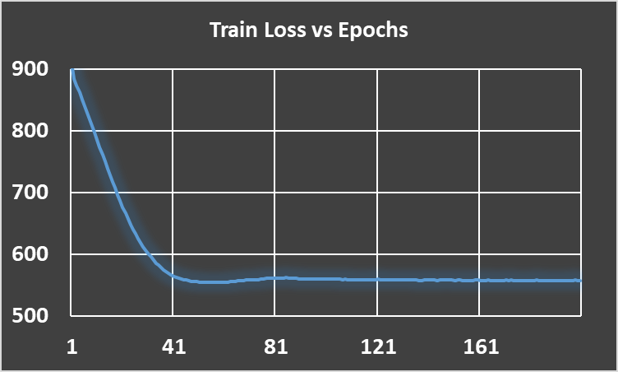
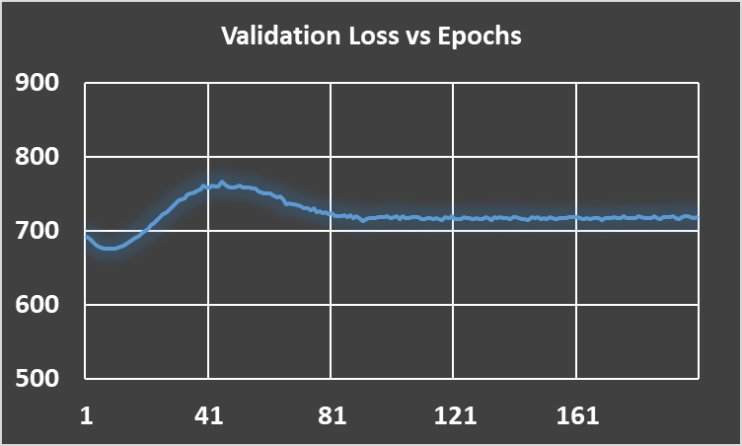
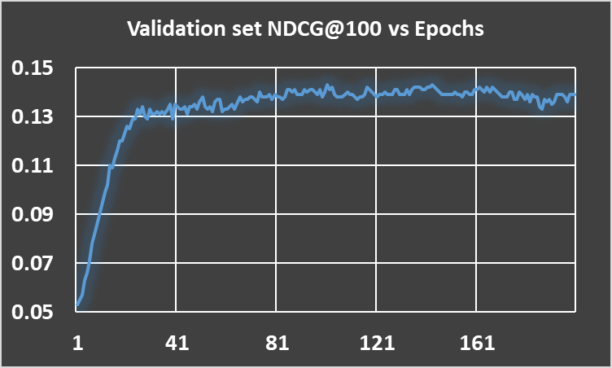
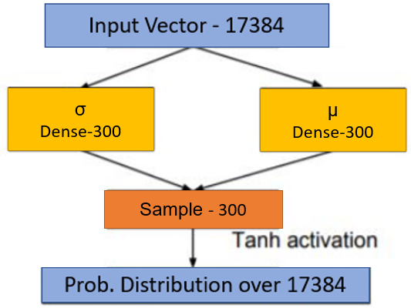
BooksCrossing
Train + Validation-92%, Test- 8%
Optimizer - Adam
Batch Size - 50
Objective Function - Evidence Lower Bound
Initial Learning Rate - 1e-3
Weight Decay - 0
Total Anneal Steps - 20000
Anneal Cap - 0.2
Dropout - 0
Notes:
On right, we have the final architecture of VAE that we used on test set.
Then these are the values of all parameters that we found from hyper parameter tuning.
We had split our dataset into 5 folds. We trained on 4 folds, validated on remaining fold to know till what epoch to train.
These 3 graphs correspond to model training of one of the 5 models.

Slide 26
BooksCrossing
Results of all 5 models on Test set
Fold | NDCG@100 | NDCG@20 | Recall@50 | Recall@20
1 | 0.141 (0.010) | 0.111 (0.010) | 0.159 (0.012) | 0.116 (0.010)
2 | 0.142 (0.009) | 0.112 (0.009) | 0.160 (0.012) | 0.121 (0.010)
3 | 0.140 (0.010) | 0.107 (0.009) | 0.158 (0.012) | 0.113 (0.010)
4 | 0.141 (0.010) | 0.110 (0.009) | 0.161 (0.012) | 0.116 (0.010)
5 | 0.144 (0.010) | 0.113 (0.009) | 0.161 (0.012) | 0.117 (0.010)
Notes:
VAE gave an avg. NDCG@100 of 0.142 . Parenthesis shows standard error values.

Slide 27
Anime
Initial Learning Rate
No. of Layers
Layers | NDCG@100 | Recall@20 | Recall@50
2 | 0.454 | 0.429 | 0.518
3 | 0.397 | 0.322 | 0.478
4 | 0.405 | 0.369 | 0.473
Initial LR | NDCG@100 | Recall@20 | Recall@50
1e-4 | 0.292 | 0.259 | 0.35
1e-3 | 0.405 | 0.369 | 0.473
1e-2 | 0.295 | 0.247 | 0.378
Notes:
these are the results of multi vae on anime dataset
At first we varied the number of layers of vae where we took 2,3,4 number of layers and got best results for 4 layers.
After that we changed the learning rate parameter on values 10^-4 to 10^-1 and got best value at 1e-3

Slide 28
Anime
Weight Decay
Total Anneal Steps
Weight Decay | NDCG@100 | Recall@20 | Recall@50
1e-4 | 0.393 | 0.359 | 0.349
1e-3 | 0.392 | 0.358 | 0.348
1e-2 | 0.375 | 0.348 | 0.331
1e-1 | 0.366 | 0.327 | 0.311
Steps | NDCG@100 | Recall@20 | Recall@50
400,000 | 0.366 | 0.327 | 0.312
200,000 | 0.366 | 0.327 | 0.311
20,000 | 0.360 | 0.325 | 0.306
2,000 | 0.322 | 0.295 | 0.271
Notes:
and we varied weight decay on the same set of values and got the best result at 10^-4 and total anneal steps 2 lakh.

Slide 29
Anime
Dropout
Total Anneal Cap
Dropout | NDCG@100 | Recall@20 | Recall@50
0 | 0.424 | 0.399 | 0.370
0.25 | 0.423 | 0.394 | 0.37
0.5 | 0.422 | 0.395 | 0.371
0.75 | 0.422 | 0.397 | 0.367
Anneal Cap | NDCG@100 | Recall@20 | Recall@50
2e-1 | 0.422 | 0.395 | 0.371
4e-1 | 0.421 | 0.394 | 0.371
6e-1 | 0.421 | 0.394 | 0.371
8e-1 | 0.421 | 0.395 | 0.371
Notes:
and we also changed dropout and anneal_cap parameters as well and got best results for p=0.5, anneal_cap = 0.6

Slide 30
Anime
Results on 5 Folds
Fold | NDCG@100 | NDCG@20 | Recall@50 | Recall@20
1 | 0.451 | 0.471 | 0.521 | 0.394
2 | 0.449 | 0.469 | 0.429 | 0.422
3 | 0.441 | 0.471 | 0.474 | 0.394
4 | 0.440 | 0.472 | 0.465 | 0.425
5 | 0.448 | 0.467 | 0.421 | 0.395
Notes:
Then this is the table of results for each fold using the params value we got from hyperparameter tuning

Slide 31
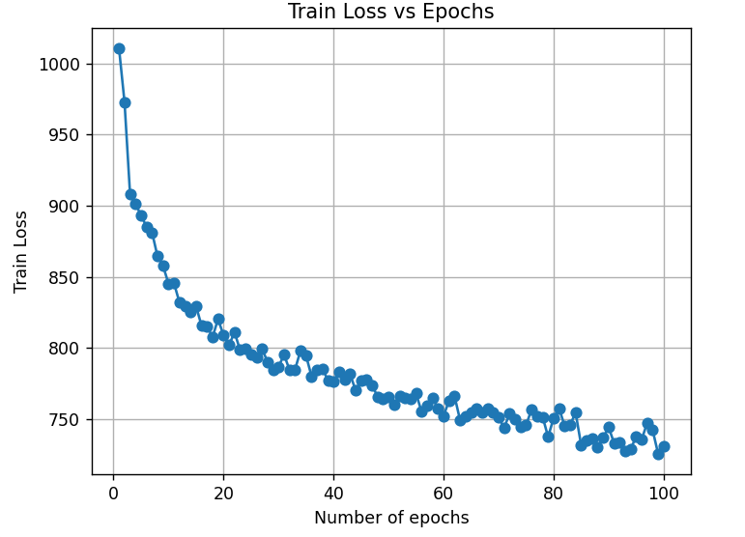
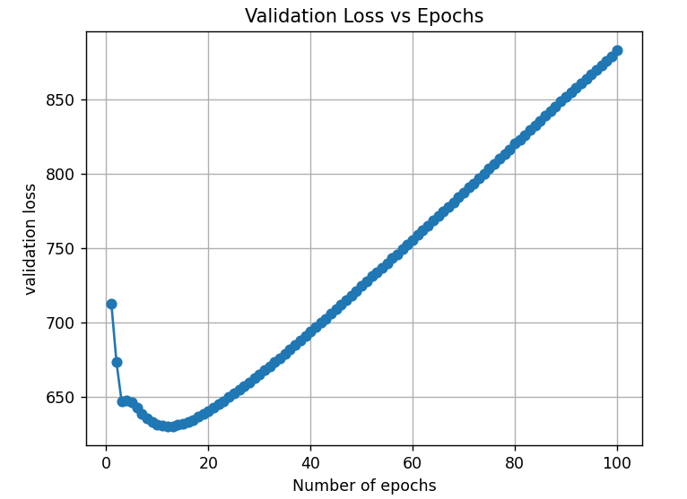
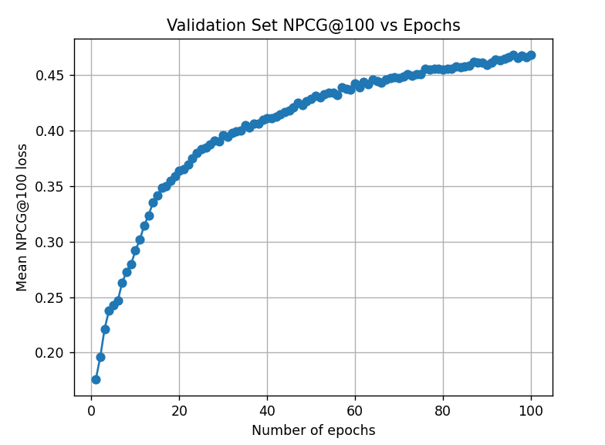
Anime
Test loss - 897.07
Test NDCG@100 - 0.45804
Test NDCG@20 - 0.40640
Test NDCG@10 - 0.41300
Recall@50- 0.52341
Recall@20- 0.42925
Recall@10 - 0.41195
Recall@2-0.42167
Recall@1-0.54000
Notes:
And finally these are the graphs of train ,validation and
ndcg@100.
validation ndcg is also increasing with number of iterations which can be seen from the plot.So multivae is performing good on anime dataset

Slide 32
Paper 4: EnhancedVAE
Notes:
Finally, we are going to present the results of the EnhancedVAE model.

Slide 33
Books Crossing
Number of latent features for a user
Hidden Layer Size
No. of Latent Features | NDCG@100 | Recall@50 | Recall@20
(100,100) | 0.06934 | 0.07329 | 0.04483
(200,200) | 0.06637 | 0.06919 | 0.04740
(300,300) | 0.06342 | 0.06527 | 0.05031
(400,400) | 0.06078 | 0.06251 | 0.05098
Size | NDCG@100 | Recall@50 | Recall@20
100 | 0.08225 | 0.08954 | 0.0685
200 | 0.10807 | 0.12451 | 0.08452
300 | 0.11643 | 0.13008 | 0.08692
500 | 0.15861 | 0.17519 | 0.13047
1000 | 0.15792 | 0.17452 | 0.12987
Notes:
We tried hyperparameter tuning by changing hidden layer size and latent features vector size for a user. On hidden layer size, firstly the evaluation metrics first increased then decreased. On latent features for a user, ndcg@100 and recall@50 decreases as no of features increases while recall@20 increases.

Slide 34
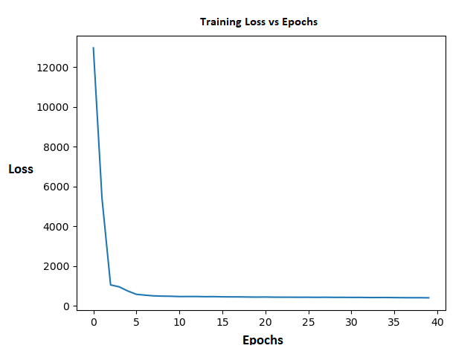
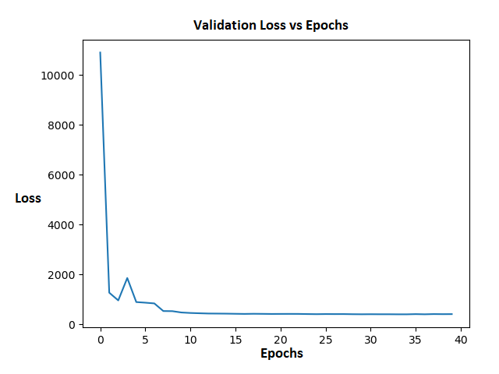
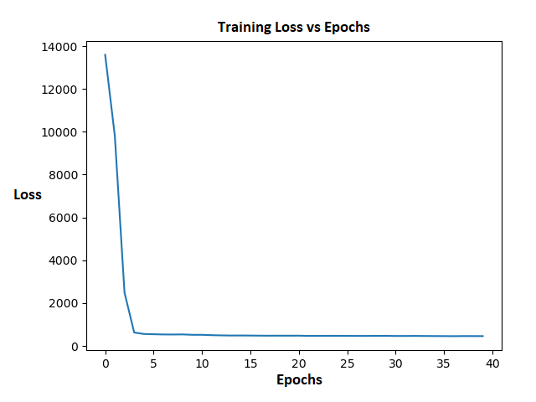
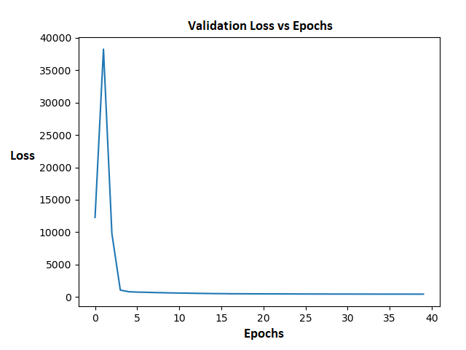
Books Crossing
HVamp
Vamp
Notes:
These are the training and validation loss vs epochs plots for Hvamp and vamp models without gating mechanism.

Slide 35
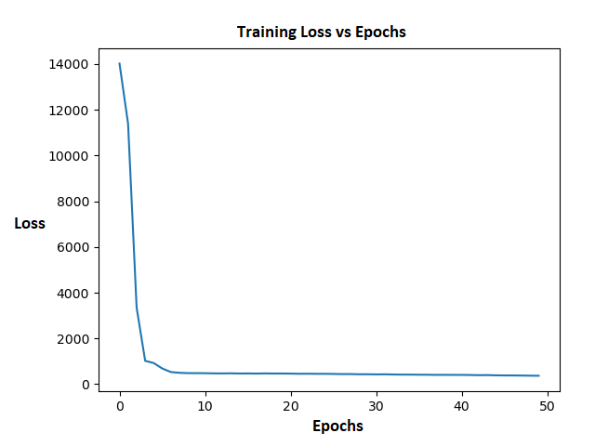
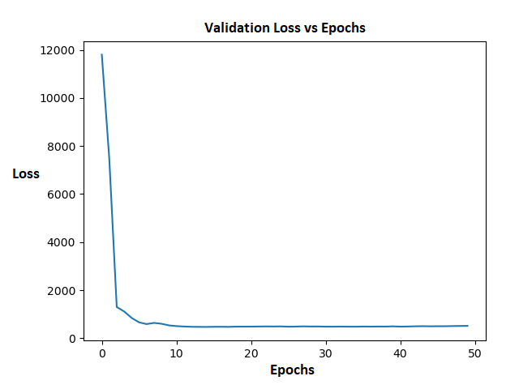
Books Crossing
Hvamp with Gating Mechanism (Best Model)
Notes:
These are the loss vs epochs plots for Hvamp with gating mechanism which is our best model on books crossing dataset.

Slide 36
Books Crossing
Best Results on different models
Models | NDCG@100 | NDCG@20 | NDCG@10 | Recall@50 | Recall@20
Baseline (Multi-VAE) | 0.14160 | 0.11060 | 0.10560 | 0.15980 | 0.11660
Vamp | 0.14824 | 0.11550 | 0.10972 | 0.16368 | 0.12258
HVamp | 0.14973 | 0.11612 | 0.11089 | 0.16401 | 0.12462
Multi-VAE (Gated) | 0.14789 | 0.11673 | 0.10991 | 0.16947 | 0.12493
HVamp (Gated) | 0.15861 | 0.12136 | 0.11758 | 0.17519 | 0.13047
Notes:
this is the table of results for different models proposed in Enhanced VAE paper. We got Hvamp with gating mechanism as our best model on books crossing dataset for all evaluation metrics.

Slide 37
Anime
Number of Layers
Hidden Layer Size
Layers | NDCG@100 | Recall@50 | Recall@20
1 | 0.466 | 0.489 | 0.42
2 | 0.461 | 0.485 | 0.417
3 | 0.454 | 0.474 | 0.407
4 | 0.442 | 0.463 | 0.399
Size | NDCG@100 | Recall@50 | Recall@20
100 | 0.456 | 0.478 | 0.408
300 | 0.466 | 0.489 | 0.42
500 | 0.459 | 0.481 | 0.411
750 | 0.449 | 0.472 | 0.404
1000 | 0.44 | 0.466 | 0.396
Notes:
In the Anime dataset, we performed hyperparameter tuning by varying the hidden layer size that is number of neurons in a layer and the number of layers. We found that the best results were achieved with a layer size of 300 and a single layer. Increasing the number of layers or layer size led to a more complex model that overfit the training data and performed poorly on the test data

Slide 38
Anime
Best Results on different models
Models | NDCG@100 | NDCG@20 | NDCG@10 | Recall@50 | Recall@20
Baseline(Multi-VAE) | 0.446 | 0.47 | 0.455 | 0.462 | 0.406
Multi-VAE (gated) | 0.451 | 0.473 | 0.459 | 0.471 | 0.41
HVamp | 0.455 | 0.479 | 0.465 | 0.48 | 0.414
Vamp (gated) | 0.46 | 0.484 | 0.469 | 0.485 | 0.418
H+Vamp (gated) | 0.466 | 0.491 | 0.473 | 0.489 | 0.42
Notes:
We recorded NDCG@k and Recall@k for different values of k and compared our results with the baseline Multi Variational Auto-Encoder. The best results were obtained with the H+vamp gated model, achieving an NDCG@100 value of 0.466

Slide 39
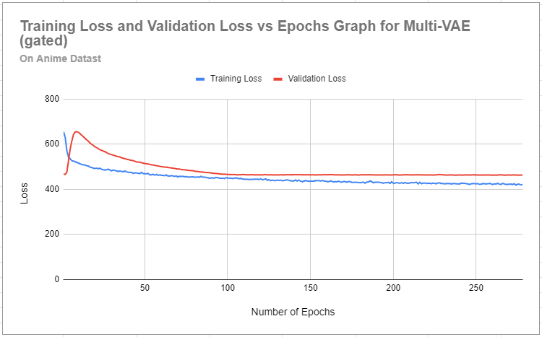
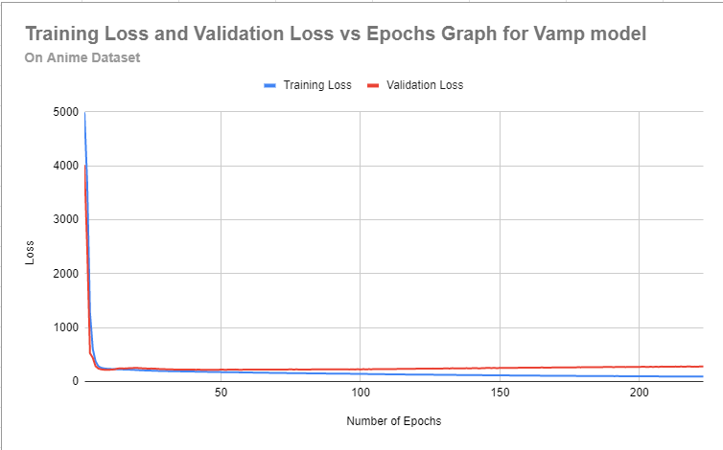
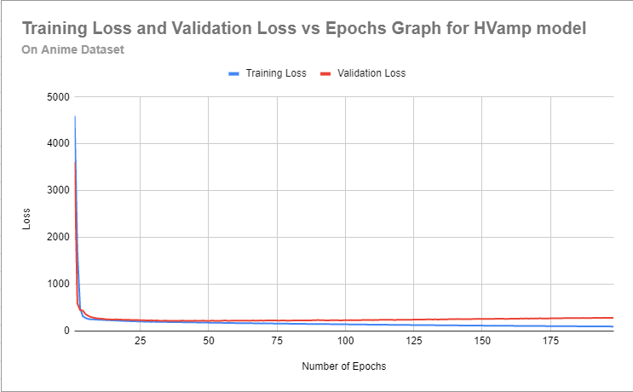
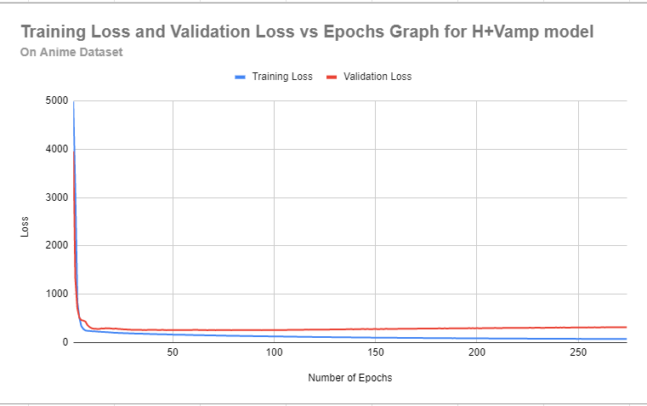
Anime
Notes:
These are some graphs for different models where we are comparing training and validation loss against the number of epochs

Slide 40
Thank you
Notes:
This concludes our presentation. You can check out the report for a deeper insight into the experiments carried out.

