Slide 1
Digi Twin
A live, explainable Cardiac Digital Twin
Digital Twin Challenge 2026 | Happiest Health
Harsh Pandey (Team Leader) | Deepak Singh | Bhairavi Singh
Kamla Nehru Institute of Technology (KNIT), Sultanpur

Slide 2
The problem
Most cardiac risk tools score a patient once, from a single snapshot.
Risk that develops between visits is missed.
A bare number rarely explains why risk is high, so it is hard to trust or act on.
Wearables produce a steady stream of vitals, but they are rarely joined to the patient's health record.
Digi Twin | Digital Twin Challenge 2026
2

Slide 3
Our solution and healthcare use case
One evolving digital twin per patient: EHR baseline plus a rolling window of live vitals.
Cardiac risk is re-scored on every new reading, so risk becomes a continuously updated line.
Each score ships with SHAP factors showing what drove it.
Alerts when risk crosses the threshold: an alert log and a flashing alarm banner.
Multi-patient dashboard, each patient with independent state.
Digi Twin | Digital Twin Challenge 2026
3

Slide 4
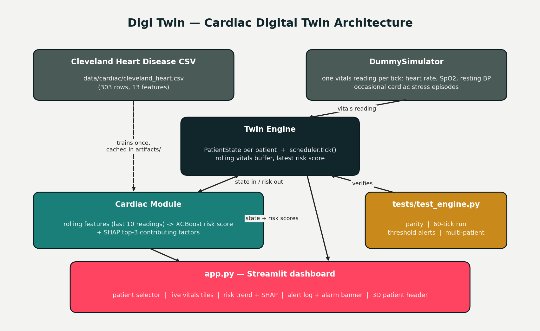
Architecture
Digi Twin | Digital Twin Challenge 2026
4

Slide 5
AI/ML model
XGBoost
AUC-ROC ~0.92
200 trees, depth 5, learning rate 0.05, trained on the UCI Cleveland Heart Disease data (13 features)
Held-out score on an 80/20 stratified split, features standardised
SHAP
Rolling features
TreeExplainer on every tick; dashboard shows the top three contributing factors
Resting BP averaged and max heart rate taken over the last 10 readings; other fields from the EHR baseline
Digi Twin | Digital Twin Challenge 2026
5

Slide 6
Technical stack and features
Stack
Features
Python 3.12
Streamlit and Plotly
XGBoost, scikit-learn
SHAP, pandas, NumPy
Web Bluetooth
flake8, tests, GitHub Actions CI
Live risk re-scored every tick
Explainable SHAP factors
Realistic simulator with stress episodes
Edge-triggered alert log and alarm banner
Live BLE heart-rate mode in the browser
3D patient figure and vital tiles
Digi Twin | Digital Twin Challenge 2026
6

Slide 7
Validation, limitations and roadmap
Validation
Limitations and roadmap
Model parity check
60-tick multi-day consistency
Threshold-breach alerts
Multi-patient personalization
CI runs lint and tests on every push
Small training set (about 300 rows); vitals are simulated
Not for clinical use
Next: real EHR and wearable feeds, larger datasets, more organ systems
Digi Twin | Digital Twin Challenge 2026
7

Slide 8
Team
Harsh Pandey
Deepak Singh
Bhairavi Singh
Team Leader
Member
Member
B.Tech Mechanical, 2027
B.Tech Mechanical, 2027
B.Tech Electrical, 2029
Kamla Nehru Institute of Technology (KNIT), Sultanpur, Uttar Pradesh
github.com/harsh23533-del/digital-twin-
Digi Twin | Digital Twin Challenge 2026
8

